Slide 1
JSPM'S RAJARSHI SHAHU COLLEGE OF ENGINEERING
DATA → INSIGHT
→ FORECAST
GRIDCAST
Electricity Consumption Analytics
& Demand Forecasting
DMA MINI-PROJECT | CS3203T-A
Time-series exploration • Moving averages • ARIMA • Forecast evaluation
Prepared by: [Student Name(s)] | Guide: [Faculty Name]
Illustrative data visualization
GRIDCAST | CS3203T-A DATA MINING AND ANALYTICS
01

Slide 2
The problem & project objective
From high-frequency readings to a clear, evaluated forecast
THE CHALLENGE
GRIDCAST’S RESPONSE
Raw minute-level readings are difficult to interpret directly.
Estimate daily energy consumption from valid readings.
Missing measurements and inconsistent timestamps require preprocessing.
Explore trend, moving average, monthly and weekday patterns.
Trend, weekly patterns and random variation can coexist.
Compare simple baselines, linear trend and ARIMA(2,1,2).
Forecasts must be evaluated on unseen future observations.
Present MAE/RMSE and future estimates in an interactive dashboard.
Aim: Analyze daily electricity consumption and compare short-term forecasting methods.
GRIDCAST | CS3203T-A DATA MINING AND ANALYTICS
02

Slide 3
Dataset & data preparation
Recommended source: UCI Individual Household Electric Power Consumption
2,075,259
~47 months
9 attributes
1 household
measurements
Dec 2006–Nov 2010
including power, voltage
Sceaux, France
KEY FIELDS USED
DATA QUALITY NOTE
Date + Time
Build timestamp
“?” values are treated as missing.
Global_active_power
Minute-averaged kW
Days below 90% expected minute coverage are marked missing.
Missing daily values are interpolated; report this caveat.
Daily energy
Mean valid kW × 24 hours
The dataset is historical and not a current Indian grid.
Source: Hebrail & Berard (2006), UCI Machine Learning Repository · DOI: 10.24432/C58K54 · CC BY 4.0
GRIDCAST | CS3203T-A DATA MINING AND ANALYTICS
03

Slide 4
End-to-end workflow
A reproducible pipeline from raw file to dashboard
01
02
03
04
05
06
07
EXTRACT
→
TRANSFORM
→
EXPLORE
→
DECOMPOSE
→
FORECAST
→
EVALUATE
→
PRESENT
Load UCI text / daily CSV
Parse, clean, aggregate
Trend, summaries, patterns
Trend / weekly / residual
Baselines + ARIMA
MAE + RMSE holdout
Dashboard + CSV / PNG
Chronological evaluation: train on earlier dates, test on the final 30 observations
No random shuffling: the test set should represent a future period.
GRIDCAST | CS3203T-A DATA MINING AND ANALYTICS
04

Slide 5
Core analytics & forecasting methods
Methods align with DMA manual Experiments 8 and 9
DESCRIPTIVE ANALYTICS
MOVING AVERAGE
Mean, median, minimum, maximum, date coverage and missingness.
Seven-day rolling mean to smooth daily changes and inspect trend.
SEASONAL DECOMPOSITION
ARIMA(2,1,2)
Additive decomposition with period = 7 to inspect weekly structure.
A statistical time-series model; p = AR order, d = differencing, q = MA order.
Compare methods against a 30-day chronological holdout, not training fit.
GRIDCAST | CS3203T-A DATA MINING AND ANALYTICS
05

Slide 6
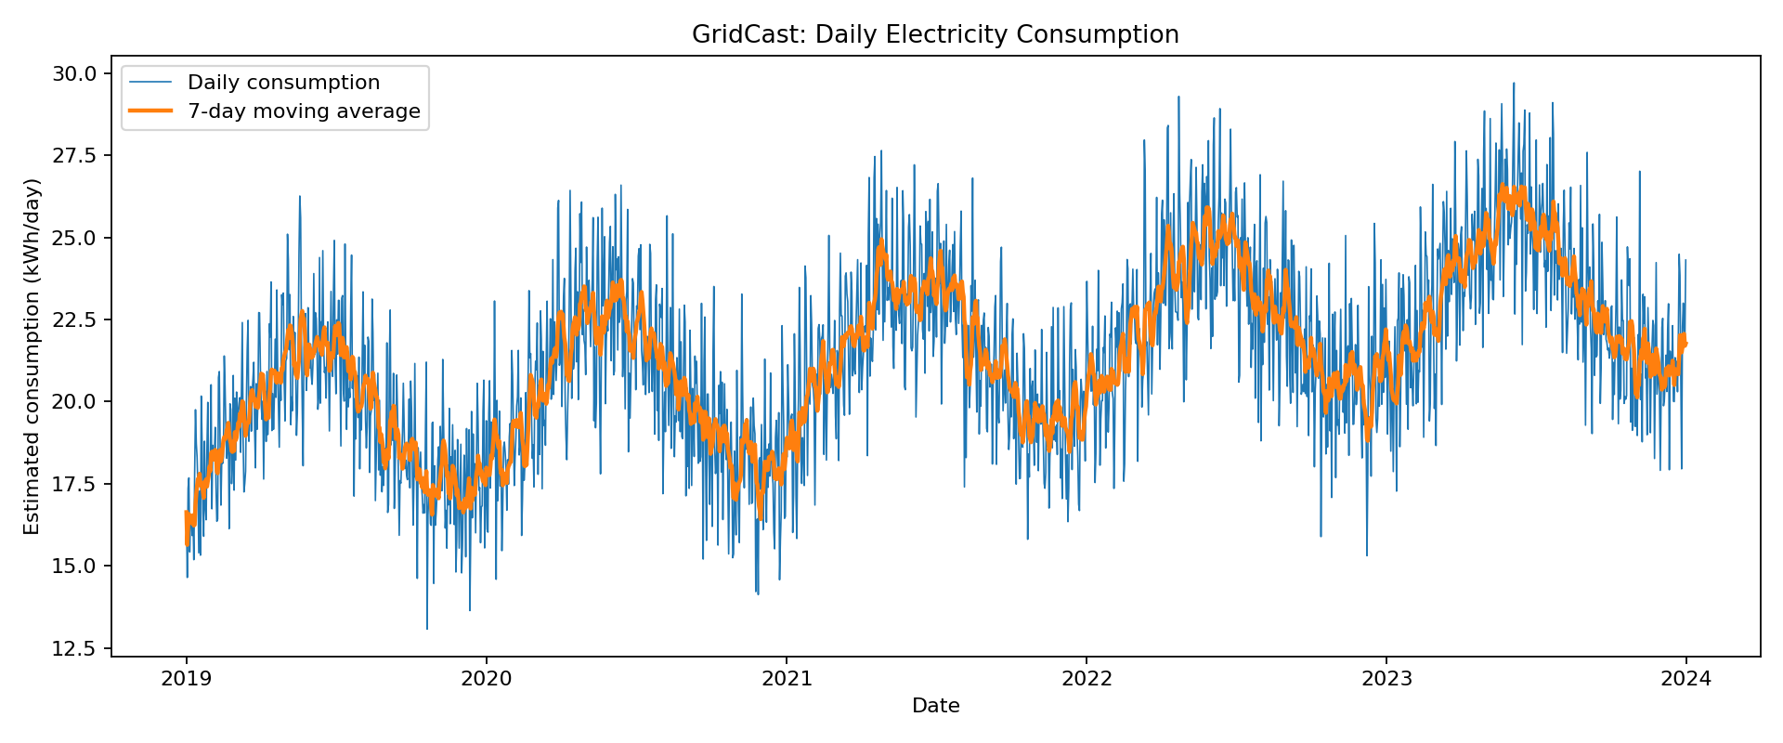
What the dashboard displays
Example trend chart generated from the bundled synthetic demonstration data
DASHBOARD VIEWS
Daily trend + 7-day mean
Monthly average consumption
Day-of-week comparisons
Trend / seasonal / residual decomposition
Holdout metrics and future forecast
Important: the plotted sample is synthetic and is only an illustration. Replace it with figures generated from the real UCI dataset.
GRIDCAST | CS3203T-A DATA MINING AND ANALYTICS
06

Slide 7
Model evaluation & metrics
The final report must use metrics produced by the real UCI dataset run
7-day moving average
Simple smoothed baseline
MAE — Mean Absolute Error
Average absolute difference
between actual and predicted values.
7-day seasonal naive
Repeats latest weekly pattern
Linear trend
Extrapolates recent linear trend
RMSE — Root Mean Squared Error
ARIMA(2,1,2)
Statistical time-series model
Penalizes larger errors more strongly.
Lower values indicate better holdout fit.
Report model • MAE (kWh) • RMSE (kWh) • test-window length • which model had the lowest holdout RMSE.
GRIDCAST | CS3203T-A DATA MINING AND ANALYTICS
07

Slide 8
Limitations & next steps
Accurate interpretation matters as much as the model score
LIMITATIONS
FUTURE ENHANCEMENTS
One household, in France, historical 2006–2010 data.
Include weather, holidays and tariffs.
Daily energy is estimated from mean power and valid-reading coverage.
Compare seasonal ARIMA (SARIMA) and more model orders.
Interpolation can affect the daily series.
Use rolling-origin validation across multiple windows.
One holdout window does not guarantee future performance.
Expand to multiple meters or a regional dataset.
GRIDCAST | CS3203T-A DATA MINING AND ANALYTICS
08

Slide 9
Conclusion
GridCast turns raw consumption observations into explainable analytics
A complete DMA workflow: clean → analyze → forecast → evaluate → communicate.
Explores trend, weekly pattern and residual variation.
Compares moving average, seasonal naive, linear trend and ARIMA.
Uses chronological holdout MAE/RMSE for evidence-based comparison.
Leaves final empirical conclusions to be written after the real UCI run.
References: UCI Individual Household Electric Power Consumption, Hebrail & Berard (2006), DOI 10.24432/C58K54.
DMA Laboratory Manual CS3203T-A, Experiments 8 and 9.
GRIDCAST | CS3203T-A DATA MINING AND ANALYTICS
09

