Slide 1

Smart Healthcare Ecosystem
developed at
AccioJob Private Limited - Gurgaon
Under The Guidance Of
Internal Guide
Dr. Hina Chokshi
External Guide
Gaurav Choudhary
Developed By
Ankit Goswami (2305112110143)
Arpan (2305102130005)
Submitted To:
Department of MCA
Faculty of IT & Computer Science,
PARUL University

Slide 2

Certificate
Certificate
This is to certify that Mr. Ankit Goswami, 2305112110143, Mr. Arpan, 2305102130005 student of MCA/MSc IT has satisfactorily completed the
Major Project on Smart Healthcare Ecosystem at Acciojob Pvt ltd. as fulfillment of MCA Semester IV.
Seat No. _______________ Date of Submission: ____________
_______________ _______________ ___________
Internal Guide Project Coordinator Director - MCA
Department of MCA
Faculty of IT & Computer Science
Parul University, Vadodara

Slide 3
Index
1. Project Profile
2. Requirement Analysis
3. Design
4. Implementation
5. Testing
6. Future Enhancements
7. Bibliography
8. Thankyou Slide

Slide 4
About Department
About Department of MCA
Parul University is a legitimate university established under Gujarat Private University Act 2009, after legislation passed by the Government of Gujarat on 26th March 2015 giving University status to Parul Group of Institutes functioning under the aegis of Parul Arogya Seva Mandal Trust.
Faculty of IT and Computer Science, Parul University has materialized as one of the prime IT education providers at global level. Various departments under Faculty of IT and Computer Science strive in preparing IT-industry ready professionals by means of various skill development courses, vocational courses, co-curricular & extra-curricular activities, industry visits and expert lectures.
The Department of Master of Computer Application at Parul University emphasizes on building professionals in the domain of computer applications by providing necessary environment by means of facilitating suitable blend of technical and non-technical learning experience. The department cultivates students in various curricular, co-curricular and extra-curricular activities in order to produce future system analysts, system designers, system programmers, application programmers, testing professionals, system managers, project managers, researchers and other leading positions in systems/IT department.

Slide 5
Project Profile
Project Definition: Smart Healthcare Ecosystem
Project Description:
The Smart Healthcare Ecosystem project focuses on building a predictive system to enhance healthcare services by integrating AI-driven solutions. The two primary modules developed so far include:
Cardiovascular Disease Prediction Model: A machine learning model that predicts the likelihood of cardiovascular diseases based on user-input health parameters.
Text Generator Model: An NLP-based chatbot capable of generating conversational responses and health-related information.
Problem Statements:
Difficulty in early detection of heart disease, leading to delayed treatment and adverse outcomes.
Lack of accessible, user-friendly tools that allow individuals to assess their heart disease risk without extensive medical knowledge.

Slide 6
Requirement Analysis
A feasibility study is conducted to assess the practicality and viability of the AI-powered Mental Health Monitoring System. This evaluation ensures that the system is technically, operationally, economically, and market-wise feasible, while also determining if it can be completed within the desired timeframe.
Technical Feasibility: Feasible in technical implementation
Operational Feasibility: Easy to operate
Economic Feasibility: Easy to maintain

Slide 7
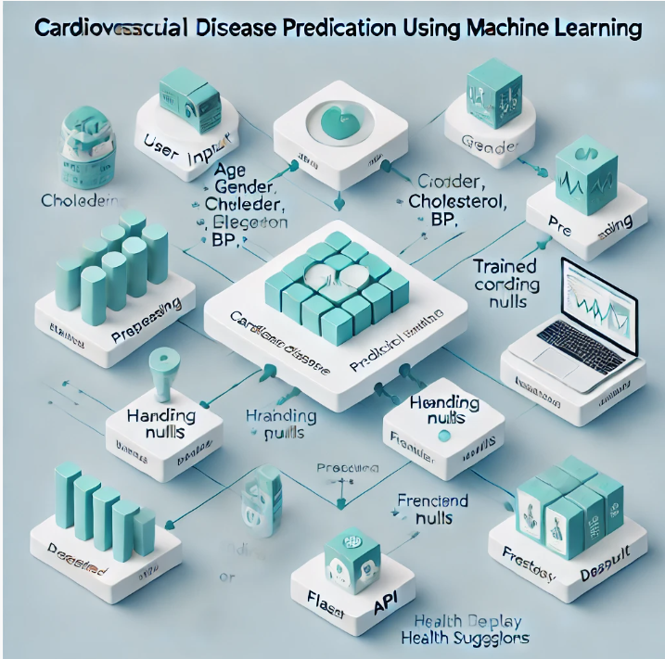
Design

Slide 8
Implementation (Data Collection)
Data Scrapping using Beautiful Soup
Data Scrapping using Selenium
Fetched data from online website and various platforms

Slide 9
Implementation (Model Development)
Data loading
Data cleaning and preprocessing
EDA
Feature engineering
Model selection
Model Accuracy
Deployment

Slide 10
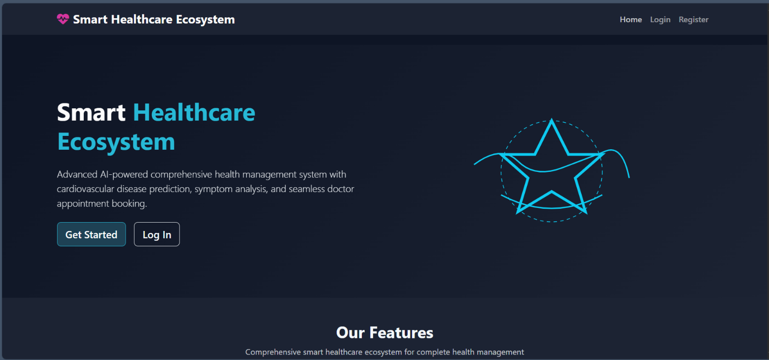
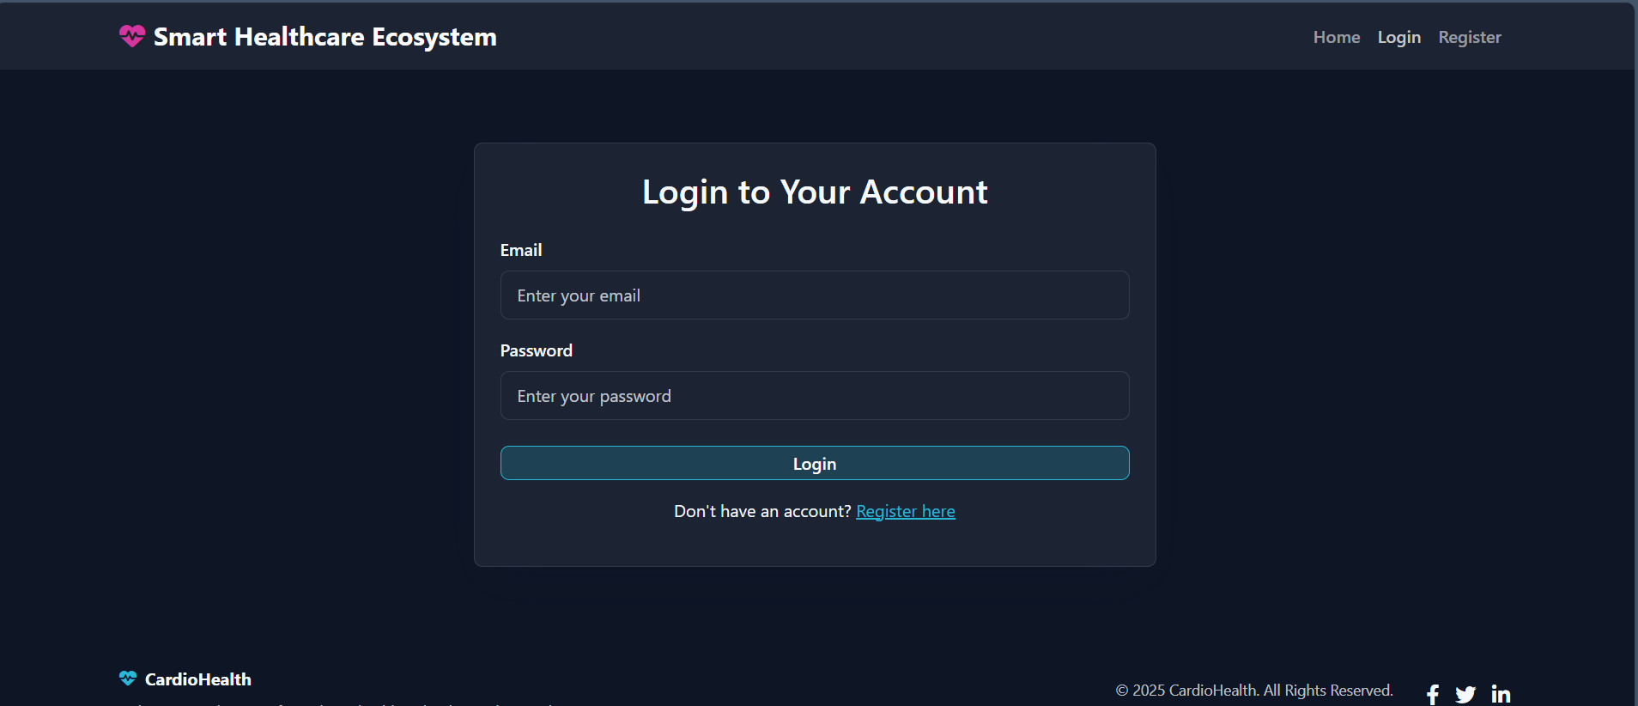

Slide 11
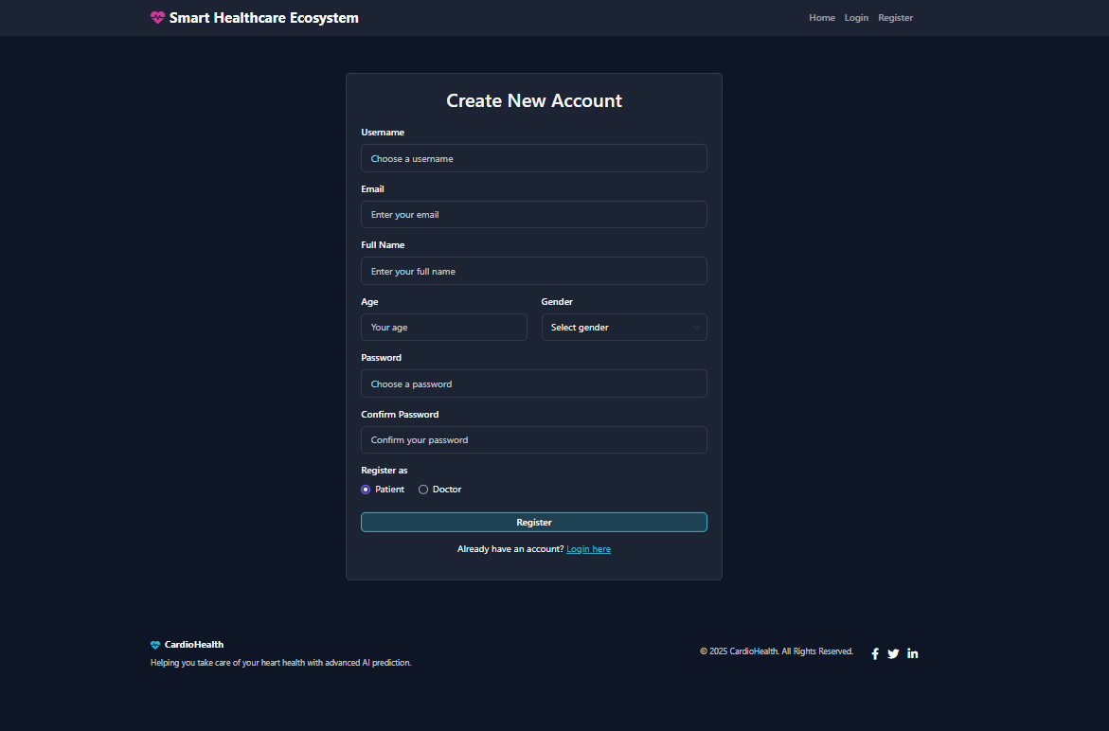
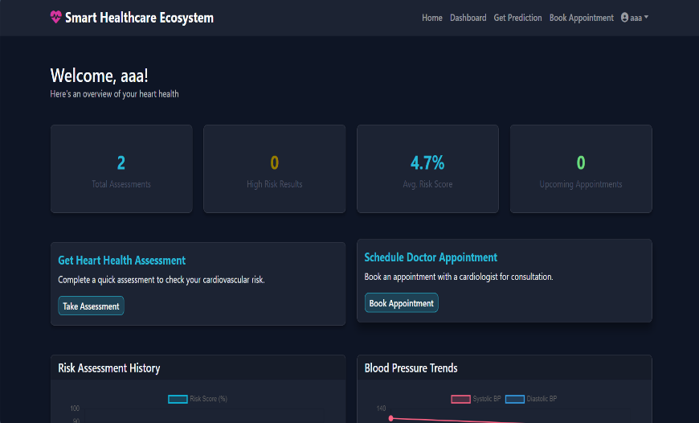
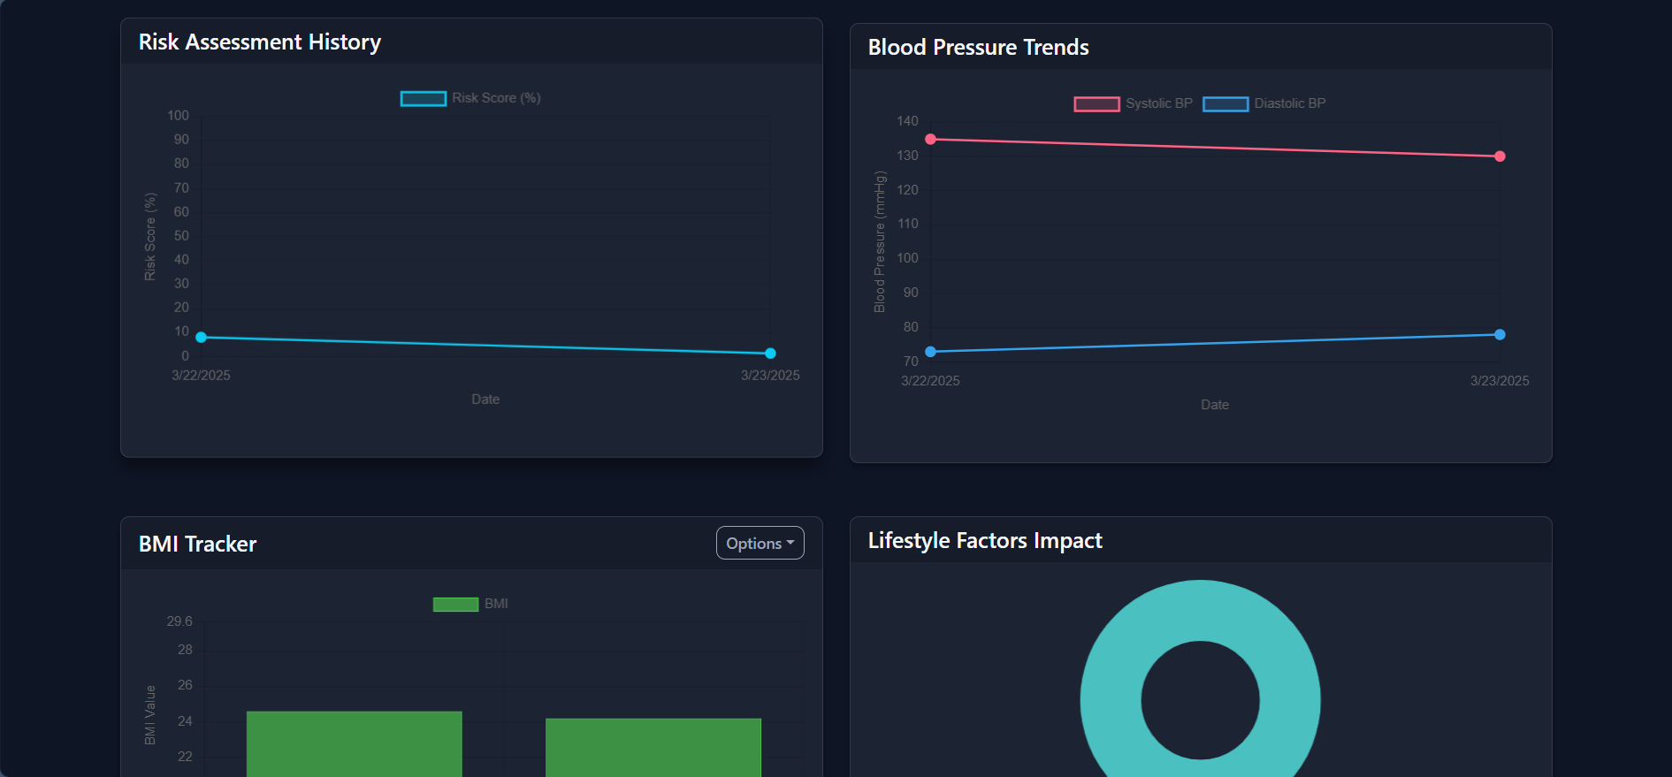

Slide 12
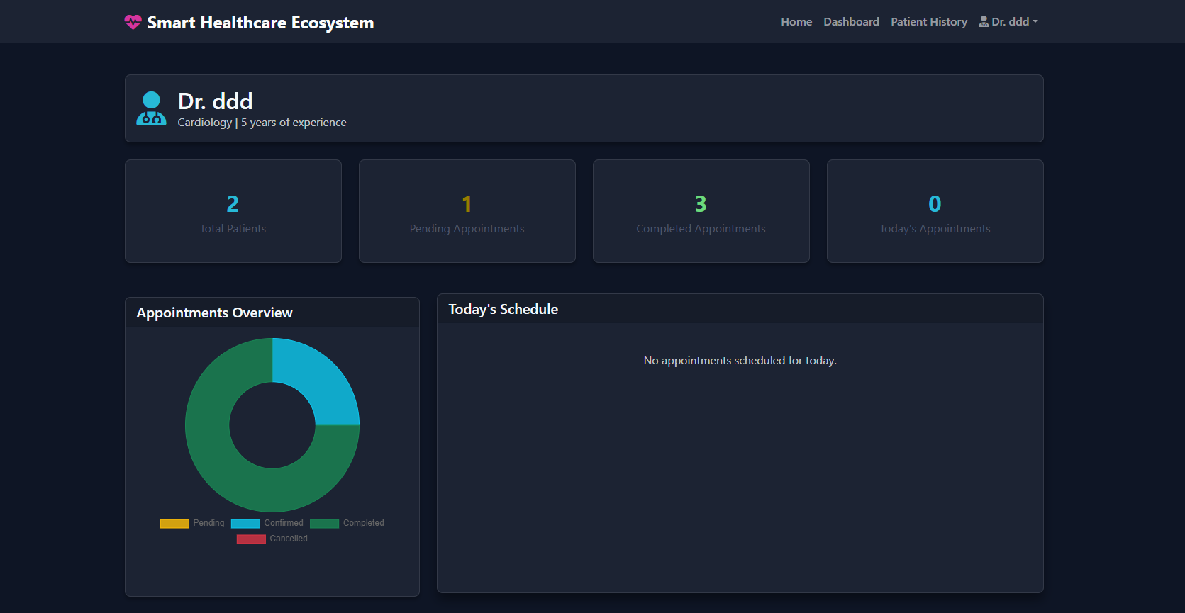
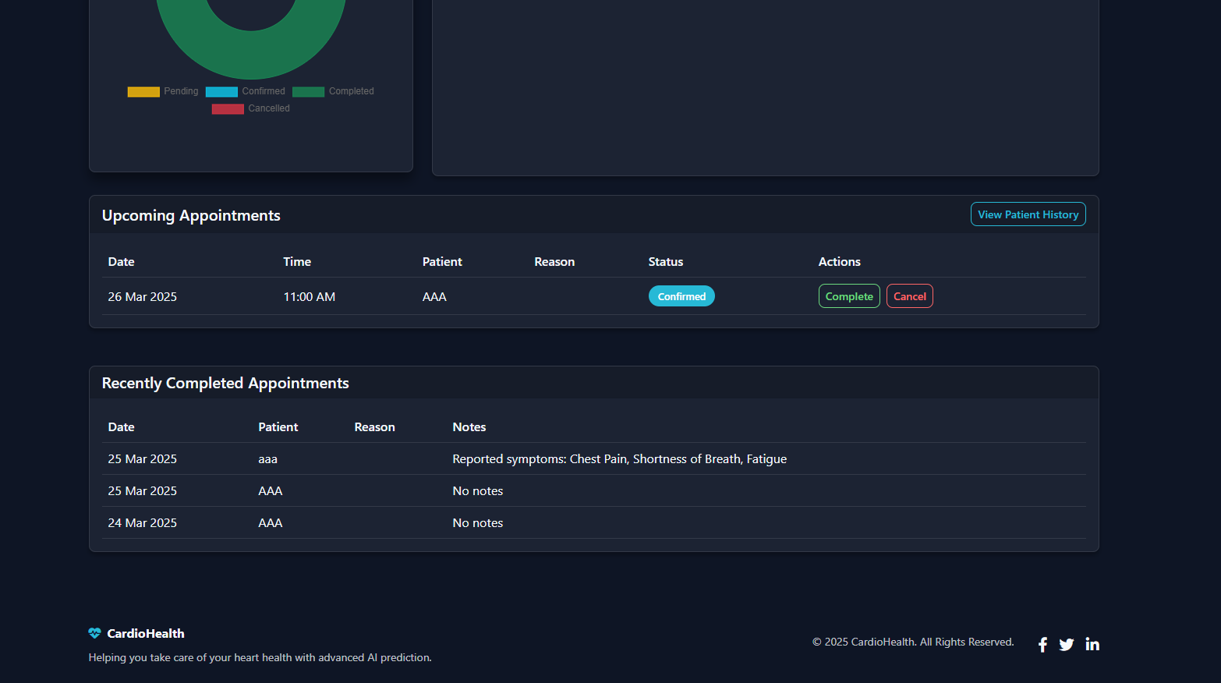

Slide 13
Testing
Manual Testing: For testing the user interface, input validation, and error messages. This will involve entering various inputs manually and checking the output.
Automation Testing: For classification testing and ensuring that new code changes do not break existing functionality. Tools like Selenium can be used for automating the form input and result checking.
Postman: For testing API endpoints, ensuring that the backend is functioning correctly.

Slide 14
Future Enhancement
Enhance accuracy with larger datasets.
Add multilingual support for better analysis.
Expand to detect other health conditions.
Integrating the system with wearable health devices (like smartwatches) can provide real-time monitoring of vital signs such as heart rate, blood pressure, and physical activity. This data can be continuously fed into the system, allowing for more accurate and up-to-date predictions.
Continuous data collection will improve prediction accuracy and enable real-time risk assessment for users.

Slide 15
Bibliography
Aurélien Géron, Hands-On Machine Learning with Scikit-Learn, Keras, and TensorFlow, O'Reilly Media, 2019.
Miguel Grinberg, Flask Web Development, O'Reilly Media, 2018.
R. Narasimha Rao, Machine Learning and Artificial Intelligence: Applications in Healthcare, Tata McGraw Hill, 2020.
Rajiv Chopra, Artificial Intelligence and Machine Learning for Healthcare, Pearson India, 2021.
Dinesh Kumar, Data Science and Analytics for Healthcare, Wiley India, 2019.

Slide 16
Thank you

