Slide 1
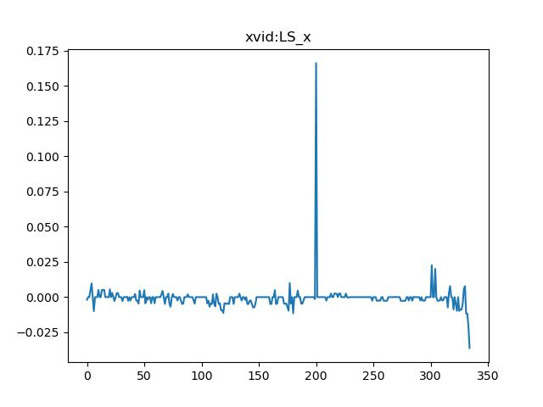
RMSE xvid-LS_x : 0.013518166856826797

Slide 2
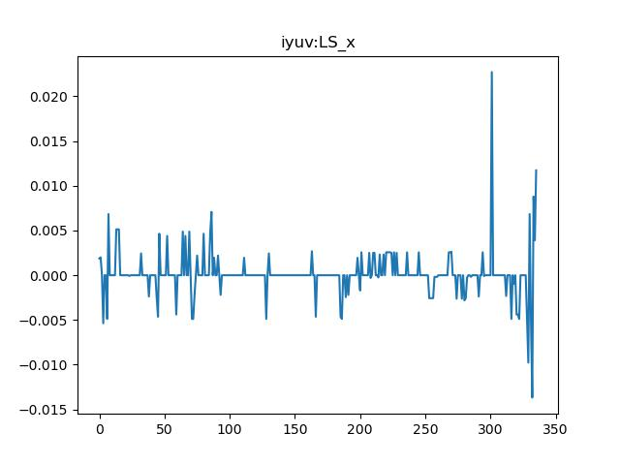
RMSE iyuv-LS_x : 0.012208633983257363

Slide 3
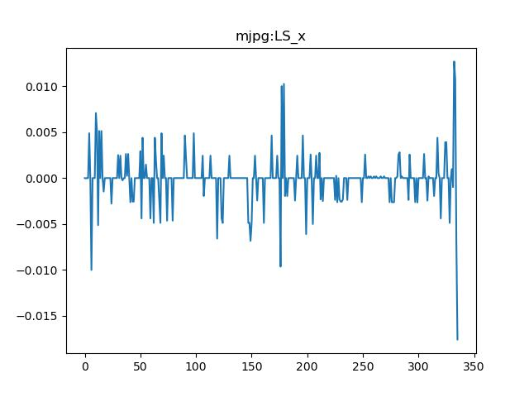
RMSE mjpg-LS_x : 0.011802775948989624

Slide 4

RMSE mp4v-LS_x : 0.013518166856826797

Slide 5
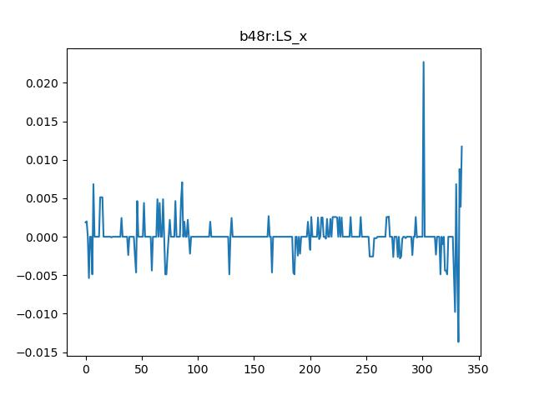
RMSE b48r-LS_x : 0.012208633983257363

Slide 6
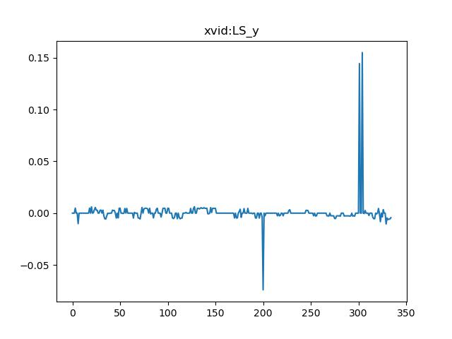
RMSE xvid-LS_y : 0.00697933693941415

Slide 7
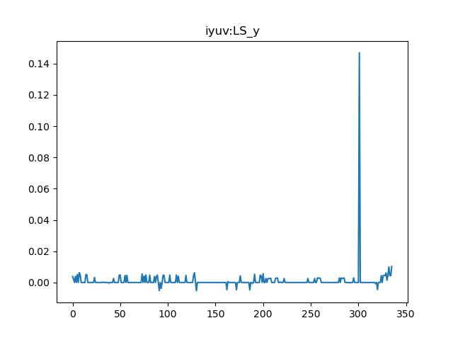
RMSE iyuv-LS_y : 0.005225805951829265

Slide 8
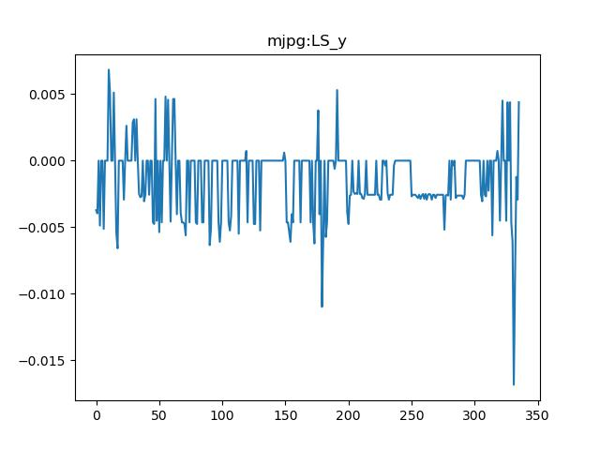
RMSE mjpg-LS_y : 0.004367788096263414

Slide 9
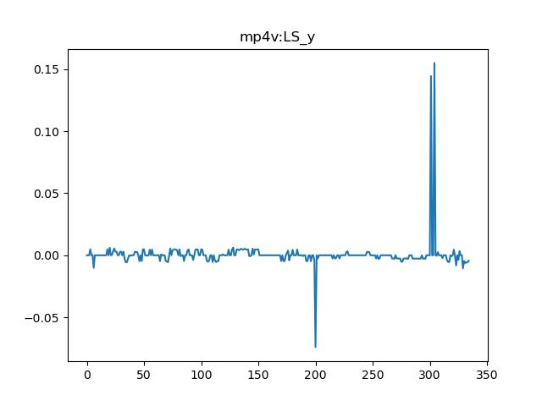
RMSE mp4v-LS_y : 0.00697933693941415

Slide 10

RMSE b48r-LS_y : 0.005225805951829265

Slide 11
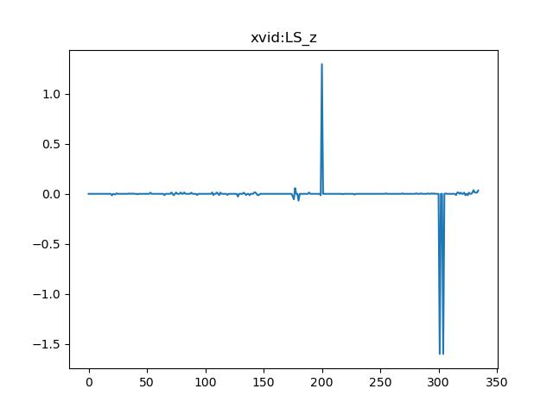
RMSE xvid-LS_z : 0.08084960514100571

Slide 12
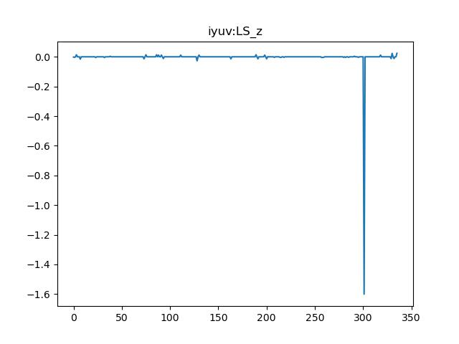
RMSE iyuv-LS_z : 0.05034429985406133

Slide 13
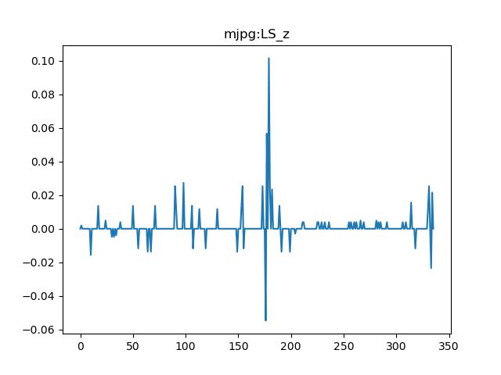
RMSE mjpg-LS_z : 0.04560234015129498

Slide 14

RMSE mp4v-LS_z : 0.08084960514100571

Slide 15
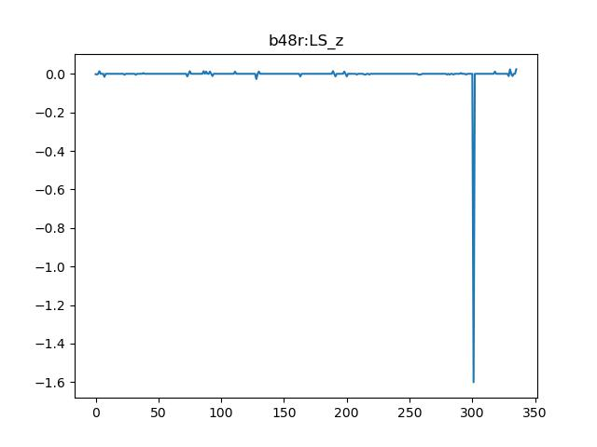
RMSE b48r-LS_z : 0.05034429985406133

Slide 16
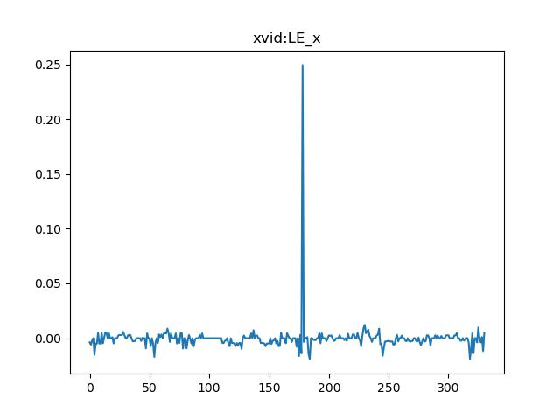
RMSE xvid-LE_x : 0.015251456092137156

Slide 17
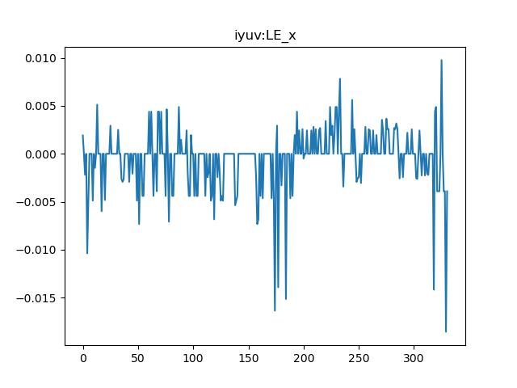
RMSE iyuv-LE_x : 0.013993173566369267

Slide 18
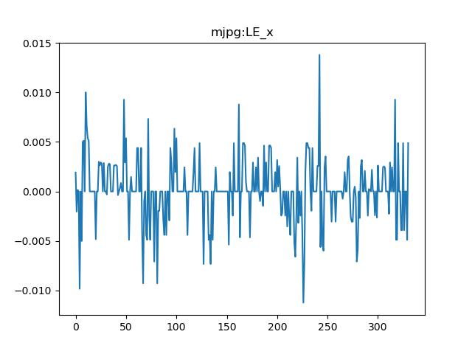
RMSE mjpg-LE_x : 0.013756652160316707

Slide 19

RMSE mp4v-LE_x : 0.015251456092137156

Slide 20
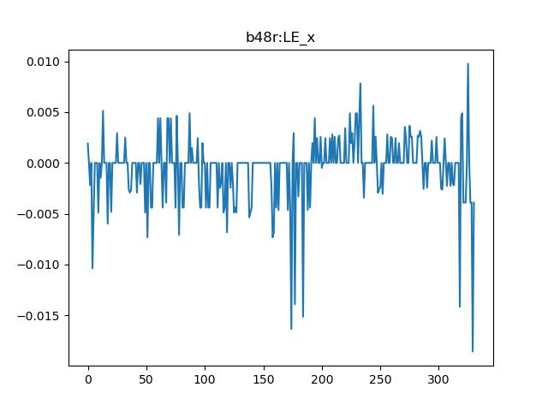
RMSE b48r-LE_x : 0.013993173566369267

Slide 21
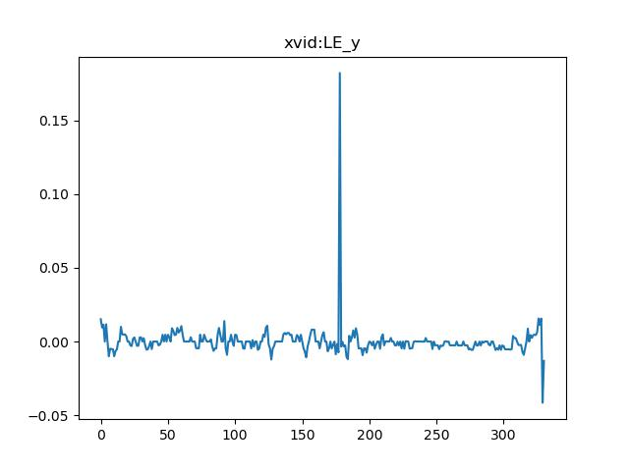
RMSE xvid-LE_y : 0.008494182151076977

Slide 22
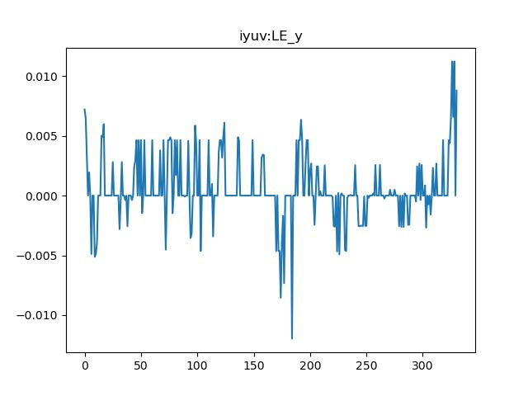
RMSE iyuv-LE_y : 0.007981625248229771

Slide 23
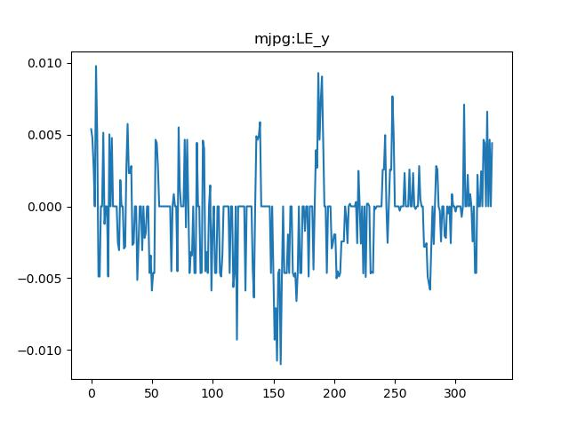
RMSE mjpg-LE_y : 0.007775455185538979

Slide 24

RMSE mp4v-LE_y : 0.008494182151076977

Slide 25

RMSE b48r-LE_y : 0.007981625248229771

Slide 26
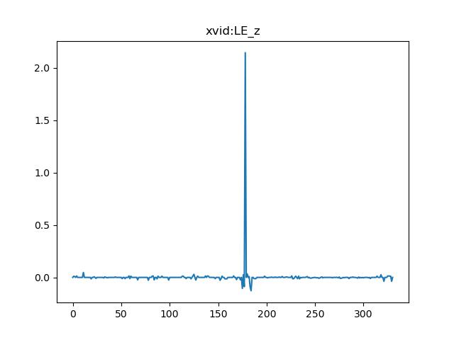
RMSE xvid-LE_z : 0.062851774305595

Slide 27
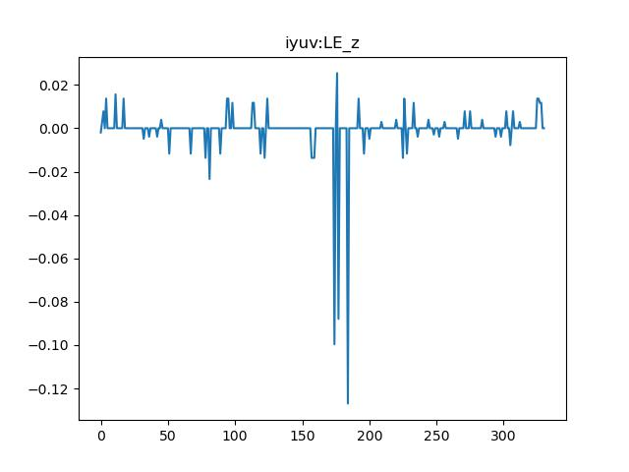
RMSE iyuv-LE_z : 0.043139743964370716

Slide 28
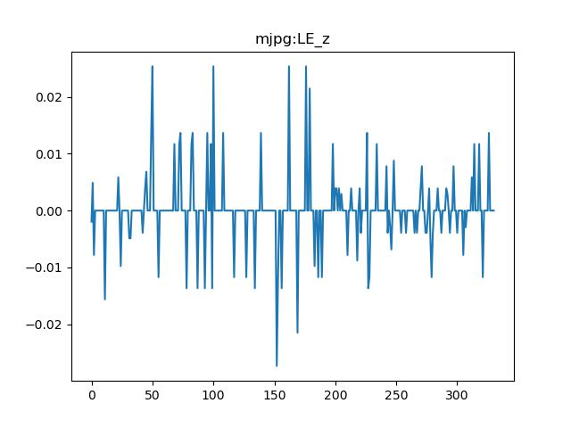
RMSE mjpg-LE_z : 0.043483183890590235

Slide 29
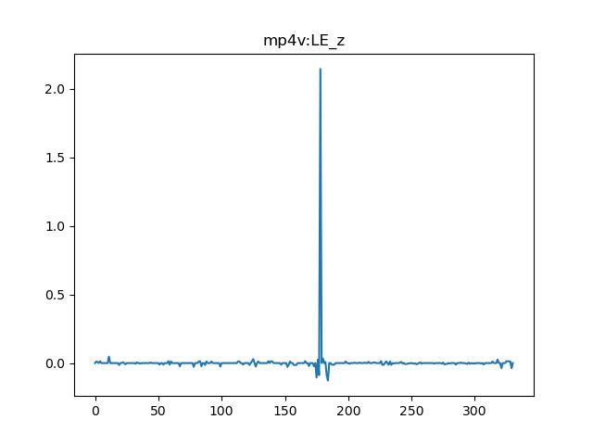
RMSE mp4v-LE_z : 0.062851774305595

Slide 30

RMSE b48r-LE_z : 0.043139743964370716

Slide 31
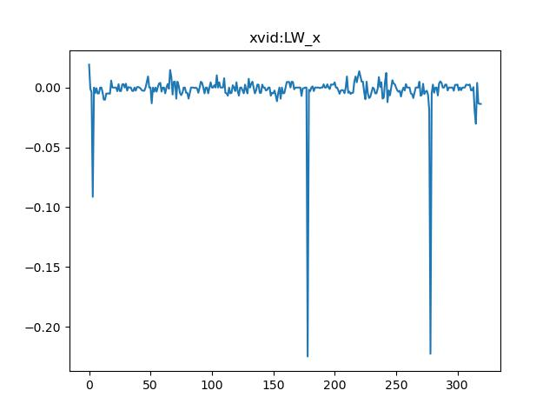
RMSE xvid-LW_x : 0.023095467525444596

Slide 32
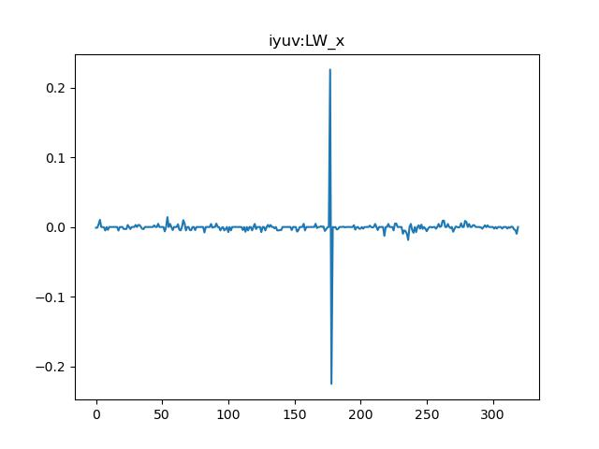
RMSE iyuv-LW_x : 0.02012034921840459

Slide 33
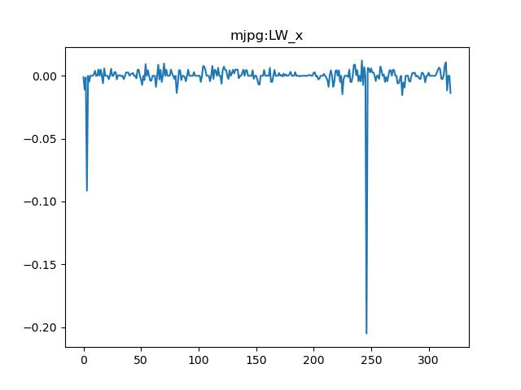
RMSE mjpg-LW_x : 0.020828687715110598

Slide 34

RMSE mp4v-LW_x : 0.023095467525444596

Slide 35
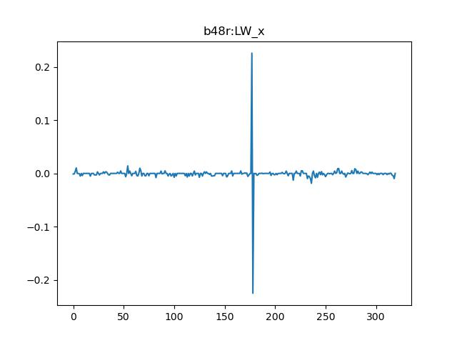
RMSE b48r-LW_x : 0.02012034921840459

Slide 36
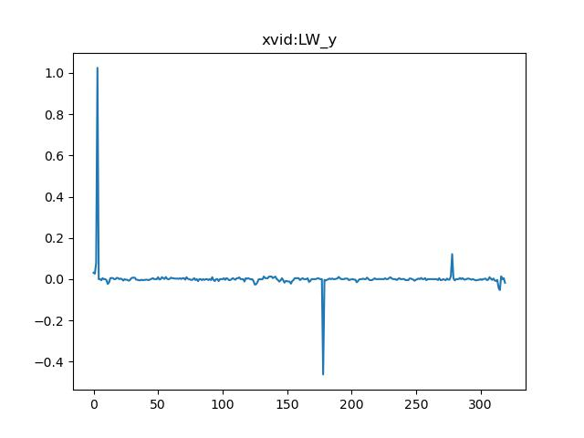
RMSE xvid-LW_y : 0.03898570962877043

Slide 37
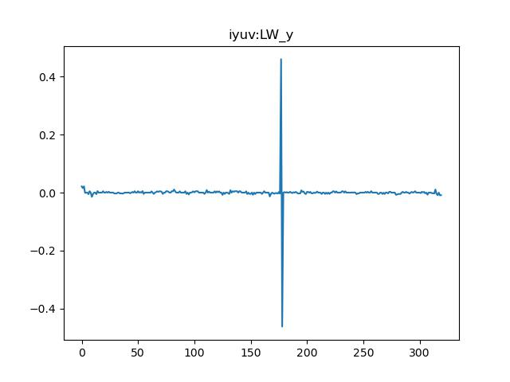
RMSE iyuv-LW_y : 0.021041331403276093

Slide 38
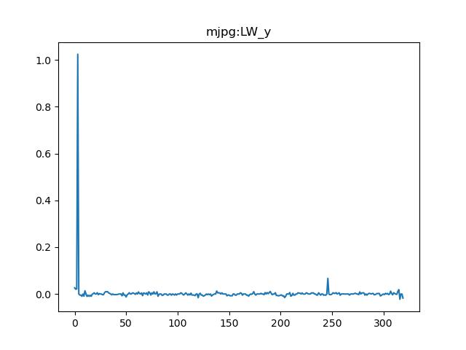
RMSE mjpg-LW_y : 0.03567167693808295

Slide 39

RMSE mp4v-LW_y : 0.03898570962877043

Slide 40
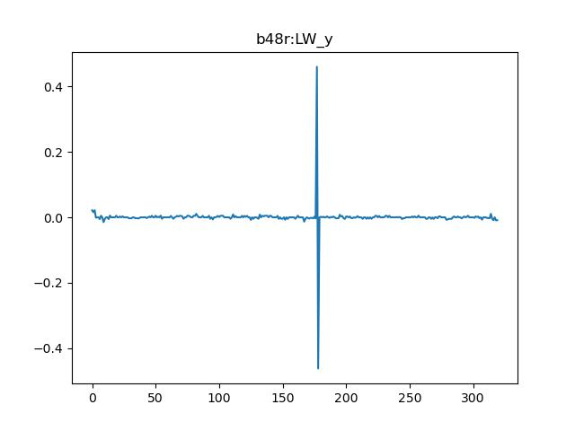
RMSE b48r-LW_y : 0.021041331403276093

Slide 41
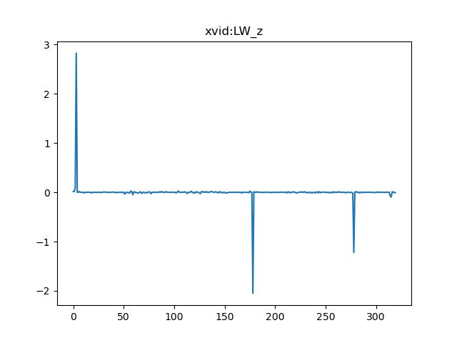
RMSE xvid-LW_z : 0.10373001386580066

Slide 42
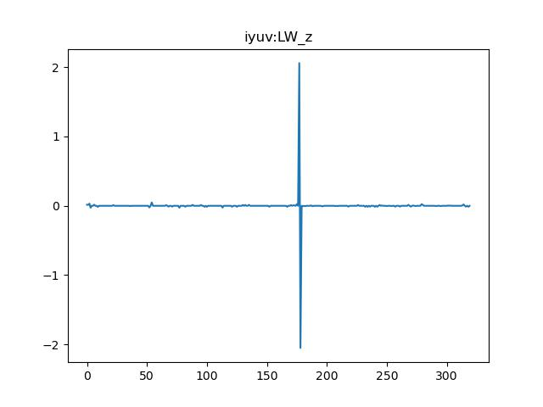
RMSE iyuv-LW_z : 0.05148369265205136

Slide 43
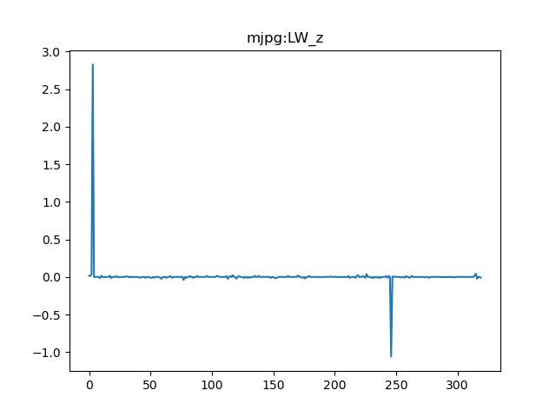
RMSE mjpg-LW_z : 0.0873277110530441

Slide 44

RMSE mp4v-LW_z : 0.10373001386580066

Slide 45

RMSE b48r-LW_z : 0.05148369265205136

Slide 46
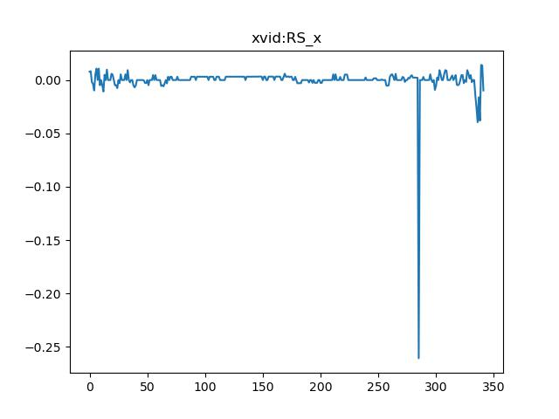
RMSE xvid-RS_x : 0.014833645853920763

Slide 47
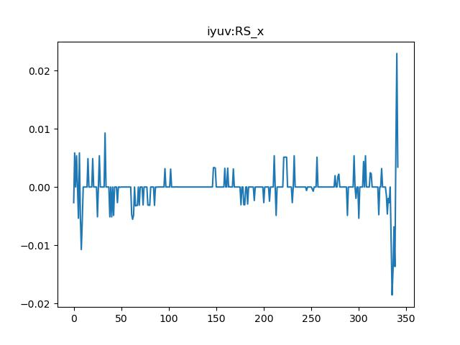
RMSE iyuv-RS_x : 0.014617027413580026

Slide 48
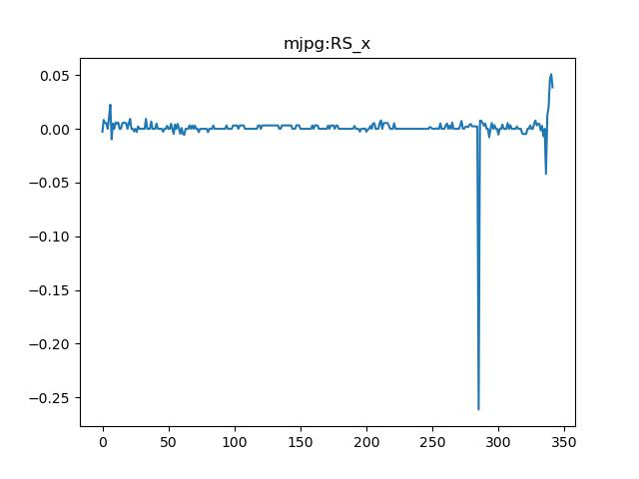
RMSE mjpg-RS_x : 0.01480252149139667

Slide 49
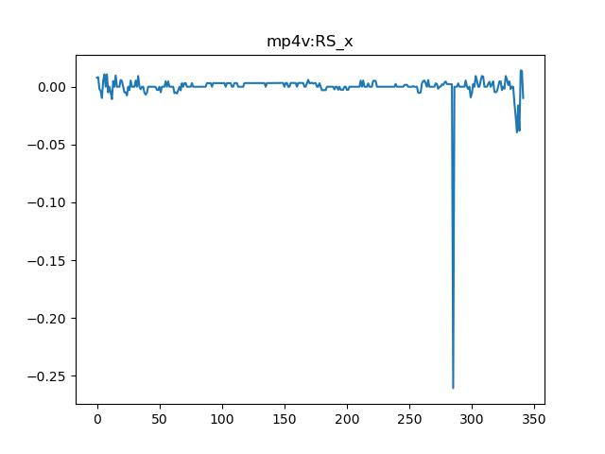
RMSE mp4v-RS_x : 0.014833645853920763

Slide 50

RMSE b48r-RS_x : 0.014617027413580026

Slide 51
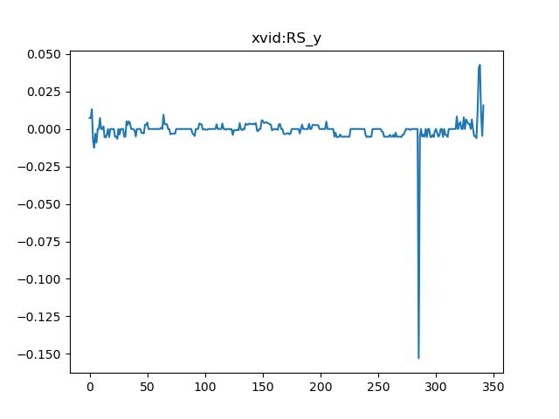
RMSE xvid-RS_y : 0.005655000787196374

Slide 52
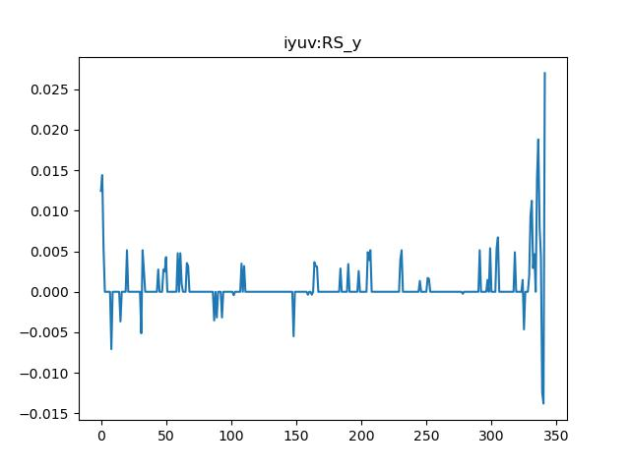
RMSE iyuv-RS_y : 0.005102551489421394

Slide 53
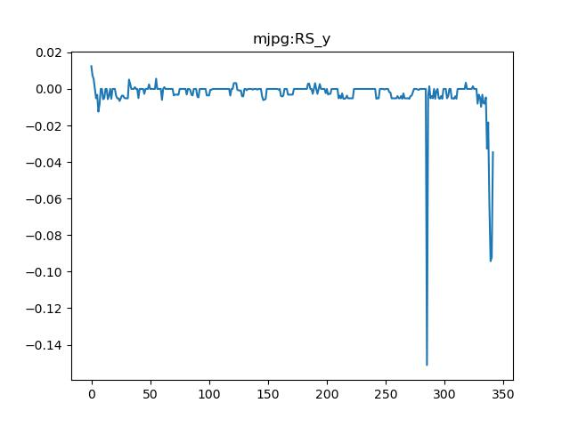
RMSE mjpg-RS_y : 0.009900813047850978

Slide 54
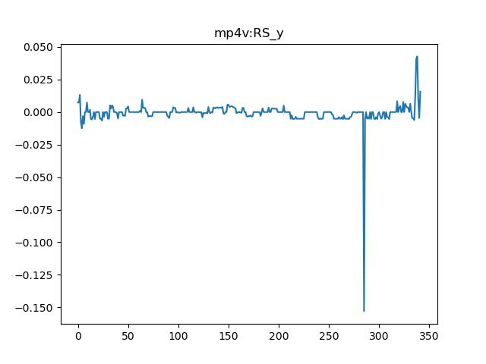
RMSE mp4v-RS_y : 0.005655000787196374

Slide 55
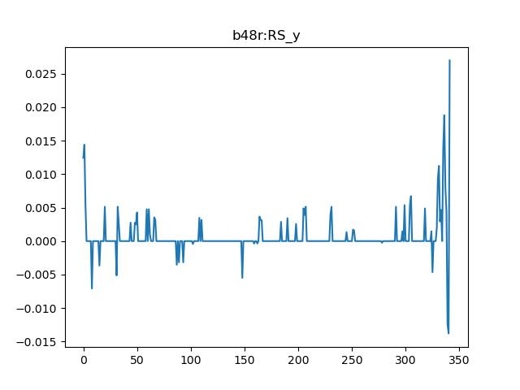
RMSE b48r-RS_y : 0.005102551489421394

Slide 56
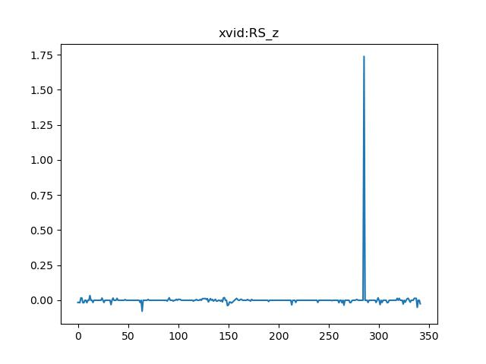
RMSE xvid-RS_z : 0.05000641590932328

Slide 57
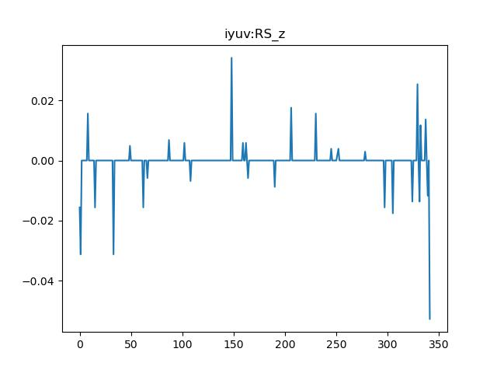
RMSE iyuv-RS_z : 0.05166355376846673

Slide 58
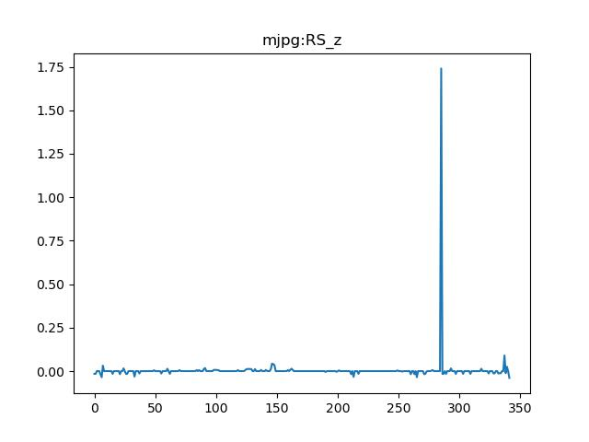
RMSE mjpg-RS_z : 0.05024248659256519

Slide 59

RMSE mp4v-RS_z : 0.05000641590932328

Slide 60
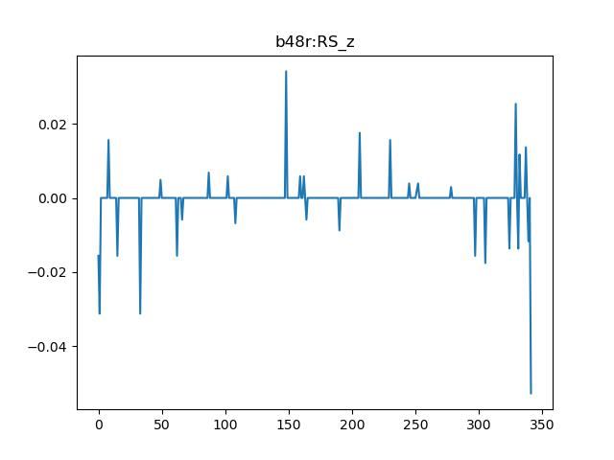
RMSE b48r-RS_z : 0.05166355376846673

Slide 61
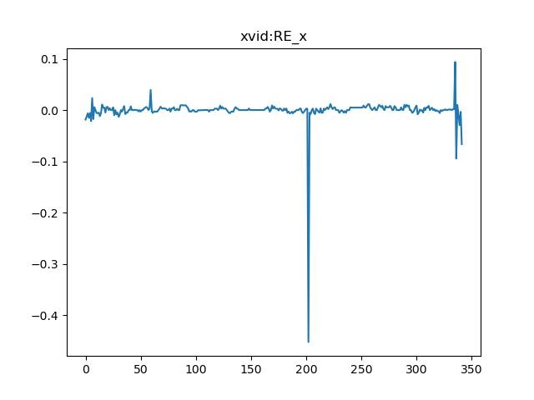
RMSE xvid-RE_x : 0.014249802768919732

Slide 62
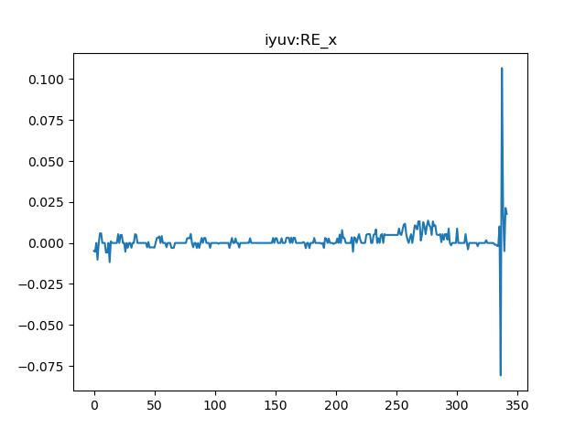
RMSE iyuv-RE_x : 0.013275976361991522

Slide 63
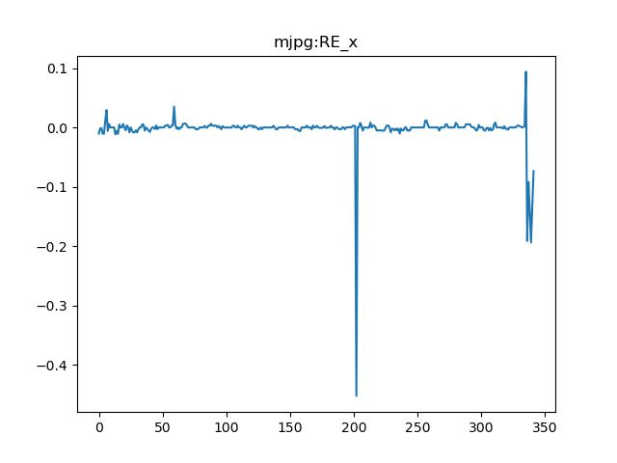
RMSE mjpg-RE_x : 0.02210473002008682

Slide 64

RMSE mp4v-RE_x : 0.014249802768919732

Slide 65

RMSE b48r-RE_x : 0.013275976361991522

Slide 66

RMSE xvid-RE_y : 0.014464312975949165

Slide 67

RMSE iyuv-RE_y : 0.008681613336412706

Slide 68

RMSE mjpg-RE_y : 0.017215347322329686

Slide 69

RMSE mp4v-RE_y : 0.014464312975949165

Slide 70

RMSE b48r-RE_y : 0.008681613336412706

Slide 71

RMSE xvid-RE_z : 0.07947650898641075

Slide 72

RMSE iyuv-RE_z : 0.04747506044319716

Slide 73

RMSE mjpg-RE_z : 0.07980560411096879

Slide 74

RMSE mp4v-RE_z : 0.07947650898641075

Slide 75

RMSE b48r-RE_z : 0.04747506044319716

Slide 76

RMSE xvid-RW_x : 0.018020053090852396

Slide 77

RMSE iyuv-RW_x : 0.01883526163984029

Slide 78

RMSE mjpg-RW_x : 0.01851072747145862

Slide 79

RMSE mp4v-RW_x : 0.018020053090852396

Slide 80

RMSE b48r-RW_x : 0.01883526163984029

Slide 81

RMSE xvid-RW_y : 0.021455455648260492

Slide 82

RMSE iyuv-RW_y : 0.03375928192918407

Slide 83

RMSE mjpg-RW_y : 0.02089693209300252

Slide 84

RMSE mp4v-RW_y : 0.021455455648260492

Slide 85

RMSE b48r-RW_y : 0.03375928192918407

Slide 86

RMSE xvid-RW_z : 0.07068748504726144

Slide 87

RMSE iyuv-RW_z : 0.10038058106108644

Slide 88

RMSE mjpg-RW_z : 0.06602729455285757

Slide 89

RMSE mp4v-RW_z : 0.07068748504726144

Slide 90

RMSE b48r-RW_z : 0.10038058106108644

Slide 91

RMSE xvid-TR_x : 0.015382184468717095

Slide 92

RMSE iyuv-TR_x : 0.013074137662660131

Slide 93

RMSE mjpg-TR_x : 0.013719807736982316

Slide 94

RMSE mp4v-TR_x : 0.015382184468717095

Slide 95

RMSE b48r-TR_x : 0.013074137662660131

Slide 96

RMSE xvid-TR_y : 0.0033812574240406693

Slide 97

RMSE iyuv-TR_y : 0.0033223508189761455

Slide 98

RMSE mjpg-TR_y : 0.0044991019039344

Slide 99

RMSE mp4v-TR_y : 0.0033812574240406693

Slide 100

RMSE b48r-TR_y : 0.0033223508189761455

Slide 101

RMSE xvid-TR_z : 0.04813443557812087

Slide 102

RMSE iyuv-TR_z : 0.04776412905926113

Slide 103

RMSE mjpg-TR_z : 0.04778723173892221

Slide 104

RMSE mp4v-TR_z : 0.04813443557812087

Slide 105

RMSE b48r-TR_z : 0.04776412905926113

Slide 106
Cumulative error for each codec
RMSE xvid : 0.09201491707746633
RMSE iyuv : 0.06574200607239329
RMSE mjpg : 0.07859782277497251
RMSE mp4v : 0.09201491707746633
RMSE b48r : 0.06574200607239329

