Slide 1
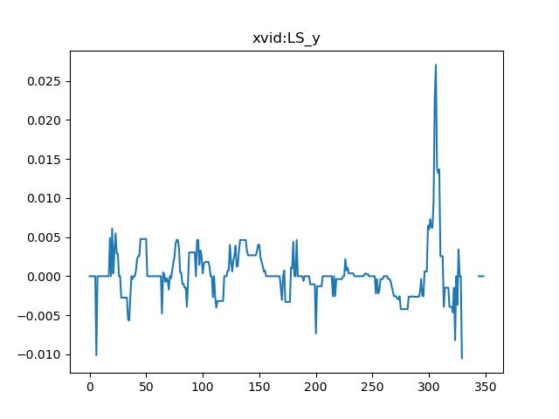
RMSE xvid-LS_y : 0.00758370254544715

Slide 2
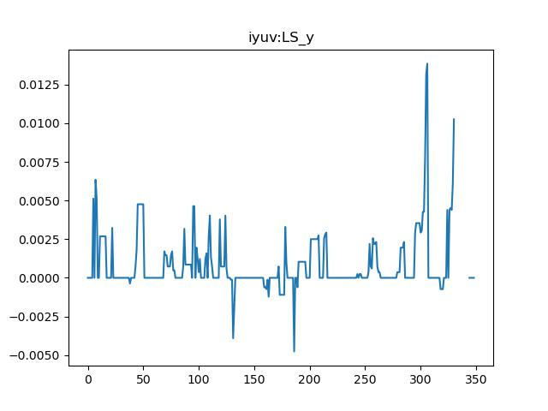
RMSE iyuv-LS_y : 0.005270615922672796

Slide 3
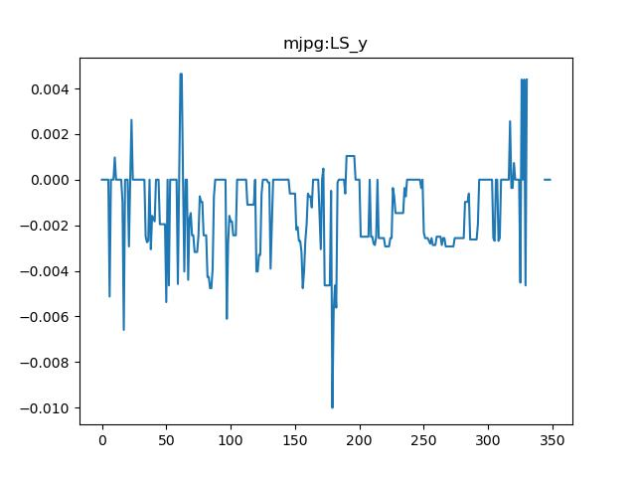
RMSE mjpg-LS_y : 0.0053066877439743735

Slide 4

RMSE mp4v-LS_y : 0.00758370254544715

Slide 5

RMSE b48r-LS_y : 0.005270615922672796

Slide 6
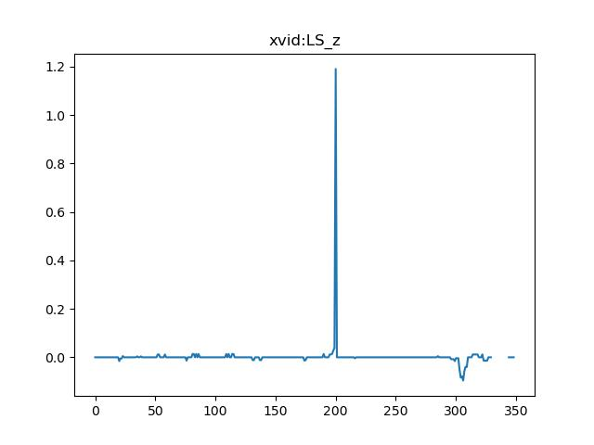
RMSE xvid-LS_z : 0.08044360950488275

Slide 7
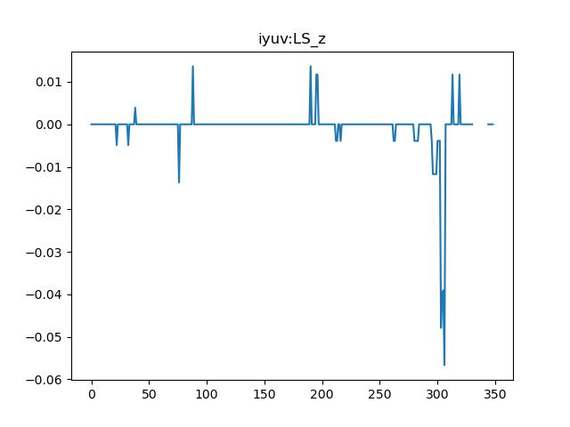
RMSE iyuv-LS_z : 0.05422517162491664

Slide 8
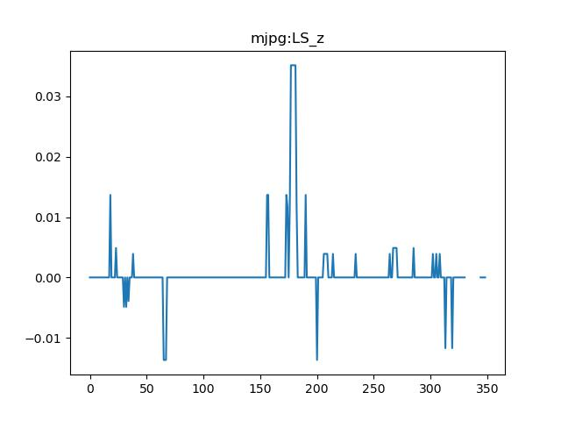
RMSE mjpg-LS_z : 0.05449276558470684

Slide 9

RMSE mp4v-LS_z : 0.08044360950488275

Slide 10

RMSE b48r-LS_z : 0.05422517162491664

Slide 11
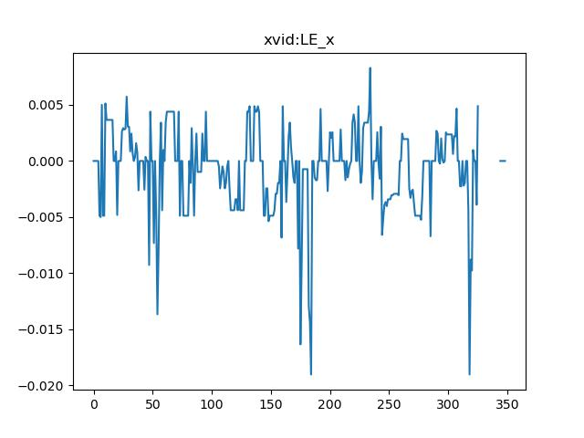
RMSE xvid-LE_x : 0.018973636604351293

Slide 12
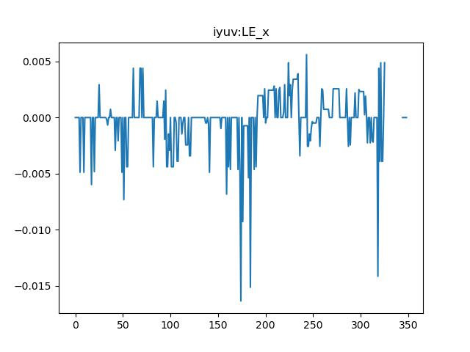
RMSE iyuv-LE_x : 0.018633470163545704

Slide 13
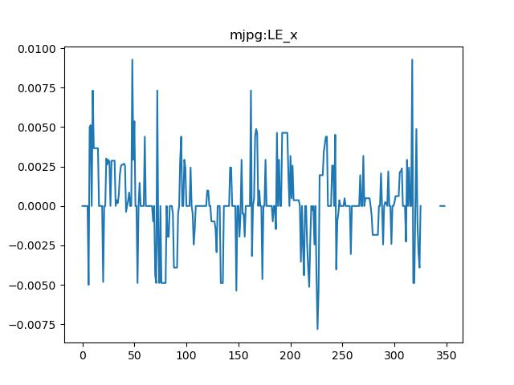
RMSE mjpg-LE_x : 0.018416555103437798

Slide 14

RMSE mp4v-LE_x : 0.018973636604351293

Slide 15

RMSE b48r-LE_x : 0.018633470163545704

Slide 16
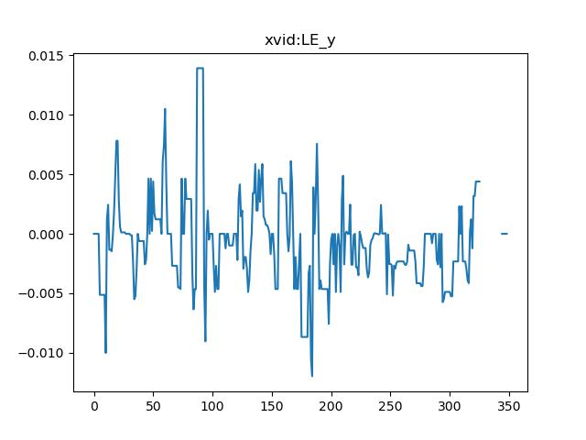
RMSE xvid-LE_y : 0.00996275724814071

Slide 17
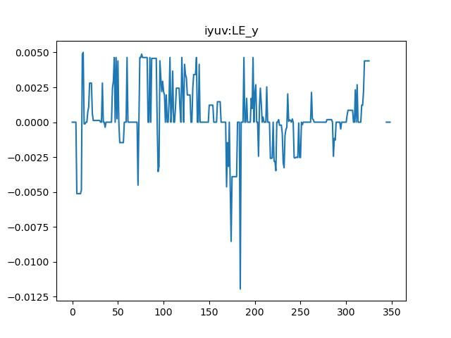
RMSE iyuv-LE_y : 0.00963703276237586

Slide 18
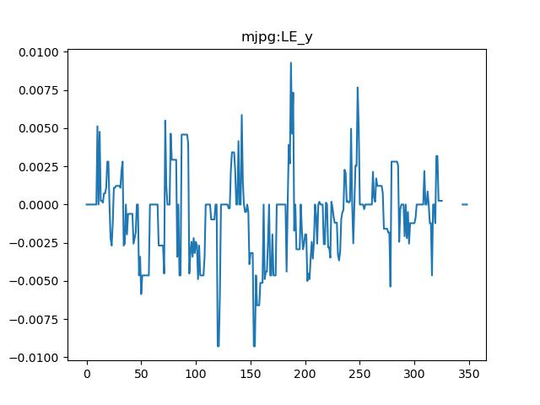
RMSE mjpg-LE_y : 0.009354401756400652

Slide 19
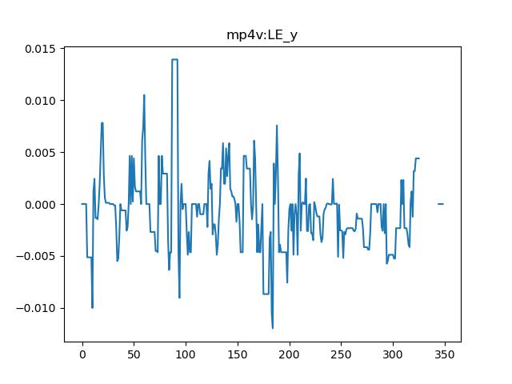
RMSE mp4v-LE_y : 0.00996275724814071

Slide 20
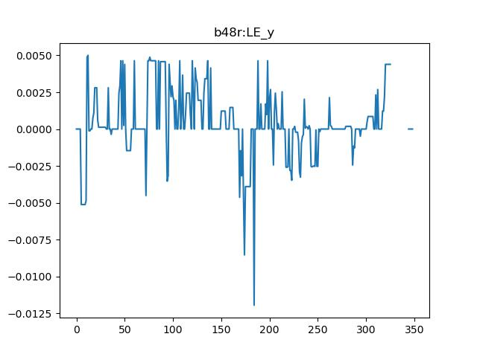
RMSE b48r-LE_y : 0.00963703276237586

Slide 21
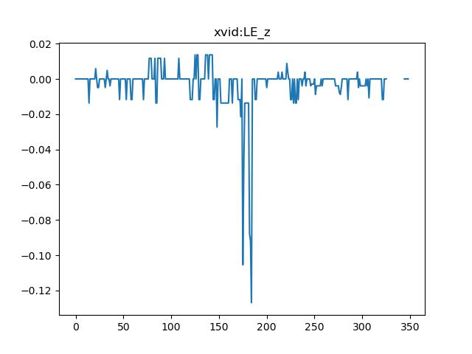
RMSE xvid-LE_z : 0.05873520150392389

Slide 22
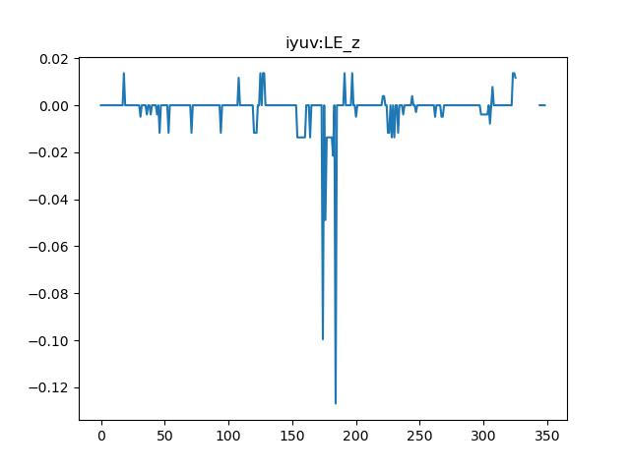
RMSE iyuv-LE_z : 0.05871265913142613

Slide 23
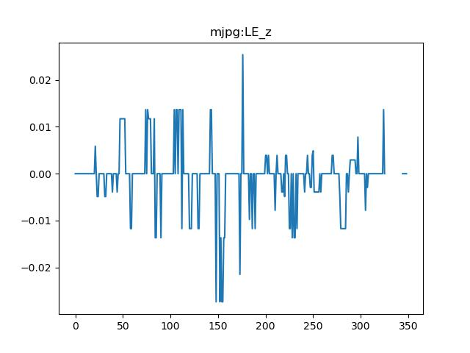
RMSE mjpg-LE_z : 0.05830890828722916

Slide 24
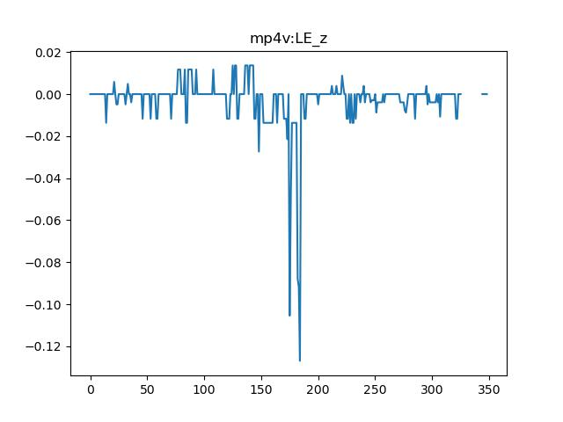
RMSE mp4v-LE_z : 0.05873520150392389

Slide 25

RMSE b48r-LE_z : 0.05871265913142613

Slide 26
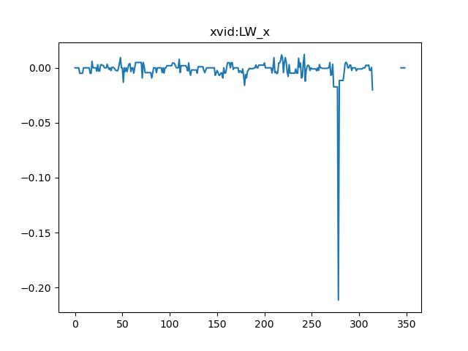
RMSE xvid-LW_x : 0.01857392260357759

Slide 27
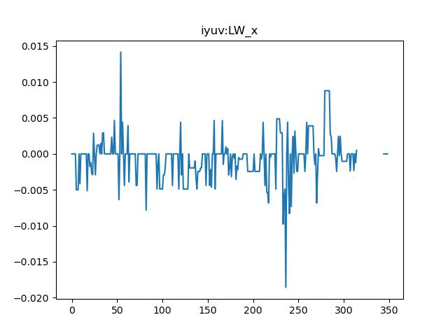
RMSE iyuv-LW_x : 0.016471951328944953

Slide 28
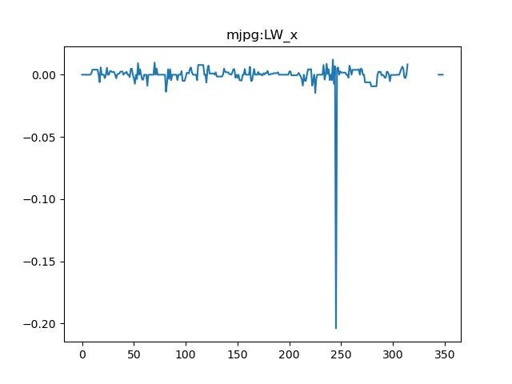
RMSE mjpg-LW_x : 0.016843574285674002

Slide 29

RMSE mp4v-LW_x : 0.01857392260357759

Slide 30

RMSE b48r-LW_x : 0.016471951328944953

Slide 31
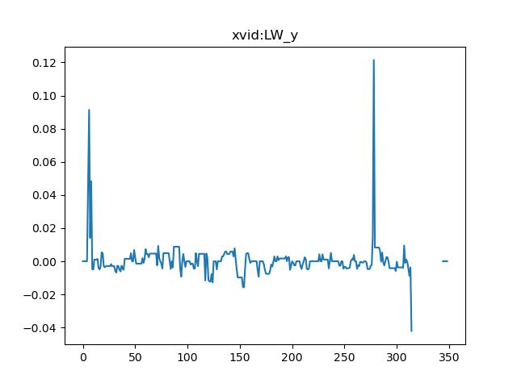
RMSE xvid-LW_y : 0.019038354208513422

Slide 32
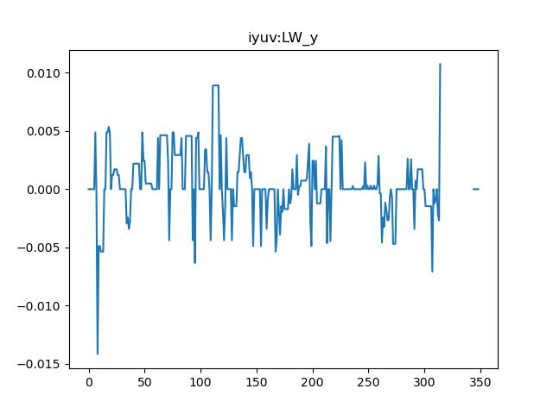
RMSE iyuv-LW_y : 0.019800697526350584

Slide 33
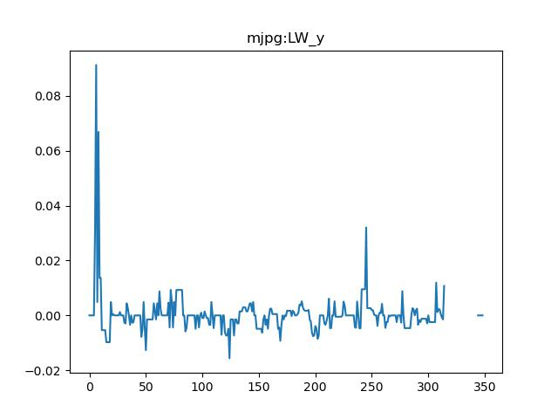
RMSE mjpg-LW_y : 0.01886587264064612

Slide 34
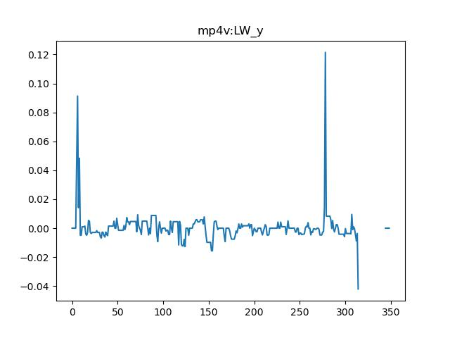
RMSE mp4v-LW_y : 0.019038354208513422

Slide 35

RMSE b48r-LW_y : 0.019800697526350584

Slide 36
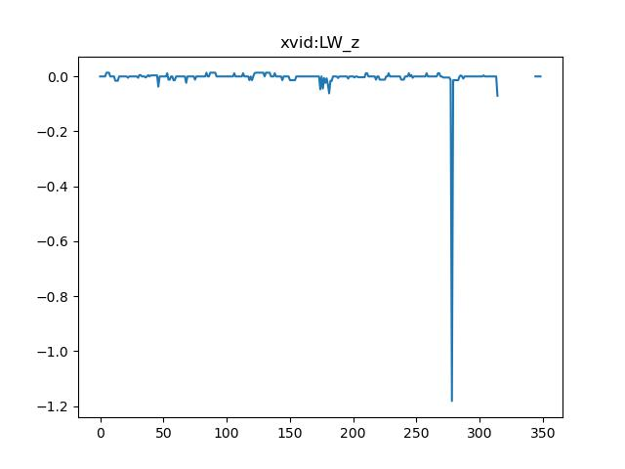
RMSE xvid-LW_z : 0.0643742432603156

Slide 37
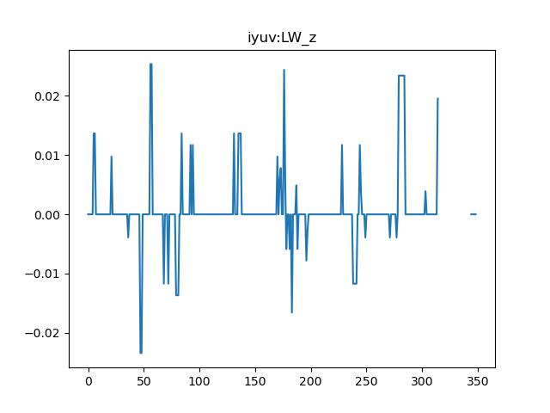
RMSE iyuv-LW_z : 0.05514471546959551

Slide 38
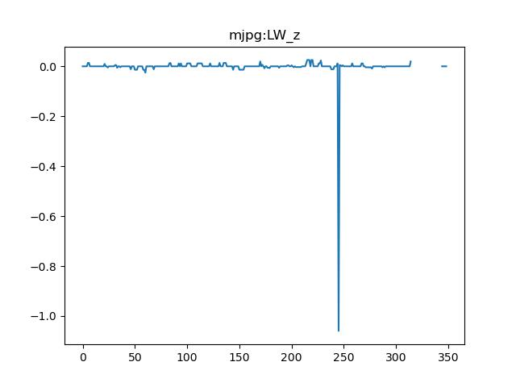
RMSE mjpg-LW_z : 0.05432976859053332

Slide 39
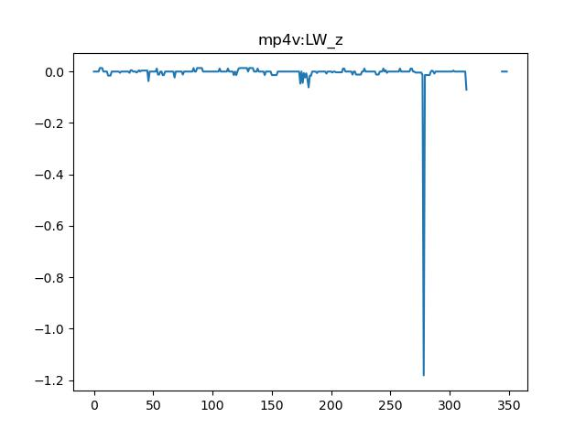
RMSE mp4v-LW_z : 0.0643742432603156

Slide 40
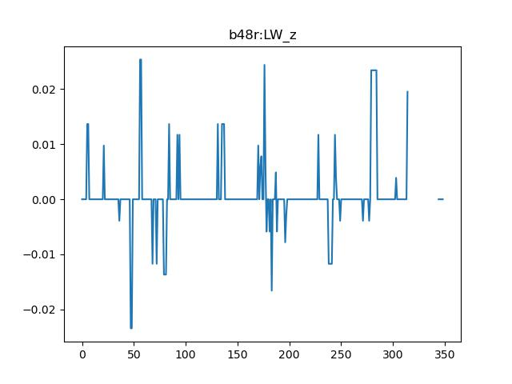
RMSE b48r-LW_z : 0.05514471546959551

Slide 41
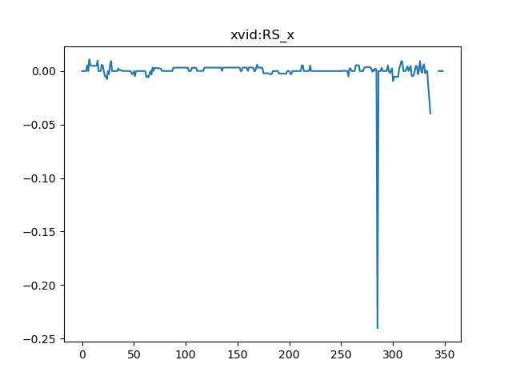
RMSE xvid-RS_x : 0.05124693852876004

Slide 42
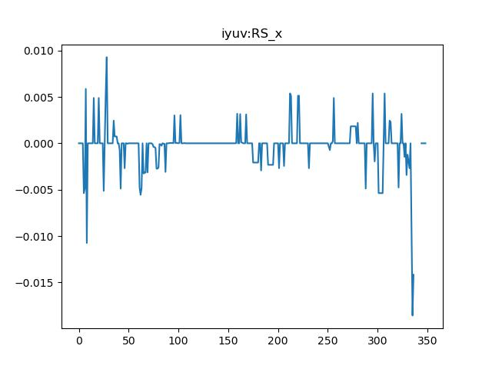
RMSE iyuv-RS_x : 0.051291121134204566

Slide 43
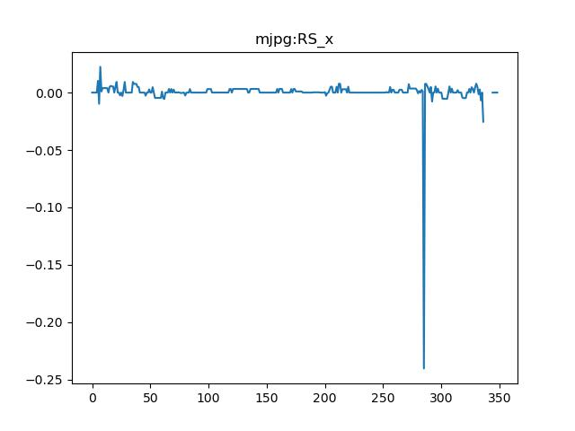
RMSE mjpg-RS_x : 0.018696183245764185

Slide 44
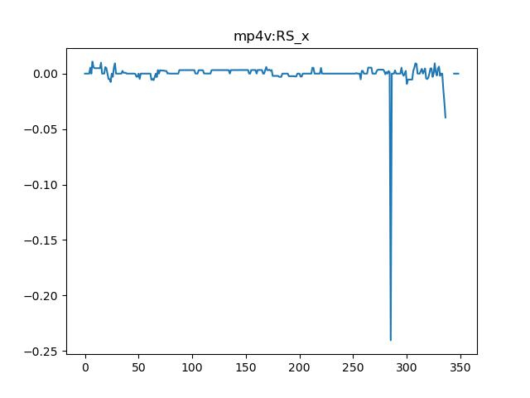
RMSE mp4v-RS_x : 0.05124693852876004

Slide 45

RMSE b48r-RS_x : 0.051291121134204566

Slide 46
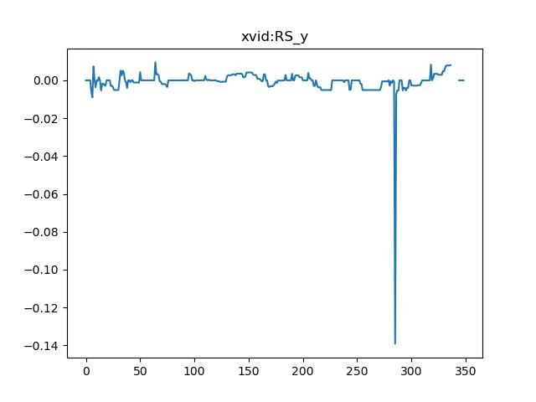
RMSE xvid-RS_y : 0.016337635516281264

Slide 47
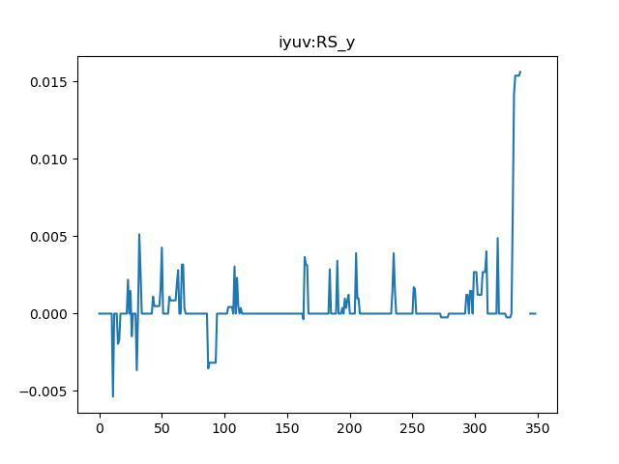
RMSE iyuv-RS_y : 0.016887168690587973

Slide 48
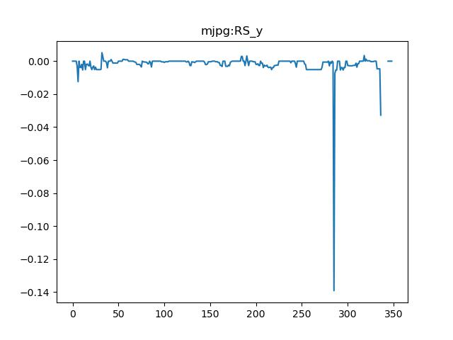
RMSE mjpg-RS_y : 0.006884169817899697

Slide 49
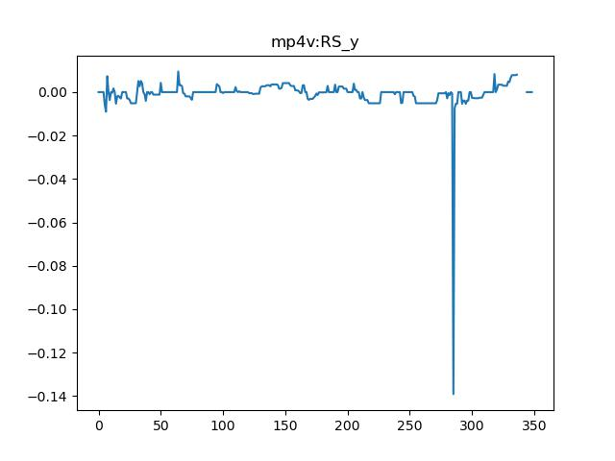
RMSE mp4v-RS_y : 0.016337635516281264

Slide 50

RMSE b48r-RS_y : 0.016887168690587973

Slide 51
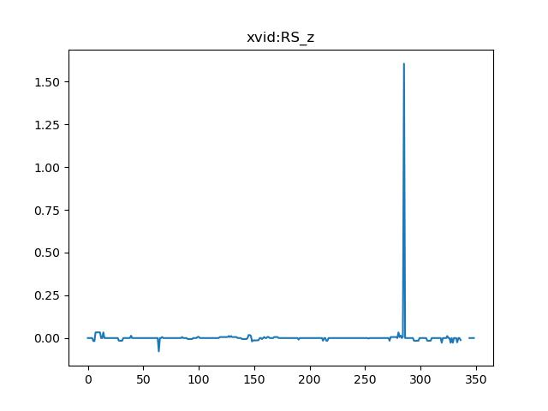
RMSE xvid-RS_z : 0.1652649317273953

Slide 52
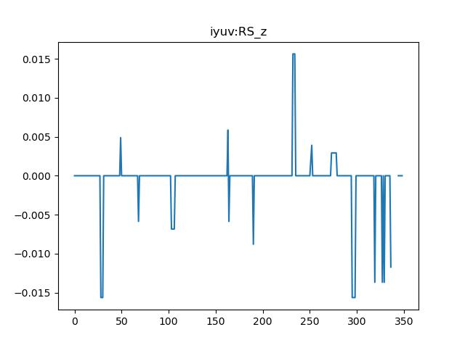
RMSE iyuv-RS_z : 0.17322255667177436

Slide 53
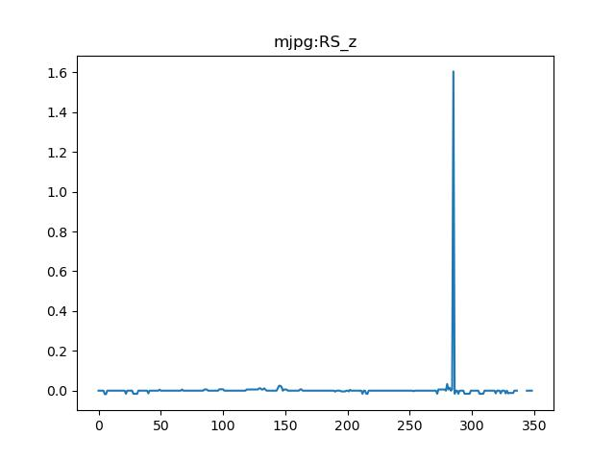
RMSE mjpg-RS_z : 0.06570700654843195

Slide 54

RMSE mp4v-RS_z : 0.1652649317273953

Slide 55
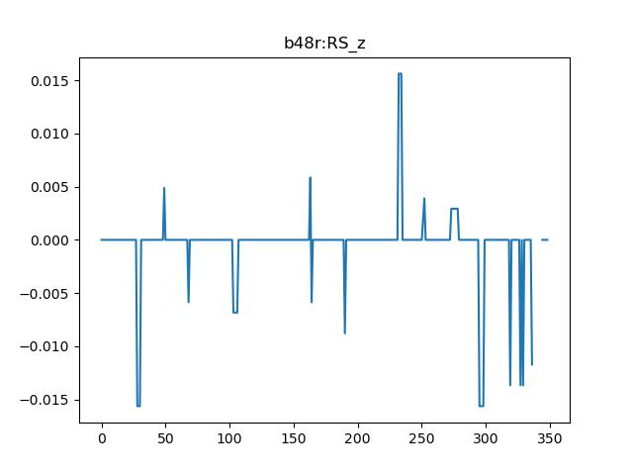
RMSE b48r-RS_z : 0.17322255667177436

Slide 56
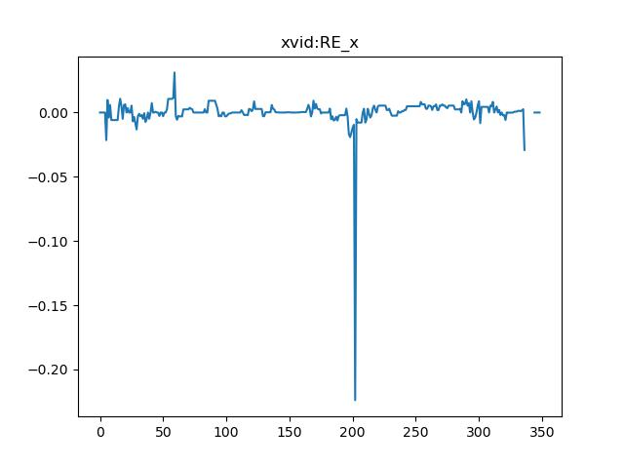
RMSE xvid-RE_x : 0.047867688511619655

Slide 57
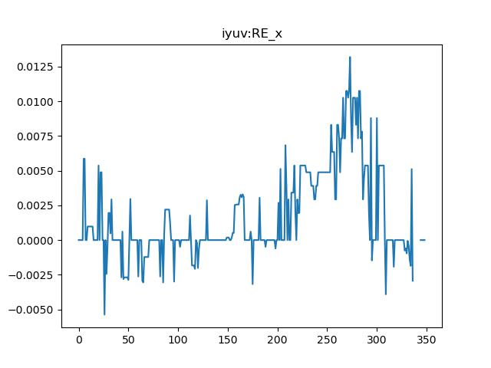
RMSE iyuv-RE_x : 0.04923305447584379

Slide 58
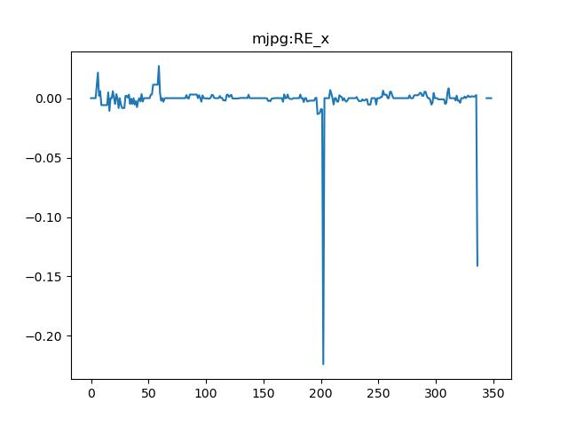
RMSE mjpg-RE_x : 0.019124081668256458

Slide 59
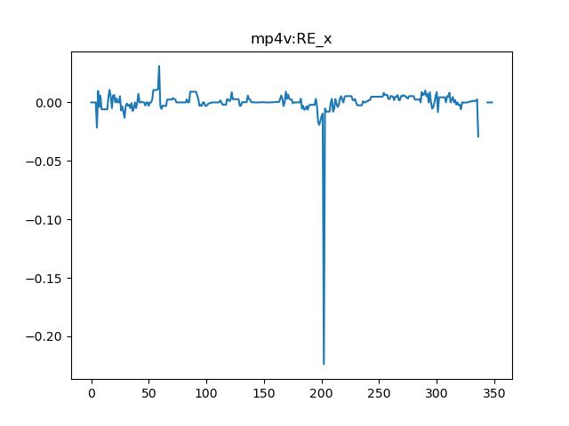
RMSE mp4v-RE_x : 0.047867688511619655

Slide 60

RMSE b48r-RE_x : 0.04923305447584379

Slide 61
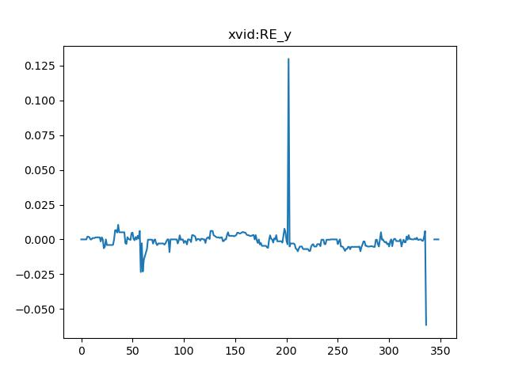
RMSE xvid-RE_y : 0.03385914324777704

Slide 62
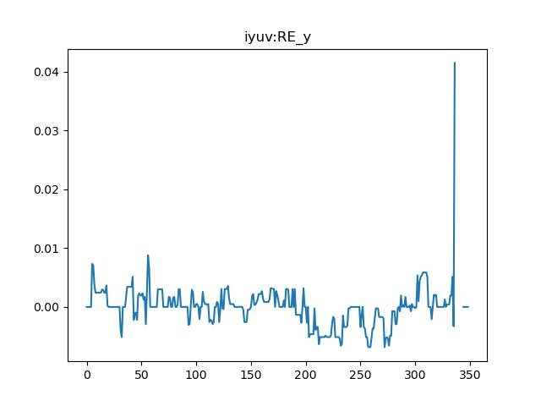
RMSE iyuv-RE_y : 0.031193014301445932

Slide 63
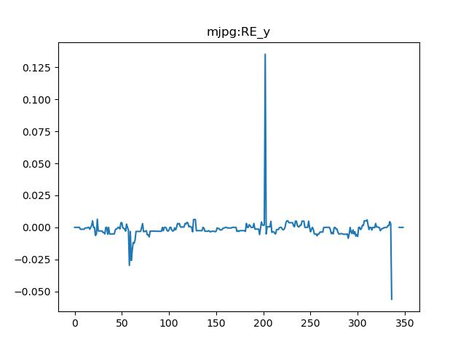
RMSE mjpg-RE_y : 0.01772155618100104

Slide 64

RMSE mp4v-RE_y : 0.03385914324777704

Slide 65
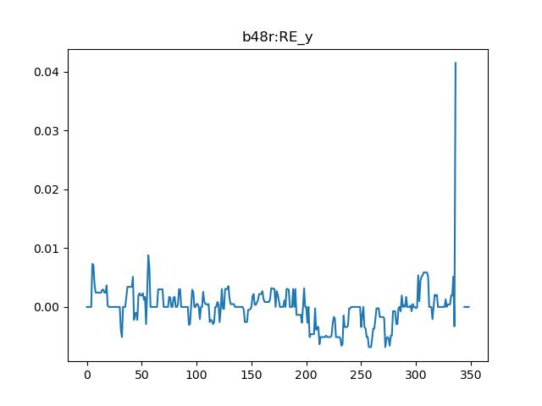
RMSE b48r-RE_y : 0.031193014301445932

Slide 66

RMSE xvid-RE_z : 0.1585124466442866

Slide 67

RMSE iyuv-RE_z : 0.16424454324132107

Slide 68

RMSE mjpg-RE_z : 0.06806799725488709

Slide 69

RMSE mp4v-RE_z : 0.1585124466442866

Slide 70

RMSE b48r-RE_z : 0.16424454324132107

Slide 71

RMSE xvid-RW_x : 0.024730429388077617

Slide 72

RMSE iyuv-RW_x : 0.025070366217768682

Slide 73

RMSE mjpg-RW_x : 0.022268245085222904

Slide 74

RMSE mp4v-RW_x : 0.024730429388077617

Slide 75

RMSE b48r-RW_x : 0.025070366217768682

Slide 76

RMSE xvid-RW_y : 0.02655248768879946

Slide 77

RMSE iyuv-RW_y : 0.02618527322533176

Slide 78

RMSE mjpg-RW_y : 0.01564677301209256

Slide 79

RMSE mp4v-RW_y : 0.02655248768879946

Slide 80

RMSE b48r-RW_y : 0.02618527322533176

Slide 81

RMSE xvid-RW_z : 0.10851026936295509

Slide 82

RMSE iyuv-RW_z : 0.10839370761824094

Slide 83

RMSE mjpg-RW_z : 0.05584212277127043

Slide 84

RMSE mp4v-RW_z : 0.10851026936295509

Slide 85

RMSE b48r-RW_z : 0.10839370761824094

Slide 86

RMSE xvid-TR_x : 0.04388009828987548

Slide 87

RMSE iyuv-TR_x : 0.042318939129158135

Slide 88

RMSE mjpg-TR_x : 0.018545102560947508

Slide 89

RMSE mp4v-TR_x : 0.04388009828987548

Slide 90

RMSE b48r-TR_x : 0.042318939129158135

Slide 91

RMSE xvid-TR_y : 0.008333738320871562

Slide 92

RMSE iyuv-TR_y : 0.008722189790476382

Slide 93

RMSE mjpg-TR_y : 0.003966957883646865

Slide 94

RMSE mp4v-TR_y : 0.008333738320871562

Slide 95

RMSE b48r-TR_y : 0.008722189790476382

Slide 96

RMSE xvid-TR_z : 0.13880298681506292

Slide 97

RMSE iyuv-TR_z : 0.13853737019637816

Slide 98

RMSE mjpg-TR_z : 0.055896519414521104

Slide 99

RMSE mp4v-TR_z : 0.13880298681506292

Slide 100

RMSE b48r-TR_z : 0.13853737019637816

Slide 101
Cumulative error for each codec
RMSE xvid : 0.046384703669972605
RMSE iyuv : 0.033490452416486
RMSE mjpg : 0.028191299514580947
RMSE mp4v : 0.046384703669972605
RMSE b48r : 0.033490452416486

