Slide 1
Java Programming

Slide 2
Java Introduction
Java is a programming language and a platform.
Java is a high level, robust, secured and object-oriented programming language.
Platform: Any hardware or software environment in which a program runs, is known as a platform. Since Java has its own runtime environment (JRE) and API, it is called platform.
Types of Java Applications
There are mainly 4 type of applications that can be created using java programming:
1) Standalone Application
It is also known as desktop application or window-based application. An application that we need to install on every machine such as media player, antivirus etc. AWT and Swing are used in java for creating standalone applications.
2) Web Application
An application that runs on the server side and creates dynamic page, is called web application. Currently, servlet, jsp, struts, jsf etc. technologies are used for creating web applications in java.
3) Enterprise Application
An application that is distributed in nature, such as banking applications etc. It has the advantage of high level security, load balancing and clustering. In java, EJB is used for creating enterprise applications.
4) Mobile Application
An application that is created for mobile devices. Currently Android and Java ME are used for creating mobile applications.

Slide 3
JVM
JVM (Java Virtual Machine) is an abstract machine. It is a specification that provides runtime environment in which java byte code can be executed.
JVMs are available for many hardware and software platforms. JVM, JRE and JDK are platform dependent because configuration of each OS differs. But, Java is platform independent
The JVM performs following main tasks:
Loads code
Verifies code
Executes code
Provides runtime environment

Slide 4
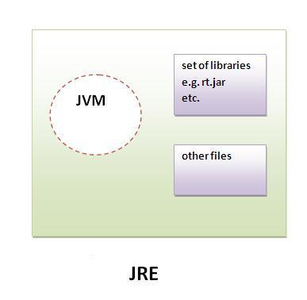
JRE
JRE is an acronym for Java Runtime Environment.It is used to provide runtime environment.It is the implementation of JVM. It physically exists. It contains set of libraries + other files that JVM uses at runtime.
Implementation of JVMs are also actively released by other companies besides Sun Micro Systems.

Slide 5
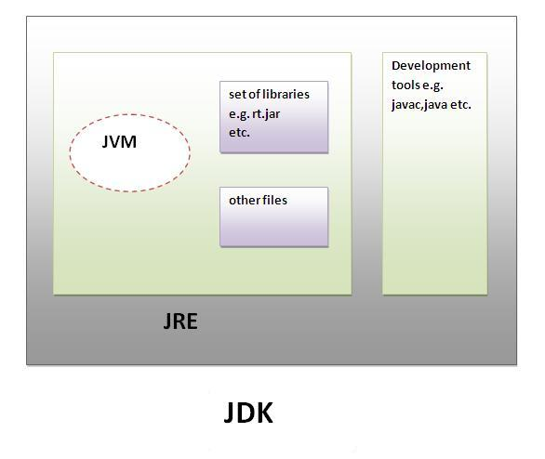
JDK
JDK is an acronym for Java Development Kit.It physically exists.It contains JRE + development tools.

Slide 6
Java Basic Data Types
Variables are nothing but reserved memory locations to store values. This means that when you create a variable you reserve some space in memory.
Based on the data type of a variable, the operating system
allocates memory and decides what can be stored in the
reserved memory. Therefore, by assigning different data
types to variables, you can store integers, decimals or
characters in these variables.
There are two data types available in Java:
Primitive Data Types
Reference/Object Data Types

Slide 7
Primitive Data Types:--
There are eight primitive data types supported by Java.
Primitive data types are predefined by the language and
named by a keyword.
Reference Data Types:
Reference variables are created using defined constructors of the classes
They are used to access objects. These variables are declared to be of a
specific type that cannot be changed. For example, Employee, Puppy etc.
Class objects, and various type of array variables come under reference
data type.
Default value of any reference variable is null.

Slide 8
Data Type Default Value (for fields) Size byte 0 1 short 0 2 int 0 4 long 0L 8 float 0.0f 4 double 0.0d 8 char '\u0000‘ 1
String (or any object) null
Boolean false

