Slide 1
SELENIUM
Web Testing tool

Slide 2
It has four components. Selenium Integrated Development Environment (IDE) Selenium Remote Control (RC) WebDriver Selenium Grid
What is Selenium?
Selenium is a free (open source) automated testing suite for web applications across different browsers and platforms. It is quite similar to HP Quick Test Pro (QTP) only that Selenium focuses on automating web-based applications.
Selenium is not just a single tool but a suite of software's, each catering to different testing needs of an organization.

Slide 3
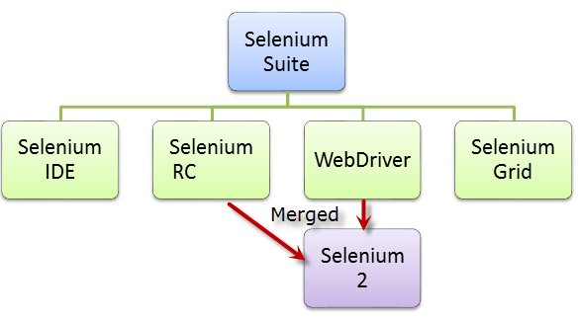
Selenium RC and Web Driver are merged into a single Framework to form Selenium2. Selenium RC refers as Selenium1

Slide 4
Who developed Selenium?
Since Selenium is a collection of different tools, it had different developers as well.
Primarily, Selenium was created by Jason Huggins in 2004. An engineer at ThoughtWorks, he was working on a web application that required frequent testing.
Birth of Selenium 2
In 2008, the whole Selenium Team decided to merge WebDriver and Selenium RC to form a more powerful tool called Selenium 2, with WebDriver being the core. Currently, Selenium RC is still being developed but only in maintenance mode. Most of the Selenium Project's efforts are now focused on Selenium 2.

Slide 5
Brief Introduction Selenium IDE:-- Selenium Integrated Development Environment (IDE) is the simplest framework in the Selenium suite and is the easiest one to learn. It is a Firefox plugin that you can install as easily as you can with other plugins. However, because of its simplicity, Selenium IDE should only be used as a prototyping tool. If you want to create more advanced test cases, you will need to use either Selenium RC or WebDriver.
Pros:--
Very Easy to use and Install
No Programming Experience is required
Can Support Tests to formats usable in Selenium RC and Web Driver.
Has Built in Help and Test Results reporting Module
Provides support for extensions
Cons:--
Available only in Firefox
Designed only to create Prototypes of Tests
No Support for Iterations and Conditional Statements
Test Execution is slow compare to Selenium RC and Web Driver.

Slide 6
Selenium Remote Control (Selenium RC)
This is the first automated web testing tool that allowed
users to use a programming language they prefer. As of
version 2.25.0, RC can support the following programming
languages:
Java
C#
PHP
Python
Perl
Ruby

Slide 7
SELENIUM RC:--
Pros
Cross Browser and Cross Platform
Can perform looping and Conditional Operations
Can support Data Driven testing
Can Readily support new Browsers
Faster Execution than IDE
Cons:--
Installation is more complicated than IDE
Must have programming knowledge
Needs Selenium RC server to be running
Inconsistent results and uses Java Script
Slower execution time than Web Driver

Slide 8
The supported languages are the same as those in Selenium RC. Java C# PHP Python Perl Ruby
Introduction WebDriver
The WebDriver proves itself to be better than both
Selenium IDE and Selenium RC in many aspects. It
implements a more modern and stable approach in
automating the browser's actions. WebDriver, unlike
Selenium RC, does not rely on JavaScript for
automation. It controls the browser by directly
communicating to it.

Slide 9
Selenium WebDriver
Pros:--
Simpler Installation than RC
Communicates directly to the browser
Browser Interaction is more realistic
No need for a separate component such as the RC Server
Faster Execution time than IDE and RC
Cons:--
Installation is more complicated than SELENIUM IDE
Requires programming knowledge
Cannot readily support new Browsers
Has no built in mechanism for logging runtime messages and test results

Slide 10
Selenium Grid
Selenium Grid is a tool used together with Selenium RC
to run parallel tests across different machines and
different browsers all at the same time. Parallel execution
means running multiple tests at once.

