Slide 1
Indian Institute of Information & Technology, Bhopal ECE 6th Sem. Minor Project -2023
Group No.
Group 10
Team Members:-
Student Name Scholar No.
ABHISHEK BRAJVASI 20U01047
ARPEET BHAISARE 20U01041
SRIRAMA ANIKETH 20U01052
SAMARTH VARSHNEY 20U01024
Supervisor
Dr. Bhupendra Singh Kirar

Slide 2
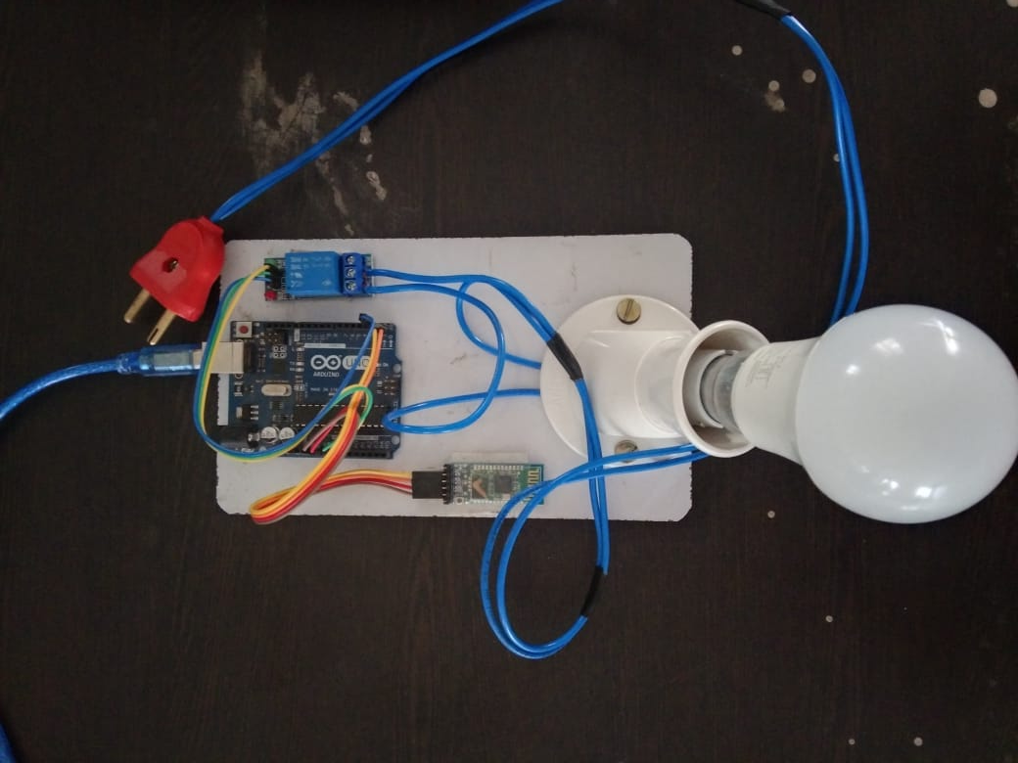
ON OFF SYSTEM USING ARDUINO AND BLUETOOTH

Slide 3
INDEX
Introduction
Bluetooth control lamp process:-
Hardware Required
Software Required
Circuit diagram
Coding
Conclusion & future scope

Slide 4
ON OFF SYSTEM USING ARDUINO AND BLETOOTH
INTRODUCTION
We are going to build a on off system using Arduino Bluetooth module and it is totally Smartphone based
Here we will control a light using my Smartphone
For making this project we are using Arduino Bluetooth Module and Relay Module
The on off circuit is built around An Arduino Uno board ,Bluetooth module HC-05 and a 1-channel relay board
The number of channels depends on the number of appliances you wish to control
• Arduino Uno is powered with a 5V DC adaptor/power source

Slide 5
Bluetooth control lamp process:-
lamp is powered on, when a signal is received through a Bluetooth control app on a Smartphone, it is captured by the Bluetooth module.
Signal is transmitted to the Arduino board via serial communication.
If the Signal value is related to the program, then the relay module will be ON or OFF.
That s, the bulb turns on or off.

Slide 6
Components Required:-
The on /off system contains four hardware components -
Smartphone
Arduino board
Bluetooth module
relay module.

Slide 7
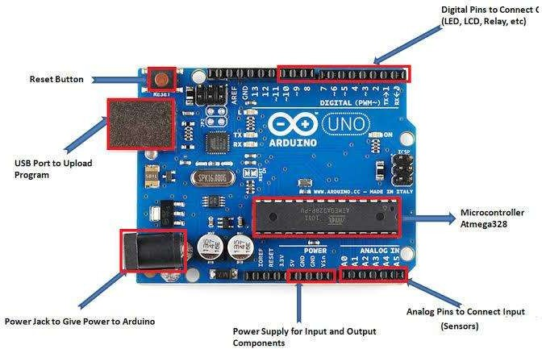
Arduino UNO:-
Arduino Uno is an open-source microcontroller board based on the processor ATmega328P. There are 14 digital I/O pins, 6 analog inputs, a USB connection, a power jack, an ICSP header, and a reset button. It contains all the necessary modules needed to support the microcontroller. Just plug it into a computer with a USB cable or power it with an adapter to get started. You can experiment with your Arduino without worrying too much about it. In the event of a worst-case scenario, you could buy a new one as the Uno is very economical compared to other boards like raspberry pi, STM, etc

Slide 8
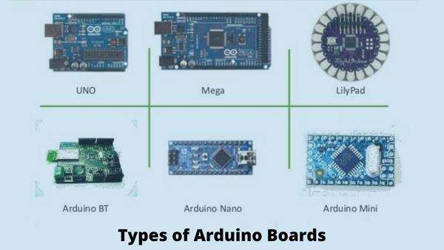
Types of Arduino Boards:-
There are different types of Arduino boards such as-
Arduino Uno
Arduino Mega(R3)Board
Lily pad Arduino Board
Arduino BT
Arduino nano
Arduino mini etc.

Slide 9
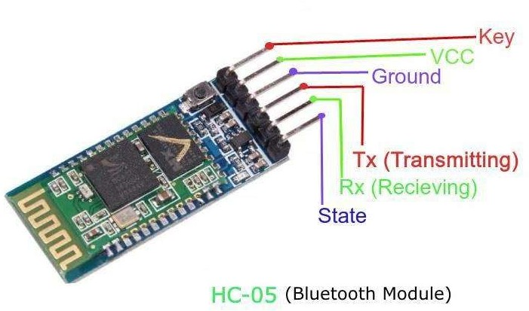
Bluetooth module HC-05:-
Bluetooth module HC-05 is used for wireless communication between Arduino Uno and Smartphone.
HC-05 is a slave device and it can operate at power 3.6 to 6 volts.
It has 6 pins: State , RXD,TXD,GND,VCC and EN.
For serial communication connect TXD pin of Bluetooth module HC-05 with RX(pin0) and RXD pin with TX(pin1) of Arduino Uno.

Slide 10
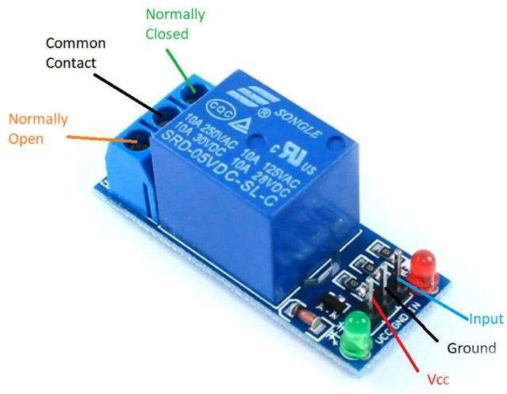
Single channel relay module:-
Relay is an electromechanical device that uses an electric current to open or close the contacts of a switch.
The signal-channel relay module is comprises of components that make switching and connection easier

Slide 11
Alternate Relay Modules:-
Dual-channel relay module
four-channel relay module
8-channel relay module

Slide 12
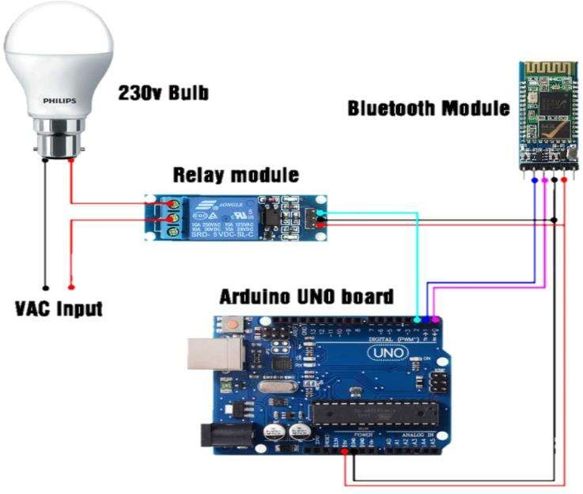
Circuit diagram:-

Slide 13
Software Required:-
Arduino IDE:-
IDE stands for Integrated Development Environment, entire programming for proposed system is done in Arduino IDE tool.
Baud rate is set to 9600 bits per second for serial communication between Arduino board and Smartphone.
Arduino IDE commands "Seral.Available0" is used to receive data serially from Smartphone and "Serial.println()" command is used to transmit data serially from Arduino board to Smartphone.
The code to receive data sera from Smartphone.
State variable is used to store the value of received byte and then it is compared with different condition and perform the specific operation. The Arduino IDE code for turn ON and OFF.

Slide 14
Arduino Bluetooth controller app:-
The Arduino Bluetooth Controller Application make to able to remote control your device with Bluetooth Module and Arduino Board.
Do you want to control via Bluetooth the Arduino project you built? Let your Android device be a remote control for any micro-controller with a Bluetooth module

Slide 15
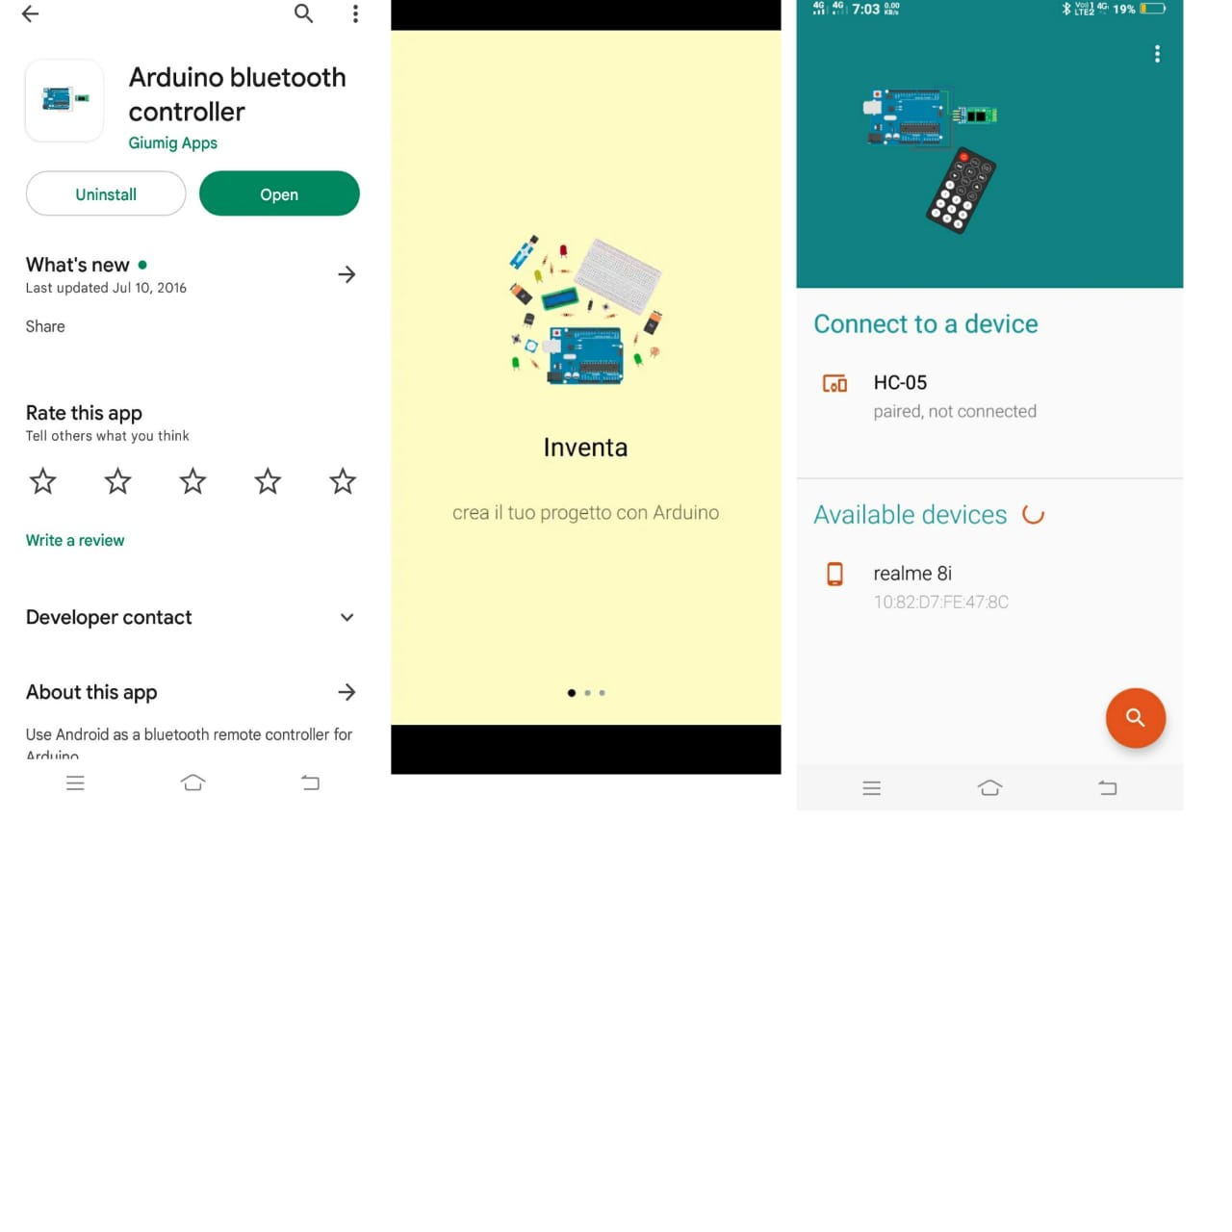
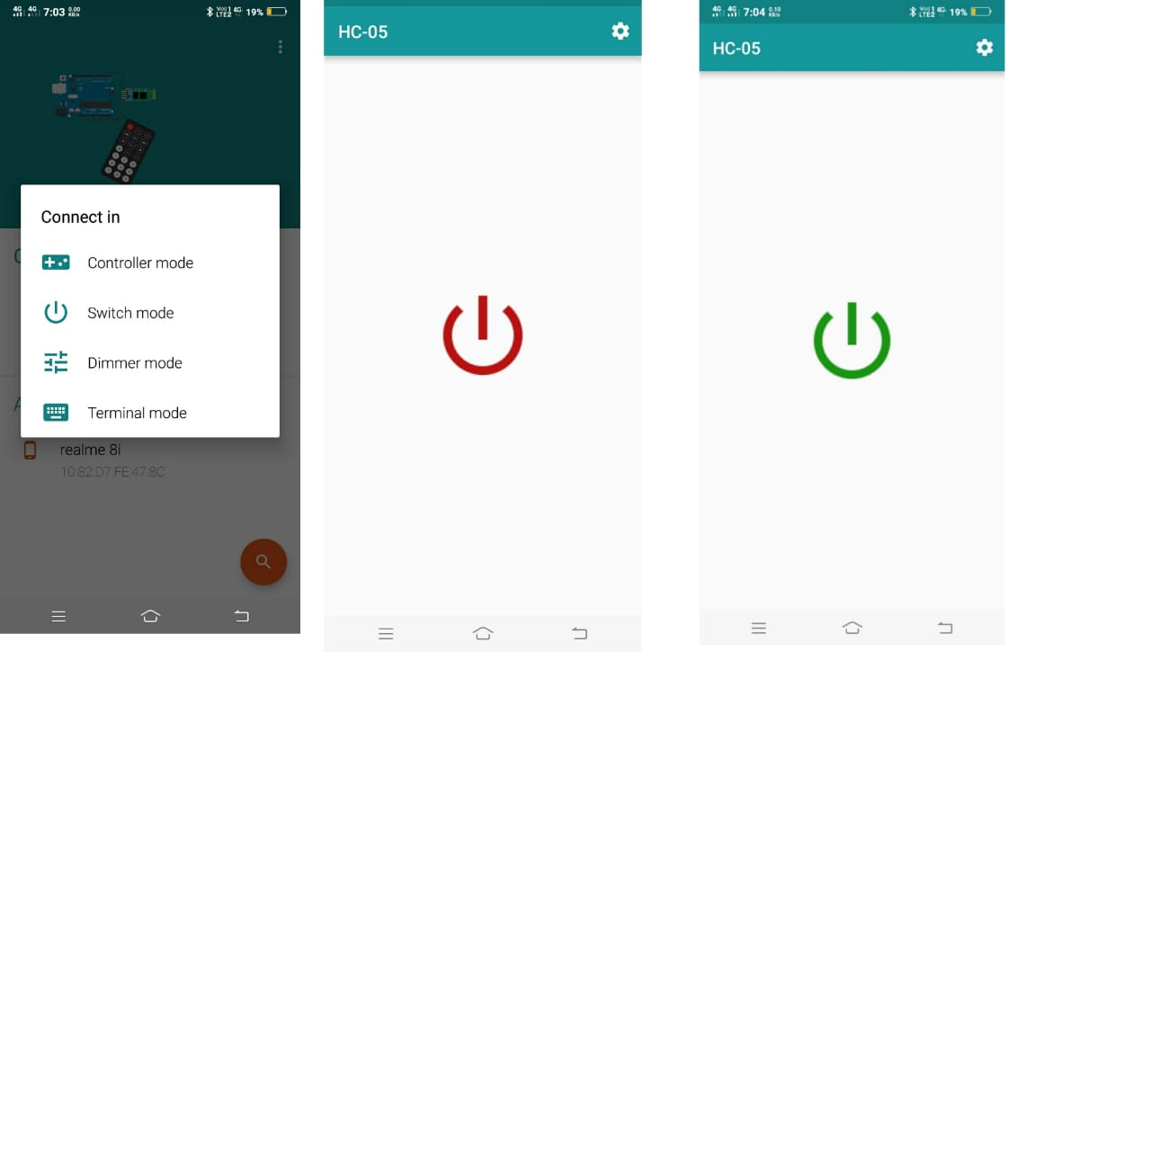

Slide 16
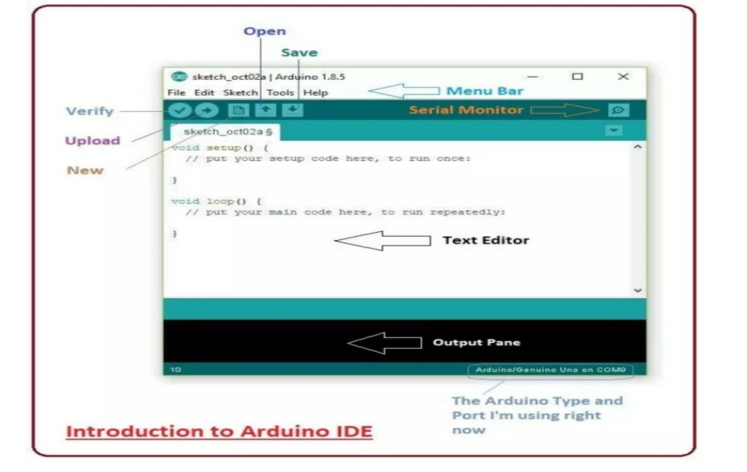
Code:-
void setup()
{
Serial.begin(9600);//enable serial monitor
pinMode(2, OUTPUT);//define relay pin
}
void loop()
{
if (Serial.available() > 0)
{
value = Serial.read();//read serial value
}
if (value == '1')
{
digitalWrite(2, LOW);//lamp ON
}
else if (value == '0')
{
digitalWrite(2, HIGH);//lamp OFF
}
else
{
digitalWrite(2,HIGH);
}
}

Slide 17
CONCLUSON:-
we have introduced design and implementation of a low cost, flexible and wireless solution to the home automation.
The system is secured for access from any user or intruder.
The users are expected to acquire pairing password for the Arduino BT and the cell phone to access the home appliances.
This adds protection from unauthorized users.
This system can be used as a test bed for any appliances that require on-off switching applications without any internet connection.

Slide 18
REFERENCES:-
https://www.electronicsmedia.info/2019/02/01/basic-concept-arduino-hardware-structre-ardno/
https://iwheels.co/bog/tpes-of-ardno-boards/
https://www.geeksforgeeks.org/a-about-hc-05-buetooth-module-connection-wth-android/
https://components101.com/switches/5v-sngle-channel-reay-modue-pinout-features-appications-working-datasheet
https://www.theengneerngprojects.com/2018/10/introduction-ide.html
https://pay.google.com/store/apps/detais?id=com.giuming.apps.bluetoothserialmonitor

Slide 19
THANKS

