Slide 1

Term Frequency – Inverse Document Frequency TF-IDF
Presented by:
Arpit Gole
Organised by: AI & ML Student Club

Slide 2
Importance of the Title
Let’s focus on a real-world problem of searching a particular token (word) in any given document/set of documents, basically corpus of text.
Naïve way – Search the token in the corpus of the text linearly.
For large corpus it puts lots of strain on the computing resource.
A faster way to achieve this is to use TF-IDF for information retrieval.

Slide 3
Vector Semantics and TF-IDF
Vector Semantics – The representation of the meaning of the corpus of text in the form of vectors.
There are many different techniques to achieve vector semantics.
Naïve way – count the no. of words in the corpus.
Yes, histogram of a word count is a form of vector representation.
It roughly captures the meaning of the corpus.
Bag-of-word model

Slide 4
TF-IDF
However,
– Different words may have different importance
– Some words occur much more frequently but are less meaningful
TF-IDF
– A weighting scheme
– Increase the weight of important words
– Decrease the weight of irrelevant words
• The property of important words for a document
– Often occurred in the document
– But less likely to be observed in the other document

Slide 5
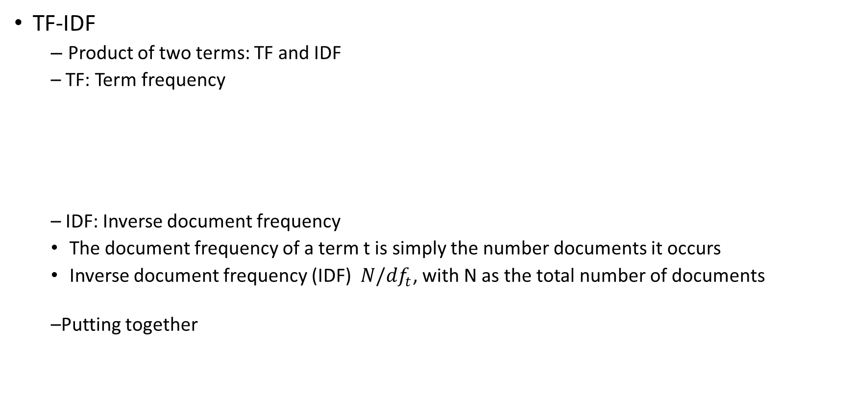
TF-IDF
TF-IDF
– Product of two terms: TF and IDF
– TF: Term frequency
– IDF: Inverse document frequency
The document frequency of a term t is simply the number documents it occurs
Inverse document frequency (IDF) $N/{df}_{t}$, with N as the total number of documents
–Putting together

Slide 6
TF-IDF
The dimensionality of TF-IDF is |V|, i.e., size of the vocabulary.
High-dimensional but sparse
– In a document, only a small fraction of words occur
Challenges
– How to store them efficient
– How to maintain the efficient storage with increasing documents
– How to search relevant document efficiently
Solution: Inverted file/Inverted index

Slide 7
Inverted File
Inverted file is a data structure which stores the document ID in which a word occurs
– It is called Inverted file because it collect the occurrence information of each word in different documents.
Each word can be seen as a “document’’ and document ID becomes “word”
– The TF-IDF of each word in each document can also be stored
– Optional, we can store the paragraph ID, sentence ID to make fine-gain retrieval
Use Inverted File for fast retrieval
– Given a query, breaking it down into a set of words
– For each word, find its occurred documents, accumulate the TF-IDF for each occurred document
– Rank the documents by the accumulated TF-IDF

Slide 8
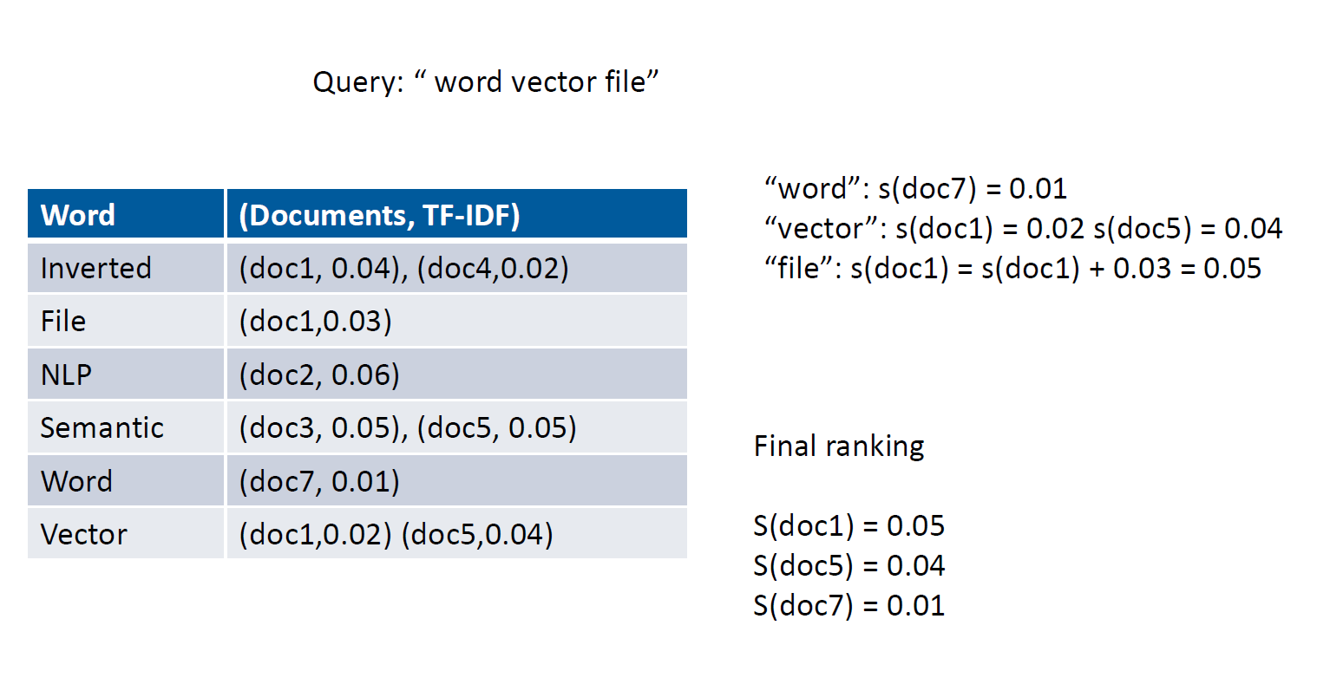
Working of Inverted File

Slide 9
The End

