Slide 1
Project Presentation on
Design and Development Of Face Recognition based Attendance System
PROJECT GUIDE Group No. 13 MR. HIRESH KUMAR GUPTA Arpit Pathak (1701410034) Asst. Prof. Pratishtha Agarwal(1701410078) Dept. of CSE Shivi Saxena(1701410096)

Slide 2
CONTENTS
Introduction
Literature Review
Project Objective
Methodology
Hardware Requirements
Software Requirements
Diagrams
Flowcharts
Conclusion
References

Slide 3
INTRODUCTION
Face Recognition : Method of identifying or verifying the identity of an individual using their face. It can be used to identify people in photos, videos or in real-time. Flow Process : Capture → Detect → Identify Used currently in personal devices, social media, law enforcement, public utilities etc.
Attendance System : Used to track and monitor the regularity of the students/employees inside an institution or an organization. Various attendance systems are being used like physical register, card punching, Biometric systems (face ID, fingerprint scanner, Iris detection) etc.

Slide 4
LITERATURE REVIEW
Focus on attendance system for students in Schools, colleges etc.
Current systems like physical register method, biometric fingerprint method, face ID method.
The main idea is about saving time while maintaining the reliability.
Attendance with a single capture using face recognition

Slide 5
PROJECT OBJECTIVE
Develop a Face recognition system to detect and identify the face of all the students from a single capture.
Attendance of the identified students should be updated in the attendance management database.
Design a web portal where students can login and track their attendance and faculties can login and track/edit the attendance of students.
Architectural Objective : Design and deploy the whole system on the top of a cloud platform for better reliability and scalability.

Slide 6
METHODOLOGY
The project flow process is divided into basically three phases. These are : -
Phase 1: Develop a face recognition system
Phase 2: Create and deploy a database integrated with Phase 1 to store the attendance of students.
Phase 3: Design and deploy a web portal connected with the database.

Slide 7
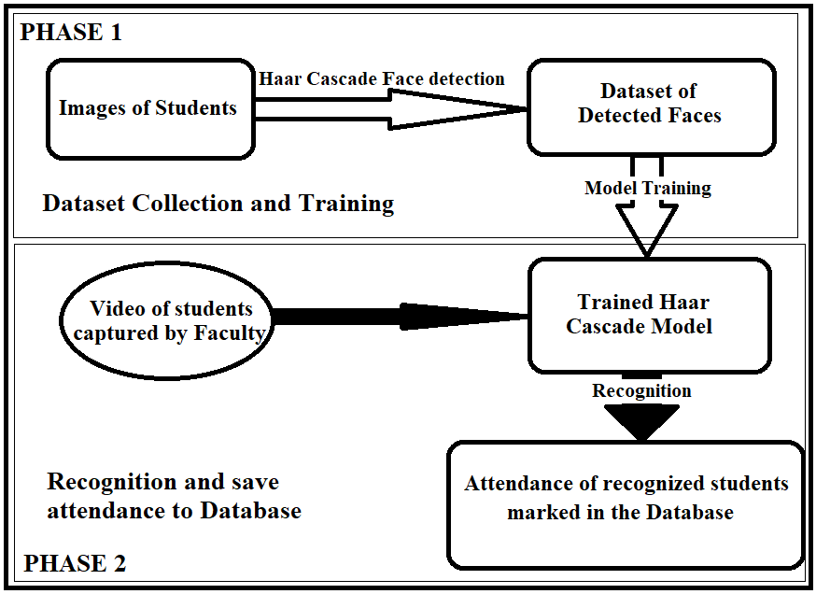
Phase 1 & Phase 2

Slide 8
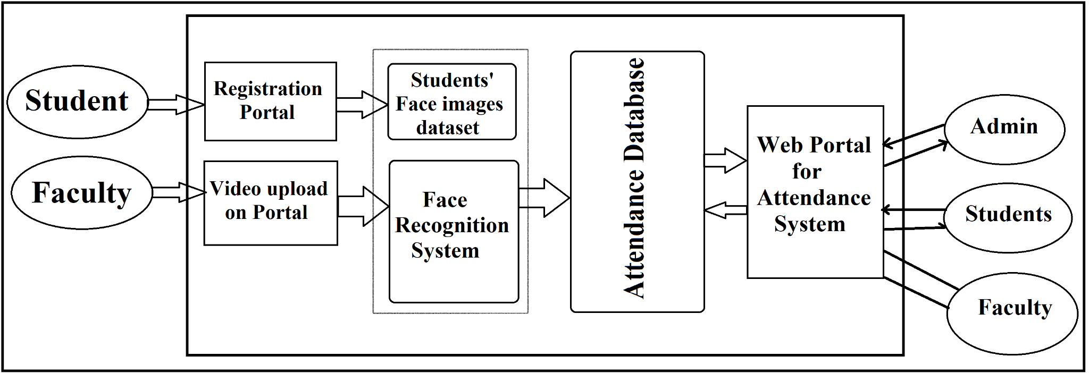
Final Deployment Model

Slide 9
HARDWARE & SOFTWARE REQUIREMENTS
SNO. | HARDWARE | SPECIFICATIONS
1 | Processor | Intel core i3
2 | RAM | 4 GB
3 | Hard disk | 15 GB
SNO. | SOFTWARE | SPECIFICATION
1 | Designing frontend | HTML, CSS
2 | Scripting | Python 3.7
3 | Web Server | Flask
4 | Database Server | MySQL 8.0 (GA)

Slide 10
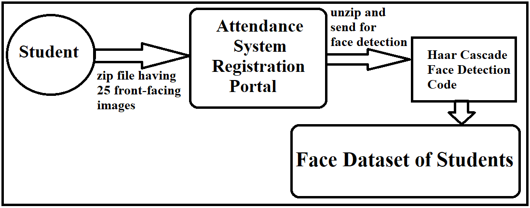
DIAGRAMS
DataSet Preparation

Slide 11
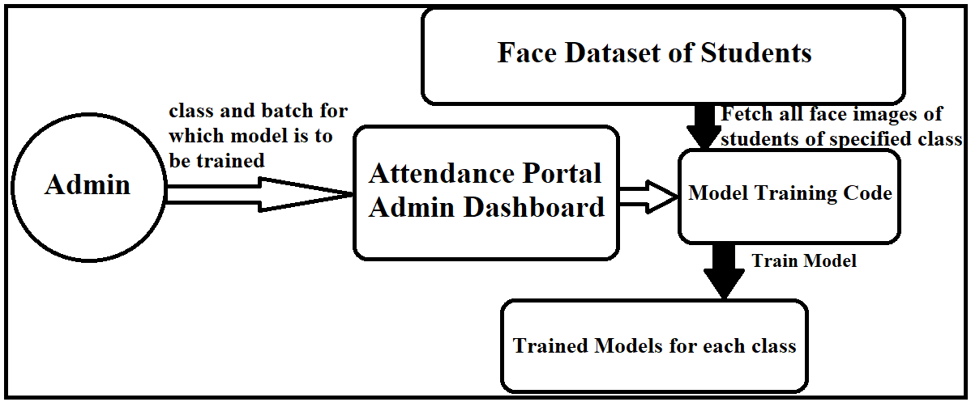
Face Recognition Model Training

Slide 12
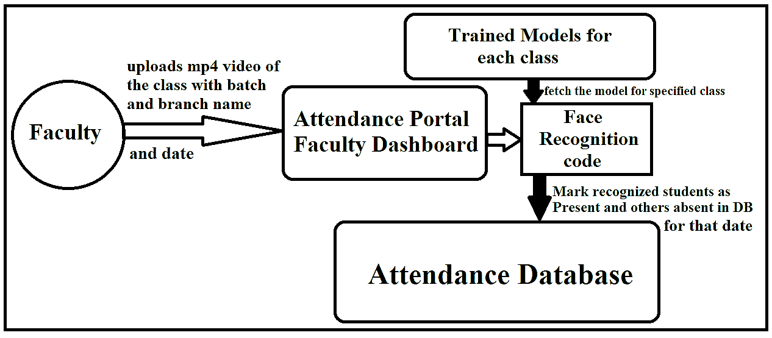
Attendance Marking in Database

Slide 13
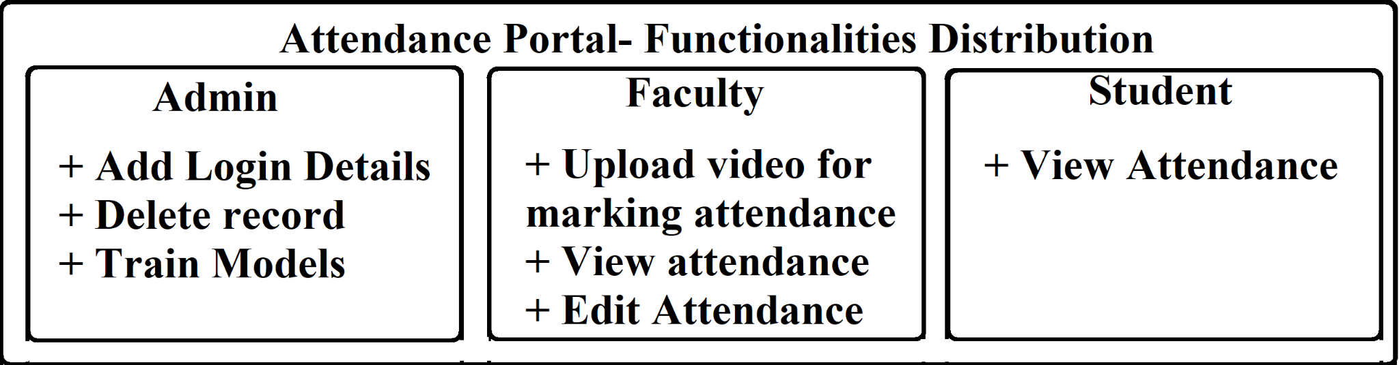
Functionalities Distribution

Slide 14
FLOWCHARTS

Slide 15
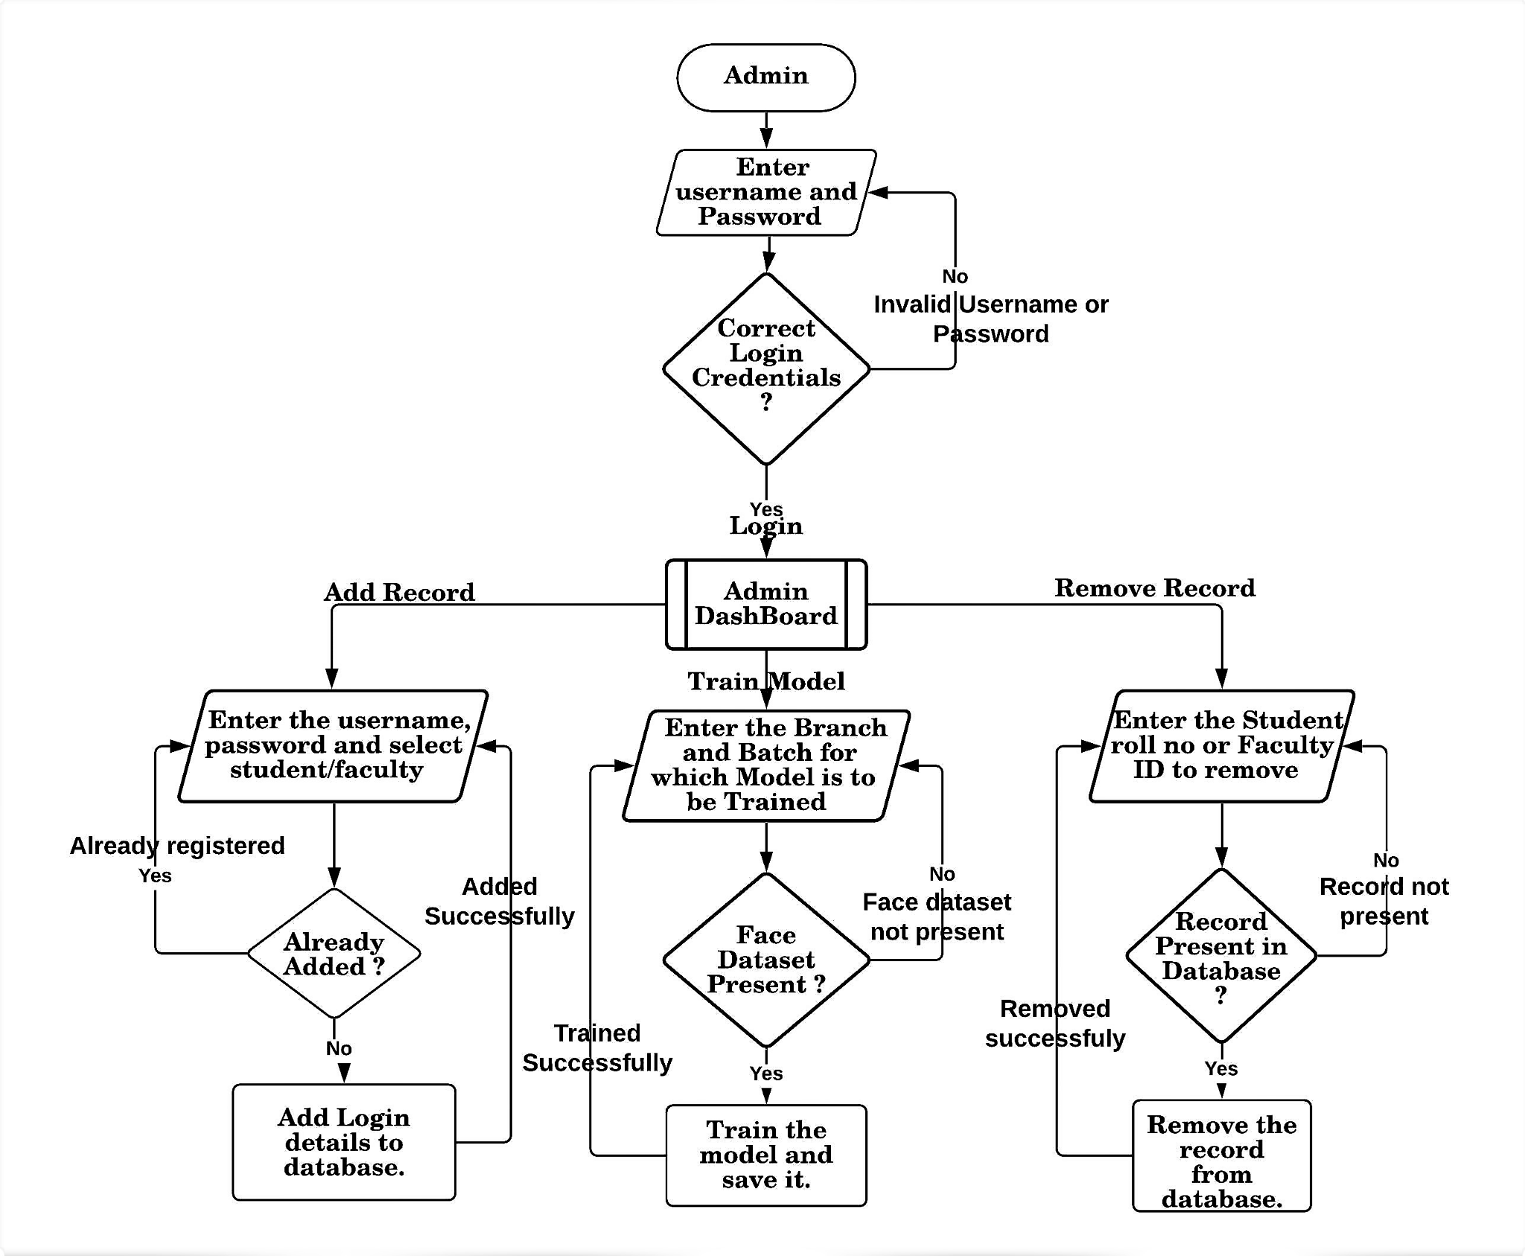
Admin DashBoard

Slide 16
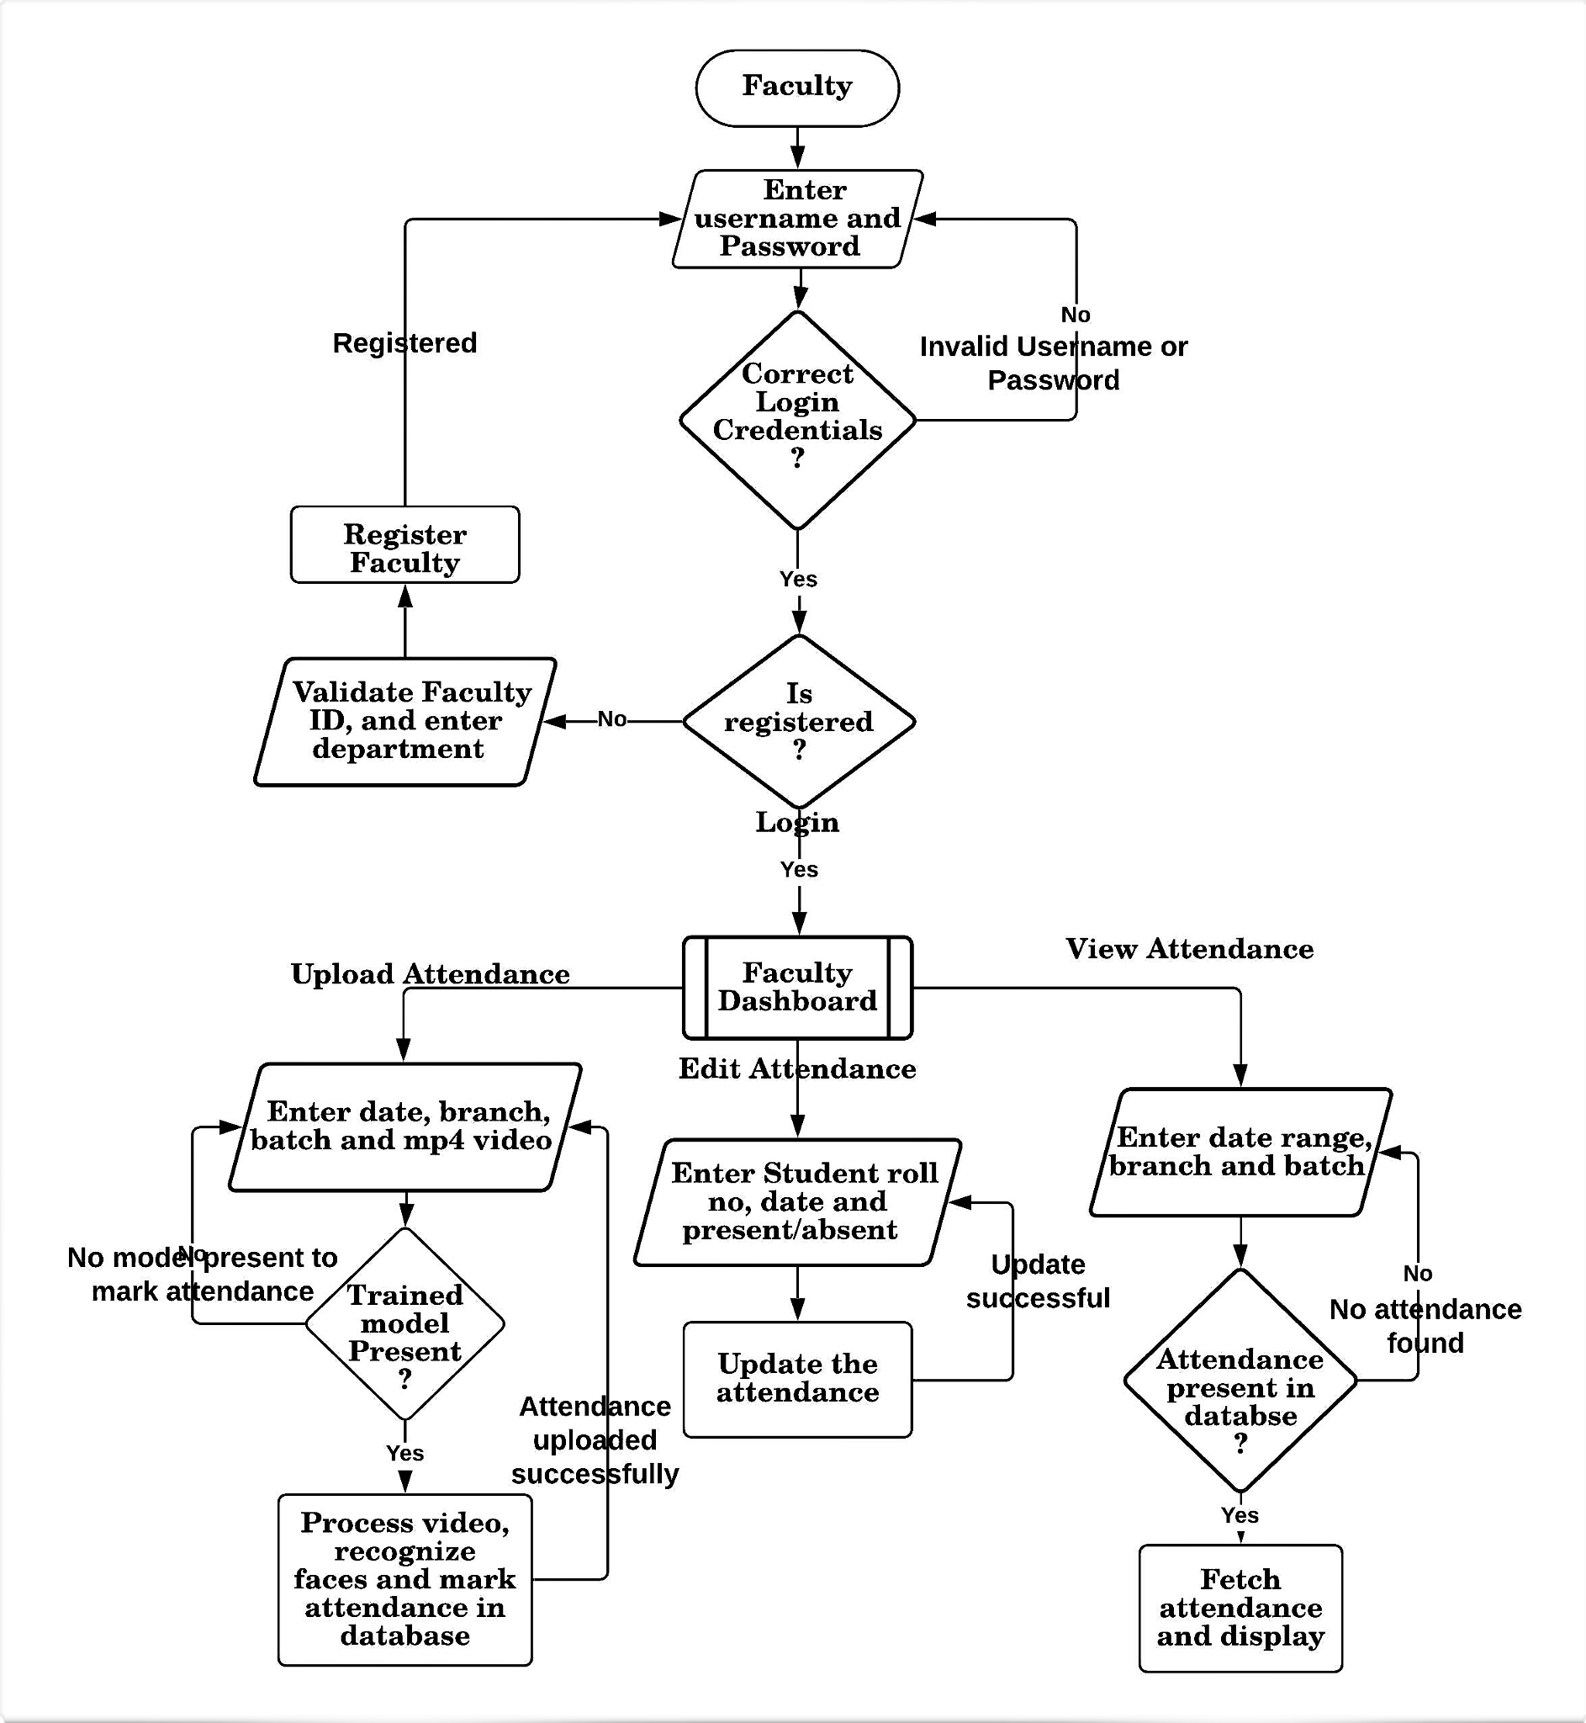
Faculty DashBoard

Slide 17
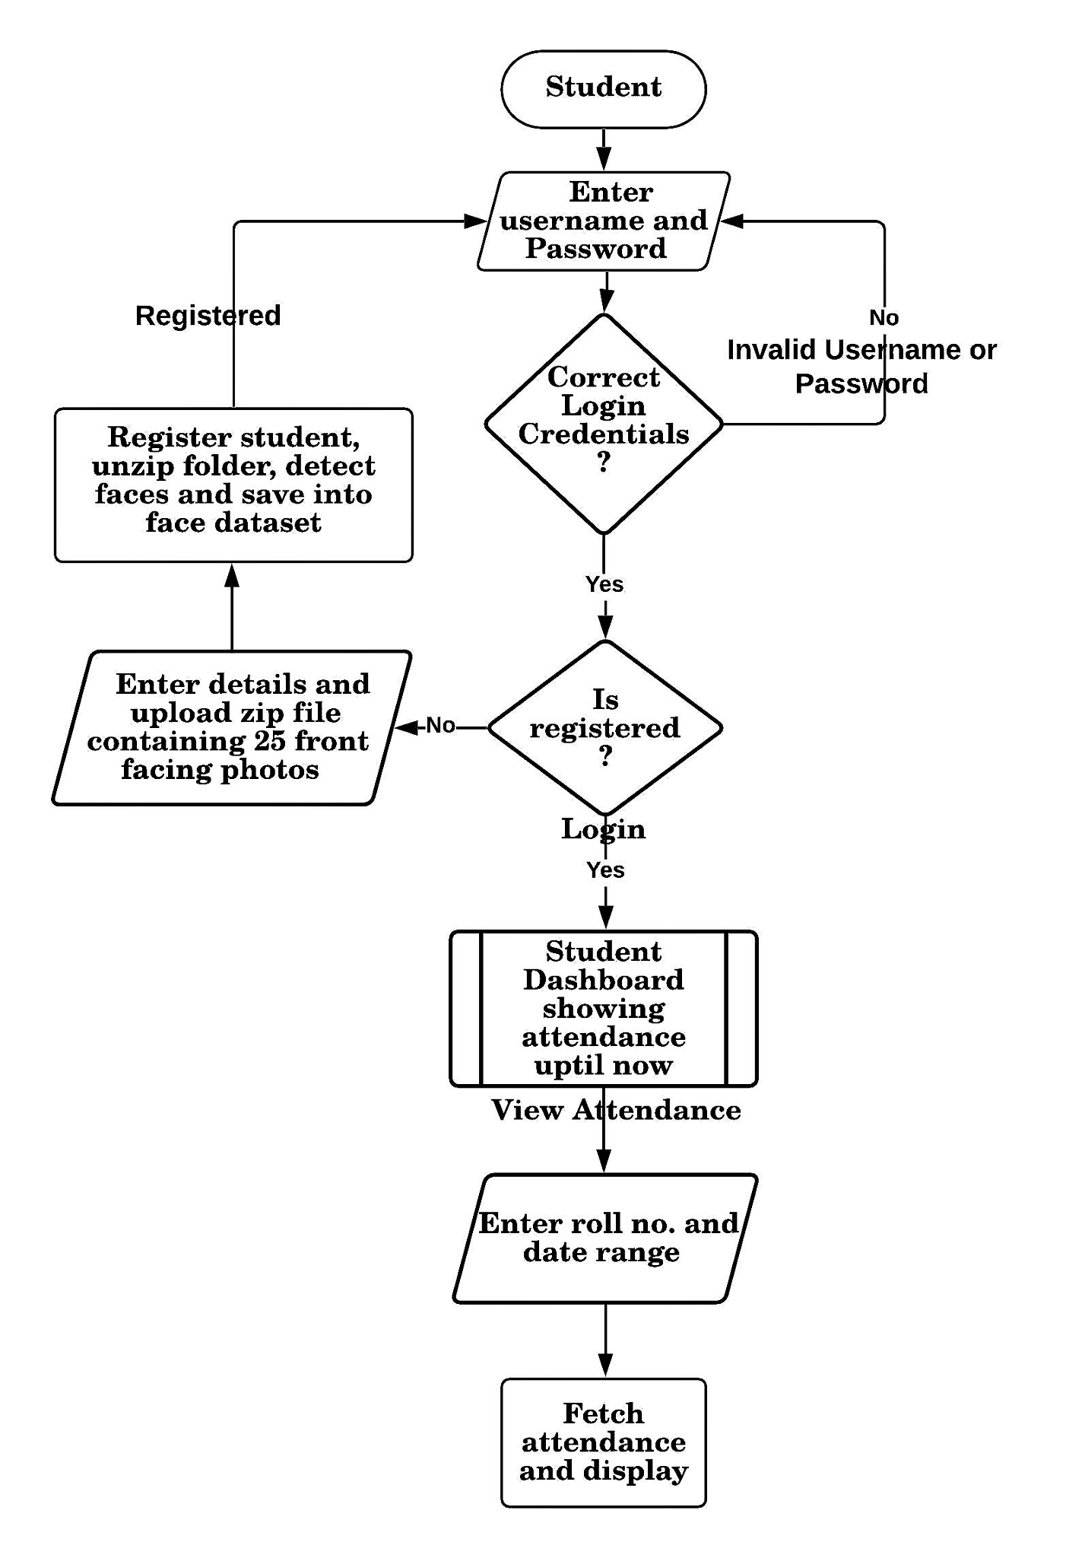
Student DashBoard

Slide 18
CONCLUSION
The purpose of this project is to save the time it takes currently for attendance of the students in the class and also to maintain the same reliability as it is in the biometric systems that are being used. However, in order to make this project a success, certain challenges are kept in mind and continuous efforts are being done to solve all problems.
The most challenging task in the multiple face recognition system is the detection of the faces. This is because if all the faces shall not be detected then the identification will not be possible. This cannot be accepted in the attendance system and that is why the system to be developed in this project should be quite precise and accurate in face detection.

Slide 19
REFERENCES
https://www.bilytica.com/peopleqlik/blog/hr-software/drawbacks-of-manual-time-and-at tendance-management
https://en.wikipedia.org/wiki/Flask_(web_framework)
https://www.codemotion.com/magazine/Glossary/python-programming-language
https://en.wikipedia.org/wiki/HTML
https://developer.mozilla.org/en-US/docs/Web/CSS
https://medium.com/dataseries/face-recognition-with-opencv-haar-cascade-a289b6ff042a
Stan Z. Li , Anil K. Jain, Handbook of Face Recognition 2nd ed. 2011 Edition

Slide 20
THANK YOU

