Slide 1
DEVELOPER INSIGHTS: SALARIES AND PYTHON TRENDS
PRESENTATION BY:
ARPIT SHAH

Slide 2
PROBLEM DEFINITION
(Analyzing Developer Salaries and Python Trends)
This study would help to analyze and extract insights related to developer salaries and trends in Python usage especially in countries like United States, India, United Kingdom, Canada and Germany.
This includes tasks such as cleaning the dataset, identifying outliers in salary data, visualizing Python awareness among developers, comparing salaries between Python and non-Python users, and examining the relationship between Python knowledge and salary.
It also involves exploring correlations between different features and identifying factors that influence developer salaries.

Slide 3
DATASET DESCRIPTION
The dataset utilized in this project is sourced from a survey conducted by StackOverflow, comprising responses from individuals across various countries.
Specifically, the data analyzed pertains to surveys conducted by StackOverflow in 2019 from January 13 to February 24.
Initially comprising over 88,000 rows and approximately 85 columns, which included sections like Basic Information, Education, Work, and Career, Technology and Tech Culture, the dataset was trimmed down to around 40,000 rows and 15 columns to meet specific project requirements.

Slide 4
RESEARCH QUESTIONS
For Countries like United States, United Kingdom, India, Germany and Canada:
What are the most desired programming languages among developers who participated in the survey, and how does Python rank among them?
Is there a correlation between developers' proficiency in Python and their average salary across different countries?
How does the distribution of average salaries differ between developers who know Python and those who don't across various countries?
How does the awareness and desire to learn Python differ among developers from these countries?

Slide 5
RESEARCH QUESTIONS
(CONTINUED)
For Countries like United States, United Kingdom, India, Germany and Canada:
How do students' interest in learning Python vary across these countries?
What are the predominant social media platforms used by developers/students in these countries?
Are there any noticeable trends in the usage and desire to learn Python among developers over time, as indicated by survey responses?

Slide 6
DATASET VARIABLES DESCRIPTION
Respondent: Randomized response ID number assigned to each respondent. (Numeric)
MainBranch: Indicates the primary professional status of the respondent, whether they are a developer or not. Options include "I am a developer by profession" and others. (Categorical)
Coding (Hobby): Indicates whether the respondent codes as a hobby. Options include "Yes" and "No". (Categorical)
Employment: Indicates the current employment status of the respondent, whether they are employed or unemployed. Options include "Yes, full-time", "Yes, part-time", and others. (Categorical)
Country: Indicates the country of residence of the respondent. (Categorical)

Slide 7
DATASET VARIABLES DESCRIPTION
EdLevel: Indicates the highest level of education completed by the respondent. Examples include "Master's degree (MA, MS, M.Eng., etc.)" and others. (Categorical)
UndergradMajor: Indicates the major pursued during undergraduate studies by the respondent. Examples include "Computer Science/Engineering" and others. (Categorical)
YearsCode: Indicates the number of years of coding experience of the respondent. (Numeric)
Salary (USD): Indicates the annual salary in USD of the respondent. (Numeric)
WorkWeekHrs: Indicates the number of hours worked per week by the respondent. (Numeric)

Slide 8
DATASET VARIABLES DESCRIPTION
LanguageWorkedWith: Indicates the programming languages with which the respondent has worked. (Text/String)
LanguageDesireNextYear: Indicates the programming languages the respondent wants to learn in the next year. (Text/String)
Social Media: Indicates the most commonly used social media platform by the respondent. Examples include "Reddit", "Twitter", etc. (Categorical)
Age: Indicates the age of the respondent. (Numeric)
Gender: Indicates the gender of the respondent. Examples include "Man", "Woman", etc. (Categorical)
Student: Indicates whether the respondent is currently a student. Options include "Yes" and "No". (Categorical)

Slide 9
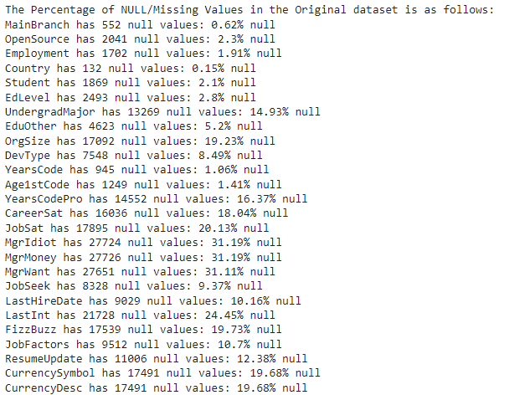
CLEANING DATASET
As it can be seen through the
screenshot attached, there are
NULL/Missing values present in the
original dataset. Hence, we would be
dropping all such cells that have
NULL/Missing values for better
accuracy in our analysis. In doing so,
we would be left with about 40,000
rows of data and about 15 columns as
per analysis requirements.

Slide 10
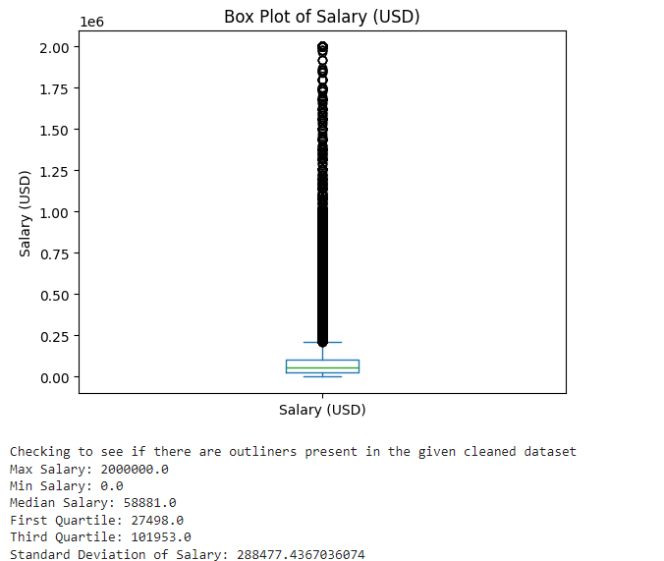

CLEANING DATASET
(REMOVING OUTLIERS)
As it can be seen by the box plot and the statistical
analysis of the 'Salary (USD)' column, there are
outliers present in this column i.e., salaries more
than 1.5 times the interquartile range. There are
About 3629 outlier points which accounts for about
8.31% of the data in these columns.

Slide 11
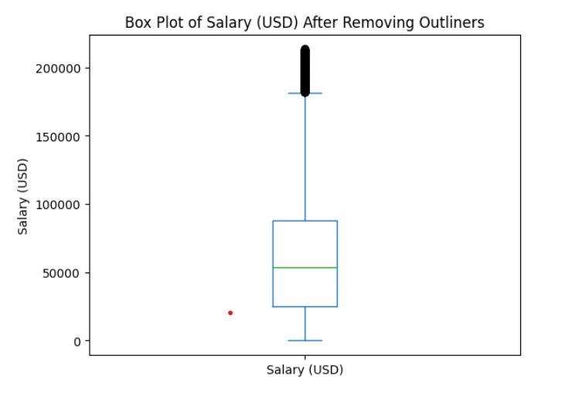
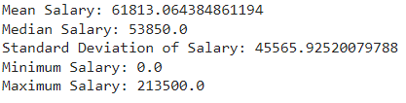

CLEANING DATASET
(REMOVING OUTLIERS)
I have tried to update this by removing the outliers by not considering all the rows that have value for this column greater than or less than 1.5 times interquartile range and this can be seen by the shape, statistical analysis and the box plot in the figures attached below.

Slide 12
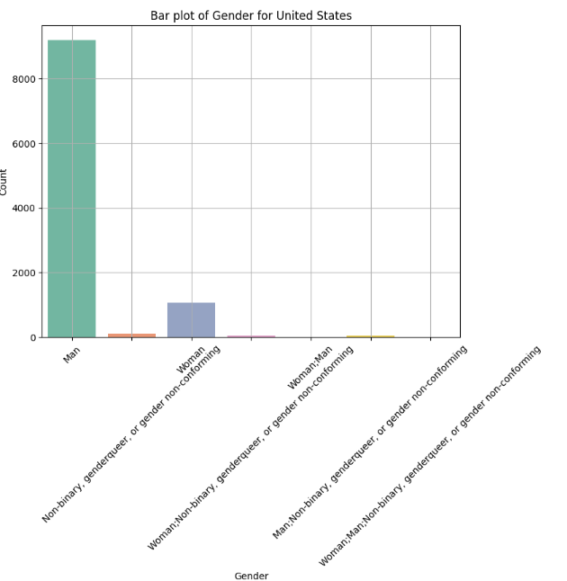
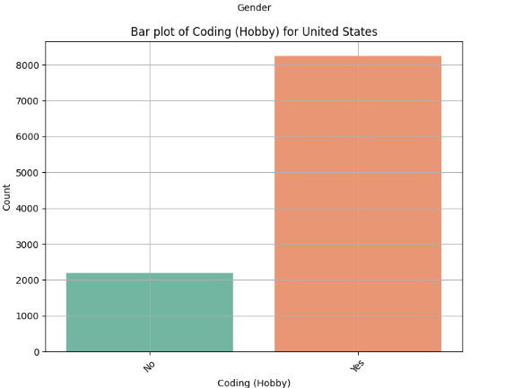
ANALYZING CATEGORICAL DATA
(GENDER AND CODING - US)

Slide 13
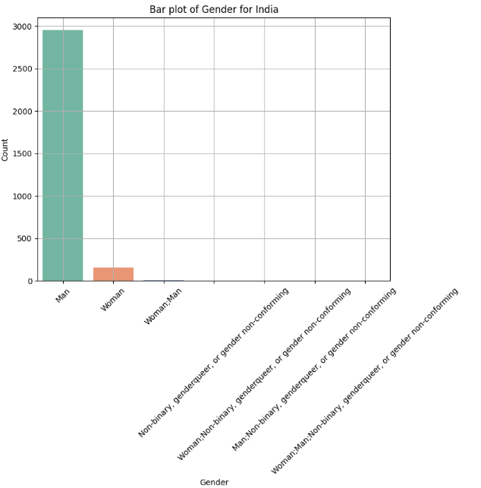
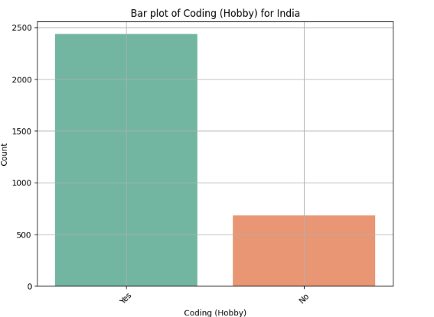
ANALYZING CATEGORICAL DATA
(GENDER AND CODING - INDIA)

Slide 14
ANALYZING CATEGORICAL DATA
(GENDER AND CODING)
The bar plots provides insights into the gender distribution among survey respondents and the number of individuals who participate in coding as a hobby.
From the plots given for US and India (code also has data for Germany, UK and Canada), it can be concluded that the dataset was mostly answered by Men who consider coding as a Hobby.
This information can be used by organizations or communities to target their audiences in these countries where they want to launch Python based programs/activities.

Slide 15
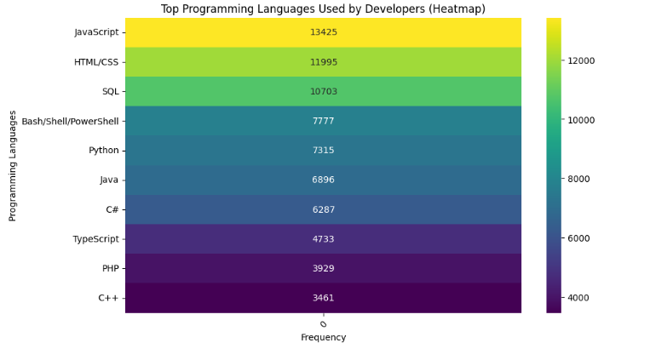
ANALYZING PYTHON RANKING AMONG PROGRAMMING LANGUAGES
As it can be seen through the
heatmap, 'Python' is the 5th most
worked with language in countries
like United States, United Kingdom,
India, Canada and Germany.

Slide 16
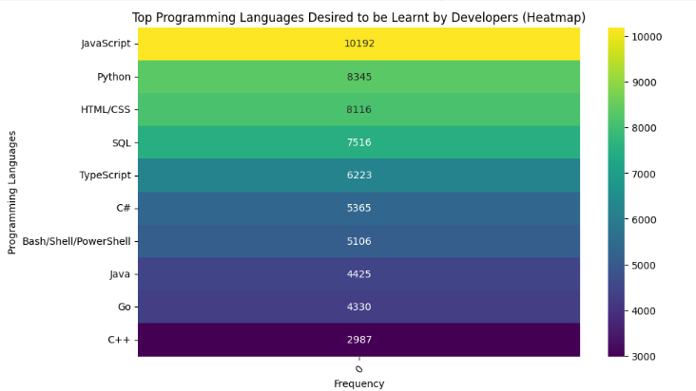
ANALYZING PYTHON RANKING AMONG PROGRAMMING LANGUAGES
Also, it is the 2nd most desired language
that the developers want to learn
from these countries.
Hence, it can be concluded that Python is
a popular programming language in these
countries and its popularity is increasing in
these countries as more developers desire
to learn about this language.

Slide 17
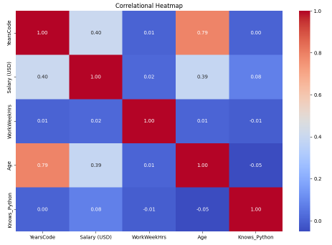
ANALYZING CORRELATION BETWEEN NUMERIC VARIABLES (CORRELATION HEATMAP)

Slide 18
ANALYZING CORRELATION BETWEEN NUMERIC VARIABLES (CORRELATION HEATMAP)
Since 'LanguageWorkedWith' was a text column, I have used a different dataframe in which this column is updated to hold 0 if ‘Python’ is not a part of the String entered and 1 if it is a part of string entered.
Even though the correlation heatmap does not provide significant insights into relation between numeric values, it can be implied that:
Salary is slightly correlated with:
The Years of coding experience (correlational value being 0.40).
'Knows Python' (correlational value being 0.08)
Additionally, the age and years of experience are correlated with each other with the correlational value being 0.79 indicating a strong positive correlation between these two variables i.e., as age increases, years of experience also tend to increase, and vice versa.

Slide 19
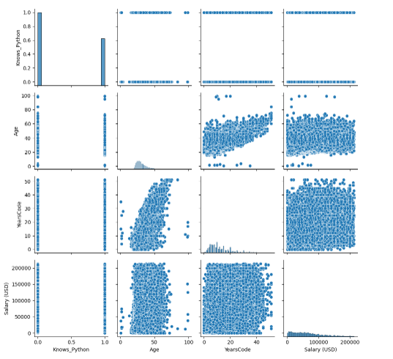
ANALYZING RELATION BETWEEN NUMERIC VARIABLES USING PAIR PLOTS
The observations made by the
correlational heatmap can
also be confirmed by the
alongside pair plots that plots
the numeric values for each
numeric variable against
the other ones present in the
dataset.

Slide 20
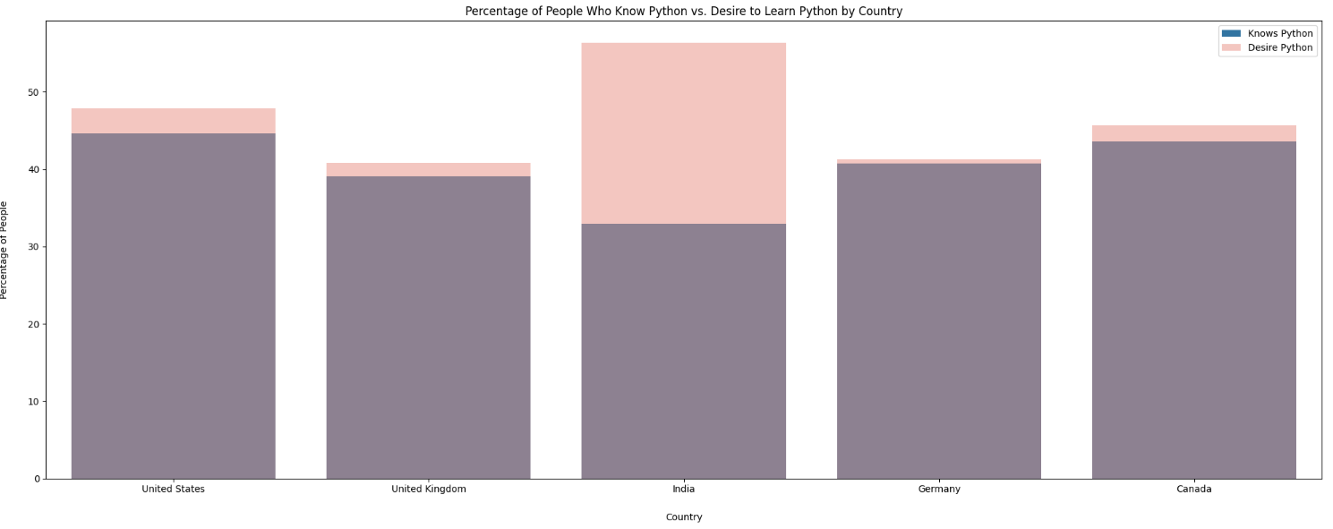
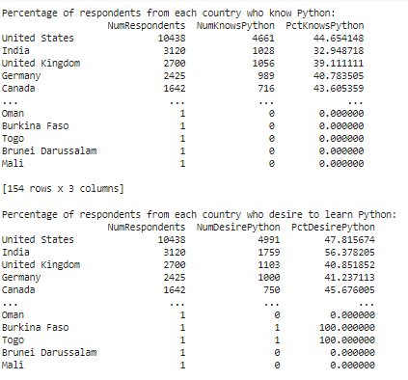
ANALYZING AWARENESS AND DESIRE TO LEARN PYTHON

Slide 21
ANALYZING AWARENESS AND DESIRE TO LEARN PYTHON
Through the graph and the corresponding readings displayed in the previous slide, it can be concluded that in the countries like United States, United Kingdom, India, Germany and Canada, the people who know Python and the People who desire to learn Python are relatively high i.e., about 50% of the entire population that answered the survey.
It can be implied from these readings that there are a lot of developers who answered the survey know Python and most of these developers desire to learn Python in the coming years. Hence, Python is a fastly growing popular programming language among developers from these countries.

Slide 22
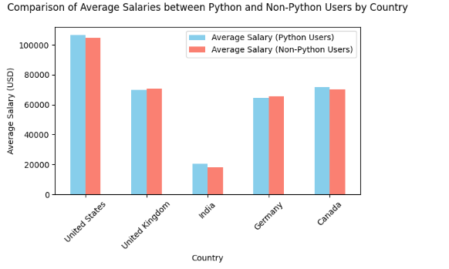
ANALYZING SALARY DISTRIBUTION BETWEEN PYTHON AND NON-PYTHON DEVELOPERS

Slide 23
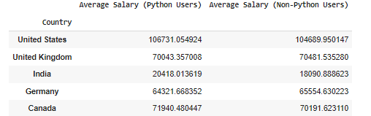
ANALYZING SALARY DISTRIBUTION BETWEEN PYTHON AND NON-PYTHON DEVELOPERS
Through the salary analysis of the developers, it can be concluded that the average salary of developers who know Python is comparatively more than the average salaries of the developers who don't know Python.
This indicates that Python can be a programming language that companies look for in the applicants of these countries and aspiring developers might want to learn about this language.

Slide 24
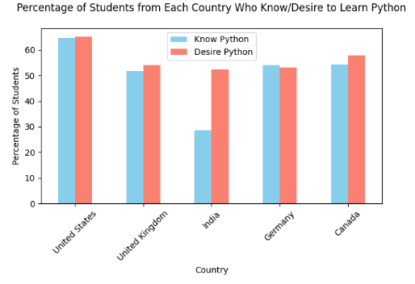
ANALYZING PYTHON TREND AMONG STUDENTS

Slide 25
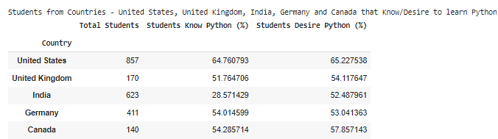
ANALYZING PYTHON TREND AMONG STUDENTS
Through the analysis from the graph created for Students who know Python and those who desire to know Python, it can be concluded that about 55% of the students in the countries United States, United Kingdom, India, Germany and Canada are interested in Python.

Slide 26
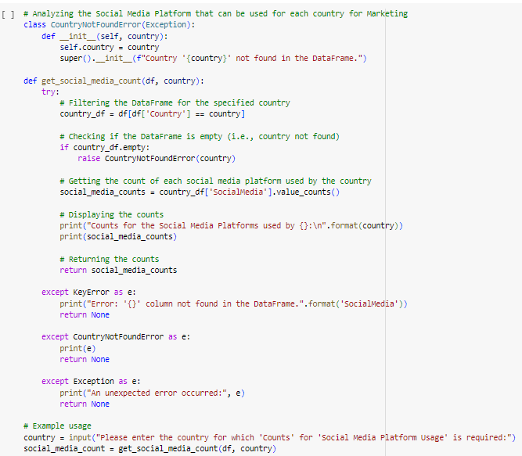
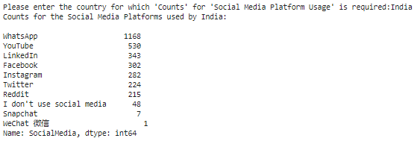
ANALYZING SOCIAL MEDIA PLATFORMS USED BY DEVELOPERS BASED ON COUNTRY ENTERED

Slide 27
ANALYZING SOCIAL MEDIA PLATFORMS USED BY DEVELOPERS BASED ON COUNTRY ENTERED
Based on the country entered, it can be concluded that the most popular social media site varies from country to country.
While US has most active site as Reddit, India has Whatsapp while China has WeChat 微信 as the most popular social media site among developers.
Hence, developers from each country prefer to choose social media as per the trends in their country.
This information can be used by organizations to target these people by focusing their marketing strategies through the most popular social media site used in each country to achieve greater reach.

Slide 28
CONCLUSIONS
Data collections is a very tedious task.
The popularity of Python is going to increasing in the coming years as more and more students are willing to learn Python and it can have a direct impact on the salaries of the developers who know it and those who don't.
Most developers also desire to learn Python to enhance their skill set indicating a shift towards this language.
Social Media usage changes based on the countries and if we have to do marketing regarding Python, it has to be done on a different website in each of the above countries for it to be efficient and profitable.

Slide 29
THANK YOU

