Slide 1
News Article Classification using Machine Learning
• Dataset: AG News Dataset
• Team Members:
Yash Jitendra Pol
Arpit Shah
Mayank Singh
Devupally Rathan

Slide 2
Problem Statement
Objective: We are building a machine learning-based text classification model to automatically categorize news articles into one of four predefined categories: World, Sports, Business, and Sci/Tech.
Planned Outcome: Build a text classification system using preprocessing and ML models to label each article by topic.
Why it matters: Enables scalable, automated content categorization for news platforms, saving time and ensuring consistent tagging of articles.

Slide 3
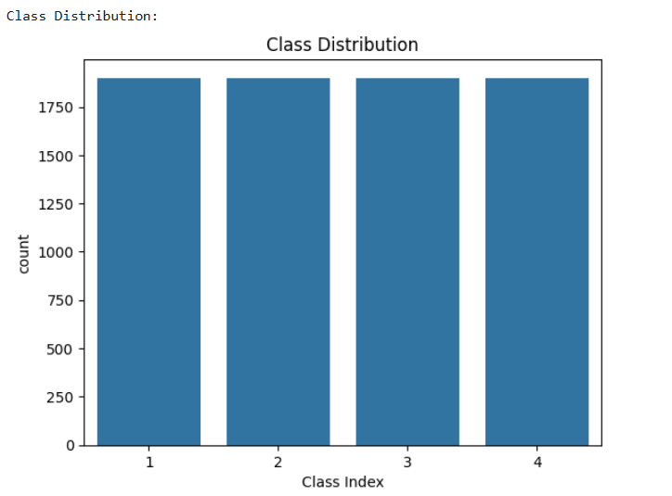
Dataset Overview
Source ~ AG News corpus (available via torchtext / sklearn.datasets).
Size ~ 7,600 test articles (4 classes).
Classes ~ World, Sports, Business, Sci/Tech – the dataset is balanced with each category comprising about 25% of the data.
Content ~ Each sample includes a news Title and Description. Descriptions are relatively short (average ~30 words, max ~130), reflecting brief news summaries.
Class distribution of the AG News dataset across the four categories. The dataset is evenly balanced, with each class.

Slide 4
TEXT PREPROCESSING
Steps applied:
We implemented two preprocessing strategies:
Text Vectorization:
• TF-IDF (1–2 n-grams, 10,000 features)
• Word2Vec (100-dim averaged vectors)
Example Transformation:
• Before: "He’s playing at 5pm. Visit https://..."
• After: "play visit"
Basic Strategy | Enhanced Strategy
Lowercasing | Contraction expansion ("don't" → "do not")
Lemmatization
Tokenization | URL & email removal
Stopword removal | Number and punctuation removal

Slide 5
MODEL BUILDING
Feature Extraction ~
Applied TF-IDF vectorization to convert preprocessed text into numeric vectors, emphasizing informative words via term frequency–inverse document frequency.
Explored Word2Vec embeddings (100D vectors) for semantic representation, averaging word vectors per sentence.
Algorithms ~ Built four classification models combining both feature extraction and classification strategies ~ TF-IDF + Logistic Regression ; TF-IDF + SVM ; Word2Vec + Logistic Regression ; Word2Vec + SVM.
Details
Train/Test Split: 80/20
Library Used: scikit-learn, gensim
Word2Vec Strategy: Averaged vectors per sentence
Hyperparameters ~ Used default settings for all classifiers (Logistic Regression with max_iter=1000 to ensure convergence; SVM with default RBF kernel). No extensive hyperparameter tuning was conducted due to time constraints.

Slide 6
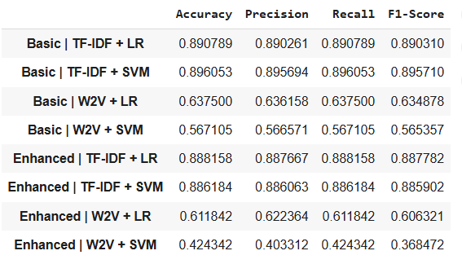
Evaluation
Model | Accuracy | Precision | Recall | F1
Logistic Regression | 89% | 0.89 | 0.89 | 0.89
Support Vector Machine | 88% | 0.88 | 0.88 | 0.88
Accuracy: Overall fraction of predictions that were correct (i.e. 89% of all news articles were assigned the correct category by Logistic Regression).
Precision: Of the articles predicted to be in a given category, the proportion that actually belong to that category (measures exactness).
Recall: Of the articles that truly belong to a given category, the proportion that the model successfully predicted (measures completeness).
F1-Score: The harmonic mean of precision and recall, providing a balanced measure of model performance (1.0 is perfect, ~0.89 here indicates high performance).

Slide 7
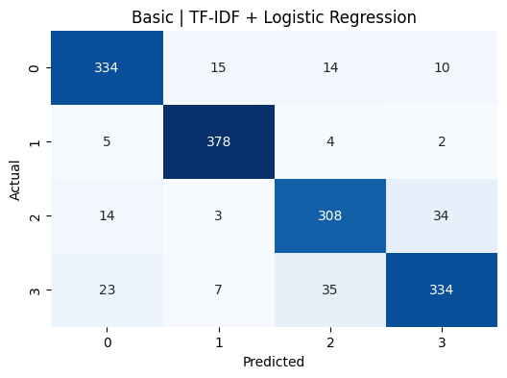

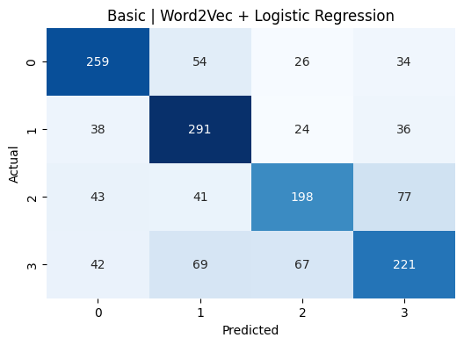
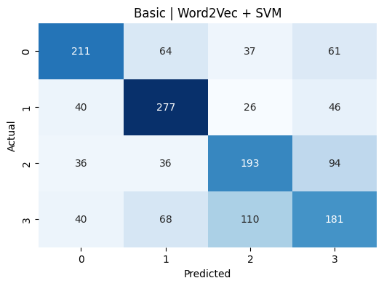
CONFUSION MATRICES

Slide 8
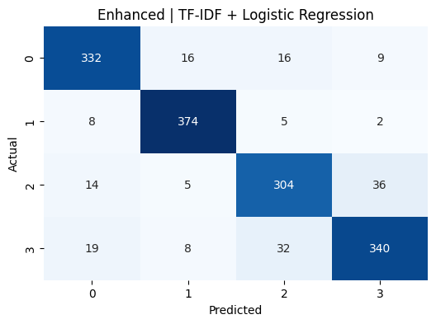

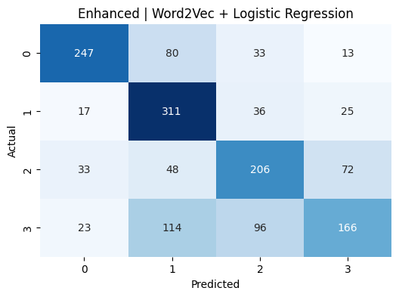
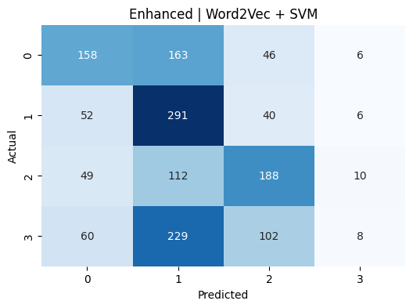
CONFUSION MATRIX

Slide 9
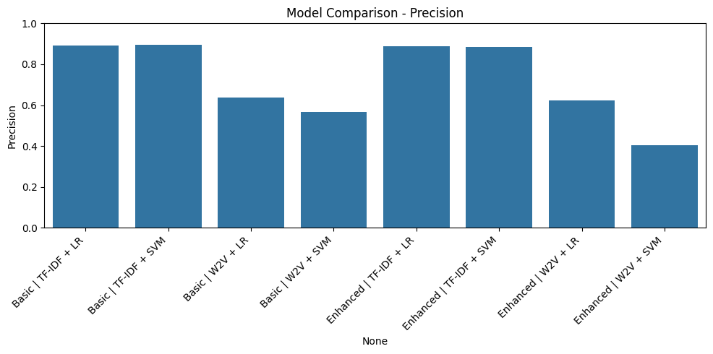
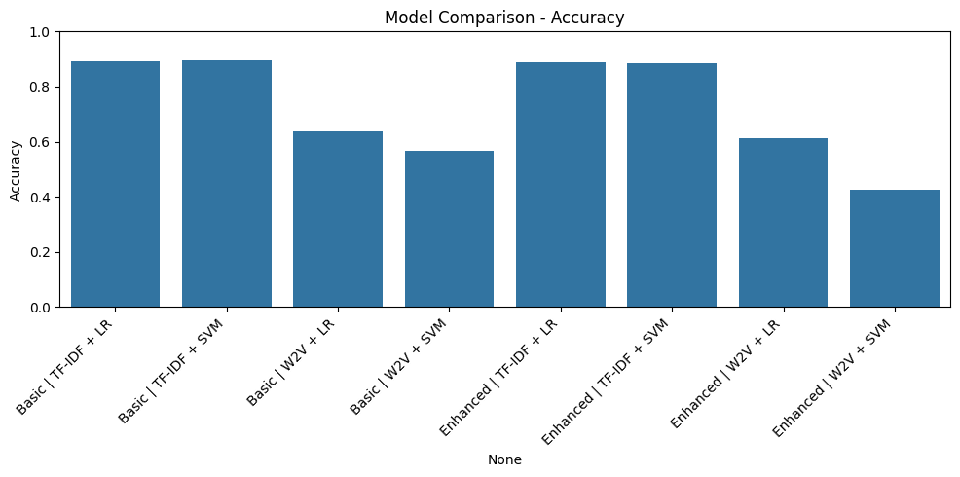

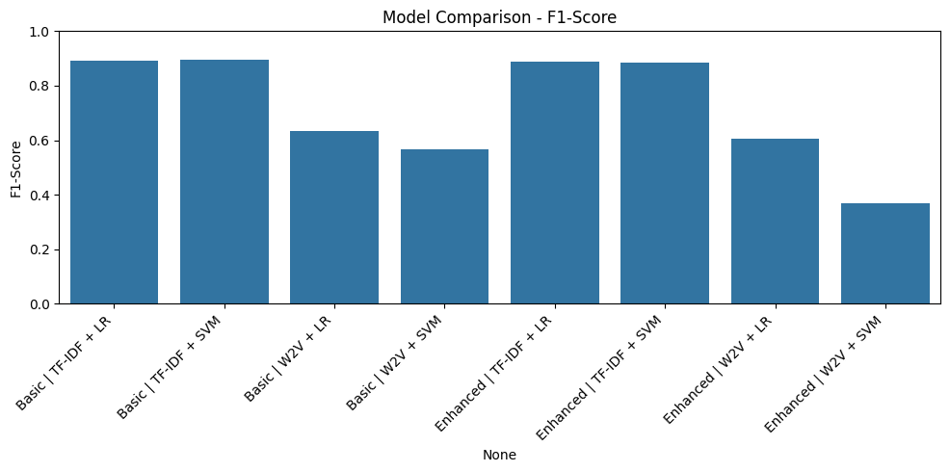
MODEL COMPARISON

Slide 10
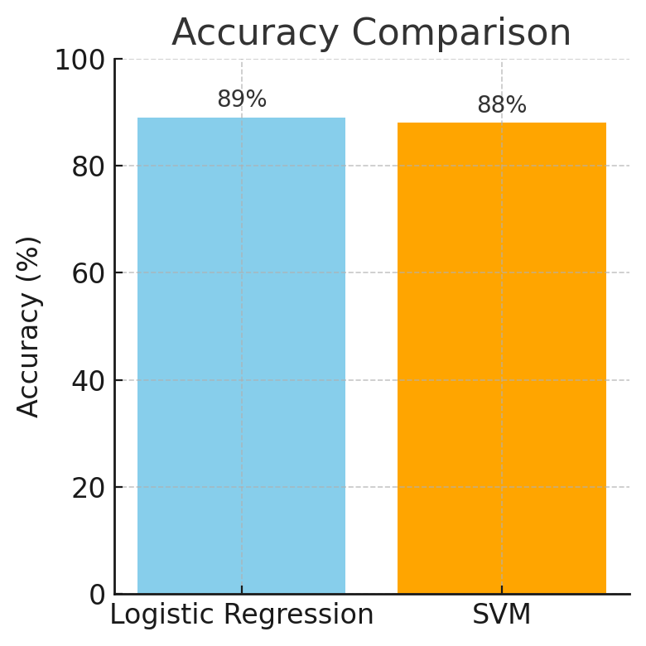
ACCURACY COMPARISON
Comparison of overall classification accuracy between the two models. The bar chart shows that Logistic Regression achieved ~89% accuracy, slightly outperforming SVM at ~88% accuracy on the test set.
Which Preprocessing Strategy Worked Best?
Basic preprocessing outperformed Enhanced in TF-IDF models.
Enhanced approach likely removed key tokens (e.g., numbers, short words).
Excessive cleaning may reduce semantic richness.
Which Algorithm Performed Best?
SVM with TF-IDF delivered top performance.
Word2Vec models underperformed, as averaging word vectors weakened contextual meaning in short texts like headlines.

Slide 11
CONCLUSION
SUMMARY
Built an end-to-end text classification pipeline for news articles using preprocessing, TF-IDF feature extraction, and ML models.
Achieved ~90% accuracy; best model was TF-IDF + Logistic Regression due to its strong accuracy and fast prediction time.
LIMITATIONS
Used a classic ML pipeline, avoiding advanced deep learning or complex embeddings.
Simple Word2Vec, untuned and not pre-trained on a large corpus, underperformed.
Conducted minimal hyperparameter tuning

Slide 12
FUTURE SCOPE
FUTURE WORK
Enhance system with pre-trained embeddings (e.or deep neural networks for better context capture.
Conduct extensive hyperparameter tuning (e.g., vectorizer max_features, model regularization).
LEARNINGS
Gained insights into the NLP pipeline: text cleaning, feature engineering (TF-IDF), and ML algorithms.
Learned preprocessing impacts model performance and simpler models excel in well-defined tasks.
Understood value of comparing approaches (TF-IDF vs. embeddings, logistic vs. SVM) to validate design choices.

