Slide 1
YOUTUBE SPAM COMMENTS DETECTION (ANALYZING VARIOUS MODELS)
Presentation by:- Arpit Shah

Slide 2
INTRODUCTION
In the realm of platforms like YouTube, where people watch a lot of videos for entertainment or learning, interaction between users and the creators is done through the comments section. There exists a way where people post scam comments which can be dangerous and they can include links to other pages which can hack any information or data or steal any confidential details when a link is composed on that comment. In some cases it can also redirect to the page where it attracts people to earn money while playing a game and most people have actually lost their money by clicking on such type of links displayed via comments. The purpose of this project is to classify the spam comments using several Machine Learning algorithms and then determine the best algorithm that can be used for Youtube Spam Comments detection by analysis.

Slide 3
PROBLEM STATEMENT
This project aims to classify the spam comments on YouTube by leveraging Machine Learning algorithms to analyze and mitigate the prevalence of harmful comments containing deceptive links or fraudulent content.
This includes tasks like preprocessing the comments data, training and evaluating multiple machine learning models, and implementing strategies for cross-validation to ensure the models' accuracy and generalization.
Additionally, the project aims to visualize the performance of each model, analyze confusion matrices to understand classification results, and explore cross-validation scores to assess model robustness.

Slide 4
RESEARCH QUESTIONS
Model Evaluation: How do various Machine Learning algorithms perform in classifying YouTube comments as ‘Spam’ or ‘Not Spam’?
Performance Comparison: Which Machine Learning algorithm achieves the highest accuracy in distinguishing between ‘Spam’ and ‘Not Spam’ comments?
Predictive Power: How well can the trained models predict whether a given comment is ‘Spam’ or ‘Not Spam’, based on its content?
Generalization: Do the trained models generalize well to unseen data, and how consistent are their performance metrics across different evaluation techniques?

Slide 5
RESEARCH QUESTIONS (CONTINUED)
Cross-Validation Strategies: How do different cross-validation strategies, such as stratified k-fold and time-series cross-validation, impact the performance and robustness of the trained models?
Confusion Matrix Analysis: What insights can we glean from the confusion matrices of the trained models regarding their true positive, false positive, true negative, and false negative rates?
Model Interpretability: Can we interpret and explain the decision-making process of the trained models, particularly in distinguishing between ‘Spam’ and ‘Not Spam’ comments?
Feature Importance: Can we determine which features or characteristics of comments are most indicative of ‘Spam’ behavior?

Slide 6
DATASET AND DATASET VARIABLES DESCRIPTION
The dataset utilized for this project is created by combining the following 5 datasets, all of which are sourced from ‘Kaggle’:
Youtube01-Psy.csv
Youtube02-KatePerry.csv
Youtube03-LMFAO.csv
Youtube04-Eminem.csv
Youtube05-Shakira.csv
Link: https://www.kaggle.com/datasets/lakshmi25npathi/images/data

Slide 7
DATASET AND DATASET VARIABLES DESCRIPTION (CONTINUED)
The dataset consists of approximately 1956 rows and 5 columns, which are subsequently trimmed to have 2 columns as per project requirements. Description of the columns is as follows:
COMMENTS_ID: Serves as a unique identifier for each comment.
AUTHOR: Denotes the user who posted the comment.
DATE: Indicates the ‘Date’ and ‘Time’ when the comment was posted.
CONTENT: Contains the actual text content of the comments.
CLASS: Represents the classification label of each comment, with values indicating whether a comment is categorized as 'Spam' (1) or 'Not Spam' (0).

Slide 8
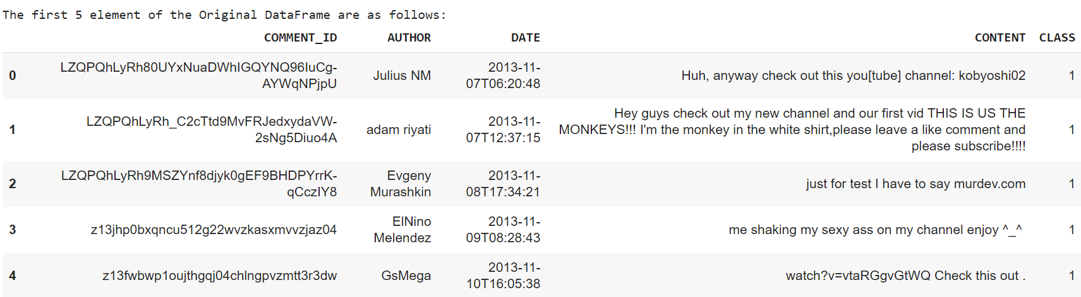
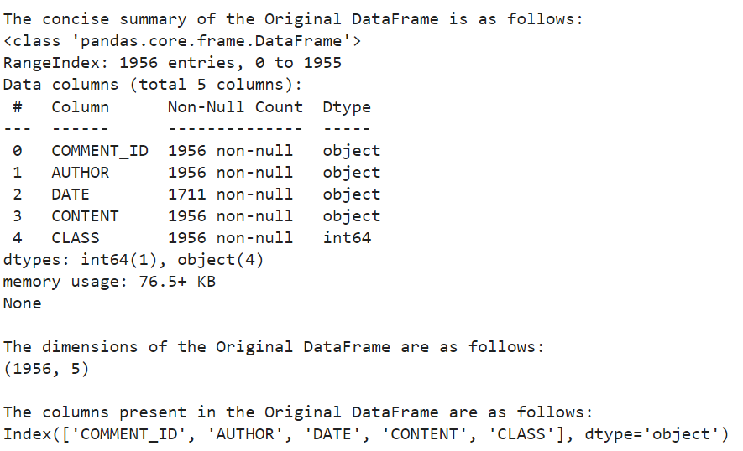
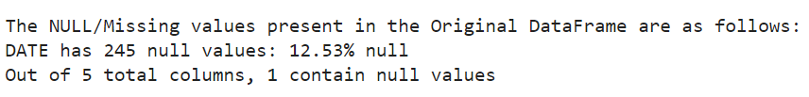
ORIGINAL DATASET
As stated in the previous slide, the dataset consists of 1956 rows and 5 columns. Some of the dataset features can be seen through the screenshot attached below:

Slide 9
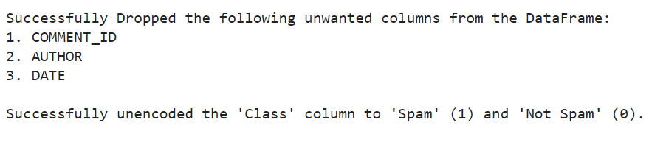
CLEANING DATASET
In order to perform Youtube Spam Comments Analysis through the Machine Learning algorithms, there are 2 things that are to be done for cleaning this dataset:
For Spam Comment Detection, only ‘CONTENT’ and ‘CLASS’ columns are required. Hence, we can drop the remaining columns without worrying about NULL/Missing values present in the ‘DATE’ column as seen in the previous slide.
‘CLASS’ column contains only 0s and 1s. It might be difficult to understand whether a comment is ‘SPAM‘(1) or ‘NOT SPAM’ (0) as per this. Hence we need to map the corresponding integer values to their respective classifications.

Slide 10
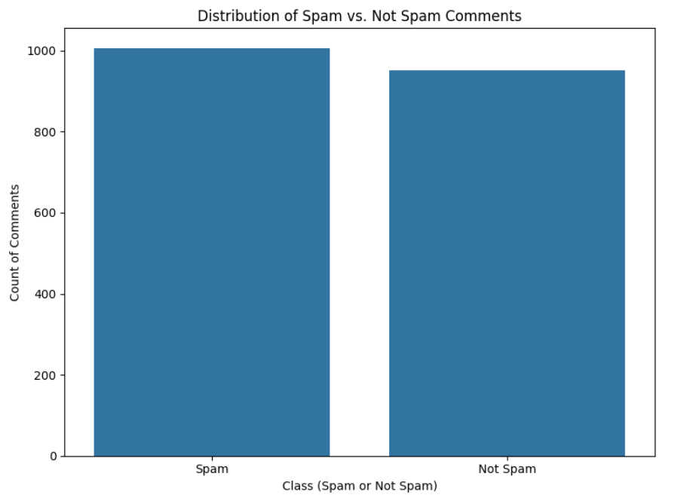
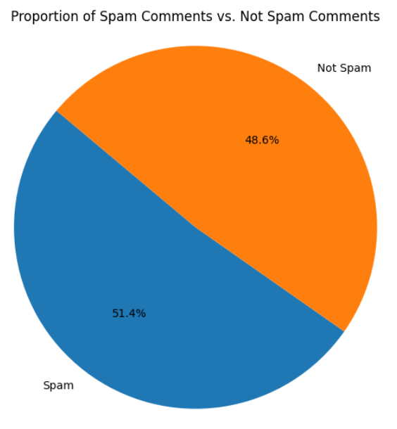
ANALYZING THE CLEANED DATASET
As seen by the screenshots of the Bar Plot and the Pie Chart, the dataset has almost equal number of ‘Spam’ and ‘Not Spam’ comments indicating a balanced distribution of ‘Spam’ and ‘Not Spam’ comments, facilitating unbiased model training.

Slide 11
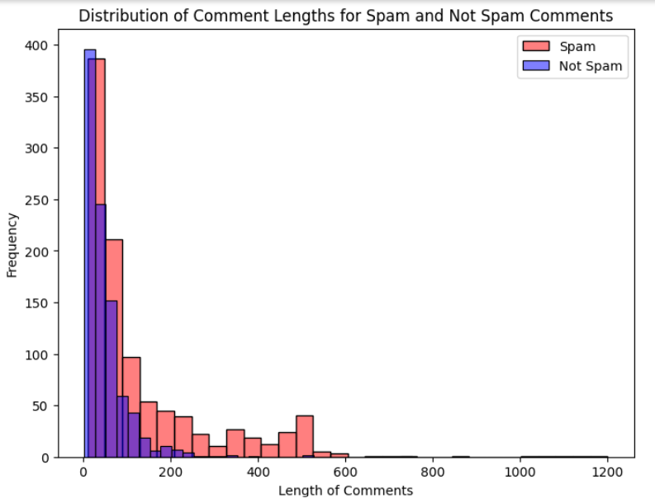
ANALYZING THE CLEANED DATASET
Visual analysis of message lengths offers valuable insights into the characteristics of ‘Spam’ and ‘Not Spam’ messages, guiding feature selection and model development for effective detection algorithms. As seen in the histogram, the length of ‘Spam’ message is usually more than the length of ‘Not Spam’ messages. However, there are certain ‘Spam’ messages which have the same length as that of ‘Not Spam’ messages. Hence, the messages cannot be classified on the basis of length. However, it guides in effective algorithms that can be applied on this data for ‘Spam’ detection.

Slide 12
PREPROCESSING THE CLEANED DATA
Problems with Textual Data:
Noise Reduction: Text data often contains irrelevant information, such as HTML tags, special characters, or punctuation, which can introduce noise into the dataset. By removing these unnecessary characters, symbols, and HTML tags, we can reduce noise and ensure that the model focuses on relevant information.
Normalization: Text data may contain variations in spelling, capitalization, and word formats. Tokenization breaks the text data into individual words or tokens, allowing for standardization and normalization of the text. This process ensures that similar words are treated identically, improving the consistency of the dataset.

Slide 13
PREPROCESSING THE CLEANED DATA (CONTD.)
Problems with Textual Data:
Dimensionality Reduction: Stopwords are common words that appear frequently in text but typically carry little semantic meaning (e.g., "the," "and," "is"). By removing stopwords from the text data, we can reduce the dimensionality of the dataset and improve the efficiency of the Machine Learning algorithms. Removing ‘stopwords’ also helps focus on the essential semantic content of the text.
In order for the Machine Learning models to classify the comments precisely, we need to preprocess the textual data present in the ‘CONTENT’ column to remove the stopwords and punctuations and then tokenize each comment present in this column.

Slide 14
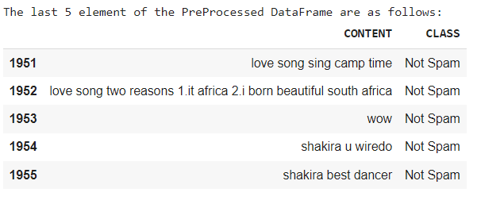
PREPROCESSING THE CLEANED DATA (CONTD.)
In order to preprocess the data as per the above mentioned slides, I have used Python’s ‘NLTK’ (for removal of stopwords and tokenization) and ‘STRING’ libraries (for removal of punctuations). The preprocessed dataset can be seen in the screenshot attached below:

Slide 15
APPLYING THE MACHINE LEARNING MODELS
(CREATING MACHINE LEARNING PIPELINE)
After preprocessing the text data by removing ‘stopwords’ and ‘punctuations’, the next crucial step is to construct a Machine Learning Pipeline. This pipeline serves as a systematic framework for transforming the textual data into a format that is compatible with Machine Learning algorithms. By incorporating components like ‘CountVectorizer’ and ‘TfidfTransformer’, the pipeline prepares the data for classification by extracting features and weighting them based on their importance. Finally, the classifier, chosen from a selection of models like Support Vector Machine, Random Forest, or Naive Bayes, is trained on the transformed data to classify comments as ‘Spam’ or ’Not Spam’.

Slide 16
CREATING MACHINE LEARNING PIPELINE (CON.)
CountVectorizer: It is a preprocessing step used to convert a collection of text documents into a matrix of token counts. It tokenizes the text data and counts the occurrences of each word in the document. It then represents each document as a vector of word counts, where each element in the vector corresponds to the count of a specific word in the document.
TfidfTransformer: It is a preprocessing step used to transform the count matrix obtained from CountVectorizer into a normalized term frequency-inverse document frequency (TF-IDF) representation. TF-IDF is a statistical measure that evaluates the importance of a word in a document relative to a collection of documents. It scales down the weight of words that occur frequently across documents while scaling up the weight of words that are unique to a specific one.

Slide 17
CREATING MACHINE LEARNING PIPELINE (CON.)
The next step after applying the ‘CountVectorizer’ and ‘TfidfTransformer’ is to train the specified classifier using the training data. This involves creating a pipeline that combines the preprocessing steps (CountVectorizer and TfidfTransformer) with the classifier. The classifier is then trained on the transformed training data to learn the patterns and relationships between the text features and their corresponding class labels.
After training the classifier, it is evaluated on the test data to assess its performance. The accuracy score and classification report are computed to measure how well the classifier predicts the class labels of the test data.

Slide 18

CREATING MACHINE LEARNING PIPELINE (CON.)
For the Youtube Spam Comments Classification, I have used the following Machine Learning algorithms as the ‘classifiers’:
Support Vector Machine (SVM) with a linear kernel
Random Forest
Multinomial Naive Bayes
Bernoulli Naive Bayes
Logistic Regression
Also, I have split the data into training and testing sets for each of these algorithms.

Slide 19
FACTORS USED FOR ANALYZING THE MODELS
Accuracy and Classification Report: It provides a summary of the performance of a classification model. It includes metrics such as accuracy, precision, recall, F1-score, and support for each class in the classification task.
Confusion Matrix: It is a table that summarizes the performance of a classification model by presenting the counts of true positive, true negative, false positive, and false negative predictions. It allows for a detailed examination of the model's performance across different classes, showing how often the model correctly or incorrectly predicted each class.
Cross-Validation Scores: It indicates the performance of the model across different folds of the dataset during cross-validation. "Folds" refer to the partitions or subsets into which the dataset is divided during the validation process. Each fold serves as a separate validation set while the remaining folds are used for training the model.

Slide 20
TERMS IN CLASSIFICATION REPORT
Precision: It is the ratio of true positive predictions to the total number of positive predictions made by the model. It measures the accuracy of positive predictions. In this context, "Not Spam" precision refers to the accuracy of predicting comments as "Not Spam," while "Spam" precision refers to the accuracy of predicting comments as "Spam."
Recall: Also known as sensitivity or true positive rate, it is the ratio of true positive predictions to the total number of actual positive instances in the dataset. It measures the ability of the model to correctly identify positive instances. In this context, "Not Spam" recall refers to the proportion of actual "Not Spam" comments that were correctly predicted.

Slide 21
TERMS IN CLASSIFICATION REPORT (CONTD.)
F1-score: It is the harmonic mean of precision and recall. It provides a balance between precision and recall, with values ranging from 0 to 1. A higher F1-score indicates better performance, with 1 being the best possible score.
Support: It refers to the number of actual occurrences of each class in the dataset. It represents the number of instances belonging to each class.
Accuracy: It is the ratio of correct predictions (both true positives and true negatives) to the total number of predictions made by the model. It measures the overall correctness of the model's predictions across all classes.

Slide 22
TERMS IN CLASSIFICATION REPORT (CONTD.)
Macro Avg: It calculates the average of the precision, recall, and F1-score for each class independently and then takes the unweighted mean of these values. It treats all classes equally, regardless of class imbalance.
Weighted Avg: It calculates the average of the precision, recall, and F1-score for each class independently and then takes the weighted mean of these values, where the weight is determined by the number of true instances for each class. It considers class imbalance, giving more weight to classes with more instances.

Slide 23
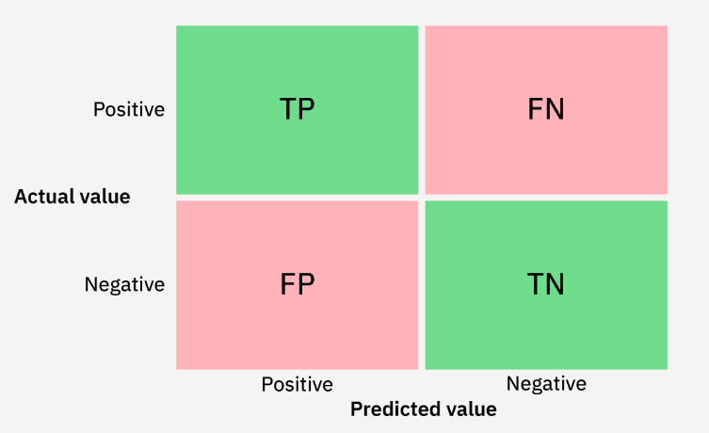
TERMS IN CONFUSION MATRIX
True Positive (TP): The number of instances correctly predicted as positive by the model.
True Negative (TN): The number of instances correctly predicted as negative by the model.
False Positive (FP): The number of instances incorrectly predicted as positive by the model.
False Negative (FN): The number of instances incorrectly predicted as negative by the model.

Slide 24
TERMS IN CROSS-VALIDATION SCORES
Folds: The number of subsets into which the dataset is divided during cross-validation. Each fold is used exactly once as the test set while the rest of the data is used for training.
Mean Accuracy: The average accuracy of the model across all folds during cross-validation.
Standard Deviation: A measure of the variability or dispersion of the accuracy scores across different folds. It indicates how much the accuracy scores vary from the mean accuracy. A lower standard deviation suggests that the model's performance is consistent across different folds.

Slide 25
ANALYZING MACHINE LEARNING MODELS
(SUPPORT VECTOR MACHINE (SVM))
Support Vector Machine (SVM) is a powerful supervised learning algorithm used for classification and regression tasks. It works by finding the optimal hyperplane that separates different classes in the feature space. In case of Youtube Spam Comments Detection, SVM is a classification algorithm where data points (comments in my case) need to be assigned to one of two classes based on their features.
In order to implement this, I have used Python’s scikit-learn libraries’ class ‘SVC’ (Support Vector Classifier) which employs the principles of SVM to classify data into one or more classes based on their features with the decision boundary between the two classes being linear.

Slide 26
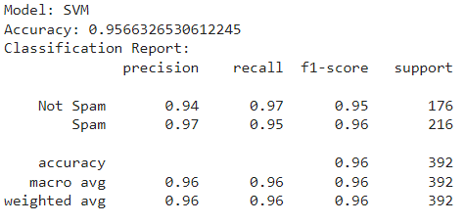
ANALYZING MACHINE LEARNING MODEL
(SUPPORT VECTOR MACHINE (SVM) - CONTD.)
The accuracy and classification report for SVM, applied on my dataset is shown. The key takeaways from this are:
Accuracy: 95.7%, indicating the overall correctness of its predictions.
Precision: This indicates that 94% of comments predicted as "Not Spam" are indeed "Not Spam," and 97% of comments predicted as "Spam" are indeed "Spam."
F1-score: The weighted average F1-score for the model is approximately 96%, indicating overall good performance across both classes.

Slide 27
SUPPORT VECTOR MACHINE (SVM) - (CONTD.)
Recall: For the "Not Spam" class, the recall is 97%, and for the "Spam" class, it is 95%. This implies that 97% of actual "Not Spam" comments were correctly predicted, and 95% of actual "Spam" comments were correctly predicted.
Support: There are 176 instances (actual instances) of "Not Spam" comments and 216 instances (actual instances) of "Spam" comments.

Slide 28
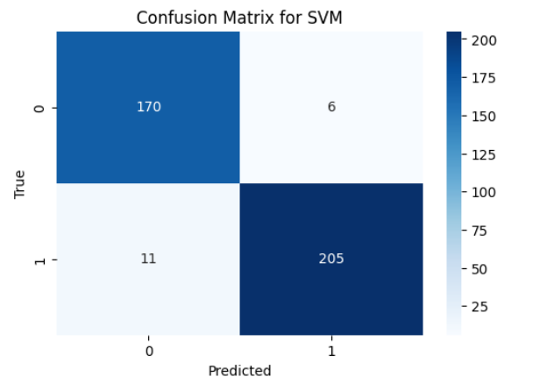
SUPPORT VECTOR MACHINE (SVM) - (CONTD.)
Through the screenshot of the confusion matrix implemented for SVM, it can be interpreted that:
TP: 170 instances (Correctly predicted ‘Not Spam’)
FP: 6 instances (Incorrectly predicted as ‘Spam’, were actually ‘Not Spam’)
TN: 205 instances (Correctly predicted ‘Spam’)
FN: 11 instances (Incorrectly predicted as ‘Not Spam’, were actually ‘Spam’)

Slide 29
SUPPORT VECTOR MACHINE (SVM) - (CONTD.)
As seen through the screenshot for the cross-validation scores for SVM, it can be interpreted that:
Mean Accuracy: Across all folds, the average accuracy achieved by the model is approximately 93.6%
Standard Deviation: 0.008
Cross-validation scores: For each fold, the scores are as follows: [0.93670886, 0.93670886, 0.93589744, 0.92307692, 0.94871795]

Slide 30
ANALYZING MACHINE LEARNING MODELS
(RANDOM FOREST)
Random Forest is a powerful ensemble learning algorithm used for classification and regression tasks. It can be employed to classify whether a comment is ‘Spam’ or ‘Not Spam’. By constructing multiple decision trees based on different subsets of the data, Random Forest can effectively capture the diverse patterns and features present in the comments. The algorithm aggregates the predictions of these trees to make a final classification decision, resulting in a robust and accurate spam detection model.
In order to implement this, I have used Python’s scikit-learn libraries’ class ‘RandomForestClassifier’ alongside passing the number of decision trees and the random seed for reproducibility.

Slide 31
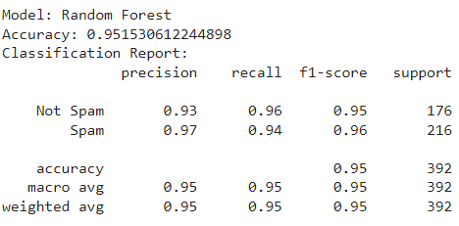
RANDOM FOREST - (CONTINUED)
The accuracy and classification report for Random Forest, applied on my dataset is shown. The key takeaways from this are:
Accuracy: The model achieved an accuracy of 95.2%, indicating the overall correctness of its predictions.
Precision: For the "Not Spam" class, the precision is 93%, meaning that 93% of comments predicted as "Not Spam" are indeed "Not Spam." For the "Spam" class, the precision is 97%, indicating that 97% of comments predicted as "Spam" are indeed "Spam."
F1-score: The weighted average F1-score for the model is approximately 96%, indicating overall good performance across both classes.

Slide 32
RANDOM FOREST - (CONTINUED)
Recall: For the "Not Spam" class, the recall is 96%, implying that 96% of actual "Not Spam" comments were correctly predicted. For the "Spam" class, the recall is 94%, meaning that 94% of actual "Spam" comments were correctly predicted.
Support: There are 176 instances (actual instances) of "Not Spam" comments and 216 instances (actual instances) of "Spam" comments. This represents the number of instances in the test set for each class.

Slide 33
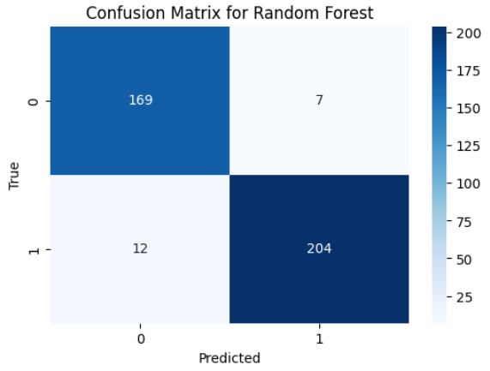
RANDOM FOREST - (CONTINUED)
Through the screenshot of the confusion matrix implemented for Random Forest, it can be interpreted that:
TP: 169 instances (Correctly predicted ‘Not Spam’)
FP: 7 instances (Incorrectly predicted as ‘Spam’, were actually ‘Not Spam’)
TN: 204 instances (Correctly predicted ‘Spam’)
FN: 12 instances (Incorrectly predicted as ‘Not Spam’, were actually ‘Spam’)

Slide 34
RANDOM FOREST - (CONTINUED)
As seen through the screenshot for the cross-validation scores for Random Forest, it can be interpreted that:
Mean Accuracy: Across all folds, the average accuracy achieved by the model is approximately 88%
Standard Deviation: 0.054
Cross-validation scores: For each fold, the scores are as follows: [0.78461538 0.86153846 0.89230769 0.93846154 0.92307692]

Slide 35
ANALYZING MACHINE LEARNING MODELS
(MULTINOMIAL NAIVE BAYES)
Multinomial Naive Bayes is a probabilistic classification algorithm commonly used in Natural Language Processing tasks. It works by estimating the likelihood of a certain word or token occurring in a “Spam” or “Not Spam” comment given its frequency in the training data. It assumes that the occurrence of each word is independent of other words, which simplifies the computation and makes it suitable for processing text data. It calculates the probabilities of a comment being “Spam” or “Not Spam” based on the frequency of words in the comment, and it assigns the class label with the highest probability
In order to implement this, I have used Python’s scikit-learn libraries’ class ‘MultinomialNB’.

Slide 36
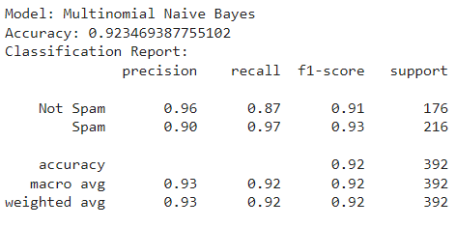
MULTINOMIAL NAIVE BAYES - (CONTINUED)
The accuracy and classification report for Multinomial Naive Bayes, applied on my dataset is shown. The key takeaways from this are:
Accuracy: The model achieved an accuracy of 92.3%, indicating the overall correctness of its predictions.
Precision: For the "Not Spam" class, the precision is 96%, meaning that 96% of comments predicted as "Not Spam" are indeed "Not Spam." For the "Spam" class, the precision is 90%, indicating that 90% of comments predicted as "Spam" are indeed "Spam."
F1-score: The weighted average F1-score for the model is approximately 92%, indicating overall good performance across both classes.

Slide 37
MULTINOMIAL NAIVE BAYES - CONTINUED)
Recall: For the "Not Spam" class, the recall is 87%, implying that 87% of actual "Not Spam" comments were correctly predicted. For the "Spam" class, the recall is 97%, meaning that 97% of actual "Spam" comments were correctly predicted.
Support: There are 176 instances (actual instances) of "Not Spam" comments and 216 instances (actual instances) of "Spam" comments. This represents the number of instances in the test set for each class.

Slide 38
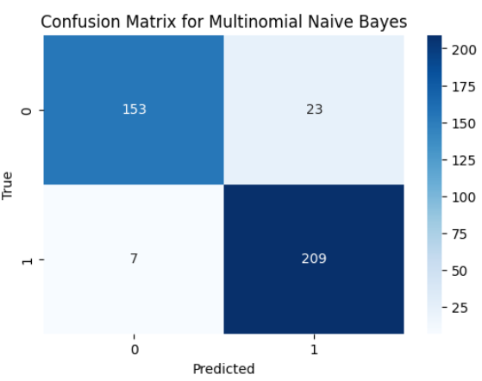
MULTINOMIAL NAIVE BAYES - (CONTINUED)
Through the screenshot of the confusion matrix implemented for Multinomial Naive Bayes, it can be interpreted that:
TP: 153 instances (Correctly predicted ‘Not Spam’)
FP: 23 instances (Incorrectly predicted as ‘Spam’, were actually ‘Not Spam’)
TN: 209 instances (Correctly predicted ‘Spam’)
FN: 7 instances (Incorrectly predicted as ‘Not Spam’, were actually ‘Spam’)

Slide 39
MULTINOMIAL NAIVE BAYES - (CONTINUED)
As seen through the screenshot for the cross-validation scores for Multinomial Naive Bayes, it can be interpreted that:
Mean Accuracy: Across all folds, the average accuracy achieved by the model is approximately 80.31%
Standard Deviation: 0.045
Cross-validation scores: For each fold, the scores are as follows: [0.75384615 0.87692308 0.78461538 0.83076923 0.76923077]

Slide 40
ANALYZING MACHINE LEARNING MODELS
(BERNOULLI NAIVE BAYES)
Bernoulli Naive Bayes is a variant of the Naive Bayes algorithm that works well with binary feature vectors, making it suitable for text classification tasks like spam detection. It models the presence or absence of each term in the comment as a binary feature, ignoring the frequency of terms. This approach simplifies the computation and can yield good results, especially when dealing with short text documents like comments.
In order to implement this, I have used Python’s scikit-learn libraries’ class ‘BernoulliNB’.

Slide 41
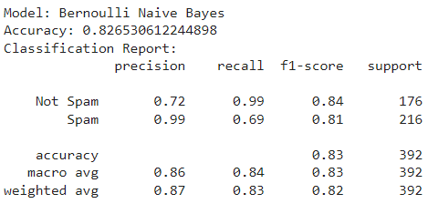
BERNOULLI NAIVE BAYES - (CONTINUED)
The accuracy and classification report for Bernoulli Naive Bayes, applied on my dataset is shown. The key takeaways from this are:
Accuracy: The model achieved an accuracy of 82.7%, indicating the overall correctness of its predictions.
Precision: For the "Not Spam" class, the precision is 72%, meaning that 72% of comments predicted as "Not Spam" are indeed "Not Spam." For the "Spam" class, the precision is 99%, indicating that 99% of comments predicted as "Spam" are indeed "Spam."
F1-score: The weighted average F1-score for the model is approximately 83%, indicating overall good performance across both classes.

Slide 42
BERNOULLI NAIVE BAYES - (CONTINUED)
Recall: For the "Not Spam" class, the recall is 99%, implying that 99% of actual "Not Spam" comments were correctly predicted. For the "Spam" class, the recall is 69%, meaning that 69% of actual "Spam" comments were correctly predicted.
Support: There are 176 instances (actual instances) of "Not Spam" comments and 216 instances (actual instances) of "Spam" comments. This represents the number of instances in the test set for each class.

Slide 43
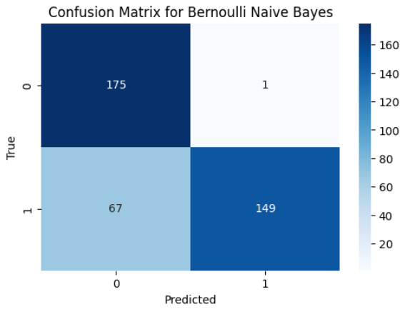
BERNOULLI NAIVE BAYES - (CONTINUED)
Through the screenshot of the confusion matrix implemented for Bernoulli Naive Bayes, it can be interpreted that:
TP: 175 instances (Correctly predicted ‘Not Spam’)
FP: 1 instance (Incorrectly predicted as ‘Spam’, was actually ‘Not Spam’)
TN: 149 instances (Correctly predicted ‘Spam’)
FN: 67 instances (Incorrectly predicted as ‘Not Spam’, were actually ‘Spam’)

Slide 44
BERNOULLI NAIVE BAYES - (CONTINUED)
As seen through the screenshot for the cross-validation scores for Bernoulli Naive Bayes, it can be interpreted that:
Mean Accuracy: Across all folds, the average accuracy achieved by the model is approximately 87.07%
Standard Deviation: 0.039
Cross-validation scores: For each fold, the scores are as follows: [0.8 0.86153846 0.90769231 0.87692308 0.90769231]

Slide 45
ANALYZING MACHINE LEARNING MODELS
(LOGISTIC REGRESSION)
Unlike linear regression, which is used for predicting continuous outcomes, logistic regression is well-suited for binary classification tasks. It models the probability of the binary outcome using the logistic function, which transforms the output into a range between 0 and 1, representing the probability of "Spam" or “Not Spam” class. This algorithm is particularly useful for its simplicity, interpretability, and efficiency, making it a popular choice for classification problems with two outcome classes.
In order to implement this, I have used Python’s scikit-learn libraries’ class ‘LogisticRegression’ alongside passing the maximum number of iterations that the optimization algorithm will perform to converge to the optimal solution.

Slide 46
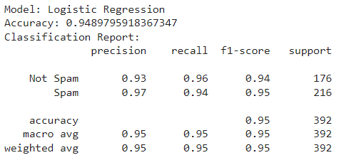
LOGISTIC REGRESSION - (CONTINUED)
The accuracy and classification report for Logistic Regression applied on the dataset are as follows:
Accuracy: The model achieved an accuracy of 94.9% , indicating the overall correctness of its predictions.
Precision: For the "Not Spam" class, the precision is 93%, meaning that 93% of comments predicted as "Not Spam" are indeed "Not Spam." For the "Spam" class, the precision is 97%, indicating that 97% of comments predicted as "Spam" are indeed "Spam."
F1-score: The weighted average F1-score for the model is approximately 95%, indicating overall good performance across both classes.

Slide 47
LOGISTIC REGRESSION - (CONTINUED)
Recall: For the "Not Spam" class, the recall is 96%, implying that 96% of actual "Not Spam" comments were correctly predicted. For the "Spam" class, the recall is 94%, meaning that 94% of actual "Spam" comments were correctly predicted.
Support: There are 176 instances (actual instances) of "Not Spam" comments and 216 instances (actual instances) of "Spam" comments. This represents the number of instances in the test set for each class.

Slide 48
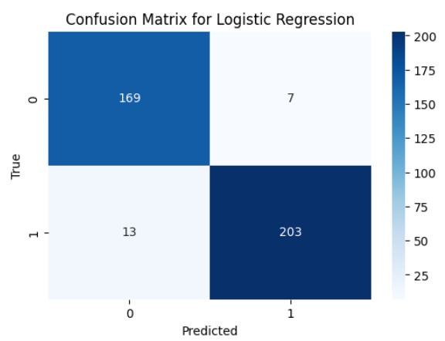
LOGISTIC REGRESSION - (CONTINUED)
Through the screenshot of the confusion matrix implemented for Logistic Regression, it can be interpreted that:
TP: 169 instances (Correctly predicted ‘Not Spam’)
FP: 7 instances (Incorrectly predicted as ‘Spam’, were actually ‘Not Spam’)
TN: 203 instances (Correctly predicted ‘Spam’)
FN: 13 instances (Incorrectly predicted as ‘Not Spam’, were actually ‘Spam’)

Slide 49
LOGISTIC REGRESSION - (CONTINUED)
As seen through the screenshot for the cross-validation scores for Logistic Regression, it can be interpreted that:
Mean Accuracy: Across all folds, the average accuracy achieved by the model is approximately 91.83%
Standard Deviation: 0.0103
Cross-validation scores: For each fold, the scores are as follows: [0.93670886 0.91139241 0.92307692 0.91025641 0.91025641]

Slide 50
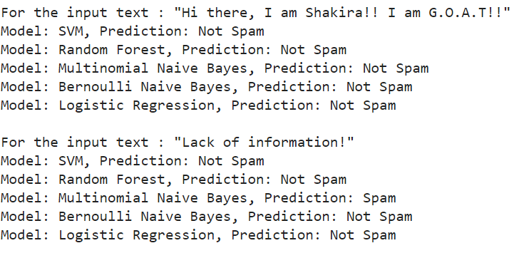
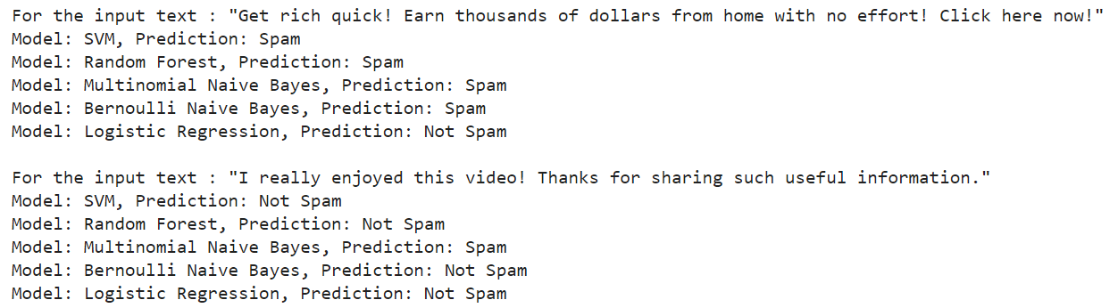
COMPARING THE MODELS
As seen in the screenshots attached below, the predictions made by five Machine Learning models shown in previous slides for four sample texts are shown. Most of the algorithms predict the SPAM and NOT SPAM comments correctly. However, for Logistic Regression, it can be seen through the sample text that for one input (Get rich....), it shows the result incorrectly.

Slide 51
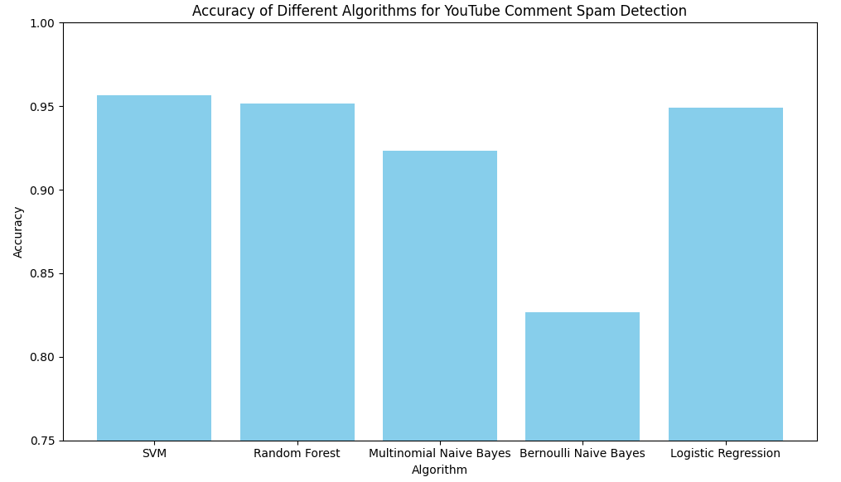
COMPARING THE MODELS - CONTINUED
As seen through the “Bar Plot” created by comparing the accuracies for all the 5 Machine Learning models shown in the previous slides, it can be seen that the Support Vector Machine (SVM) algorithm has the highest accuracy.

Slide 52
RESULTS
Based on the analysis of various Machine Learning algorithms and their performance metrics, the SVM (Support Vector Machine) model emerges as the best choice for the task of YouTube Spam Classification for the given dataset. Some reasons for using the same are:
High Accuracy: The SVM model achieves the highest accuracy among all the tested algorithms, with an accuracy of approximately 95.7%.
Precision and Recall: The SVM model demonstrates consistently high precision and recall values for both the "Not Spam" and "Spam" classes. This indicates that it effectively identifies true positives while minimizing false positives and false negatives.
Therefore, based on these considerations, the SVM model is recommended as the optimal choice for YouTube spam analysis due to its high accuracy, precision, recall, and consistent performance across different evaluation metrics.

Slide 53
RESULTS (CONTINUED)
Consistent Performance: The SVM model maintains its accuracy and robustness across different evaluation metrics, including precision, recall, and F1-score.
Cross-validation Scores: The SVM model exhibits stable performance across different cross-validation folds, with a mean accuracy of approximately 93.6% and a low standard deviation.
Confusion Matrix Analysis: The confusion matrix analysis further supports the effectiveness of the SVM model, with a balanced distribution of true positives, true negatives, false positives, and false negatives.

Slide 54
CONCLUSIONS
In this project, I aimed to analyze and create several Machine Learning models to classify YouTube comments as either 'Spam' or 'Not Spam.' Leveraging datasets sourced from Kaggle, I preprocessed the data, applied various classification algorithms, and evaluated their performance. Below is the conclusion drawn from my analysis:
Implemented machine learning algorithms for classifying YouTube comments as "Spam" or "Not Spam" correctly.
Efficiently preprocessed the dataset by cleaning text data, tokenizing words, and removing stopwords.

Slide 55
CONCLUSIONS
Tested five classification algorithms: SVM, Random Forest, Multinomial Naive Bayes, Bernoulli Naive Bayes, and Logistic Regression.
SVM emerged as the most effective model, achieving an accuracy of approximately 95.7%.
SVM demonstrated high precision and recall for both "Spam" and "Not Spam" classes.
Consistent performance of SVM across different evaluation metrics and cross-validation folds.
Confusion matrix analysis provided insights into the model's performance.

Slide 56
THANK YOU
Arpit Shah

