Slide 1

Vendor Performance : A Comprehensive Analysis

Slide 2

Introduction
Vendor performance analysis is a critical component of maintaining operational excellence and ensuring service quality in any organization.
Effective vendor performance analysis not only helps in identifying areas where vendors excel but also highlights potential inefﬁciencies and areas for improvement. By leveraging data on service start times, slot times, delays, and other performance indicators, organizations can gain valuable insights into their vendors' reliability and efﬁciency.
This analysis supports informed decision-making, fosters stronger vendor relationships, and drives continuous improvement in service delivery. Ultimately, a robust vendor performance analysis framework contributes to enhanced customer satisfaction, cost-effectiveness, and competitive advantage in the marketplace.

Slide 3



Vendor Performance Metrics
Understanding key performance metrics is essential for evaluating vendor effectiveness. Metrics such as
On-Time Delivery Rate
Service Quality
Flexibility and Responsiveness Customer Satisfaction Communication and Transparency Performance Rating
Cost efﬁciency Delay in Service
Performance Incentive

Slide 4

Data Collection and Preparation
In our analysis, we utilized data comprising service start times, slot times, and delays. Service start times indicate the actual commencement of services, slot times represent the scheduled times for these services, and delays measure the difference between the scheduled slot times and the actual start times.
Assumptions made during data preparation included treating minor variations in times due to clock discrepancies as negligible and assuming that the provided slot times were accurate representations of the scheduled service times.

Slide 5
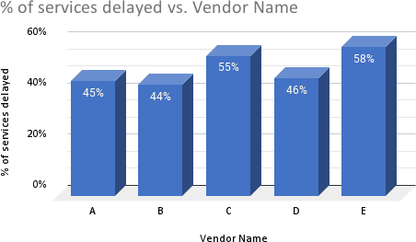
Visualizations
Bar Chart for % of Services Delayed by Vendor

Slide 6
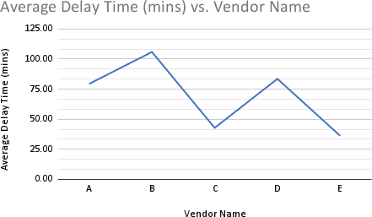
Visualizations
Line Chart for Average Delay Time by Vendor

Slide 7
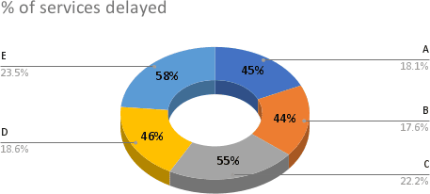
Visualizations
Pie Chart for Proportion of Delayed Services

Slide 8
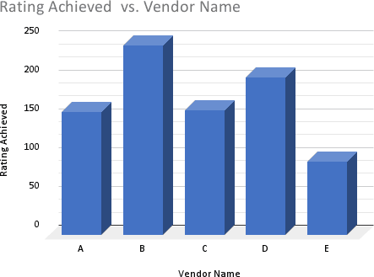
Visualizations
Bar Chart for Ratings Achieved Vendor wise

Slide 9
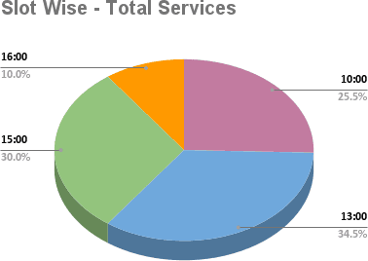
Visualizations
Pie Chart for Slot Wise Services

Slide 10

Key Insights and Findings
Optimizing vendor performance requires a comprehensive approach that encompasses Performance Rating, Delay in Service and Total Services etc. By implementing these strategies, businesses can achieve sustainable vendor success.
Top Performing Vendors
Vendor B with Minimum % of service delayed (44%), Ma . services done (32) and Ma weighted score (148.6)
Vendors with Improvement Opportunities
Vendor D with 2nd Min. % of service delayed (46%), Ma . services done (26) and Ma weighted score (123.35)
Overall Rating Performance
Vendor C with Ma . % of service rating achieved (81%)

Slide 11
Recommendations
Strategies for Improvement
Enhanced Scheduling Accuracy
Real-Time Monitoring and Communication Performance Analytics
Training and Development
Regular Performance Reviews Continuous Training and Development Advanced Technology Integration
Best Practices
Future Monitoring and Evaluation
Automated Reporting Systems Regular Audits and Inspections Performance Review Meetings Customer Feedback Systems

Slide 12
Thanks !
Submitted By - Arpit Jain

