Slide 1
Satellite/Aerial Image Retrieval
Assignment 3
Submitted By:
Arpit Hasmukhbhai Patel – A20424085
Hitanshu Rami – A20458137
Hariharan Shankar - A20442562

Slide 2
Index
Problem Statement/Objective – Slide 3
Aim – Slide 4
Introduction – Slide 5
Retrieving Quad Key – Slide 6
Approach – Slide 8
Steps to run our assignment – Slide 12
Results – Slide 13
Reference – Slide 16

Slide 3
Problem Statement / Objective
The main objective is to develop a program using Bing maps tile system that automatically downloads an aerial imagery of maximum resolution for a given latitude / longitude and compose one image of the exact bounding box region.

Slide 4
Aim
Input : The pair of latitude and longitude of the two points(that is two diagonal points of the required box - upper left point & lower right point)
Goal: Return the aerial imagery of finest resolution which is bounded by the two given points using Bing Maps Tile System

Slide 5
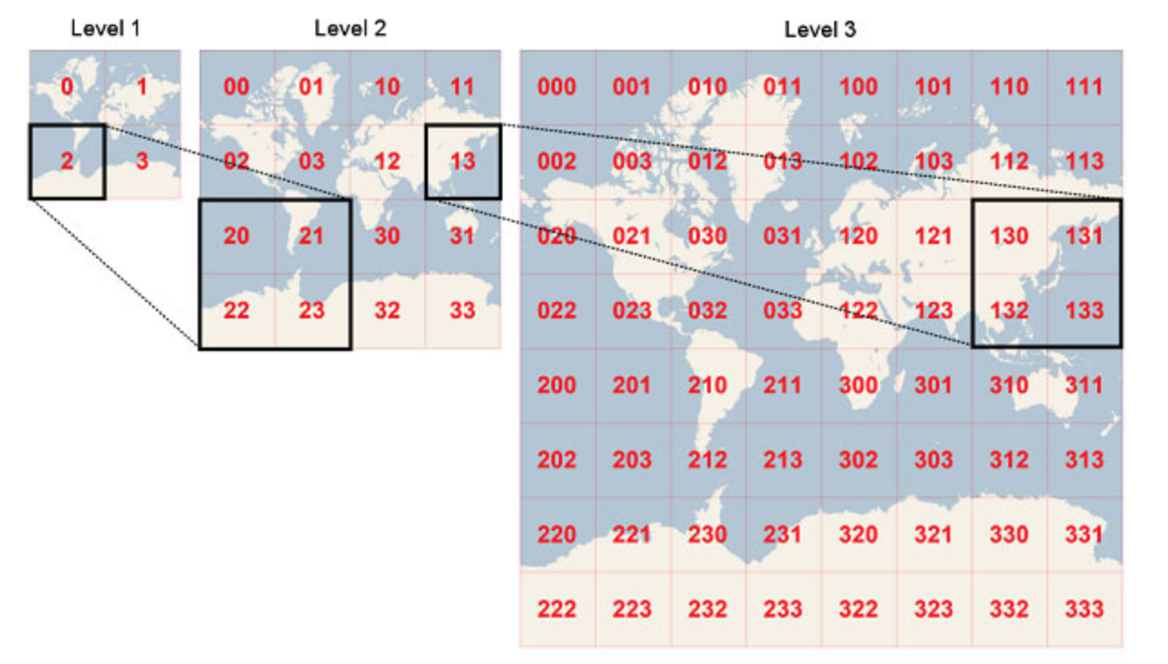
Introduction
What is Bing Maps Tile System?
Bing Maps provides a world map that users can directly manipulate to pan and zoom. To make the interaction as fast and responsive as possible, they have chosen to pre-render the map at many different levels(as shown in the figure) of detail, and to cut each map into tiles for quick retrieval and display.
The projection, coordinate systems, and addressing scheme of the map tiles, which collectively are called the Bing Maps Tile System.

Slide 6
Retrieving Quad Key
To optimize the indexing and storage of tiles, the two-dimensional tile ((X,Y) coordinates of Bing map tile system) are combined into one-dimensional strings called “Quadkey” .
Quad key has 3 characteristics:
The length of a quadkey (the number of digits) equals the level of detail of the corresponding tile.
Second, the quadkey of any tile starts with the quadkey of its parent tile(as shown in the figure on previous slide)
Two tiles that have nearby XY coordinates usually have quadkeys that are relatively close together. This is useful in optimizing the performance as it is more likely that neighboring tiles are requested in groups.

Slide 7
Retrieving Quad Key
Quadkey matrix represents a group of tiles in a map which comes under the required bounding box. Steps to retrieve this matrix involves:
Tile 1 has maximum longitude and minimum latitude and tile 2 has maximum latitude and minimum longitude.
Get the top left tile of the bounding box using input 1(y1,x1).
Get the bottom right of the bounding box using input 2(y2,x2).
An Iterator function is written to calculate all the remaining tiles in between max y value to min y value with respect to max x value to min x value.
The polynomial is converted to matrix of quadkeys with:
Number of Rows = Maximum value of y
Number of Columns = Maximum value of x

Slide 8
Approach
The approach uses Bing Tile System with the utility functions provided in aerialView.py to generate tiles.
An improved quality tile is overwritten on the previous image if found.
Firstly, an initial image is created.
The starting point is chosen as the image with the highest resolution and the tile has at least one side.
The resolution is increased and iterated through the generated tiles which are acquired from Bing Server.
The tile with the better resolution among those is attached to the initial image.
This process is carried out unless and until Bing Server responds with null i.e. there is no better quality available.
Finally, a bounding box is created.

Slide 9
Approach
Step 1: Accepting the inputs and returning the tile level with coordinates.
Input latitudes, longitudes: lat1, lon1, lat2, lon2
Convert inputs to tile coordinates: x1, y1, x2, y2
It tries to get the smallest tile which bounds the bounding box.
Within base tile, recursively find finest tiles.
Return the tile level and tile coordinate x1, y1

Slide 10
Approach
Step 2: Finding the finest tile
Input tile coordinates: x1, y1, x2, y2 and tile level.
From level 25 to lower levels, it try to find non-null tile aerial images.
After that it Stitches these tiles together to get a “finest tile”.
Return finest tile image.

Slide 11
Approach
Step 3: Generating the bounding box
Input: lat1, lon1, lat2, lon2 and finest tile image.
Within finest tile Converts Longitudes and latitudes to pixel coordinates
Crop the finest tile to the bounding box of required aerial image.
Return the bounding box image.

Slide 12
Steps to Run Our Assignment
The main program file to run is HW3.py
Go to directory of the file and open command line.
Please enter the following command to run the file. python HW3.py 41.839579,-87.629573,41.831328,-87.623101
Finally, the output is the satellite aerial retrieved image is stored.
The result file is saved in the current working directory as image.jpg
A working internet connection is required to be able to download the tiles from the Bing server.
The Python Image Library is required and is imported among others at the start.
If the given tile is too small no output will be obtained.

Slide 13
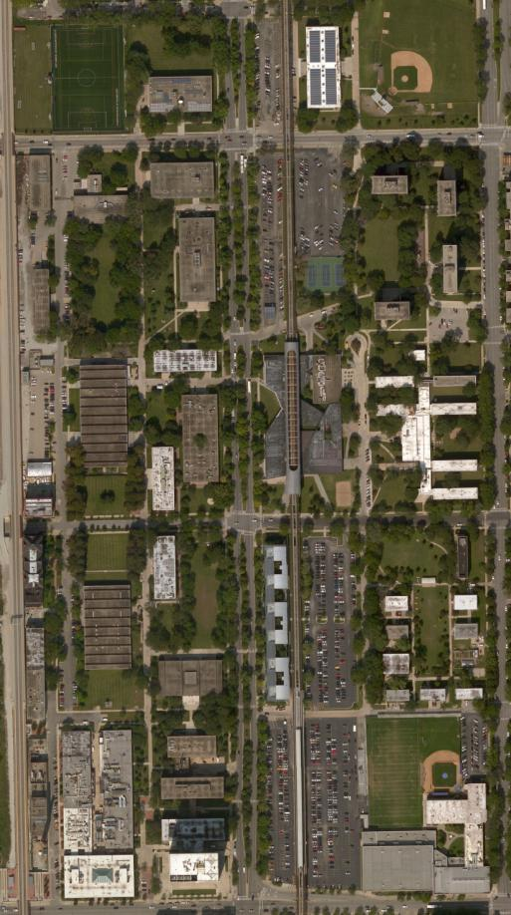
Results
This is an image of the Illinois Institute of Technology downloaded using the program.
Upper Left Coordinates :
41.839579, -87.629573
Lower Right Coordinates:
41.831328, -87.623101

Slide 14
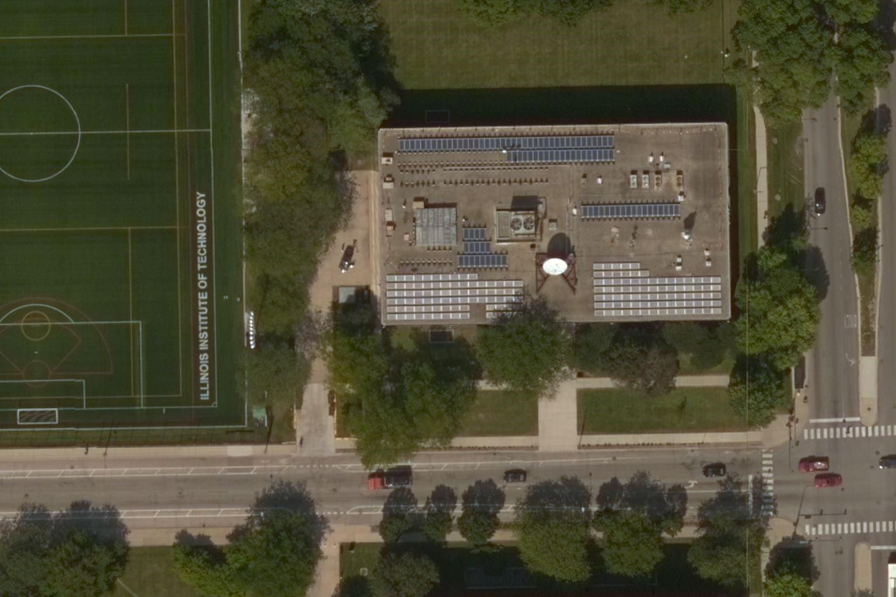
Results
This is an image of the Illinois Institute of Technology, Stuart Building downloaded using the program.
Upper Left Coordinates :
41.838929, -87.628398
Lower Right Coordinates:
41.838224, -87.626568

Slide 15
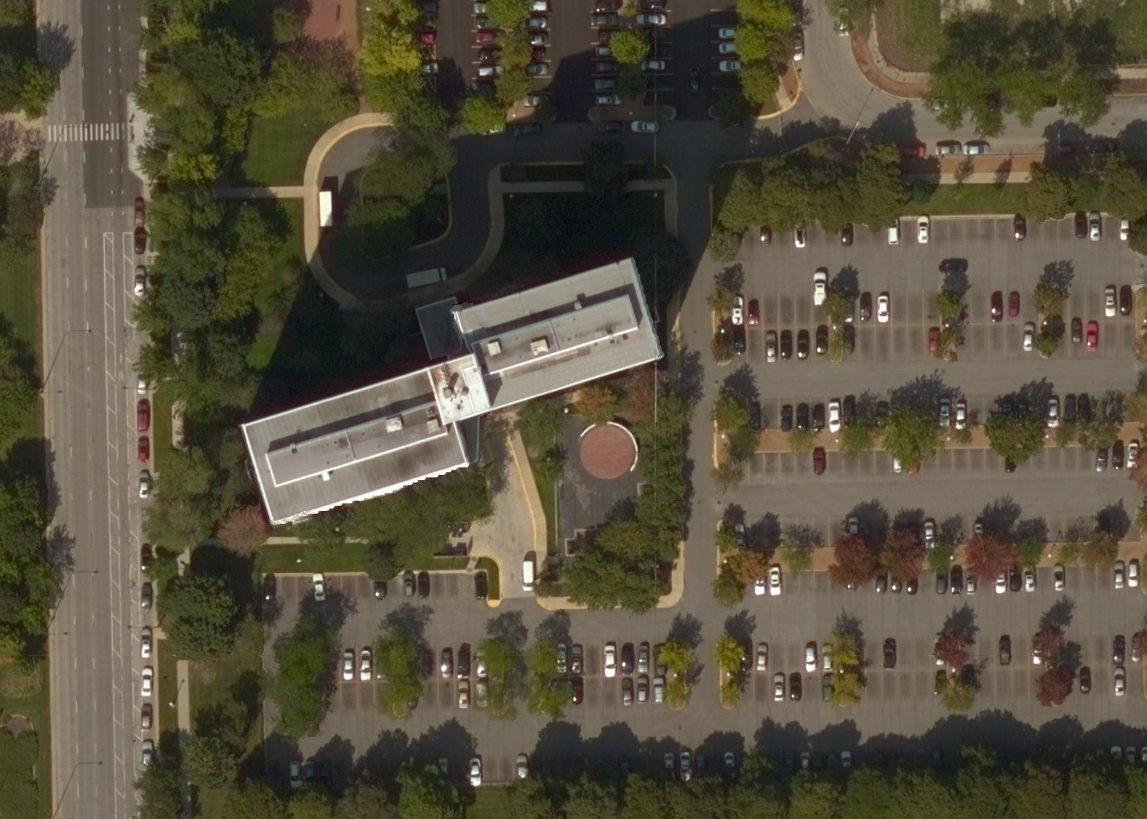
Results
This is an image downloaded using the program of 3001, South King Drive.
Upper Left Coordinates :
41.839728,-87.617002
Lower Right Coordinates:
41.838779,-87.615226

Slide 16
References
Bing Maps Tile System - https://docs.microsoft.com/en-us/bingmaps/articles/bing-maps-tile-system
Google Maps.

