Slide 1

Driver Drowsiness Detection using CNN
AAT 2 | Introduction to Deep Learning (22IS741)
Arpit Srivastava (1DS23IS023) Khushi Agrawal (1DS23IS074)
Himanshu (1DS23IS061) Harsh Kumar Gupta (1DS23IS054)
Dept. of ISE, Dayananda Sagar College of Engineering
Eyes closed for 15 frames → alarm
Notes:
DriveAlert watches the driver through a camera. A CNN decides in every frame whether the eyes are open or closed, and an alarm sounds when they stay closed for 15 frames in a row.

Slide 2



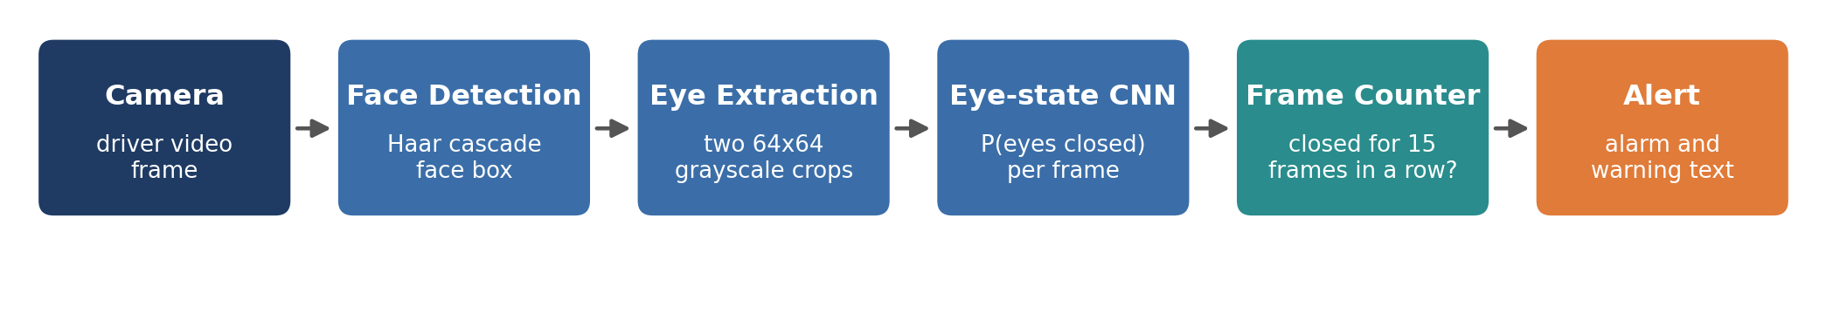
Long eye closure is the clearest sign of drowsiness
The problem
The signal
Our approach
Drowsy drivers react slowly and can fall asleep for seconds; there is no roadside test for it.
A normal blink lasts about 0.1 s. A drowsy driver keeps the eyes shut much longer.
A CNN classifies each eye as Open or Closed; a frame counter turns that into an alert.
Notes:
Problem, signal and approach. The pipeline below: camera, Haar face detection, two eye crops, eye-state CNN, frame counter, alarm.

Slide 3


Whole-face models failed on unseen drivers
69.7%
49.7%
99.45%
accuracy on unseen faces
accuracy on unseen faces
accuracy on unseen faces
CNN on the whole face
MobileNetV2 features
CNN on eye state
98% on training faces, AUC 0.58 on new people
Pre-trained ImageNet CNN on the whole face: chance level
Final design: eye closure does not depend on who the driver is
Always answering "Drowsy" already scores 58.5%: the whole-face models learned who the person is, not how tired they look.
Notes:
We tested fairly by splitting the Driver Drowsiness Dataset by person. The whole-face CNN memorised identities. Switching to eye state fixed that.

Slide 4
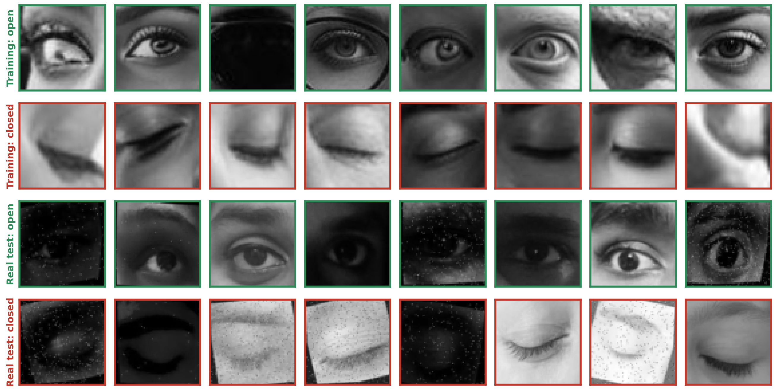
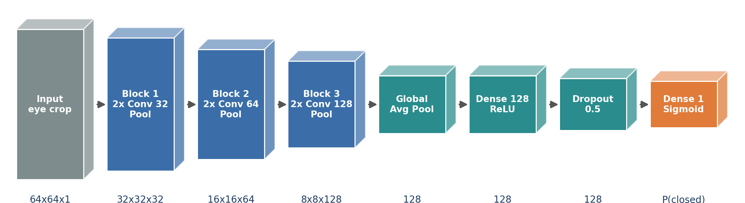
A small CNN trained on 42,131 eye crops
Input: 64×64 grayscale eye
3 conv blocks, 304,417 parameters
Split by face: 70 / 15 / 15
Augmentation: flip, rotate, blur, noise
Adam, binary cross-entropy, early stopping
Training eyes (rows 1-2) and the separate real-world test photos (rows 3-4)
BatchNorm momentum 0.9: the default 0.99 made the model predict Closed for every image
Notes:
Eyes are cropped as squares of 1.6 times the eye width so the crop size cannot leak the label. A BatchNorm momentum bug was found and fixed during training.

Slide 5
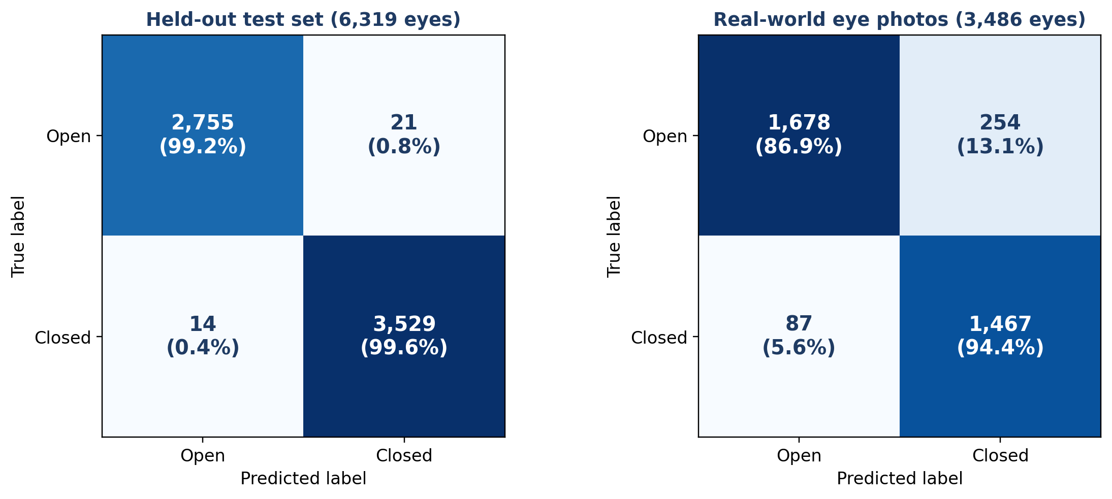
99.45% on held-out eyes, 90.22% on real photos
99.45%
held-out test, 6,319 eyes
90.22%
real photos, 3,486 eyes
0.944
Real photos come from a different source, so the drop to 90.22% (AUC 0.962) is the realistic figure
recall on real closed eyes
Notes:
The held-out set comes from the same source as training. The real-world set is the honest test. Most real errors are open eyes called closed; the 15-frame rule filters those single-frame errors.

Slide 6
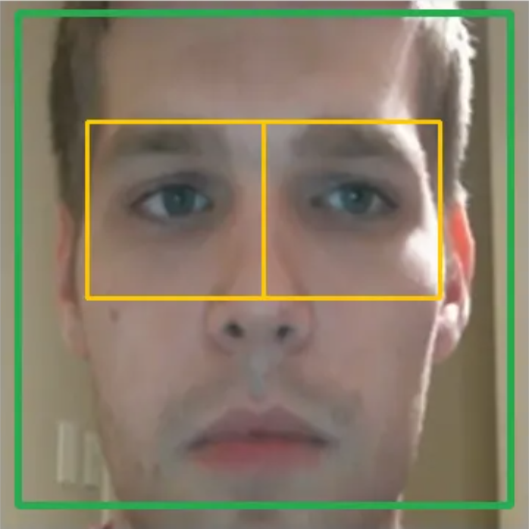
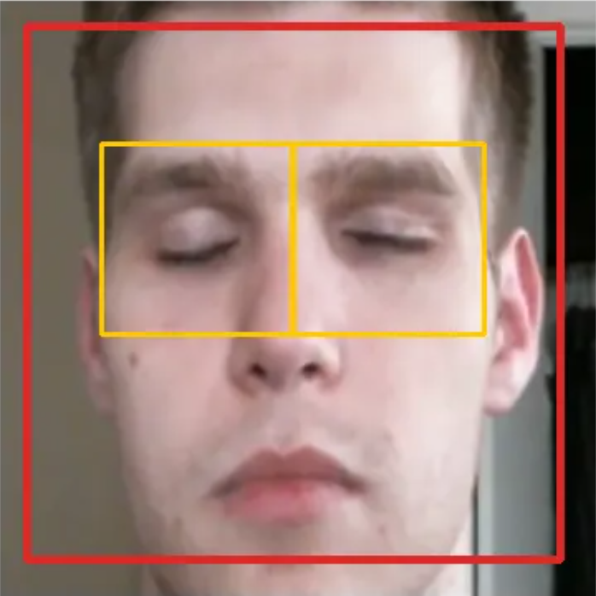
25 of 26 drowsy videos had more eye closure
ALERT
DROWSY
P(closed) = 0.00
P(closed) = 1.00
Gradio app, same driver
Average closed-eye share: 66.5% in drowsy videos vs 23.0% in alert videos
Notes:
The whole pipeline was run on 13,924 frames of real driver videos the model never saw. On the right, the Gradio app on two real frames of the same driver.

Slide 7



Eye-state CNN gives a reliable drowsiness alarm
Eye state, not identity
Next steps
Splitting the task into eye state plus a frame counter generalises to new drivers
More real and infrared driver images
Add yawning and head nodding
Landmark-based eye localisation
Test in a real vehicle
Tested honestly
99.45% held-out, 90.22% on real photos from another source
Working system
Gradio web app and a real-time webcam monitor with an alarm
Thank you
github.com/Arpit529Srivastava/Deep-Learning-AAT
Notes:
Summary and next steps. Code, models and report are on GitHub.

