Slide 1

DEPARTMENT OF
COMPUTER SCIENCE & ENGINEERING
Experiment 2
Student Name: Arpit Anand Branch: CSE
Semester: 5th
Subject Name: ADBMS
UID: 23BCS12710
Section/Group: KRG 3-A
Date of Performance:24/07/2025 Subject Code: 23CSP-333
Aim: To demonstrate the use of self-joins and conditional joins in SQL for managing hierarchical employee relationships and performing conditional lookups using LEFT JOIN and IFNULL across two related tables.
Employee-Manager Hierarchy Using Self-Join
Conditional Join Between Financial Tables
Objective:
To design and populate relational tables with hierarchical and temporal data.
To perform a self-join on an employee table to retrieve manager-employee relationships.
To implement a conditional LEFT JOIN between two tables to handle non-matching records.
To apply the IFNULL function to handle missing values in joined queries.
To practice using joins for querying structured business-related datasets.
3. DBMS script and output:
Solution-(a)
CREATE DATABASE company; USE company;
CREATE TABLE employee ( empid INT PRIMARY KEY, ename VARCHAR(50),
department VARCHAR(50), managerid INT
);
INSERT INTO employee (empid, ename, department, managerid) VALUES (1, 'Alice', 'HR', NULL),
(2, 'Bob', 'Finance', 1),

Slide 2

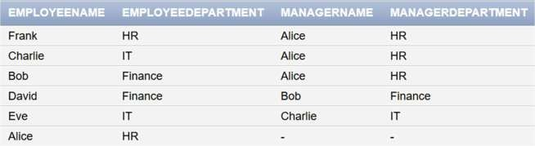
DEPARTMENT OF
COMPUTER SCIENCE & ENGINEERING
(3, 'Charlie', 'IT', 1),
(4, 'David', 'Finance', 2),
(5, 'Eve', 'IT', 3),
(6, 'Frank', 'HR', 1);
SELECT
e.ename AS EmployeeName,
e.department AS EmployeeDepartment, m.ename AS ManagerName, m.department AS ManagerDepartment
FROM
employee e LEFT JOIN
employee m ON e.managerid = m.empid;
Solution-(b)
create database company2; use company2;
CREATE TABLE Year_tbl ( ID INT,
YEAR INT,
NPV INT
);

Slide 3
DEPARTMENT OF
COMPUTER SCIENCE & ENGINEERING
CREATE TABLE Queries ( ID INT,
YEAR INT
);
INSERT INTO Year_tbl (ID, YEAR, NPV) VALUES
(1, 2018, 100),
(7, 2020, 30),
(13, 2019, 40),
(1, 2019, 113),
(2, 2008, 121),
(3, 2009, 12),
(11, 2020, 99),
(7, 2019, 0);
INSERT INTO Queries (ID, YEAR) VALUES
(1, 2019),
(2, 2008),
(3, 2009),
(7, 2018),
(7, 2019),
(7, 2020),
(13, 2019);
SELECT q.ID,

Slide 4
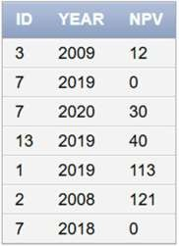
DEPARTMENT OF
COMPUTER SCIENCE & ENGINEERING
q.YEAR,
IFNULL(y.NPV, 0) AS NPV FROM
Queries q LEFT JOIN
Year_tbl y ON q.ID = y.ID AND q.YEAR = y.YEAR;
Learning Outcomes:
Understand how to model and query hierarchical relationships using self-joins.
Learn to perform LEFT JOINs to include unmatched records from one table.
Apply composite join conditions on multiple columns (e.g., ID and YEAR).
Use IFNULL to handle NULL values in result sets for reporting purposes.
Develop SQL skills for solving real-world data retrieval scenarios in organizations.

