Slide 1

Task-2
Arpit Mathur

Slide 2
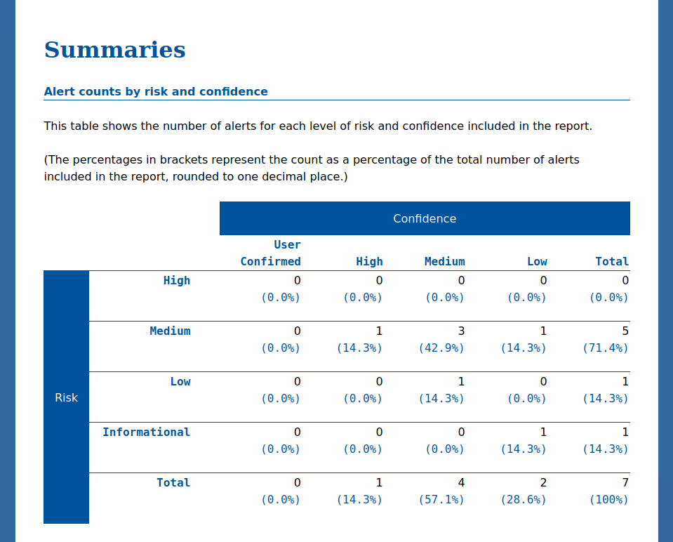
Scanning Report Summary
Automatic vulnerability scanner- OWASP ZAP Test web application URL - http://zero.webappsecurity.com/

Slide 3
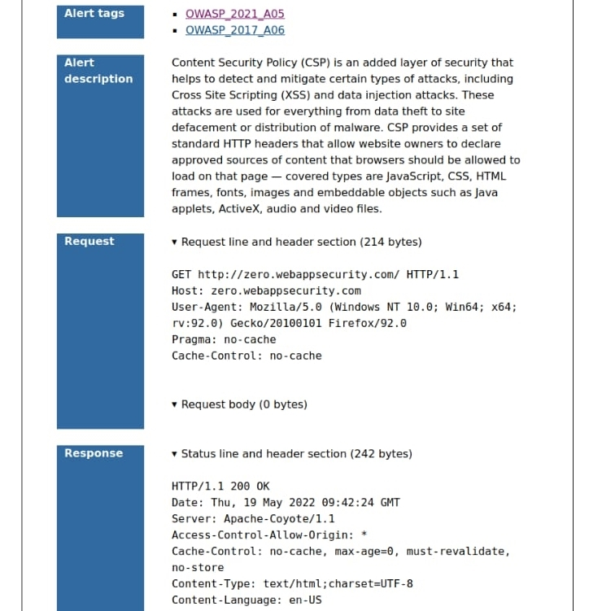
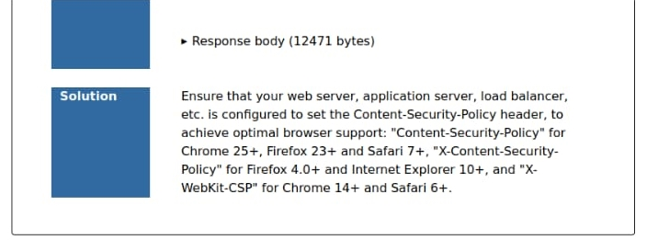
Vulnerability name- Content Security Policy (CSP) Header not set

Slide 4
My Report
Test web application name - http://zero.webappsecurity.com/
Vulnerability name- Content Security Policy (CSP) Header not set
About Vulnerability- A Content Protection Policy (CSP) is a security standard that provides an additional layer of protection from cross site scripting, clickjacking and other code injection attacks. It is a defensive measure against any attacks that rely on executing malicious content in a trusted web context. CSP provides a set of HTTP headers that allow website owners to declare approved sources of content that browsers should be allowed to load on that page.
Impact- Due to this vulnerability, web application is vulnerable to cross site scripting(XSS) , clickjacking , SQL injection and other data injection attacks. These attacks can be oriented for everything from data theft to site defacement or distribution of malware.
Solution- This vulnerability can be removed by ensuring that the web server, application server etc. are configured to set the content security policy header, so that the web application along with its content and server is not compromised. This also assures the safety of the web application users.

