Slide 1
E VOTING WEBSITE
Presented By:
Arpit Mittal (191500148)
Aman Pandey (191500094)

Slide 2
OUTLINE
About the Project
Objective
Requirements
Snapshots from the website

Slide 3
ABOUT THE PROJECT
It would be a voting website, with polling system. In this website any user would have authority to create a poll and as well as cast the vote for a poll. A user would also be able to track statistics of an ongoing poll. The idea is to provide social experiments and surveys easily available on your device with real time data.
Any User would be able to create a poll and join a poll.
A user has to make a profile in order to cast the vote which will specify max authenticity of real and actual data.
A user verification via email would also be there to validate user’s unique identity.
Real Time Data would be displayed while polling and once Voting is done any user whosoever has participated in voting would get the detailed result and statistics.

Slide 4
OBJECTIVE
The objective is to provide best service for voting with utmost securities of individual’s votes. User would be surely relaxed for non-partial voting system.
User friendliness: The project should be very easy to use enabling even a novice person to use it

Slide 5
REQUIREMENTS
Software Specification Used:-
Technology Implemented: Full Stack Web Development
Languages/Technologies Used: HTML, CSS, JavaScript
IDE Used: Visual Studio Code
Web Browser: Google Chrome

Slide 6
Hardware Used:
Processor Used: Intel i5
Operating System: Windows 10
RAM: 4 GB (minimum)
Hardware Devices: Computer System
Hard Disk: 256 GB

Slide 7
THIS IS HOW OUR WEBSITE LOOKS
Hope you will like it :)

Slide 8
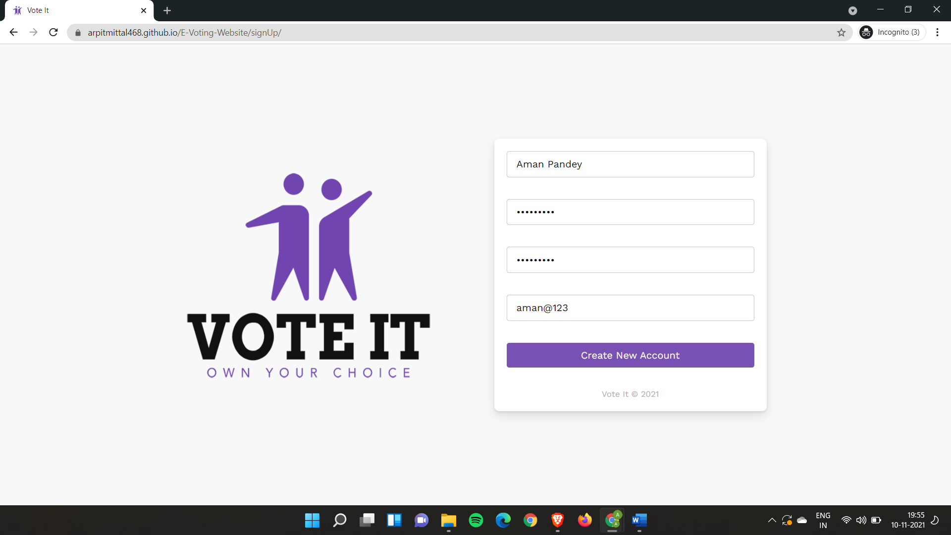
SIGNUP PAGE

Slide 9
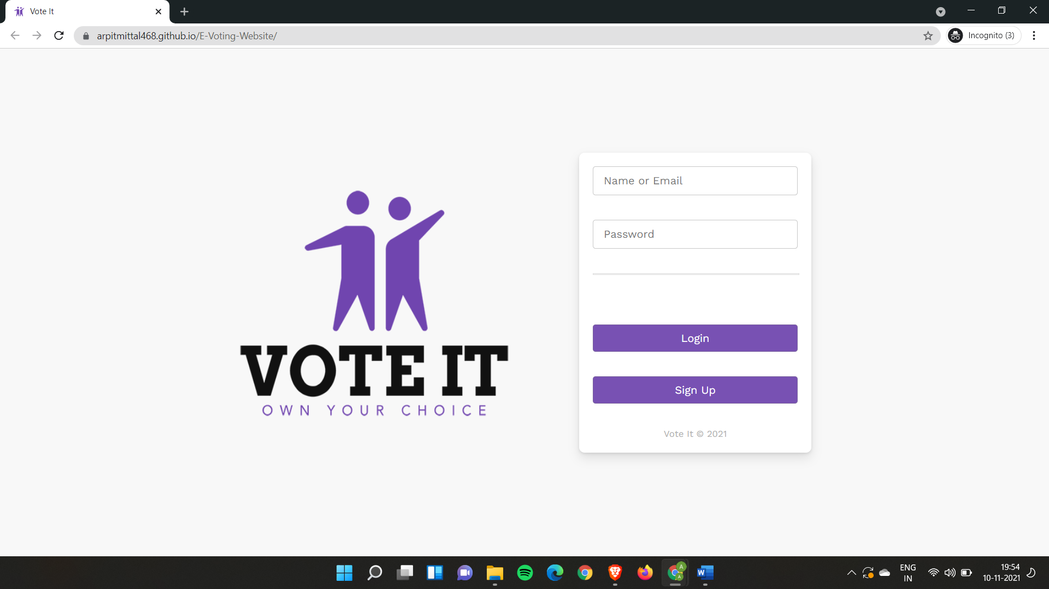
2. LOGIN PAGE

Slide 10
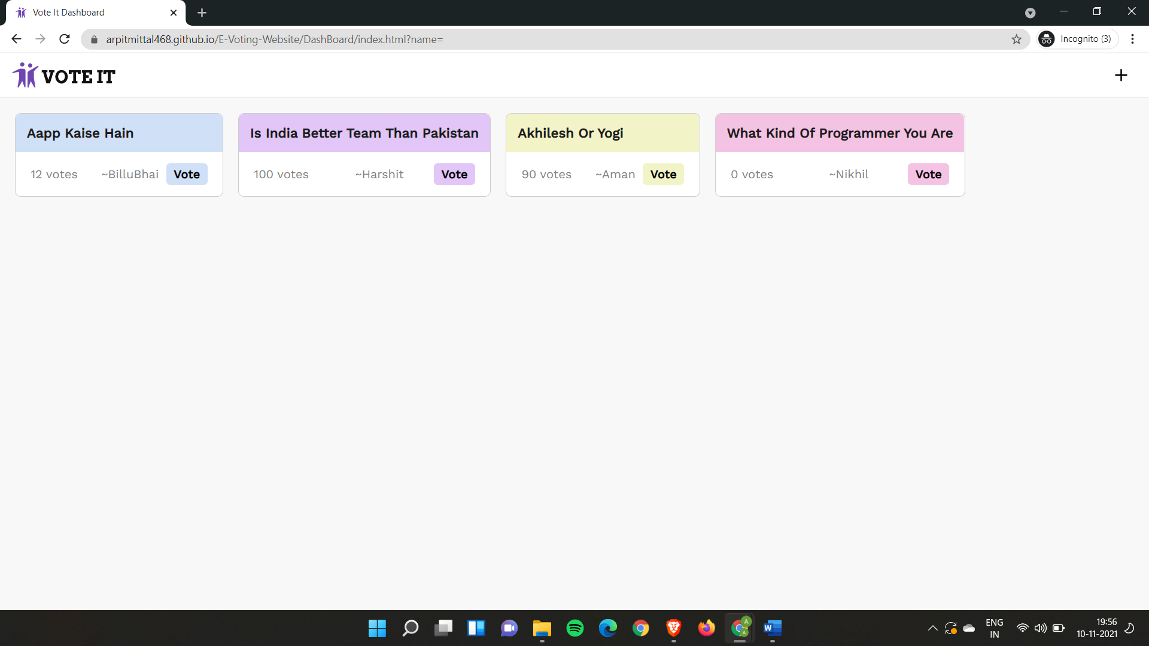
3. HOMEPAGE

Slide 11
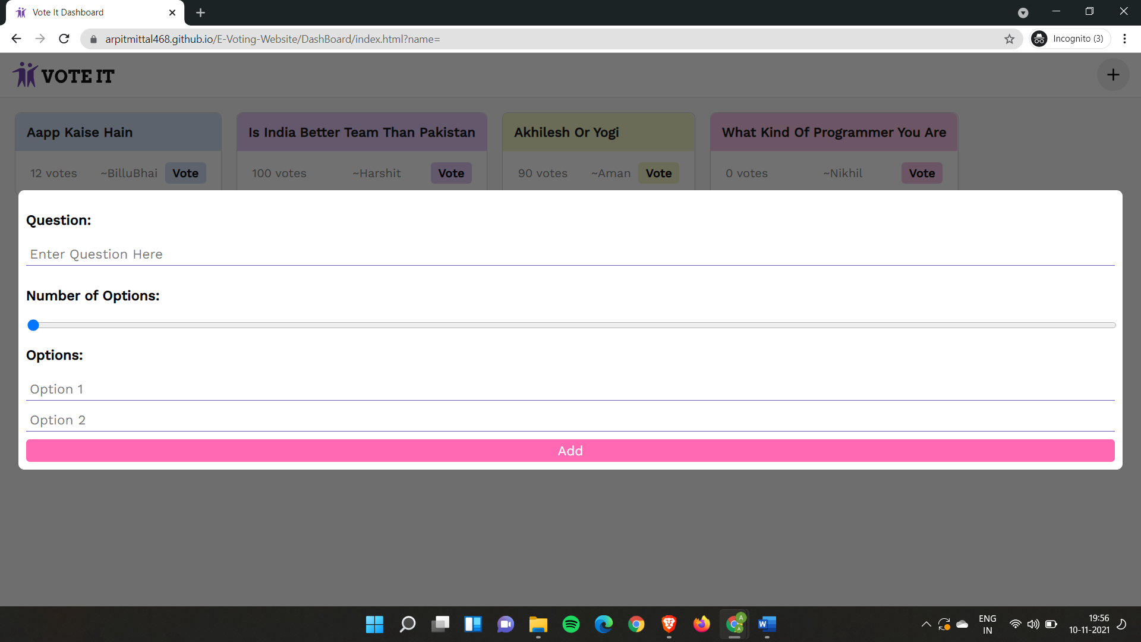
4. ADDING A QUESTION

Slide 12
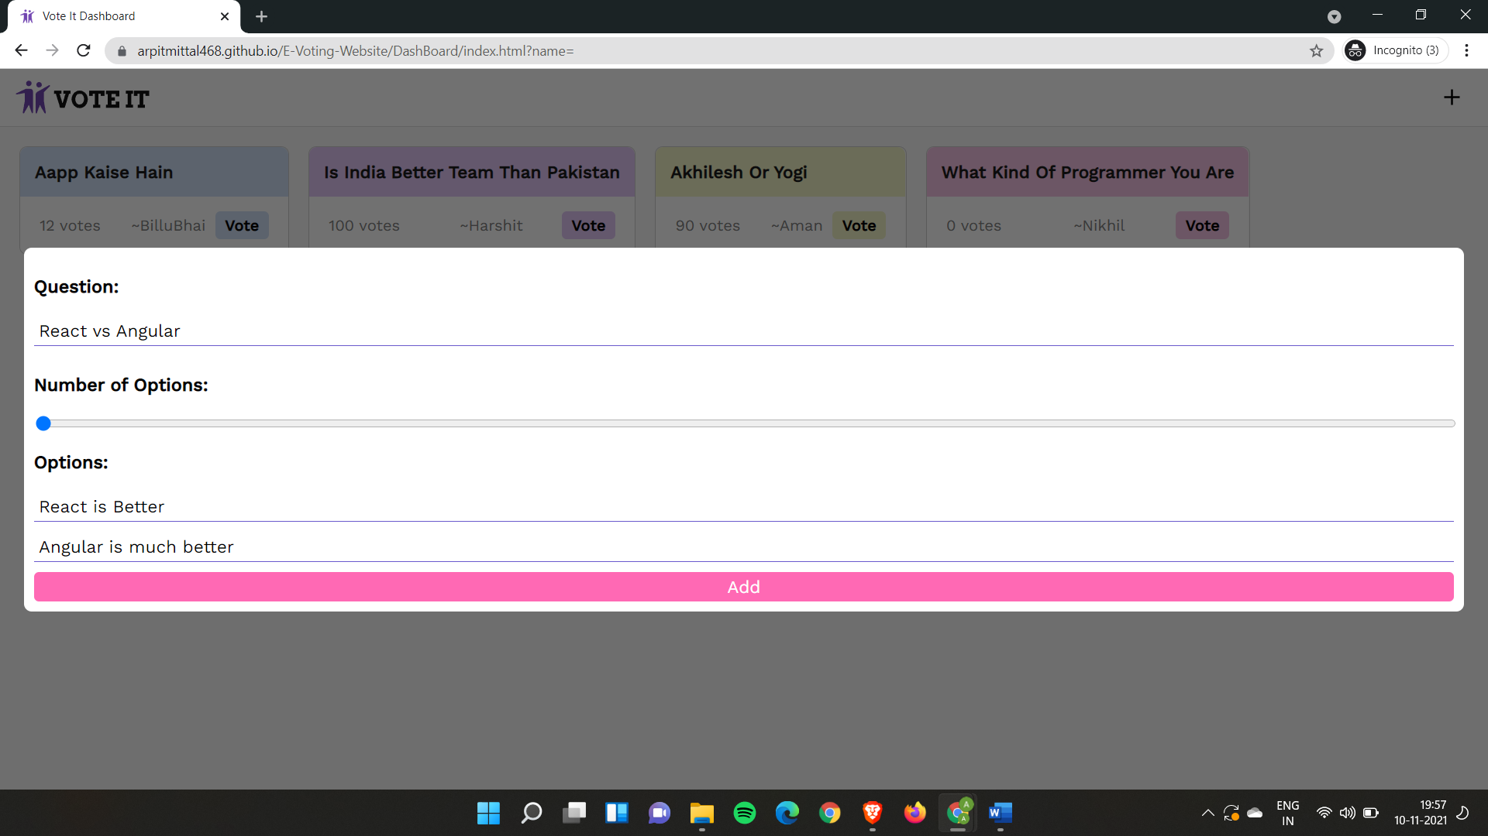
5.

Slide 13
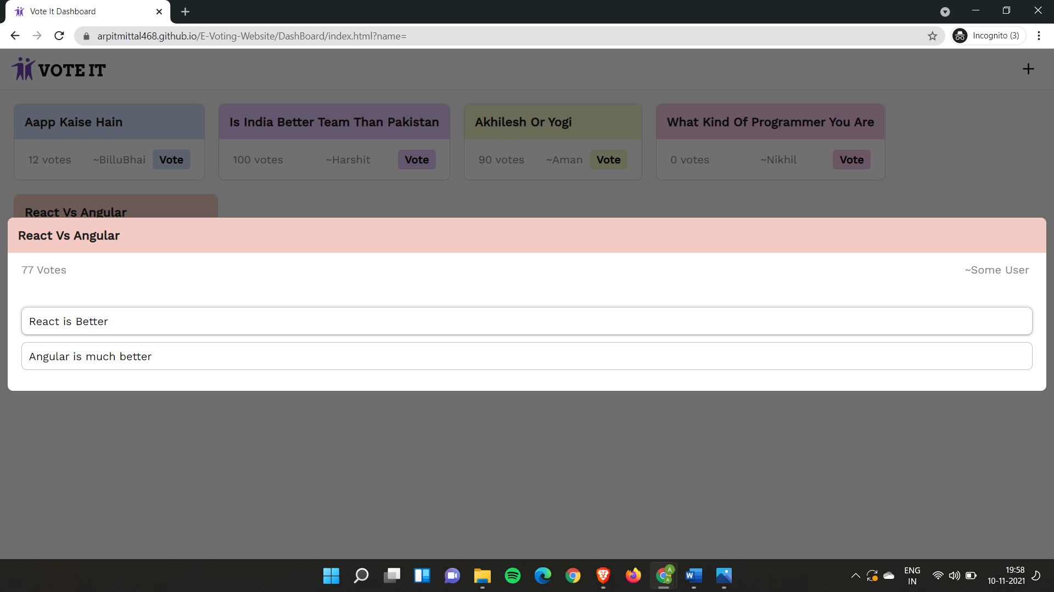
6. TAP TO VOTE

Slide 14
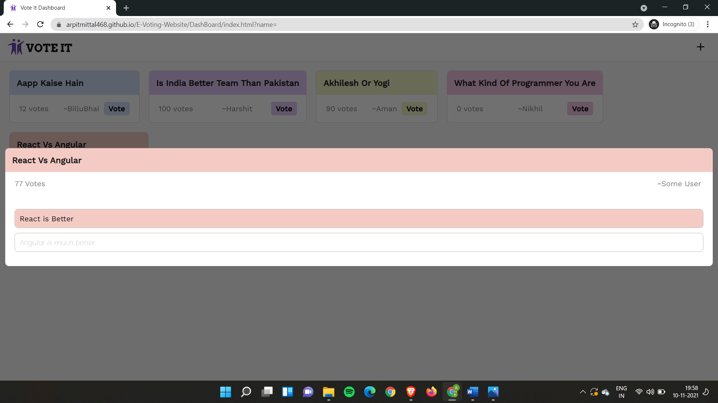
7.

Slide 15
Thank You!!!

