Slide 1
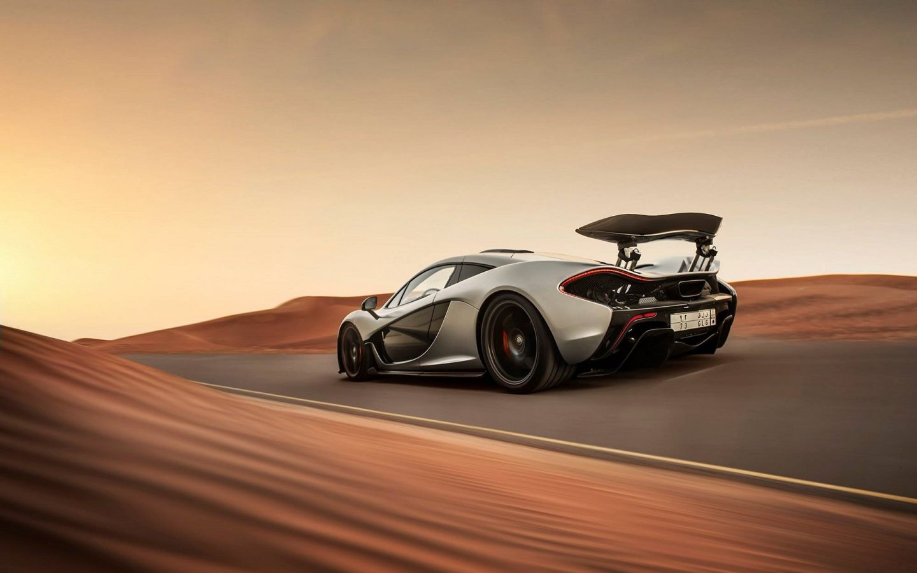

Shivajirao Kadam Institute of Technology and Management-Technical Campus, Indore​
​
Department of Computer Science and Engineering
Car Insight
Roadmap to informed choices
Guided By:​​
​Prof. Ayesha Mandloi​
​
Presented By:​​
Arpit Nigam (0875CS201013)​​
Ayan Magardey (0875CS201017)​​
Samkit Jain (0875CS201058)​

Slide 2
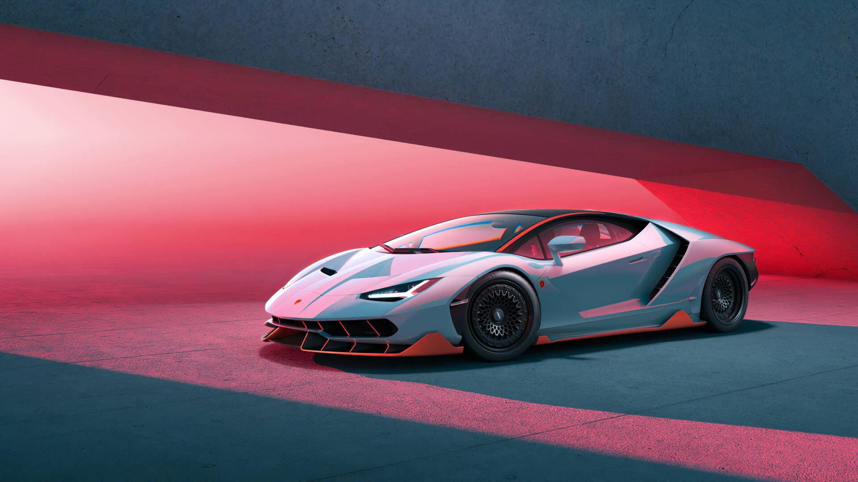
Car Insight
Roadmap To Informed Choices

Slide 3

Objectives:-
To develop a user-friendly platform that analyzes car reviews and extracts valuable insights.
To enable side-by-side comparisons between car models, both new and old.
To assist users in identifying budget-friendly car options that align with their needs.
To keep buyers informed about new car launches in the market.
To curate car recommendations based on user reviews and data analysis.

Slide 4

Problem Identification :-
The car buying journey is often complex and overwhelming, with a vast array of options available and numerous factors to consider. Traditional research methods can be time-consuming and lack in-depth analysis of user experiences.
This project, titled "Cars Insight - Roadmap to Informed Choices," addresses this challenge
by leveraging the power of data and user insights.

Slide 5
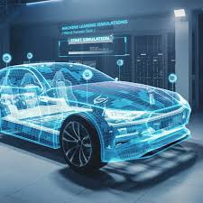
Methodology :-
New and old cars buying and selling functionallity
Car Comparison: The platform facilitates side-by-side comparisons between existing and older car models, allowing users to evaluate features and make informed choices based on their needs.
Budget Optimization: The system identifies "Best Buy" options within user-defined budgets, considering factors like features, reviews, and value for money.

Slide 6
Market Awareness: The platform provides updates on new car launches, keeping users informed about the latest offerings in the market.
Curated Recommendations: A "Car of the Month" and "Car of the Year" section highlights top-rated vehicles based on user reviews and data analysis.
Car magzine feature will showcase top stories and articles for the users

Slide 7
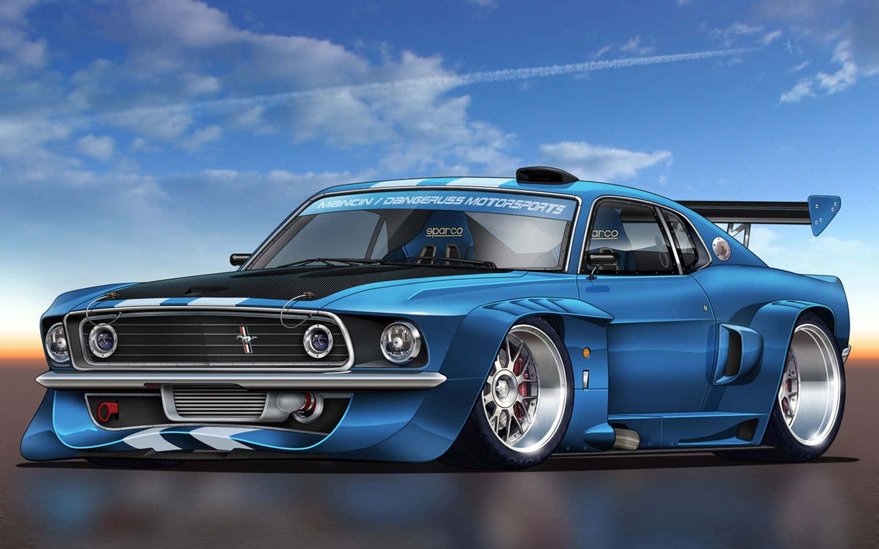
Expected Outcome/ Benefits:-
Users will get vision of thier budget friendly and the fitest car for thier need.
This will help users to get more knowlegde about cars.
It will help users to know more about the experience of others who own the same car they are planning to buy for.
We will gain to know more about the iconic stories of the cars.

Slide 8
Refrences
https://www.ibm.com/topics/machine-learning
https://www.mongodb.com/mern-stack
Amit Kumar Singh, Pawan Kumar, and Ankit Pandey, A Study on Customer Perception towards Online Car Websites in India, International Journal of Advanced Research in Computer Science and Software Engineering (IJARCSSE), Vol. 8, Issue 2, February 2018
CarDekho (https://www.cardekho.com/)
CarWale (https://www.carwale.com/)

Slide 9


