Slide 1
COMPUTER ARCHITECTURE PROJECT: 2
MEHAK (MXL200018)
ARPITA ANIL KUMANE (AXK200011)

Slide 2
PART 1 : CACHES AND SETUP
CACHES:
A cache is a reserved storage location that collects temporary data to help websites, browsers, and apps load faster.
The CPU and hard drive often use a cache, as do web browsers and web servers.
A cache is made up of many entries, called a pool.
IMPORTANCE:
Purpose of cache memory - store program instructions and data that are used repeatedly in the operation of programs or information that the CPU is likely to need next. Fast access to the instructions increases the overall speed of the program.
Cache can be used for writing (write cache) and reading (read cache) or a combination of both (hybrid cache)
SETUP:
Gem based simulator for x86 microprocessor running on Ubuntu 18.04 Operating System. On personal laptop

Slide 3
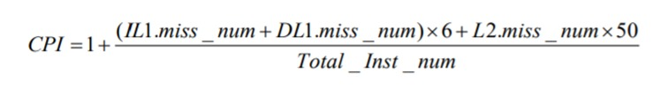
PART 2- FINDIND CPI
Where:
L1i_miss_num = miss rate in the L1 instruction cache
DL1d_miss_num = miss rate in the L1 data cache
L2_miss_num = miss rate in the L2 cache.
Total_inst_num= Total number of instruction in cache

Slide 4
PART 2: CPI CALCULATIONS
IL1 miss_num = Icache x Icache_access
DL1miss_num = Dcache x Dcache_access
L2miss_num = L2 x L2_access
Total_inst_num = 500000000
By using the following formula,
CPI = (Icache X Icache_access + Dcache x Dcache_acess) x 6 + (L2 x L2_access) x 50
Total_Inst_num

Slide 5
PART 2 : BENCHMARK CALCULATION
FOR 458.sjeng
Cache line size = 32
L2size = 1 MB
L2 associativity = 1
CPI = (0.000025 x 33951661 + 0.234676 x 24001539) x 6 + (0.999807 x 5633460) x 50
500000000
CPI = 1.6308
FOR 470.lbm
Cache line size = 32
L2 Size = 1MB
L1 Size= 256KB
CPI = (0.000001 x 740208217+ 0.054277 x 216142304) x 6 + (0.997169 x 13893985) x 50
500000000
CPI = 2.5521

Slide 6
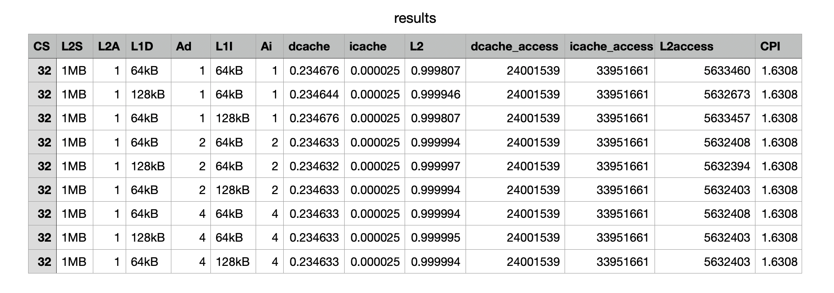
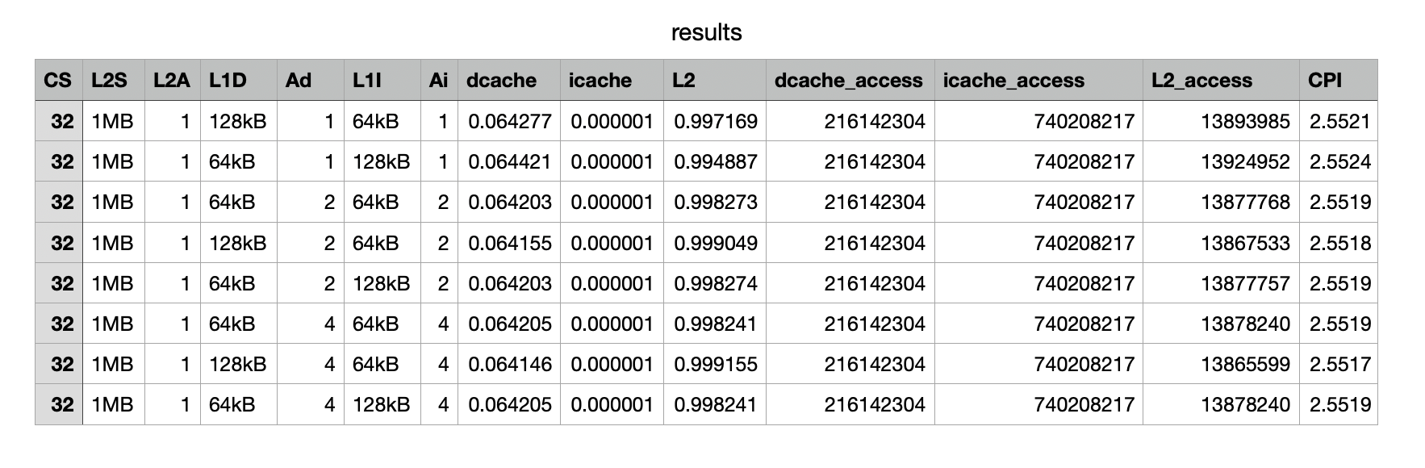
PART 2 : RESULTS FOR MULTIPLE COMBINATIONS:
FOR 458.sjeng
FOR 470.lbm

Slide 7
PART 3: Effect of Cache block size on CPI
FOR BENCHMARK 470.lbm
Gem5 simulation tool was used to vary the cache block size from 32bytes to 256bytes. Below table shows the values.
Cache line size | D_cache miss rate | i_cache miss rate | L2 miss rate | Dcache_ access | Icache_ access | L2_access | CPI
32 | 0.064146 | 0.000001 | 0.998775 | 216142304 | 740208217 | 13865599 | 2.5512
64 | 0.033141 | 0.000001 | 0.997791 | 216142294 | 740208217 | 7163710 | 1.8007
128 | 0.017602 | 0.000000 | 0.998076 | 216142288 | 740208217 | 3804879 | 1.4254
256 | 0.009105 | 0.000000 | 0.997908 | 216142285 | 740208217 | 1968241 | 1.2200
The optimal configuration for lowest CPI is for cache line size = 256, L2 Size= 1 MB , L1 Size = 128 KB

Slide 8
PART 3: Effect of Cache block size on CPI (Contd..)
X-axis-Cache line size(in bytes)
Y-axis - CPI
.As it can be seen from the graph, the cache block size reduces the CPI until an extent.
• Beyond a certain point, increasing block size doesn’t add value.

Slide 9
PART 3: Effect of Cache block size on CPI (Contd..)
FOR BENCHMARK 458.sjeng:
Cache line size | D_cache miss rate | I_cache miss frate | L2 miss rate | Dcache_ access | Icache_ access | L2_access | CPI
32 | 0.234676 | 0.000024 | 0.999807 | 24001539 | 33951661 | 5633460 | 1.6308
64 | 0.117325 | 0.000015 | 0.999990 | 24001533 | 33951661 | 2816502 | 1.3154
128 | 0.058668 | 0.00010 | 0.999998 | 24001532 | 33951661 | 1408446 | 1.1577
256 | 0.029338 | 0.000006 | 0.999970 | 24001532 | 33951661 | 704375 | 1.0788
The optimal configuration for lowest CPI for cache line size=256, L2 Size= 1M, L1 Size= 128KB

Slide 10
PART 3: Effect of Cache block size on CPI (Contd..)
X -axis- Cache line size (in bytes)
Y-axis - CPI
.As it can be seen from the graph, the cache
block size reduces the CPI until an extent.
• Beyond a certain point, increasing block size doesn’t add vale.

Slide 11
PART3: Effect of Associativity on CPI
Increasing the associativity reduces the miss rate by taking advantage of spatial locality.
But improving one aspect of cache comes at the expense of another. Higher associativity increases hit time, thereby having less net impact on a fixed sized cache.
CPI remains same as we change the associativity.

Slide 12
PART 3: Effect of Associativity on CPI (Contd..)
X-Axis- L1 Associativity
Y-Axis- CPI
X-Axis- L2 Associativity
Y-axis- CPI

Slide 13
PART 4 : Defining a cost function
Unified L1 cache is the most expensive block. Increasing the size increases cache cost.
In L1, associativity also affects the pricing. Higher associativity is more expensive.
Cost of L2 cache. L2 is cheaper compared to L1.
Cost of CPU. The Timing Simple – the simplest CPU, with no pipeline
Minor CPU – In order execution.

Slide 14
Part 4 – Defining a cost function (Contd..)
L1 cache is made of SRAM, which has lowest access time.
The L1 cache can be priced per 8kB blocks. $5 is fixed for increase in every 8kB of L1 cache.
Size of L1 Cache(I and D) | Cost per block
32KB | $20
64KB | $40
128KB | $80
256KB | $160

Slide 15
PART 4: Defining cost function(contd..)
Cost of L2 cache is lower as it is placed away from the chip.
L2 cache is shared by multiple cores and can be larger than L1.
L2 cache is cheaper than L1.
L2 cache size | Cost per 256 KB
256KB | $10
512KB | $20
1MB | $40

Slide 16
PART 5: CPI vs COST
Considering the evaluation function as :
Cost x (CPI - 1)^2 = constant
It is defined such that cost and CPI are inversely proportional to each other. Constant value depends on CPU type and architecture overhead, which we will be ignoring in our case as all the parameters are same.
Defining the Cost function as:
Cost = A x (Size of L1 + associativity) + B x(size of L2 + associativity)

Slide 17
PART 5 : CPI vs COST (Contd..) F0R BENCHMARK 458.sjeng:
Size of L1 | Associativity | Size of L2 | CPI | Cost in dollars
64KB | 1 | 1MB | 1.6308 | 40+0+40 = $80
128KB | 2 | 1MB | 1.6309 | 80+4+40=$124
64KB | 2 | 1MB | 1.6306 | 40+4+40=$84
128KB | 4 | 1MB | 1.6307 | 80+8+40=$128
64KB | 4 | 1MB | 1.6308 | 40+8+40=$88
64KB | 2 | 256KB | 1.6208 | 40+4+10=$54
128KB | 4 | 256KB | 1.6508 | 80+8+10=$98
64KB | 4 | 256KB | 1.5908 | 40+8+10=$58
64KB | 2 | 521KB | 1.6308 | 40+4+20=$64
128KB | 4 | 512KB | 1.6318 | 80+8+20=$108
X-axis-CPI
Y-Axis- Cost (in dollars)

Slide 18
FOR BENCHMARK 470.lbm:
Size of L1 | ASSOCIATIVITY | SIZE OF L2 | CPI | COST
64KB | 2 | 1MB | 2.5513 | 40+4+40=$84
128KB | 2 | 1MB | 2.5517 | 80+4+40=$124
64KB | 4 | 1MB | 2.5515 | 40+8+40=$88
128KB | 4 | 1MB | 2.5513 | 80+8+40=$128
64KB | 2 | 512KB | 2.5524 | 40+4+20=$64
128KB | 2 | 512KB | 2.5523 | 80+4+20=$104
64KB | 4 | 512KB | 2.5524 | 40+8+20=$68
X-axis-CPI
Y-Axis- Cost (in dollars)

