Slide 1

BIG DATA ANALYTICS | MINI PROJECT
0.977
Real-Time Financial Fraud Detection Lakehouse
ROC-AUC
Using Distributed Streaming and Machine Learning
Kafka → PySpark → Delta Lake → Random Forest → Streamlit
67.4%
65.3%
Bhumika Raut – 23070521221
Arpita Mahakalkar – 23070521020
Computer Science and Engineering, Batch 2023–2027
Symbiosis Institute of Technology, Nagpur
Guided by: Dr. Dharmaveer Chaudhary
Precision
Recall
Repository-reported, temporal hold-out
Notes:
Good morning. We are Bhumika Raut and Arpita Mahakalkar. Our mini project is a real-time financial fraud detection lakehouse: transactions flow through Kafka, are processed by PySpark Structured Streaming into Delta Lake tables, scored by a Random Forest combined with rules, and shown on a Streamlit dashboard. The circles show the repository-reported evaluation on simulated data.

Slide 2
Agenda
1
Concepts
2
Architecture
Fraud problem, objectives, why streaming
System design, tech stack, Kafka, Delta layers
3
Features
4
Model
Quality, windows, user state, rules
Random Forest, hybrid decision
5
Results
6
Wrap-up
Metrics, benchmark, dashboard, Spark UI
Reliability, limits, future scope, conclusion
Notes:
Six parts: the concepts, the architecture, the feature engineering, the model and hybrid decision, the results, and finally reliability, limitations and conclusion.

Slide 3




Why real-time fraud detection matters
The problem
Payments produce a continuous stream of events. A transaction can look normal alone but be suspicious against the user's history, the last ten minutes, or a sudden device change. Detection must happen while the stream flows, and the system must survive restarts.
History
Velocity
Amount far above the user's own average
Many transactions in a few minutes
Device
Merchants
New or changing device with high amount
Unusually many different merchant types
Notes:
Fraud is both stateful and time-sensitive. These four signals are exactly what our pipeline measures: history, velocity, device change and merchant diversity.

Slide 4






Project objectives
1
2
3
Ingest
Validate
Engineer features
Synthetic transactions into Kafka
Bronze, Silver, quarantine
Windows + per-user state
4
5
6
Train
Decide
Monitor
Random Forest, temporal split
Hybrid ML + rules, explainable
Dashboard, Spark UI, tests
Notes:
Six objectives, one per stage of the pipeline. Each following section maps to one of them.

Slide 5





Why streaming and PySpark
Event time
Watermark
Sliding windows
User state
Delta Lake
Uses the transaction's own timestamp, not arrival time
5 minutes: bounds state, tolerates late events
10-minute windows, 2-minute slide
applyInPandasWithState, one record per user
ACID tables, idempotent writes
A single user remains one logical state key, so user_id is deliberately not salted: salting would split one person's fraud history.
Notes:
These are the Spark features the project uses. The last line explains a design decision: we do not salt the user key because that would split one customer's history into several wrong histories.

Slide 6
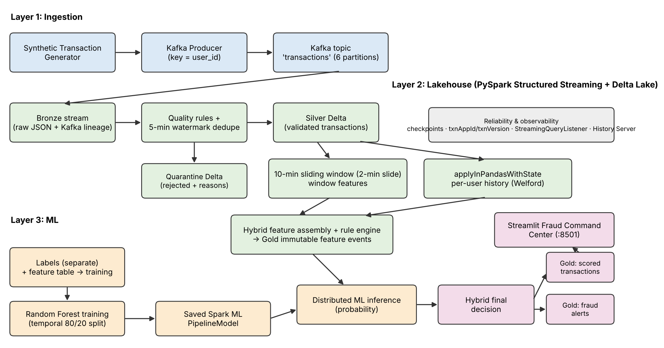
System architecture
Figure: end-to-end architecture drawn from repository code and docs/architecture.md
Notes:
Three layers. Ingestion: generator, producer, Kafka topic with six partitions keyed by user. Lakehouse: Bronze raw, quality and dedupe into Silver with quarantine, then window features and per-user state, assembled into Gold feature events. ML: Random Forest trained offline on a temporal split, loaded for distributed inference, then the hybrid decision writes scored transactions and alerts which the Streamlit dashboard reads.

Slide 7
One transaction, end to end
1
2
3
4
5
6
7
Generate
Bronze
Validate
Features
Score
Decide
Show
Producer sends JSON; key = user_id
Raw JSON + Kafka offset
11 rules; dedupe 5-min
Window + user history
Random Forest probability
Flag, severity, reasons
Gold tables → dashboard
Invalid events go to a quarantine table with reasons. The current transaction is compared with the user's state before it updates that state.
Notes:
Follow one transaction: it is produced to Kafka, stored raw in Bronze, validated and deduplicated, enriched with window and history features, scored by the model, given a final decision, and stored in Gold for the dashboard. Bad records go to quarantine; they are never silently lost.

Slide 8
Technology stack
Component | Role | Why
Apache Kafka 4.3.1 | 6-partition topic, key = user_id | Replayable, partitioned ingestion
PySpark / Spark 3.5.9 | Streaming, windows, state, MLlib | Distributed event-time processing
Delta Lake | Bronze, Silver, Gold, quarantine | ACID, idempotent writes
Spark MLlib | Imputer, encoder, Random Forest | One persisted PipelineModel
Streamlit | Fraud Command Center :8501 | Lightweight Python UI
Spark History Server | Jobs, stages, executors :18080 | Spark-level observability
Docker Compose | Broker, streams, dashboard | Reproducible, restart policies
Notes:
Each tool has one job. Kafka transports events, Spark computes, Delta stores reliably, MLlib trains and scores, Streamlit shows results, Docker runs everything together.

Slide 9
Kafka ingestion and the data contract
Producer
Topic 'transactions' · 6 partitions · key = user_id
Bronze stream
0
1
2
3
4
5
Field | Type | Description
transaction_id | string | Unique identifier
user_id | string | Customer; also Kafka key
timestamp | timestamp | Event time
amount | double | Transaction amount
merchant_category | string | Merchant type
device_id | string | Device used
No label leakage
Labels (is_fraud_simulated, fraud_type) never enter Kafka. Ground truth is stored separately and joined only for training.
Generator defaults: fraud 2%, duplicates 1%, late events 3% + 1%
Notes:
The generator creates synthetic transactions with six fields only. Keying by user keeps one user's events in one partition. The fraud labels are never put into Kafka; they live in a separate ground-truth table used for training only.

Slide 10
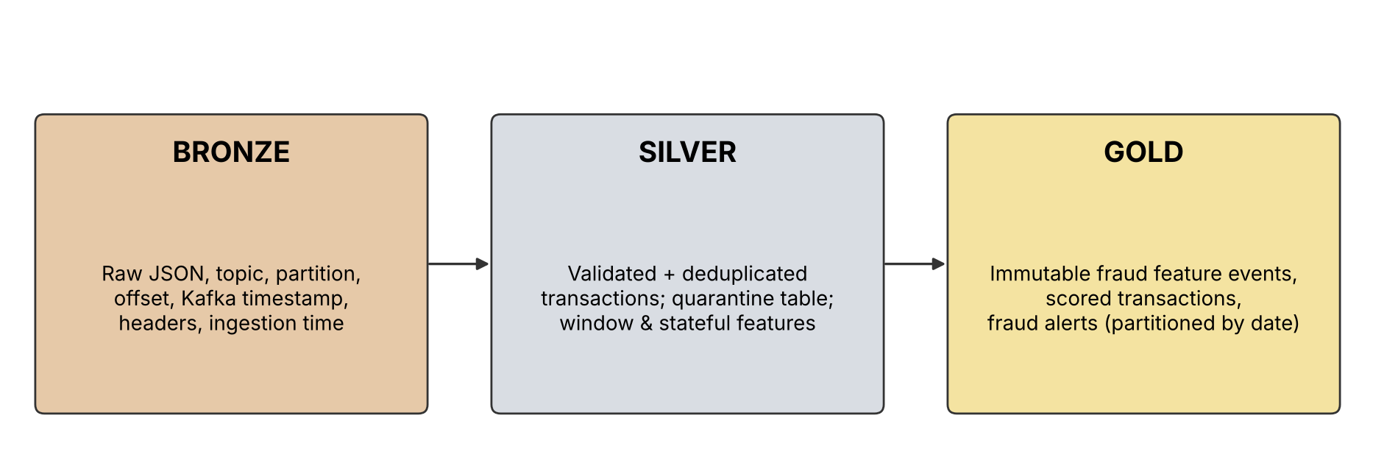
Bronze – Silver – Gold lakehouse
Bronze
Silver
Gold
Raw JSON with topic, partition, offset, Kafka timestamp. Replay and audit. 5-second trigger, up to 5,000 offsets per batch.
Validated, deduplicated transactions; quarantine table; window and stateful features.
Immutable feature events, scored transactions and fraud alerts, partitioned by event date.
Notes:
The medallion pattern keeps raw evidence, validated data and serving data separate. Bronze is replayable, Silver is trustworthy, Gold is ready for serving. Gold feature events are append-only so they can be read as a normal stream.

Slide 11
Data quality, deduplication and quarantine
11 validation rules (all failures recorded)
Valid → Silver
INVALID_JSON
MISSING_TRANSACTION_ID
Watermark 5 min + dropDuplicatesWithinWatermark on transaction_id bounds dedupe memory.
MISSING_USER_ID
MISSING_EVENT_TIMESTAMP
MISSING_AMOUNT / NAN_AMOUNT
NON_POSITIVE_AMOUNT
Invalid → Quarantine
EXCESSIVE_AMOUNT (> 1,000,000)
MISSING_MERCHANT_CATEGORY
Kept with Kafka lineage and reasons. Suspicious but valid transactions (e.g. a large purchase) continue to the fraud engine.
MISSING_DEVICE_ID
TIMESTAMP > 5 min in future
Notes:
Every Bronze record is checked against eleven rules and all failures are stored. Invalid ones are quarantined, not discarded. A suspicious-looking but structurally valid transaction is not rejected, because the fraud engine should see it.

Slide 12
Behavioural feature engineering
Sliding window (per user)
Persistent user state
10-minute window, 2-minute slide, 5-minute watermark
Count, total, average, max, std of amount
Transactions and spend per minute
Unique devices and merchant categories
applyInPandasWithState, one record per user
Count, mean, variance, last time, last device
Historical z-score and amount ratio
Inactivity timeout 30 min (default)
Welford online update (O(1) memory)
n ← n + 1; δ ← x − μ; μ ← μ + δ / n; M2 ← M2 + δ (x − μ); s² = M2 / (n − 1)
History is read before the current transaction updates the state, so a transaction never influences its own baseline.
Notes:
Two complementary views. Windows capture the last ten minutes of activity. The per-user state captures long-term behaviour using Welford's algorithm, which updates mean and variance without storing every past transaction. The important point is that we read the history first and update afterwards.

Slide 13
Rule engine: weighted fraud signals
Rule | Weight | Default trigger
Historical amount anomaly | 3 | Amount abnormal versus user history
Extreme z-score | 2 | z-score ≥ 3.0
High amount ratio | 2 | Amount ÷ historical mean ≥ 3.0
High velocity | 2 | ≥ 5 transactions in 10 minutes
Device change + high amount | 2 | Device changed and ratio ≥ 2.0
Multi-device activity | 1 | Several devices in window
High merchant diversity | 1 | Diversity ratio ≥ 0.80
Rapid repeat | 1 | Rapid repeat transactions
14
maximum rule score
Rule flag at score ≥ 4
All thresholds are read from environment variables and can be tuned without code changes.
Notes:
Eight transparent signals, each with a weight. The sum is the fraud rule score. At four or more the rule flag is raised. These weights and thresholds are hand-set defaults, which we list as a limitation.

Slide 14



Random Forest training pipeline
Features
Imputer
Encode
Assemble
Random Forest
20 numeric + 6 flags
Median
Merchant one-hot
Vector
200 trees, depth 10
Class weights
Temporal split
Saved pipeline
Fraud is rare, so each training row is weighted by inverse class frequency.
Train on events up to the 80th time percentile, test on later events. No future leakage.
The whole PipelineModel is persisted and loaded once by the live scoring stream.
Notes:
The Spark ML pipeline imputes missing values, one-hot encodes merchant category, assembles the features and trains a 200-tree Random Forest with subsampling 0.8 and seed 42. We handle imbalance with class weights and evaluate on a later time period instead of a random split.

Slide 15
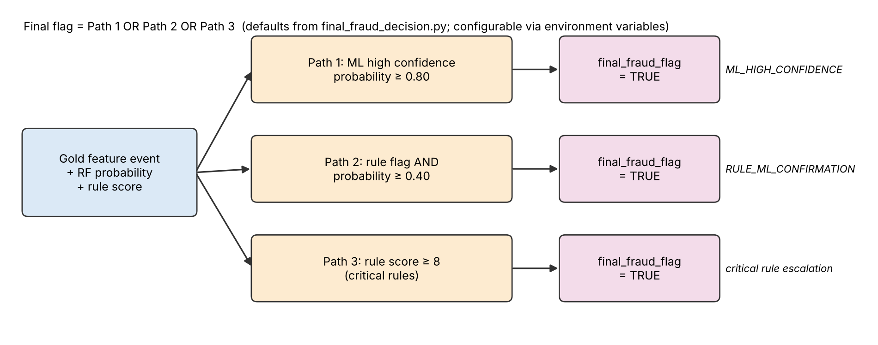
Hybrid final decision
Severity
Decision basis
Explainable
LOW, MEDIUM, HIGH, CRITICAL
ML_HIGH_CONFIDENCE, RULE_ML_CONFIRMATION, critical rules
fraud_reasons lists the active rule signals
Notes:
A transaction is flagged if the model alone is highly confident, or if a rule flag is confirmed by a moderate probability, or if the rule score is critical. Every alert carries severity, the path that triggered it, and human-readable reasons. All thresholds are configurable.

Slide 16
Model evaluation (repository-reported)
0.9772
ROC-AUC: strong ranking of fraud above normal
Accuracy misleads
About 5% of the test set is fraud. Predicting 'never fraud' would already score 94.75% accuracy, so precision, recall and PR-AUC matter more.
Notes:
These values are quoted from the repository's model-evaluation output; we did not independently re-run training. ROC-AUC is very high, but PR-AUC is 0.70, which is the more honest view on imbalanced data. Accuracy of 96.4 percent is only slightly above the 94.75 percent we would get by never predicting fraud.

Slide 17
Where the mistakes happen
Actual \ Predicted | Not fraud | Fraud
Not fraud | 1,628 | 33
Fraud | 30 | 62
65.3%
67.4%
0.663
Precision 62 / 95
Recall 62 / 92
F1-score
Precision–recall trade-off
30 missed frauds = direct financial loss
33 false alerts = customer friction
Lower threshold: higher recall, more false alerts
Teal = correct; coral = errors. Total 1,753; fraud 92 (5.25%).
Offline metrics on synthetic data; not proof of live performance.
Notes:
62 frauds caught, 30 missed, 33 false alarms and 1,628 correctly passed. Precision is 62 over 95, recall is 62 over 92. These numbers are consistent with each other. The hold-out contains only 92 fraud cases, so the uncertainty is wide, and the data is synthetic.

Slide 18
Benchmark: choosing shuffle partitions
4
partitions selected (baseline 8)
What it shows
All settings met the 5 s trigger budget
Balanced P95: 1,066 ms at 4 partitions
A hot user is still one state key, so more partitions did not help
Notes:
We measured four, eight, sixteen and thirty-two shuffle partitions on a single local node, with balanced traffic and with ninety percent of traffic from one user. Four partitions gave the highest throughput in both cases and was selected. These are local figures, not cluster results.

Slide 19
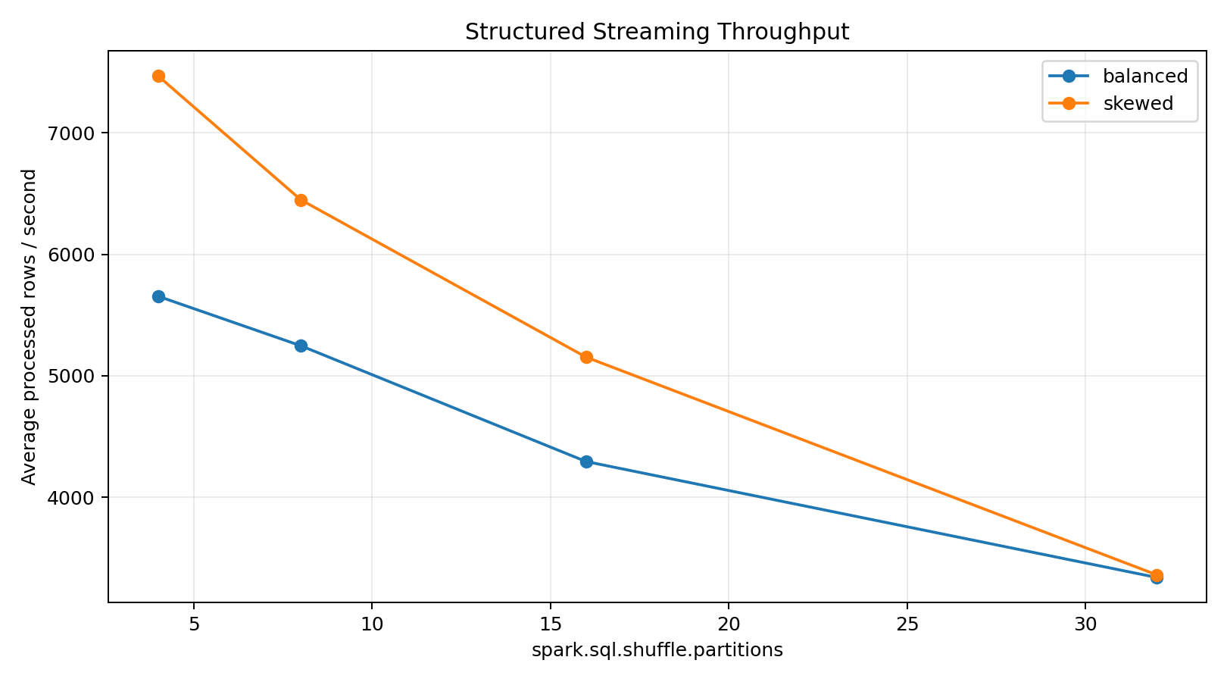
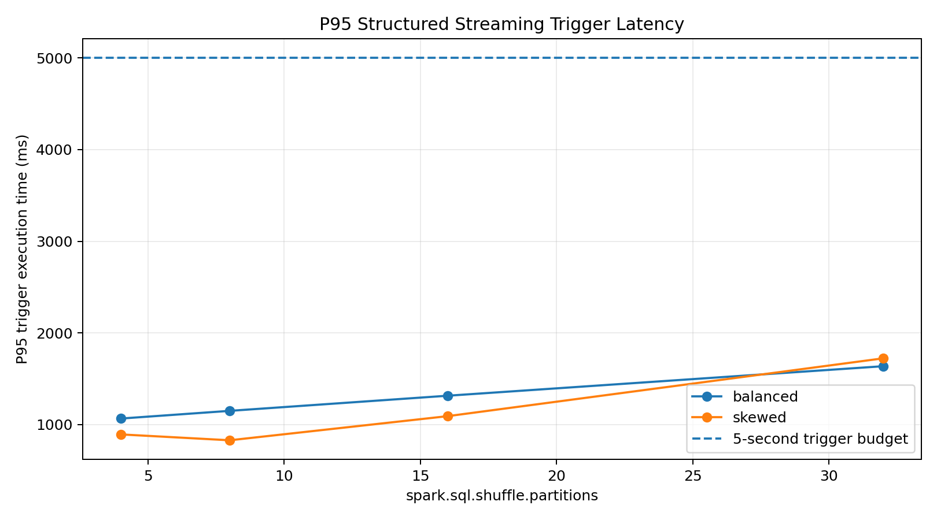
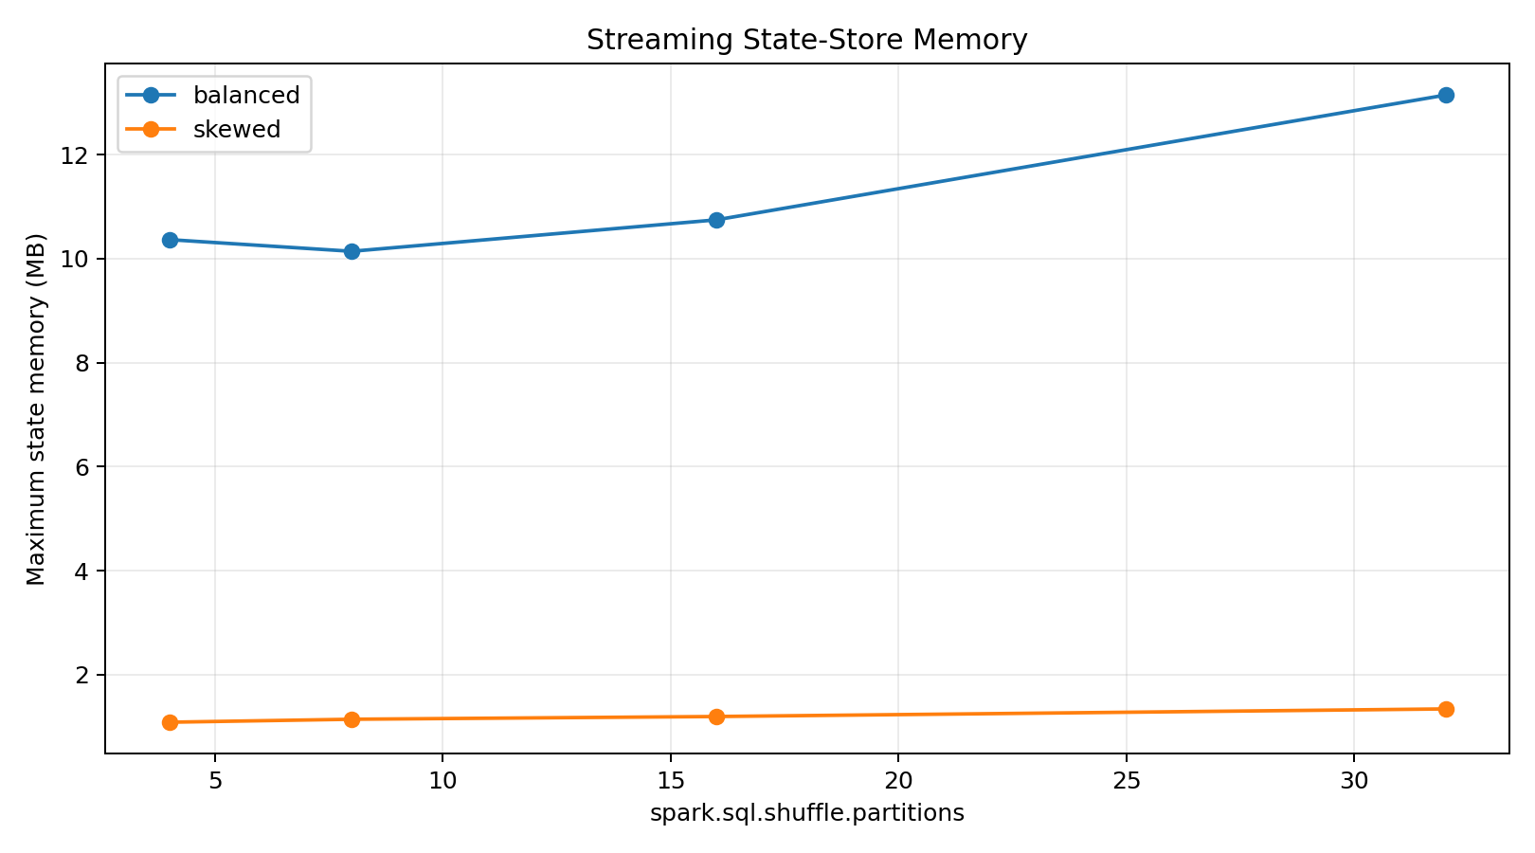
Benchmark charts from the repository
Throughput
P95 trigger latency
State-store memory
Workload | Partitions | Rows/s | P95 (ms) | State MB
balanced | 4 / 8 / 16 / 32 | 5,655 / 5,248 / 4,295 / 3,340 | 1,066 / 1,150 / 1,315 / 1,637 | 10.4 / 10.1 / 10.7 / 13.1
skewed | 4 / 8 / 16 / 32 | 7,469 / 6,450 / 5,154 / 3,362 | 893 / 829 / 1,092 / 1,723 | 1.09 / 1.14 / 1.20 / 1.34
Notes:
These are the three charts stored in the repository, with the full numbers underneath. Throughput falls as partitions increase; state memory is largest at 32 partitions in the balanced run.

Slide 20
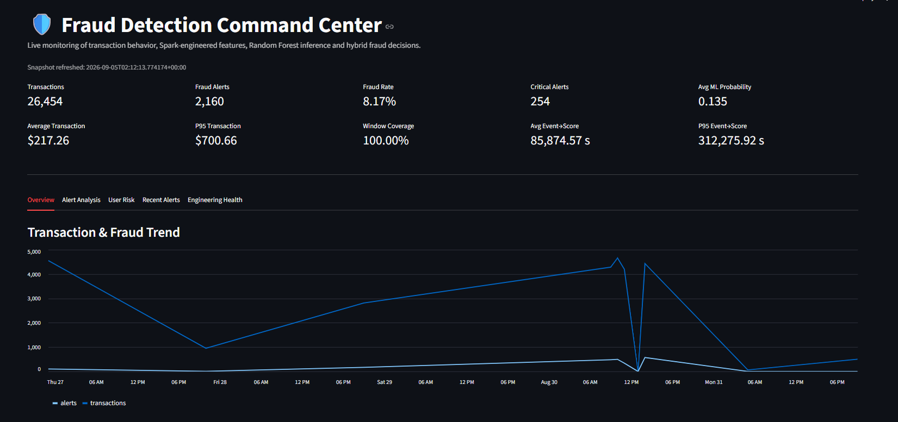
Fraud Command Center: overview
26,454
transactions in snapshot
2,160
fraud alerts (8.17%)
Replayed demo stream: alert rate is not precision. 254 critical alerts, 1,969 users.
Notes:
This is the real dashboard screenshot from the repository, taken from a demonstration run on simulated data. The 8.17 percent alert rate counts all flagged transactions in a replayed stream including false positives, so it should not be read as the model's precision.

Slide 21
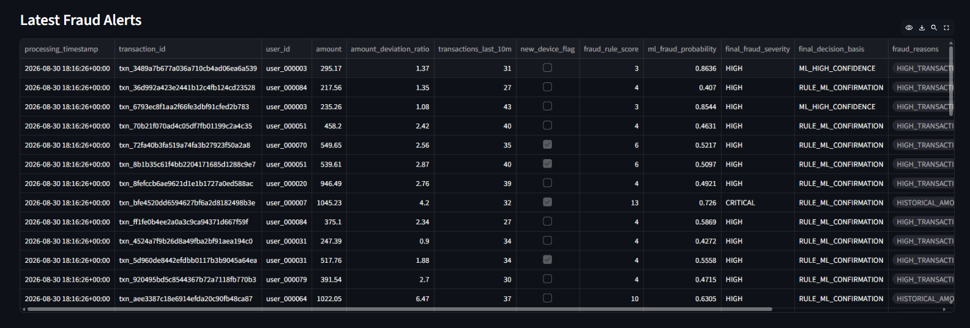
Explainable fraud alerts
CRITICAL example
ML path
Columns
user_000007, amount 1,045.23, ratio 4.2, rule score 13, ML probability 0.726 → RULE_ML_CONFIRMATION
Alerts with probability 0.86 used ML_HIGH_CONFIDENCE
Amount, deviation ratio, 10-min count, device flag, rule score, probability, severity, basis, reasons
Notes:
Each alert shows why it was raised: amount, deviation from history, ten-minute velocity, device flag, rule score, model probability, severity and decision path. This is what makes the hybrid design explainable to an analyst.

Slide 22
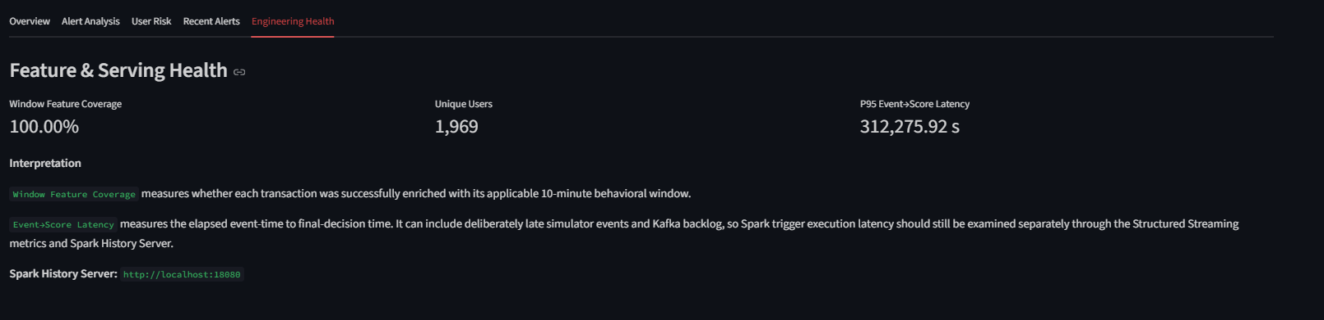
Engineering health tab
100%
1,969
Not Spark latency
Event-to-score time includes deliberately late replayed events and Kafka backlog; trigger latency is benchmarked separately
window-feature coverage
unique users in snapshot
Notes:
The engineering health tab reports feature coverage and event-to-score latency. The very large latency value comes from replayed late events and backlog in the demonstration, which the dashboard itself explains, so we do not treat it as Spark latency.

Slide 23
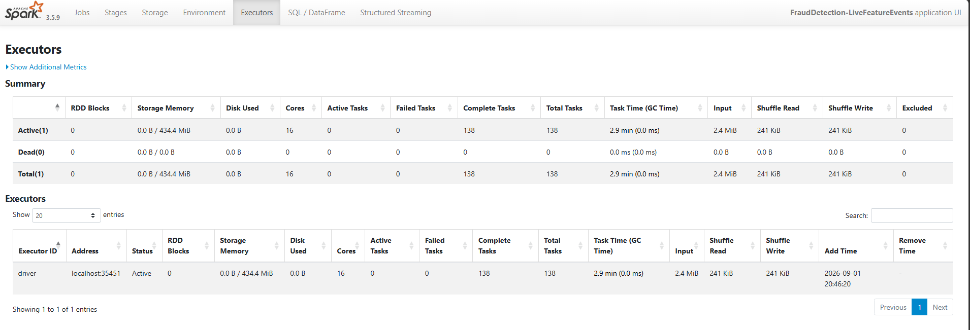
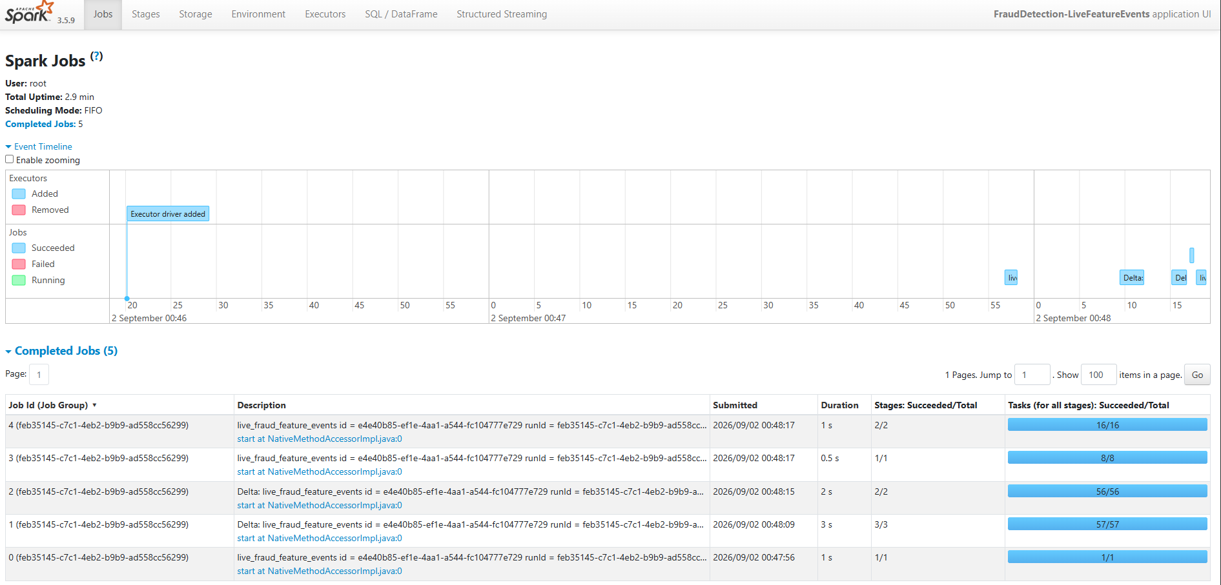
Spark History Server evidence
Executors
1 active executor, 16 cores
138 complete tasks
0 failed tasks
Jobs: 5 completed, all stages succeeded
Notes:
Spark History Server screenshots from the FraudDetection-LiveFeatureEvents application: five completed jobs and one executor with 138 completed tasks and no failed tasks. This shows those jobs ran without task failures; it does not by itself prove overall correctness.

Slide 24






Reliability, testing and deployment
Checkpoints
Idempotent writes
Quarantine
Offsets and state restored after restart
Delta txnAppId + txnVersion
Bad events kept with reasons
Docker
Observability
Tests
restart: unless-stopped, health checks
StreamingQueryListener + History Server
7 test functions: 5 unit + 2 integration
Tests cover Welford statistics, quality rules, final decision, checkpoint recovery and Delta idempotency. Results were not re-run for this report.
Notes:
Docker restarts a failed process; Spark checkpoints restore progress and state. Delta transaction identifiers make retried writes safe. The repository has seven test functions, but we have not re-run them, so we make no pass or fail claim.

Slide 25
Limitations and future scope
Limitations
Future scope
Synthetic data from a simulator
Only 92 fraud cases in the hold-out; no confidence intervals
Precision 0.65 and recall 0.67: false alerts and misses
Hand-set rule weights; uncalibrated probabilities
Single-node benchmark, not a cluster
Metrics not reproducible without re-training
Test on real or public transaction data
Gradient-boosted trees and probability calibration
Drift monitoring and scheduled retraining
Multi-node cluster and larger hot-key tests
Alert delivery and analyst feedback loop
Dashboard authentication and field encryption
Notes:
We are open about the limits: the data is synthetic, the evaluation set is small and the benchmark is local. Future work moves toward real data, better models and a cluster.

Slide 26
Conclusion
0.977
65% / 67%
4
3
ROC-AUC
precision / recall
shuffle partitions chosen
alert decision paths
Kafka, PySpark and Delta Lake form a Bronze–Silver–Gold pipeline with quarantine
Window and Welford user-state features feed a Random Forest and a rule engine
Hybrid decisions are explainable; recovery is checkpointed and idempotent
All results are from synthetic data; real-data validation is future work
Thank you | Questions?
Notes:
To conclude: an integrated, containerised, real-time fraud detection platform with explainable hybrid decisions and measured performance. The main caveat is that everything is evaluated on synthetic data. Thank you; we are happy to take questions.

