Slide 1
FlyEasy-Airlines (Final)
Online Airline Reservation Program
Prepared for submission

Slide 2
Objective
Build a transactional, console-based airline booking prototype using Java and MySQL.

Slide 3
Architecture
Console Java App -> JDBC -> MySQL
Key components: Models, DAOs, BookingService (transactional), Main (UI)

Slide 4
Database Schema
Tables: flights, passengers, bookings
Bookings references flights and passengers with foreign keys.

Slide 5
Key Java Classes
DBConnection, Flight, Passenger, FlightDAO, BookingDAO, BookingService, Main

Slide 6
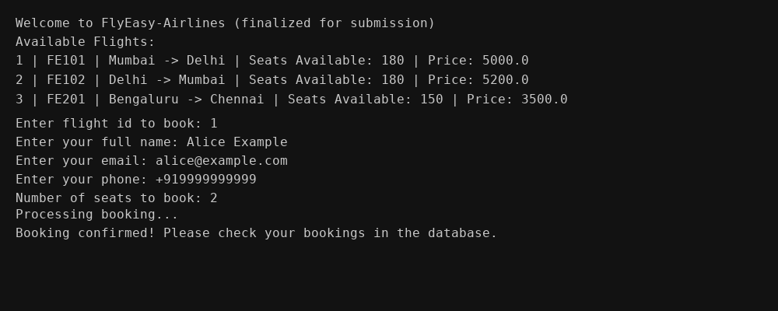
Demo: Booking Flow (terminal)

Slide 7
How to Run
1. Load SQL schema
2. Update DB credentials in DBConnection.java
3. Build with Maven: mvn clean package
4. Run the app: java -cp target/...jar com.flyeasy.Main

Slide 8
Submission Checklist
1. Presentation (this PPTX)
2. GitHub repository with code & README
3. SQL schema file
4. Instructions to run

Slide 9
Repository
GitHub Repository:
https://github.com/Arpita100906/FlyEasy-Airlines

