Slide 1

Fractal Forge
Arpita Jitendra Sonparote
Aditya Vilas Kandle
Ritesh Auodumbar Debadwar
Email id: arpita.j.sonparote2317@gmail.com
Shri Guru Gobind Singhji Institute of Engineering and Technology, Nanded

Slide 2
Banking Customer Churn Prediction
The objective of this project is to predict customer churn in a banking context using detailed customer profile, behavioral, transactional, digital engagement, complaint, and marketing response data. Given historical customer data with 8,101 labeled records and a separate test set of 2,026 records without labels, the goal is to build a robust machine learning model that can accurately identify customers who are likely to close their accounts or become inactive in the upcoming period.
The dataset spans 97 features across multiple dimensions, including customer demographics, account activity, product holdings, credit and loan behavior, digital banking usage, service complaints, and retention interactions. The final solution must generate churn predictions and probabilities for the test set, while ensuring strong predictive performance, minimal data leakage, and clear business interpretability for decision-making.

Slide 3
Project Goals
Develop an end-to-end machine learning pipeline for banking customer churn prediction using customer demographic, transactional, digital engagement, and complaint data.
Identify customers who are likely to leave the bank and enable proactive customer retention strategies.
Perform exploratory data analysis and feature engineering to uncover key behavioral patterns influencing churn.
Optimize the model for high Recall, F2-score, and PR-AUC to maximize churn detection capability and reduce missed churn cases.
Compare multiple machine learning algorithms and select the best-performing model based on business-oriented evaluation metrics.
Generate actionable business insights and churn probability predictions to help banks improve customer retention and reduce revenue loss.

Slide 4
Dataset Overview and Tech Stack
Dataset Used:
The project uses the ChurnZero Banking Customer Dataset, designed for predicting customer churn behavior in the banking sector.
Dataset Information:
Total Records: 8,101 customers
Test Records: 2,026 customer
Total Features: 97
Target Variable: churn
Problem Type: Binary Classification
Target Variable
0 → Customer Retained
1 → Customer Churned
Programming Language: Python
Libraries & Tools
Pandas
NumPy
Matplotlib
Seaborn
Scikit-learn
Joblib
ML Techniques Used
Data Preprocessing
Missing Value Handling
Feature Engineering
Feature Scaling
One-Hot Encoding
Model Training & Evaluation
Hyperparameter Tuning
Threshold Optimization
Model Comparison
Feature Importance Analysis
Churn Probability Prediction

Slide 5
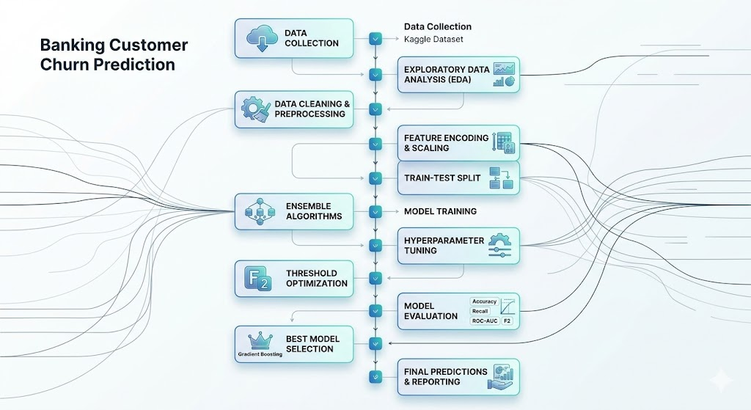
Project Workflow

Slide 6
Data Cleaning and Preprocessing
Data Cleaning:
Missing values in numerical features were handled using median imputation to preserve data distribution.
Duplicate records and irrelevant identifiers like customer_id were removed to avoid bias in modeling.
Data was reviewed for consistency to ensure reliable input for analysis.
Preprocessing:
Categorical variables were transformed using one-hot encoding to convert them into machine-readable format.
Binary encoding was applied to features like gender for simplicity.
Numerical features were standardized using StandardScaler to ensure uniform scaling across variables.
Dataset was split into training and testing sets using stratification to maintain class balance.
Outcome:
The dataset was cleaned, encoded, and scaled into a structured format, making it suitable for training machine learning models with improved stability and performance.

Slide 7
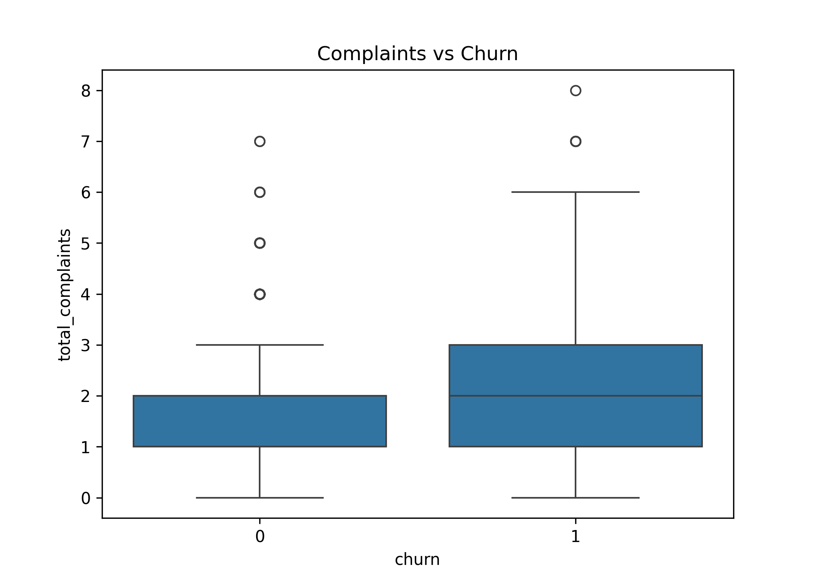
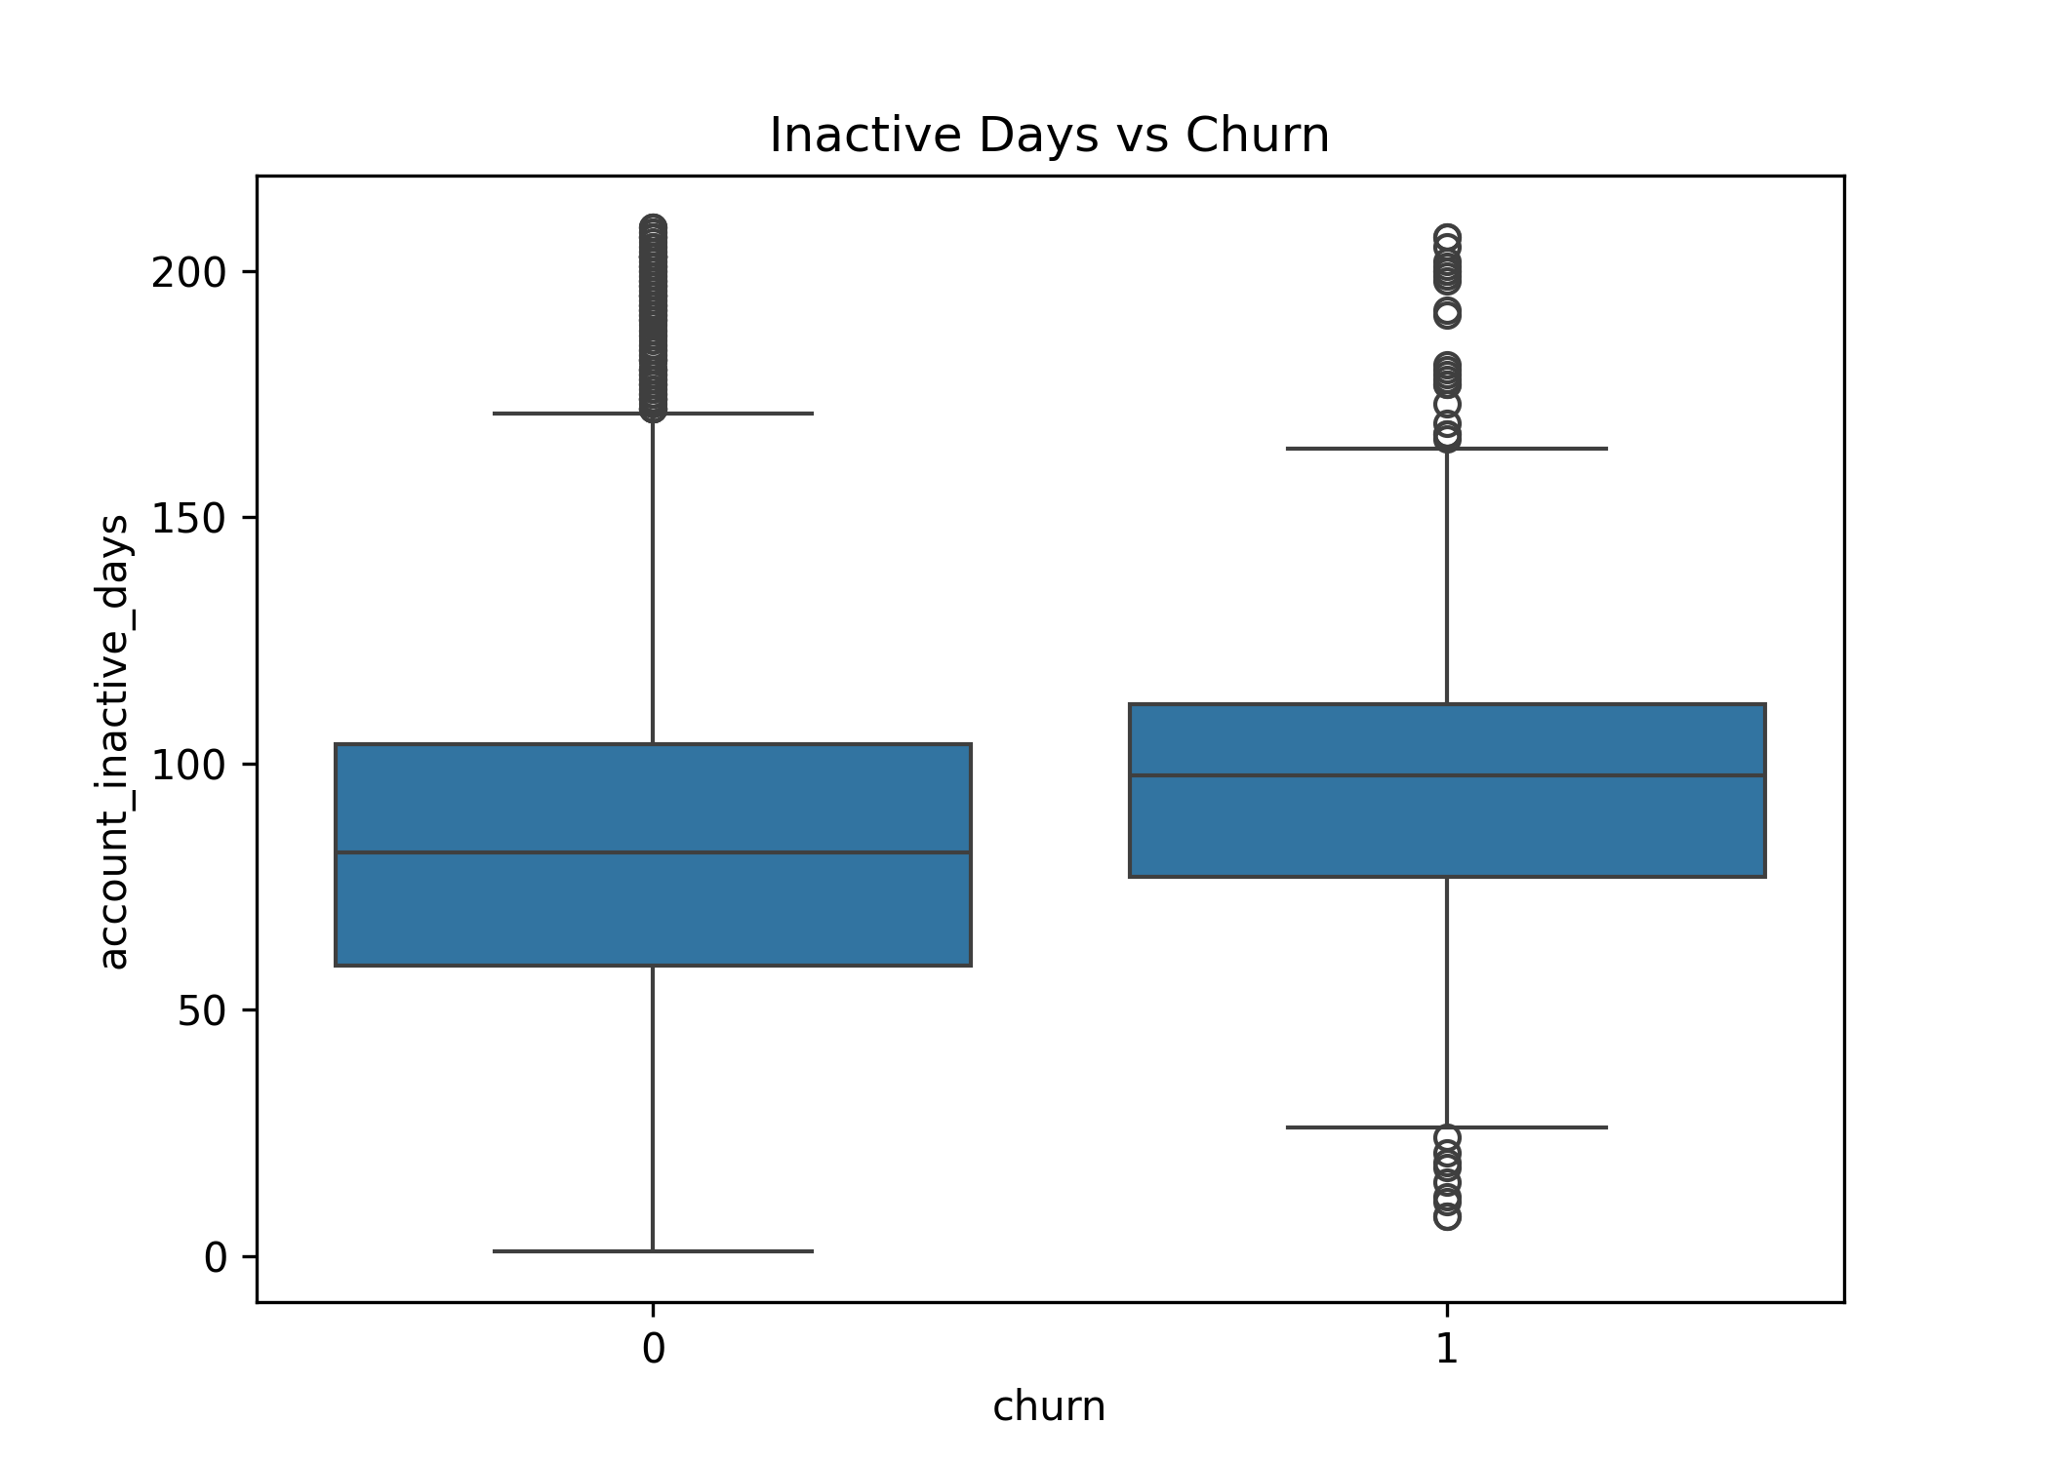
Customer Behaviour (EDA) Insights
Insights:
Customers with frequent complaints show a significantly higher tendency to churn compared to satisfied customers.
Longer inactivity periods are strongly associated with increased churn risk.
Churned users generally display lower engagement and reduced interaction with banking services.
Increasing dissatisfaction and inactivity indicate a gradual decline in customer loyalty over time.
Complaint history and inactivity act as strong early warning indicators of churn behavior.
These behavioral features are highly valuable for identifying at-risk customers early.
Monitoring such patterns helps banks implement proactive retention and customer engagement strategies.

Slide 8
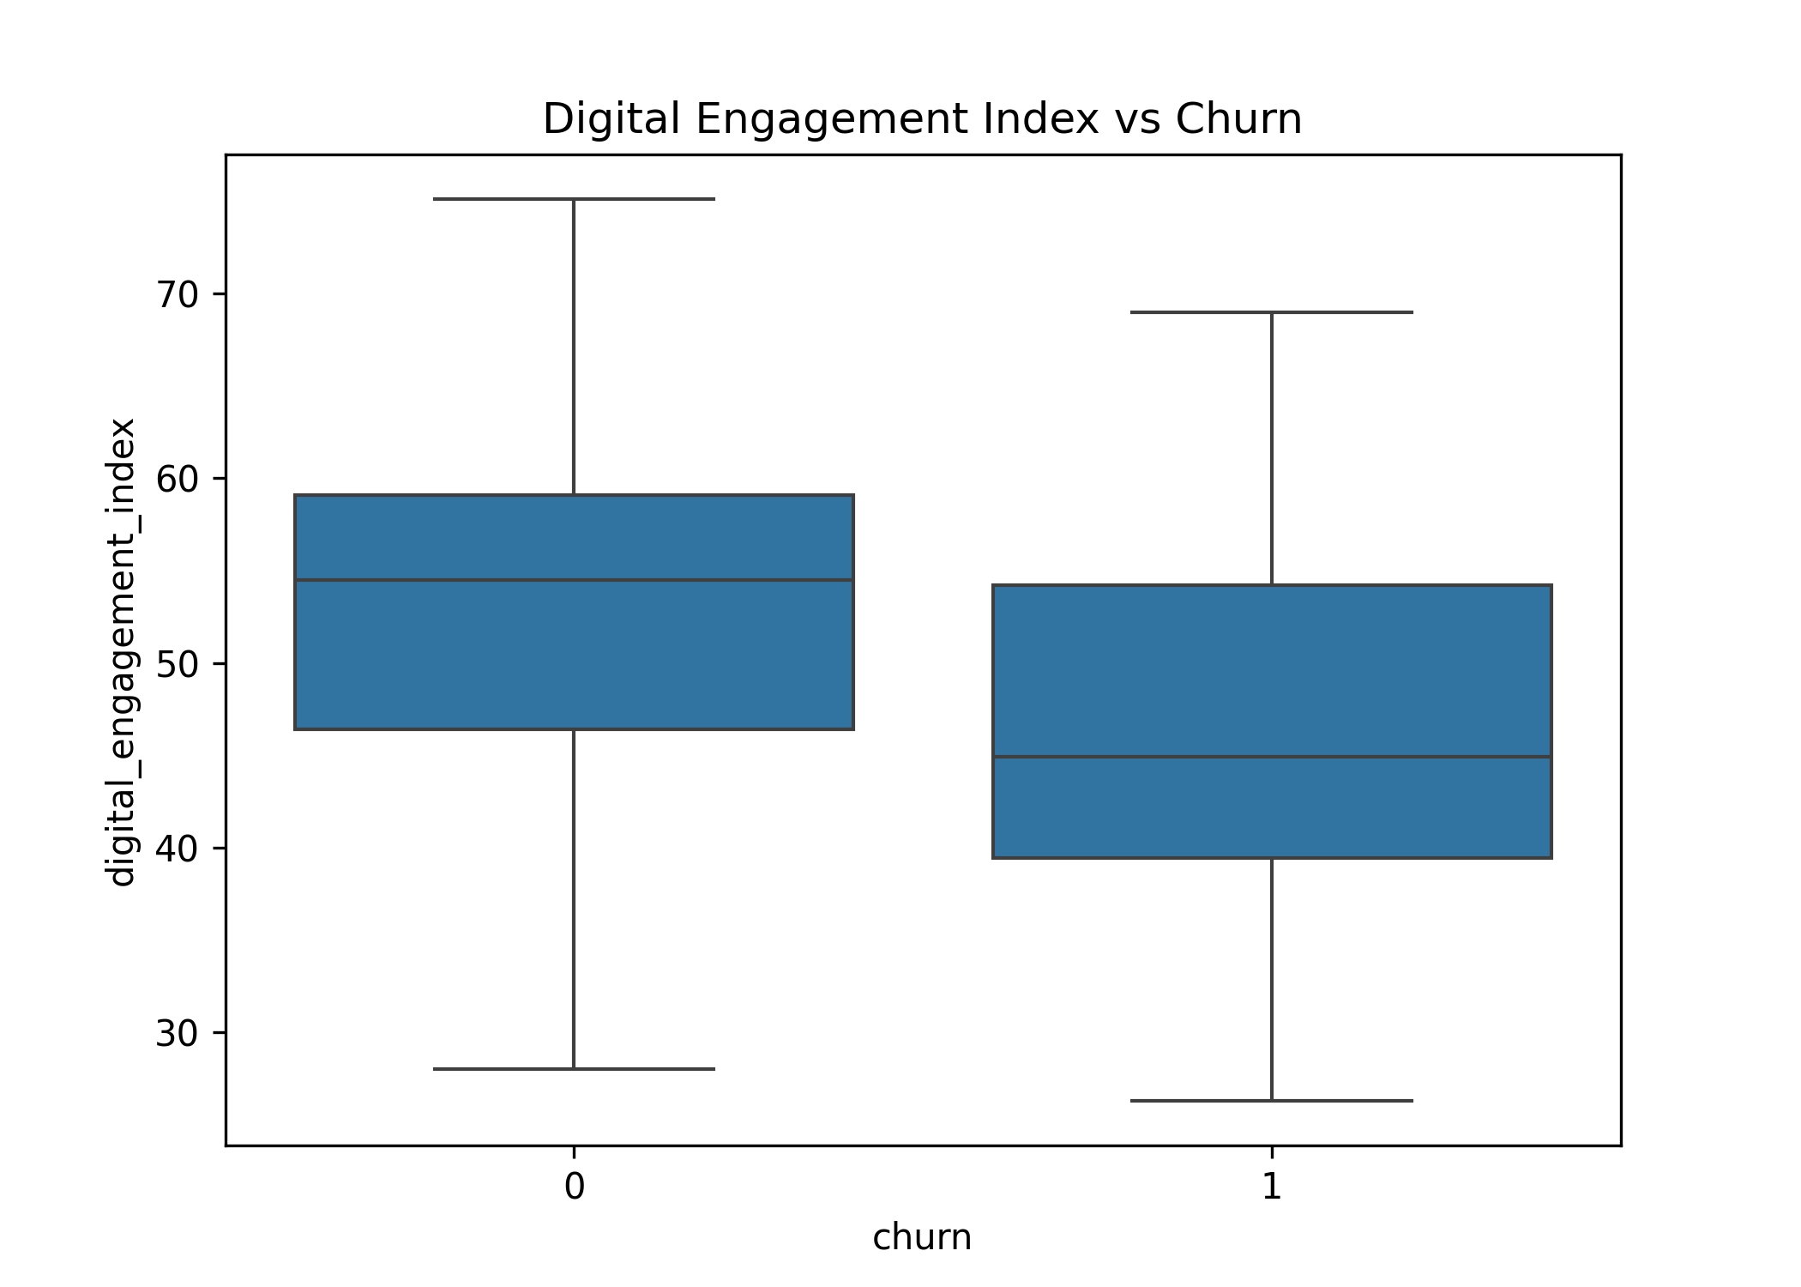
Digital Engagement Analysis
Insights:
Churned customers consistently show lower digital engagement compared to retained customers.
The median digital engagement score of churned users is significantly lower, indicating reduced interaction with banking services.
Retained customers exhibit higher app usage, stronger email engagement, and more frequent login activity.
Their engagement patterns are also more stable compared to churned users.
Lower digital engagement is strongly correlated with higher churn risk.
Inactive or less digitally connected customers are more likely to leave the bank.
Digital inactivity serves as an early warning signal for customer attrition.

Slide 9
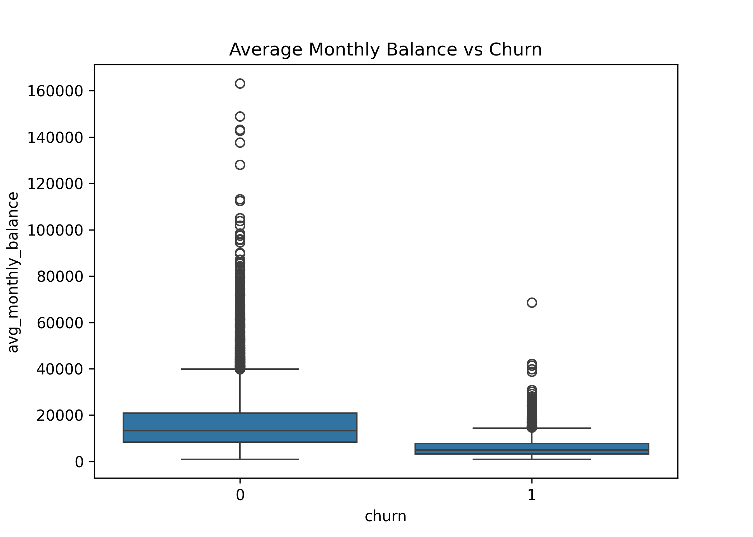
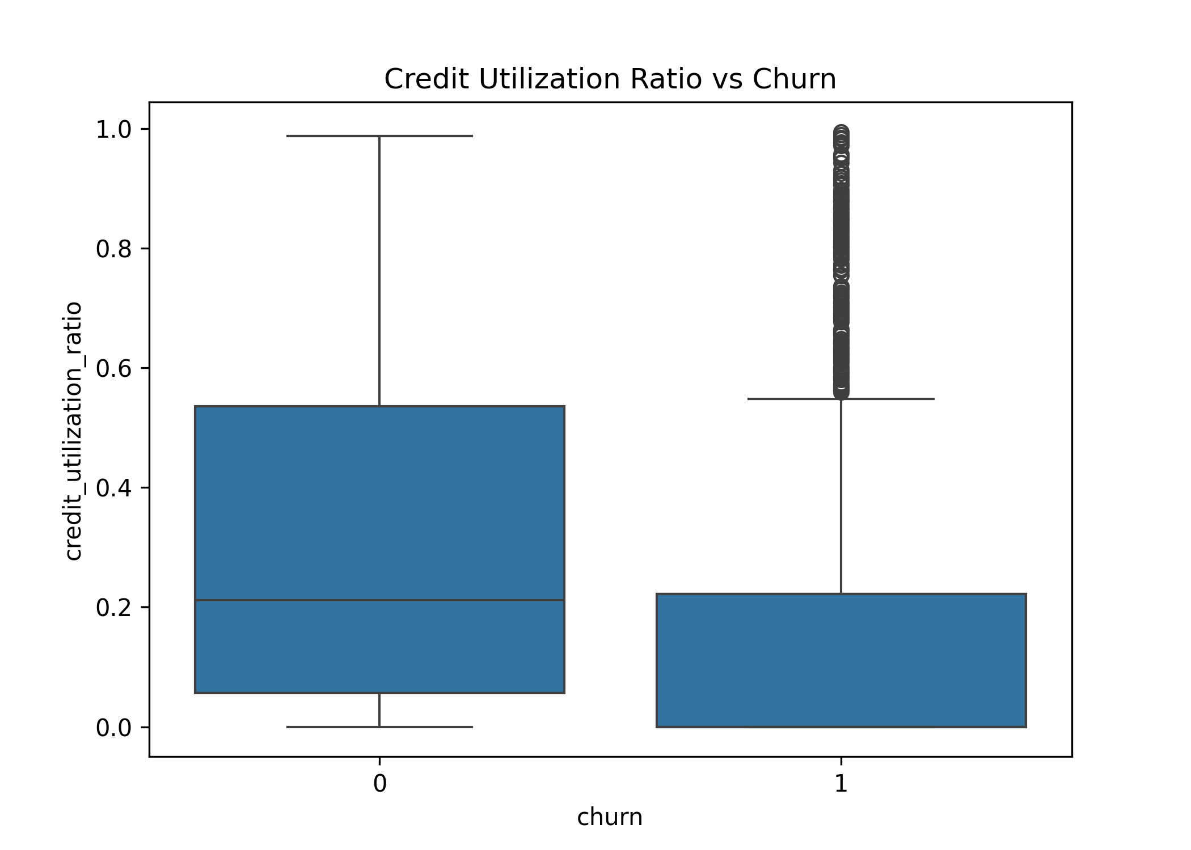
Financial Behaviour Insights
Insights:
Financial behavior patterns show a strong relationship between account activity and customer churn.
Churned customers generally maintain lower monthly balances compared to retained customers.
They also show reduced transaction activity and lower credit utilization levels.
Retained customers demonstrate healthier financial engagement with higher balances.
They actively use banking products and credit services more frequently.
Declining balances and reduced transactions indicate disengagement from banking services.
Low financial activity significantly increases the likelihood of churn.
Overall, declining account value and inactivity are major predictors of customer attrition.

Slide 10
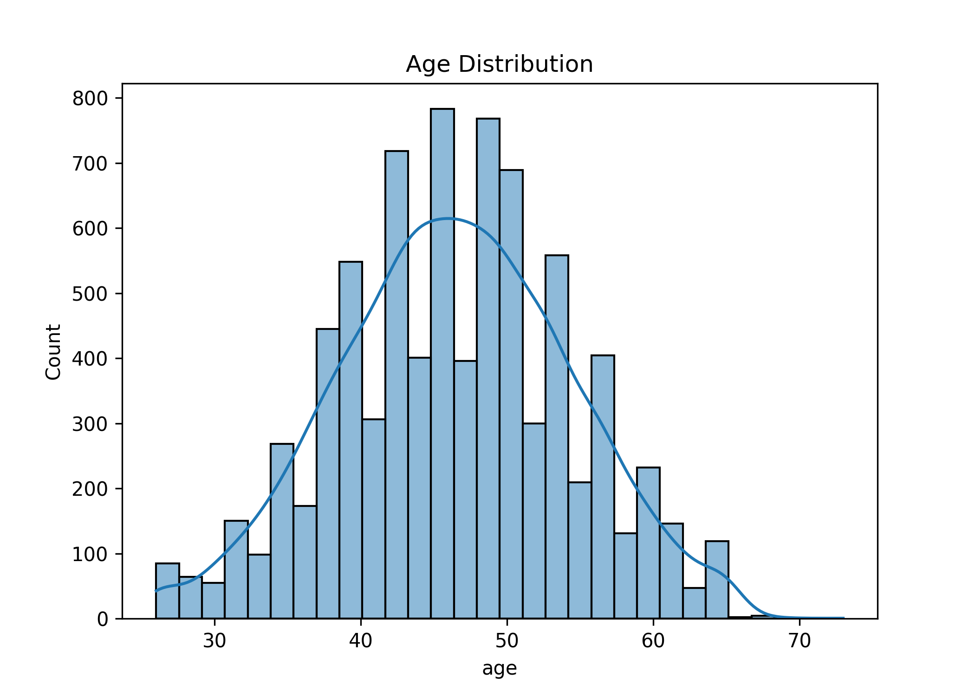
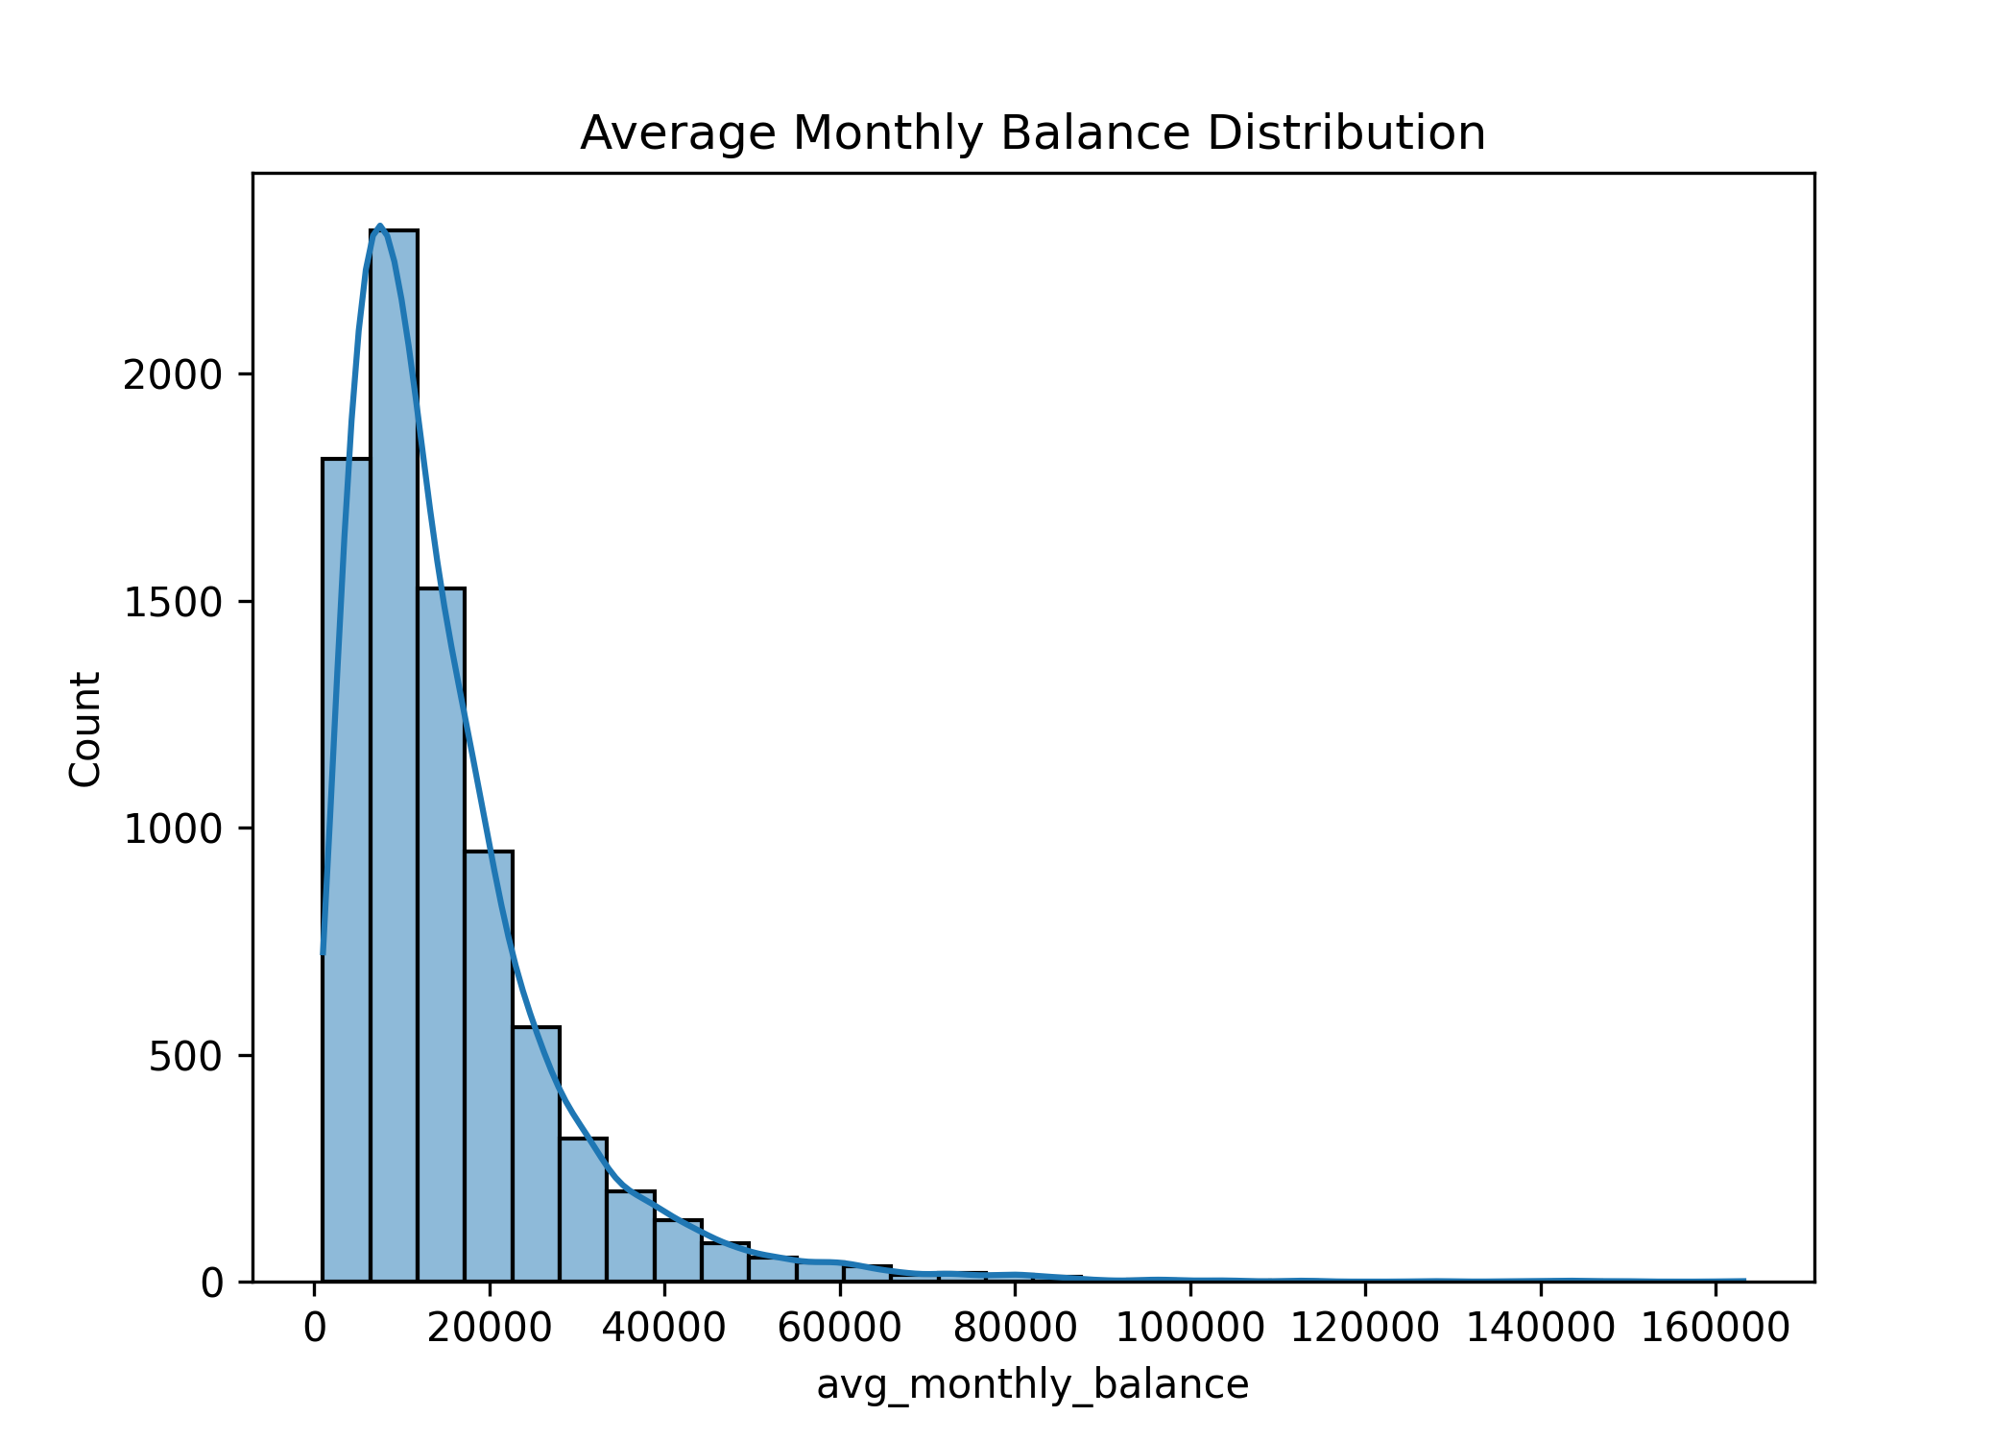
Age & Average Monthly Balance Distribution
Age Distribution: Customer ages are normally distributed, centered around 45–50, with most between 35–55 and very few at the extremes. The bank mainly serves middle-aged customers, so strategies should focus on this group.
Balance Distribution: Account balances are highly right-skewed, with most customers holding low balances (5k–15k) and a small group holding very high values up to 160k. A small high-value segment drives major value, making their retention very important.

Slide 11
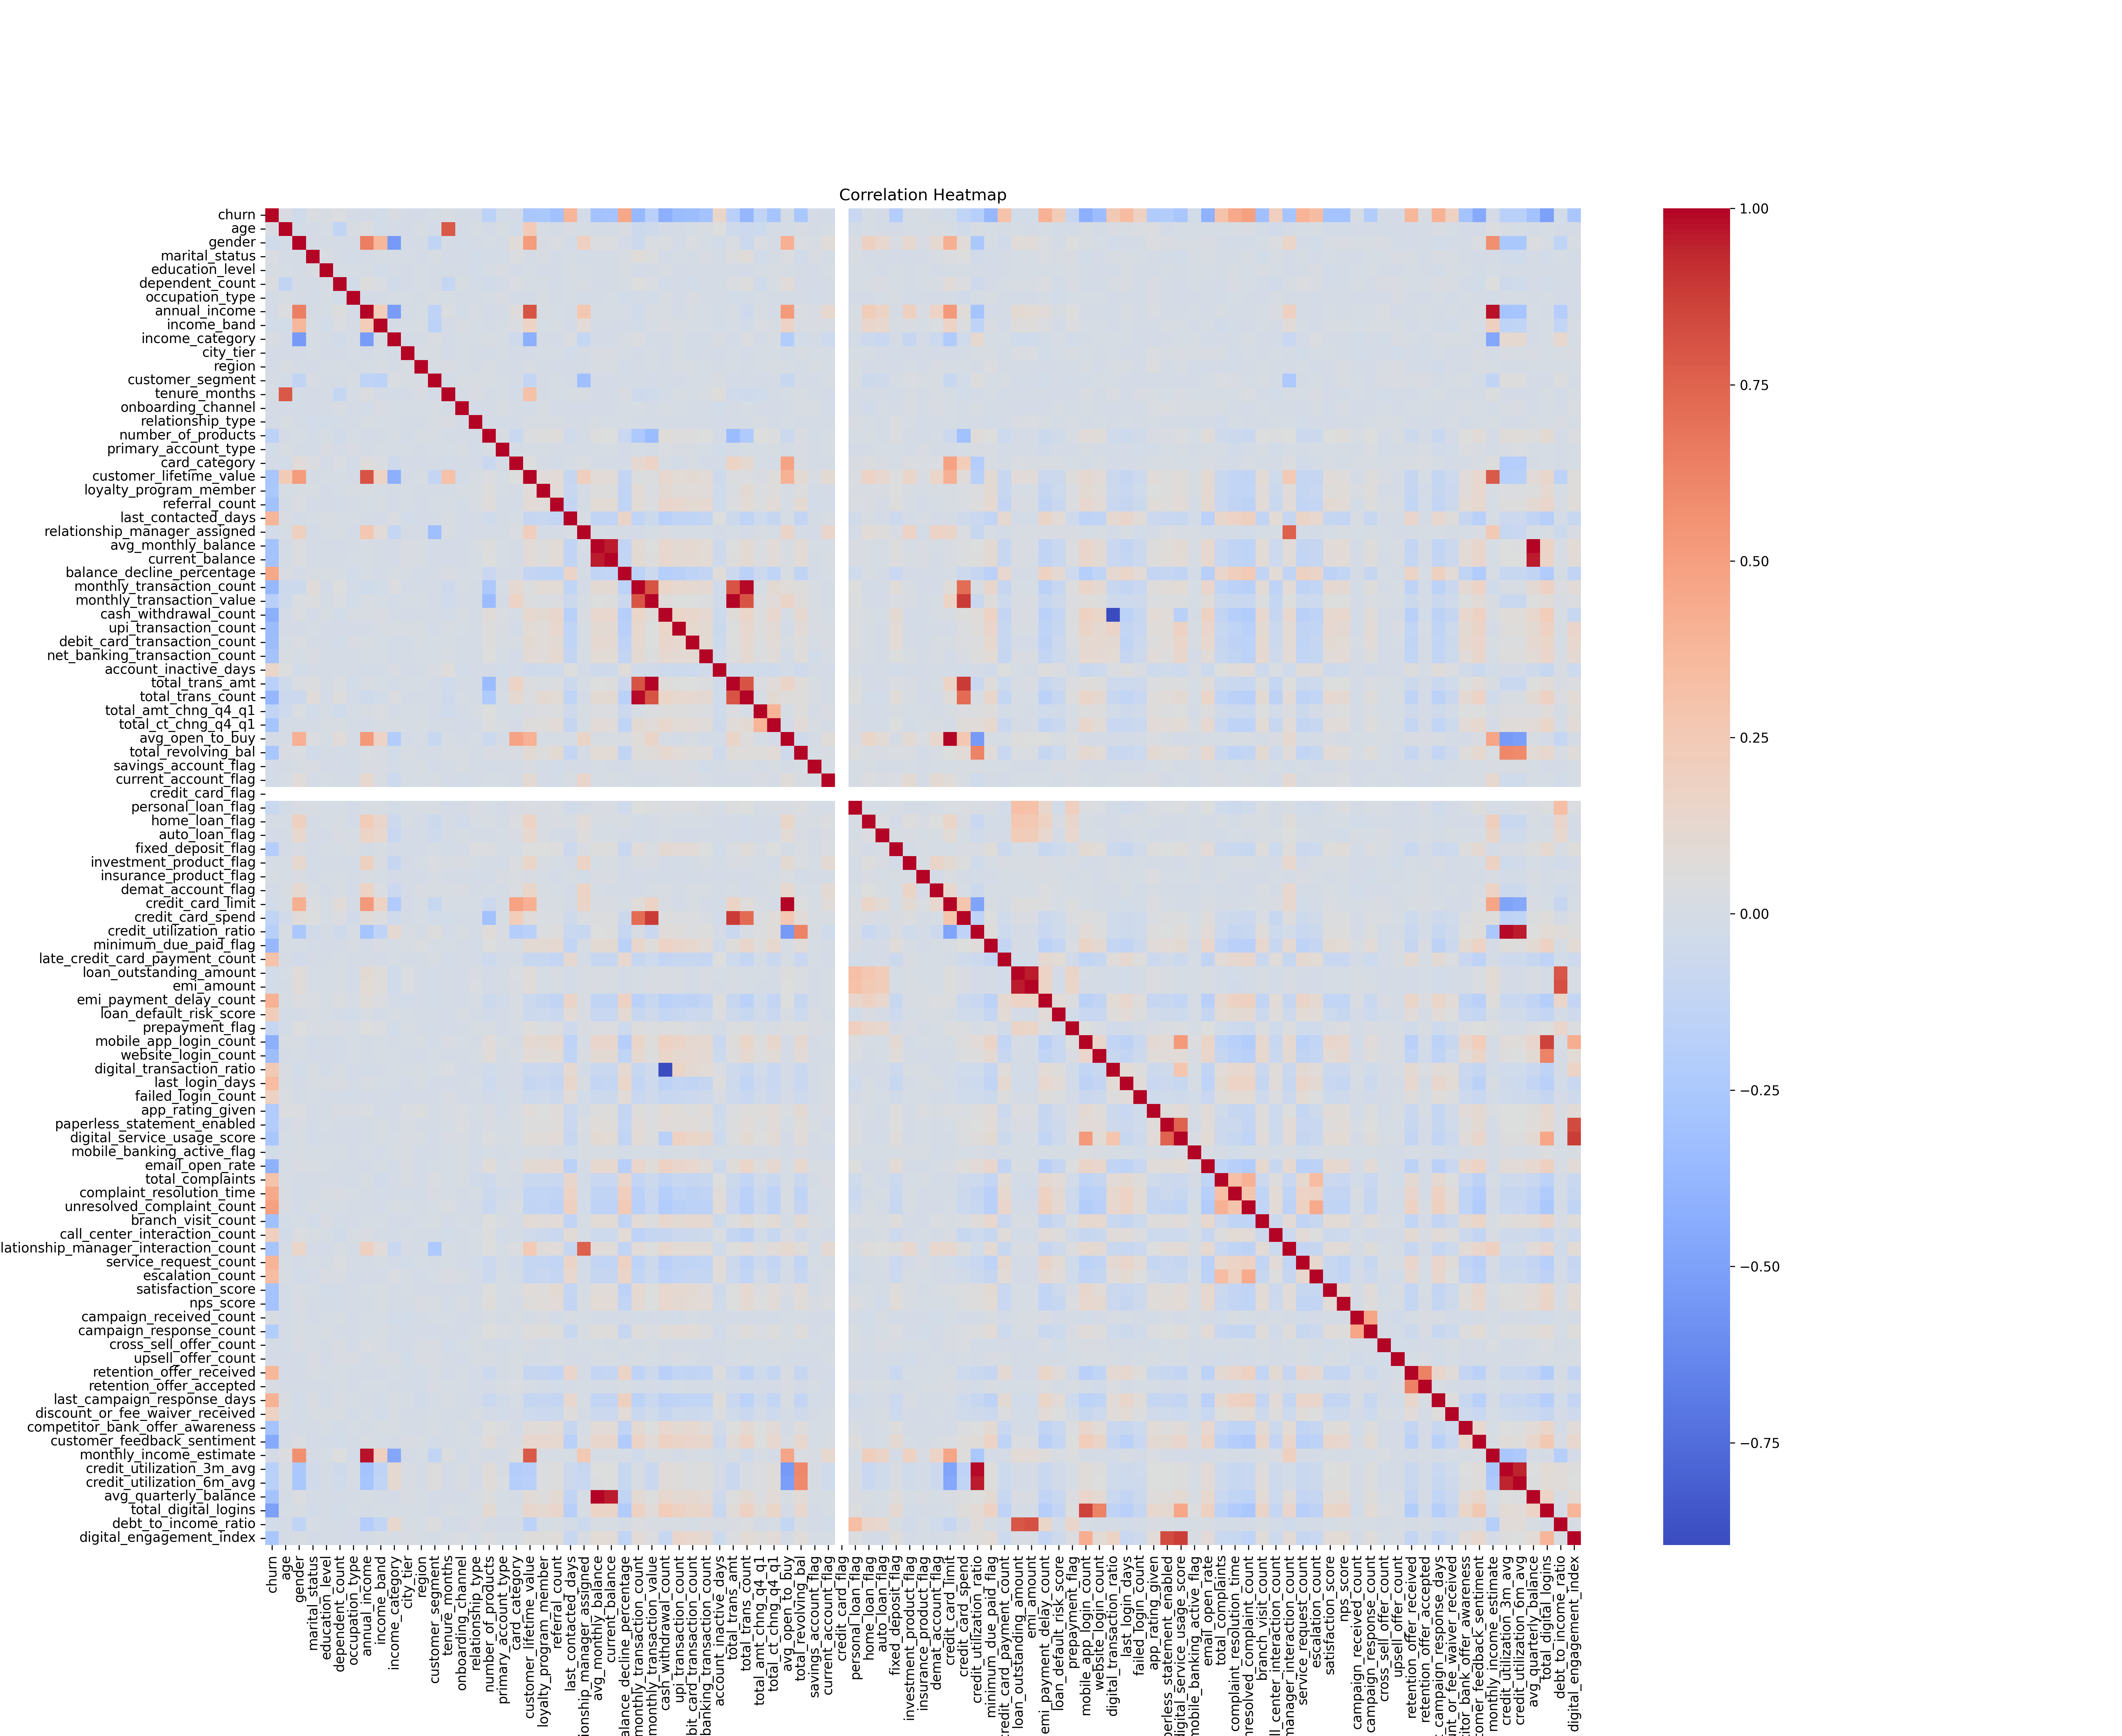
Correlation Heatmap
Correlation Insight: The heatmap shows mostly weak correlations between features, indicating that most variables are independent, with only a few strong positive clusters (such as balance/transaction metrics, credit/income variables) and some logical negative relationships (like cash withdrawals vs digital transactions). Importantly, churn has no strong direct correlation with any single feature, suggesting it is driven by a combination of subtle patterns rather than one dominant factor.
Conclusion: The dataset has low multicollinearity and churn is a non-linear problem, so tree-based models like Random Forest are more suitable than simple linear models.

Slide 12
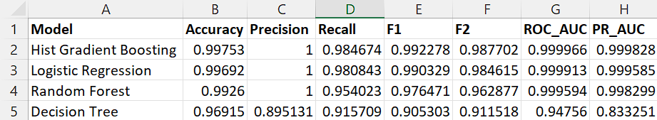
Models Trained
Hist Gradient Boosting performs best overall, achieving the highest Accuracy (99.75%) and F1-Score (99.23%). Logistic Regression and Random Forest also show strong results, both reaching perfect Precision (1.00), indicating no false positives. All top models demonstrate very high F2-Scores, showing strong capability in reducing false negatives, critical for churn prediction. ROC_AUC and PR_AUC values are nearly perfect (>0.999), confirming excellent classification performance.
In contrast, the Decision Tree shows comparatively lower performance across all metrics, reinforcing the advantage of ensemble and advanced models.

Slide 13

Hyperparameter Tuning & Threshold Optimization
Hyperparameter Tuning
Multiple ML models were optimized using tuned parameters such as:
Balanced class weighting
Increased estimators (n_estimators=300)
Higher iterations (max_iter)
Early stopping for MLP
This improved:
Recall
Model stability
Class imbalance handling
Threshold Optimization
Instead of the default threshold (0.5), a custom threshold of:
$$0.35$$
was used to improve churn detection.
Benefits
Higher Recall & F2-score
Reduced False Negatives
Better high-risk customer identification
Improved customer retention strategy

Slide 14
Final Model Performance
The model achieves exceptional overall performance with an Accuracy of 99.75%, indicating highly reliable predictions.
Precision of 100% shows that nearly all predicted churners are actual churners, minimizing unnecessary retention efforts.
Recall of 98.47% confirms that the model successfully captures most churned customers, significantly reducing revenue leakage.
Strong F1-Score of 99.23% reflects a balanced trade-off between precision and recall.
F2-Score of 98.77% highlights the model’s strong focus on correctly identifying churners (recall-oriented performance).
Near-perfect ROC-AUC of 0.9999 and PR-AUC of 0.9998 indicate excellent class separation between churned and retained customers.
The Hist Gradient Boosting model demonstrates production-ready performance, delivering highly accurate churn detection with near-perfect separation ability, making it highly suitable for real-world deployment in customer retention systems.
Metric | Score
Accuracy | 0.9975
Precision | 1
Recall | 0.9847
F1-Score | 0.9923
F2-Score | 0.9877
ROC-AUC | 0.9999
PR-AUC | 0.9998

Slide 15
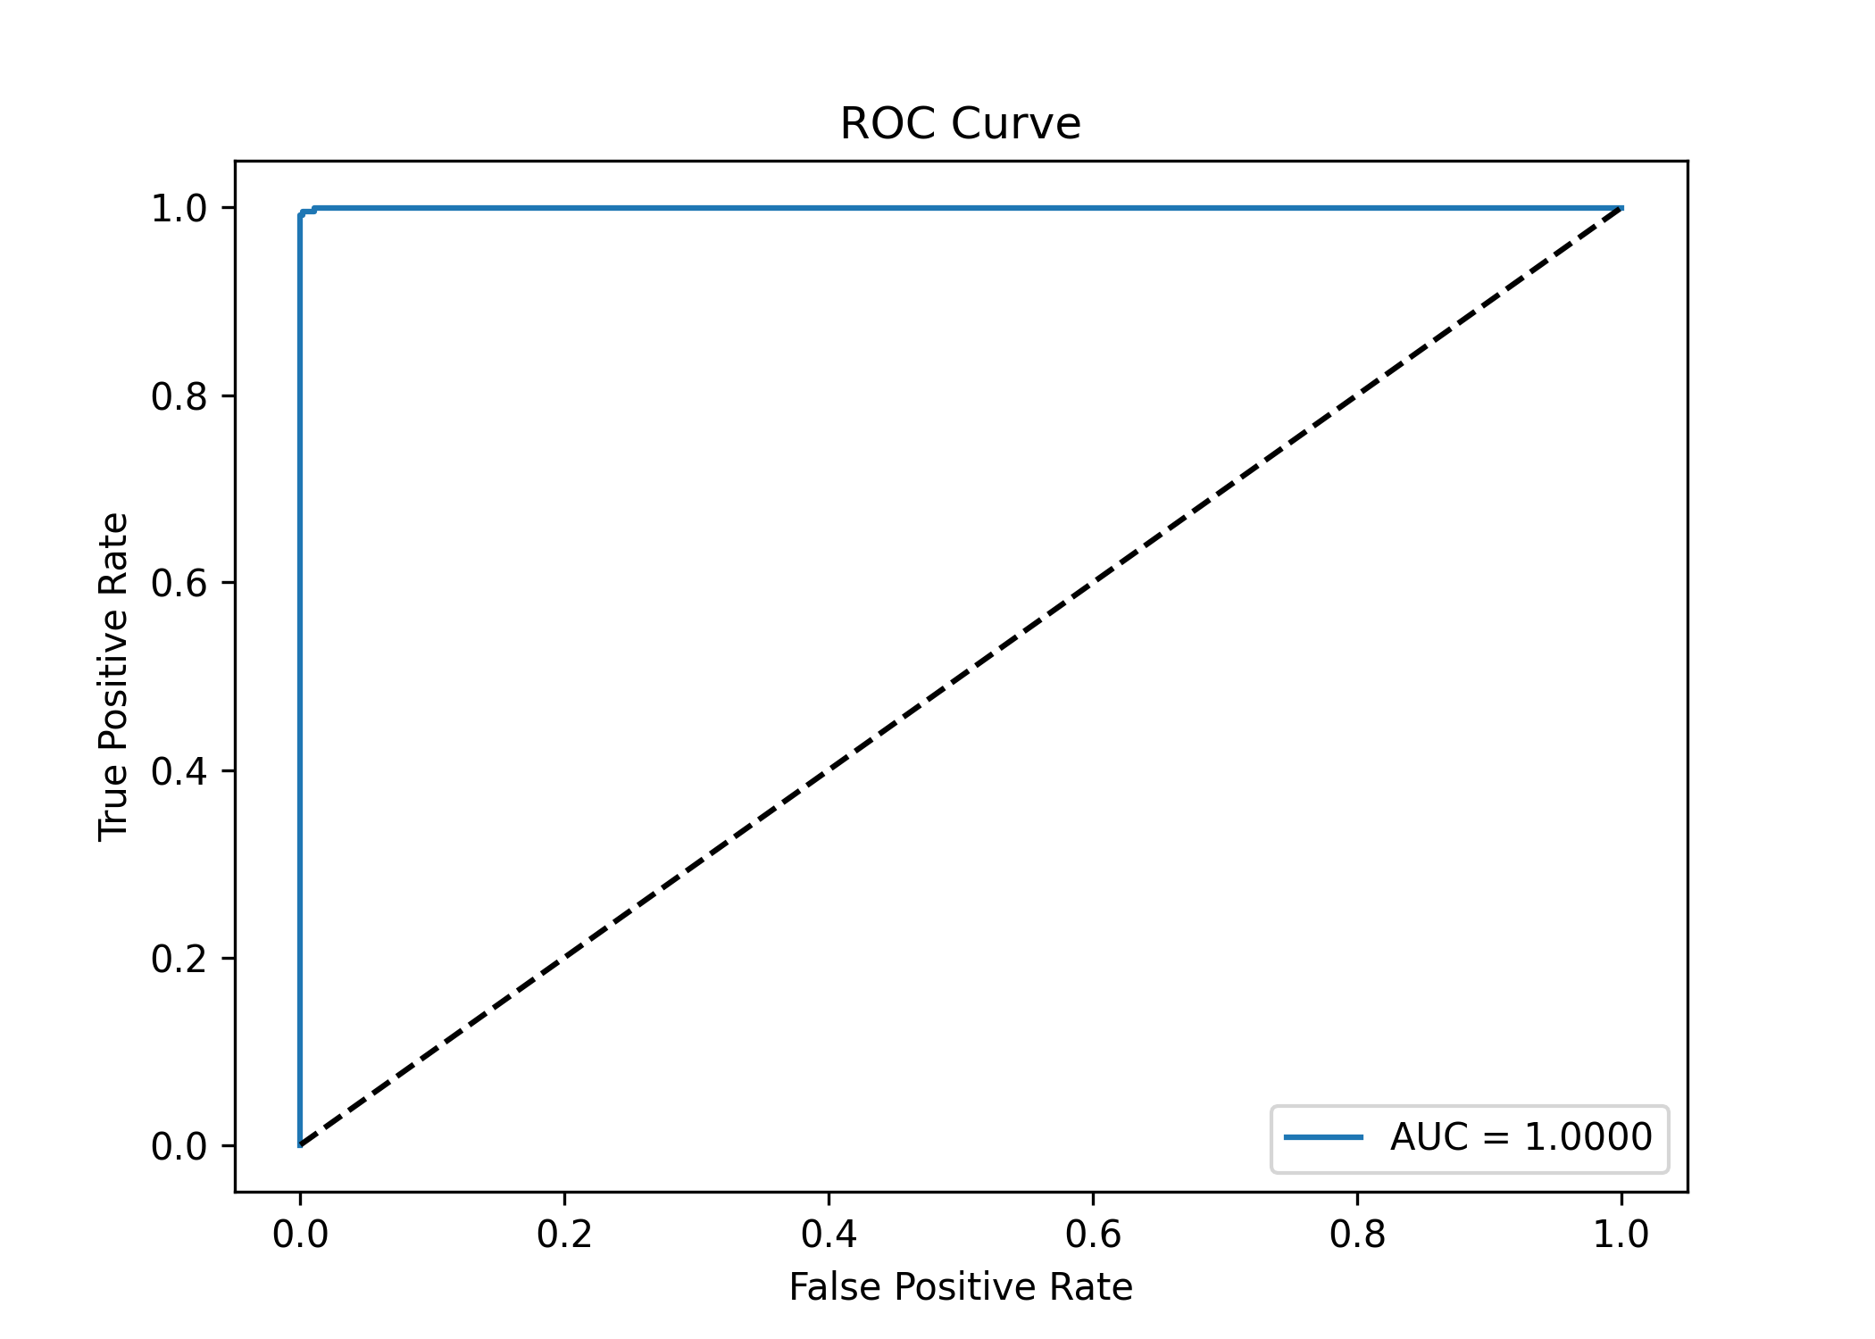
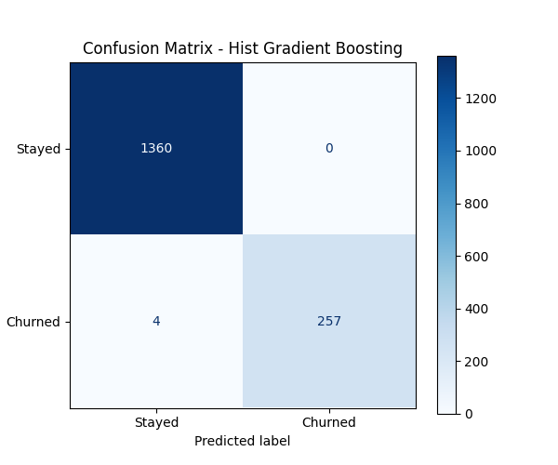
ROC Curve & Confusion Matrix
Interpretation:
The ROC curve shows an AUC of 1.0000, indicating perfect separation between churned and retained customers. This unusually perfect score suggests possible data leakage or overfitting and should be carefully validated.
Interpretation:
The model correctly identifies 257 out of 261 churned customers with only 0 false positive and 4 false negatives. Conclusion: Extremely low errors indicate near-perfect performance, but also reinforce the likelihood of leakage or overly strong predictive features.

Slide 16
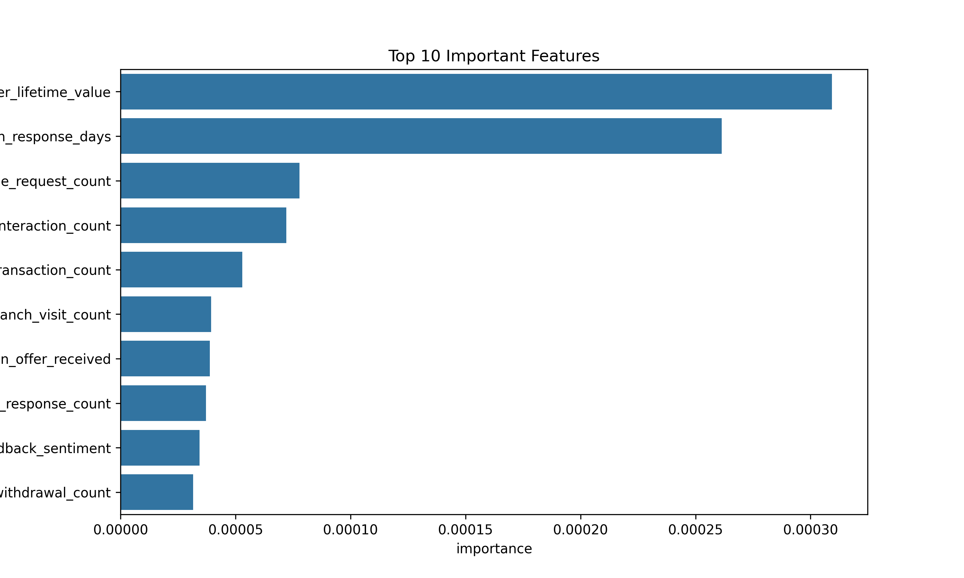
Feature Importance
Observations:
Top Drivers: Customer lifetime value and campaign response time are the strongest churn predictors, heavily influencing model decisions.
Service Signals: Service requests and relationship manager interactions are key mid-level factors linked to retention behavior.
Behavior Patterns: Transaction activity (branch visits, withdrawals, monthly usage) contributes but has lower predictive power.
Sentiment & Offers: Customer feedback and campaign exposure have minimal impact but slightly improve model accuracy.
Conclusion: Churn is mainly driven by value and engagement timing, while other features act as supporting signals.

Slide 17
Business Cost Analysis
Cost Assumptions:
False Negative (FN): ₹40,000 loss per churned customer missed
False Positive (FP): ₹500 cost per unnecessary retention action
Model Outcome:
False Negatives = 4 customers → ₹1,60,000 loss
False Positives = 0 customers → ₹0 waste cost
Business Insight:
The model strongly minimizes false negatives, meaning it successfully captures almost all customers who are about to churn. This is critical because missing a churned customer results in significantly higher financial loss compared to wrongly targeting a retained customer.
Why Recall is Prioritized:
Since the cost of losing a customer (₹40,000) is far higher than retention effort cost (₹500), Recall is the most important metric. The model is optimized to identify as many churned customers as possible, even if it slightly increases false alarms.

Slide 18
Predictions Output and Recommendations
Generated Output Includes:
customer_id
churn_prediction (0/1)
churn_probability
Key Result:
Total 2026 customer predictions generated
Each customer is assigned a churn probability score for risk-based classification
Business Value:
This output allows the bank to prioritize customers based on churn risk and take proactive retention actions before actual loss occurs.
Key Business Actions:
Focus on inactive and low-engagement customers as they show highest churn risk
Improve digital engagement
Launch personalized retention campaigns for high-risk users
Monitor declining balances and reduced transactions as early warning signals
Address customer complaints quickly to reduce dissatisfaction-driven churn
Business Impact:
These strategies help reduce churn rate, improve customer satisfaction, and increase long-term revenue retention.

Slide 19
Code Reproducibility
Reproducibility Measures:
Fixed random_state=42 used across train-test split and machine learning models to ensure consistent results.
Standardized preprocessing pipeline applied uniformly for training and prediction datasets.
Feature engineering and encoding steps were automated to maintain identical transformations every run.
Processed datasets, trained models, metrics, and prediction outputs were saved for reproducibility and future evaluation.
Separate folders (graphs/, models/, outputs/) were maintained for organized project structure.
All critical artifacts including trained models, scalers, processed datasets, evaluation metrics, graphs, prediction outputs, and business reports were saved for verification and future deployment.
Model performance reports and prediction CSV files allow easy verification and regeneration of results.
End-to-end automation enabled seamless regeneration of results, visualizations, and prediction reports without manual intervention.
Outcome:
The project pipeline is fully reproducible, structured, and deployment-ready, ensuring reliable experimentation and consistent model behavior across executions.

Slide 20
Conclusion and Future Insights
Future Insights:
Apply Deep Learning models for capturing complex behavioral patterns
Enable Real-time churn prediction system integrated with banking platforms
Implement Explainable AI (XAI) to improve interpretability for business stakeholders
Introduce time-series behavior tracking for early churn detection
Move from static batch prediction to a real-time intelligent retention system that proactively identifies and prevents churn before it happens.
Conclusion:
The churn analysis shows that customer attrition is mainly driven by behavioral factors like low engagement, inactivity, and reduced satisfaction rather than demographics. Financial patterns such as low credit usage and low balances also indicate higher churn risk. High-value customers are especially important due to their revenue contribution. Overall, churn is a complex, multi-factor problem that requires predictive models and proactive retention strategies instead of simple rule-based approaches.
GitHub Link: https://github.com/Arpita368/Bank-Churn-Prediction
predictions.csv: https://github.com/Arpita368/Bank-Churn-Prediction/blob/main/outputs/predictions.csv

