Slide 1


21AIE495 PROJECT PHASE - 1
Transforming E-Learning with VLearnUp: Cloud-Driven and AI-Powered Personalized Learning
Team-A19
VISHAL AADIITH G – CH.EN.U4AIE21063
VISHNU KP – CH.EN.U4AIE21064
Coordinator: Dr.V.Vamsi Krishna
1

Slide 2
PROBLEM STATEMENT
The rapid growth of e-learning platforms has brought many advancements in online education. However, these platforms still face several critical issues that hinder their effectiveness and user satisfaction. Despite the technological advancements, many e-learning platforms struggle with integrating comprehensive tools to enhance the learning experience.
Many platforms do not offer in-depth analytics to monitor student progress, making it difficult to identify learning gaps and provide timely interventions.
Existing systems often fail to efficiently handle and enhance educational resources, such as class materials and handwritten notes, affecting the quality of learning.
Traditional e-learning platforms frequently lack interactive features like quizzes and challenges, which can lead to reduced student motivation and engagement.
There is often a lack of effective channels for providing personalized support and mentorship, which can leave students feeling unsupported.
Many platforms struggle to keep users informed about the latest educational news and trends, leading to outdated content.
2

Slide 3
PROBLEM IDENTIFICATION
To effectively address the shortcomings of current e-learning platforms, it is crucial to identify and analyze specific issues that impact both learners and educators. The key challenges often encountered include difficulties in performance tracking, resource management, and maintaining user engagement. Addressing these problems requires targeted solutions to enhance the learning environment.
Lack of tools to monitor and evaluate student performance in detail, resulting in missed opportunities for timely and effective feedback.
Challenges with uploading, organizing, and enhancing educational materials, especially handwritten notes.
Limited interactive features such as quizzes and challenges that fail to keep students engaged.
Insufficient mechanisms for providing personalized mentorship and support to students.
Difficulty in accessing and staying updated with current educational news and trends.
School of Computing
2

Slide 4
SIGNIFICANCE
The innovative features of VLearnUp bring substantial benefits by addressing key issues in e-learning platforms. These improvements have far-reaching implications for society, technology, and various stakeholders.
Impact on Society
Enhanced Learning Experience: VLearnUp improves educational outcomes by providing detailed analytics and interactive elements, fostering a more effective and engaging learning environment for students.
Advancements in Technology
Innovative Features: Incorporates advanced analytics, interactive quizzes, and personalized support, pushing the boundaries of current e-learning technology and setting new standards for educational platforms.
Benefits for Stakeholders
Educators and Institutions: Offers tools for better student tracking and resource management, enhancing teaching effectiveness and institutional performance.
Practical Applications
Versatile Use: Suitable for educational institutions, corporate training programs, and individual learners, making it a flexible solution for various learning needs.
3

Slide 5
OBJECTIVE
To Develop a Comprehensive E-Learning Solution
VLearnUp aims to create a robust platform that integrates advanced analytics, interactive learning tools, and personalized support features.
To Improve Handwritten Note Utilization
Leverage OCR technology to digitize handwritten notes, identify missing parts, provide suggestions, and create quizzes based on the content of the notes.
To Enhance Learning Engagement and Effectiveness
Utilize interactive quizzes, a reward system, and personalized support to increase student motivation, participation, and overall learning outcomes.
To Provide Up-to-Date Educational Content
Incorporate a news feed to ensure that users have access to the latest educational developments and trends.
4

Slide 6
SCOPE
Advanced Analytics
Integrate detailed analytics to monitor student progress and performance.
Provide insights and predictive analysis to identify learning gaps and recommend interventions.
Resource Management
Enable uploading, organizing, and enhancing of class materials, including handwritten notes.
Implement tools to detect and fill gaps in handwritten notes.
Personalized Support
Create private discussion rooms for one-on-one mentorship and support.
Implement scheduling features for virtual office hours and appointments.
Real-Time Assistance
Integrate a chatbot for instant assistance and support with common queries and issues.
Educational News Feed
Provide a news feed with the latest educational updates, trends, and articles.
Interactive Learning Tools
Develop interactive quizzes and challenges tailored to individual learning journeys.
Introduce a reward system with badges, points, and certificates to boost engagement.
5

Slide 7
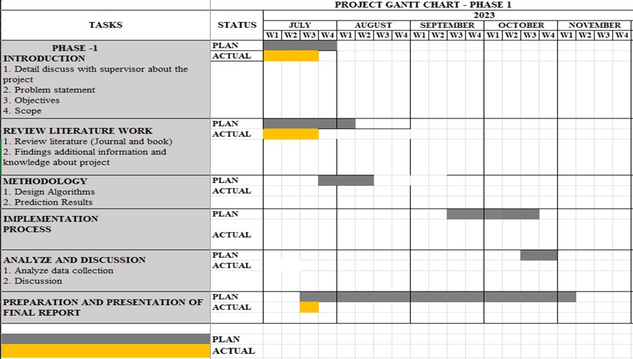
GANTT CHART
5

