Slide 1
agentic AI Health Symptom Checker
INTERNSHIP PROJECT
Presented By :
Student name : Arpita Chaudhary
College Name : Ambalika Institute of Management and Technology
Department : CS-AIML

Slide 2
OUTLINE
Problem Statement
Technology used
Wow factor
End users
Result
Conclusion
Git-hub Link
Future scope
IBM Certifications

Slide 3
Problem Statement
Millions face confusion and misinformation when searching symptoms online, often leading to unsafe self-diagnosis and delayed care. There's a need for a reliable, multilingual, and intelligent assistant that understands natural symptom descriptions and guides users with safe, verified health information.
Proposed Solution: An AI-powered health checker that understands symptoms in natural language, offers safe advice using verified medical data, and guides users with urgency levels, home remedies, alerts and multilingual support — without making any diagnosis.

Slide 4
Technology used
IBM Cloud Lite Services
Natural Language Processing (NLP)
Trusted Medical Sources (Like WHO)
IBM Granite model

Slide 5
IBM cloud services used
IBM Cloud Watsonx AI Studio
IBM Cloud Watsonx AI runtime
IBM Cloud Agent Lab
IBM Granite foundation model
IBM Cloud Object Storage

Slide 6
Wow factors
This smart, multilingual AI health Symptom Checking Agent delivers safe, non-diagnostic symptom guidance in real time — personalized, accessible, and verified.
Unique features:
Natural language symptom interpretation.
Urgency triage (mild, moderate, severe).
Verified, non-diagnostic advice.
Multilingual interaction.
Real-time, safe, and user-friendly.
Prevents misinformation and reduces panic.
Promotes early action and awareness.

Slide 7
End users
General public (All age groups).
Rural and multilingual populations.
Healthcare helpdesks and NGOs.
Senior citizens and caregivers.
Health awareness campaigns.
Students & first-time symptom seekers.

Slide 8
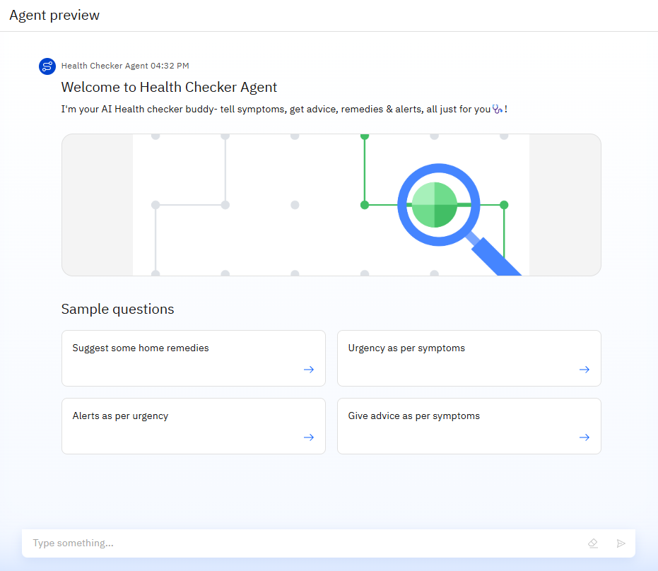
Results

Slide 9
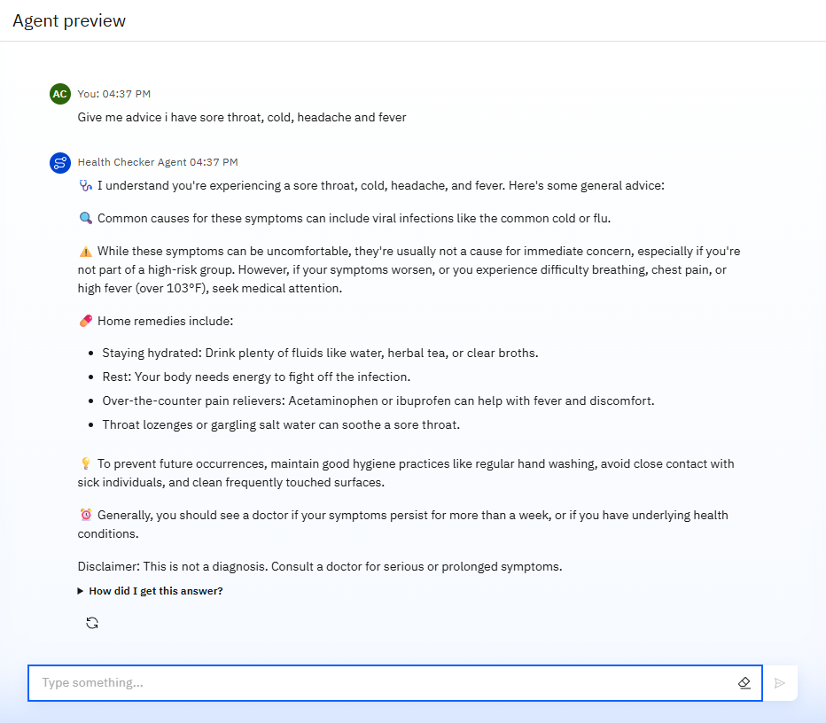
Results

Slide 10
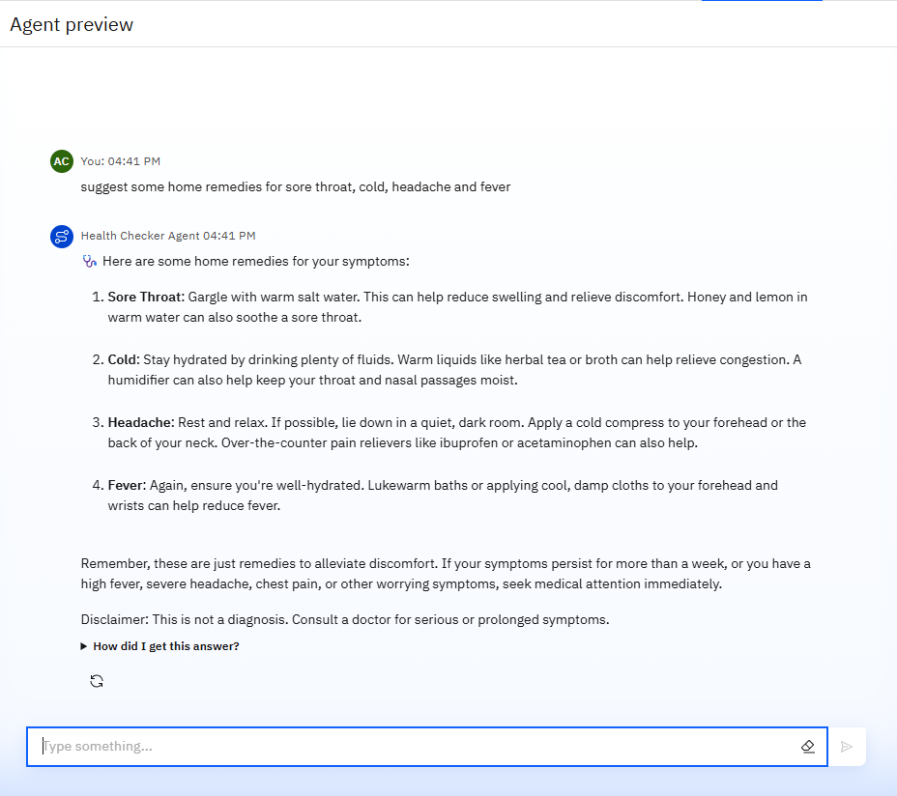
Results

Slide 11
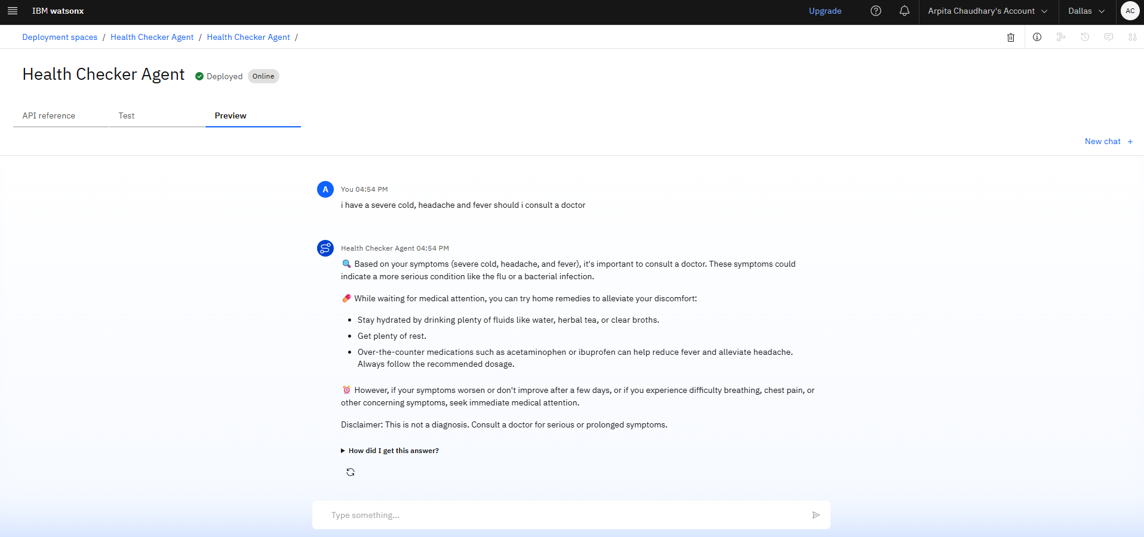
Results
Deployed AI Agent

Slide 12
Conclusion
The AI agent simplifies access to verified health information for all users, including non-tech-savvy individuals.
It provides symptom-based guidance without making diagnoses, ensuring safety and clarity.
By promoting early detection and awareness, it reduces panic and delays in care-seeking.
Multilingual support and a user-friendly design make it inclusive, empowering people to take informed health actions.

Slide 13
GitHub Link
https://github.com/ArpitaChaudhary111

Slide 14
Future scope
Voice interaction and accessibility integration.
Wearable health data integration (IOT).
Symptom tracking over time.
Geo-aware doctor and hospital recommendations.
Support for chronic condition monitoring.
Mental health check-ins.

Slide 15
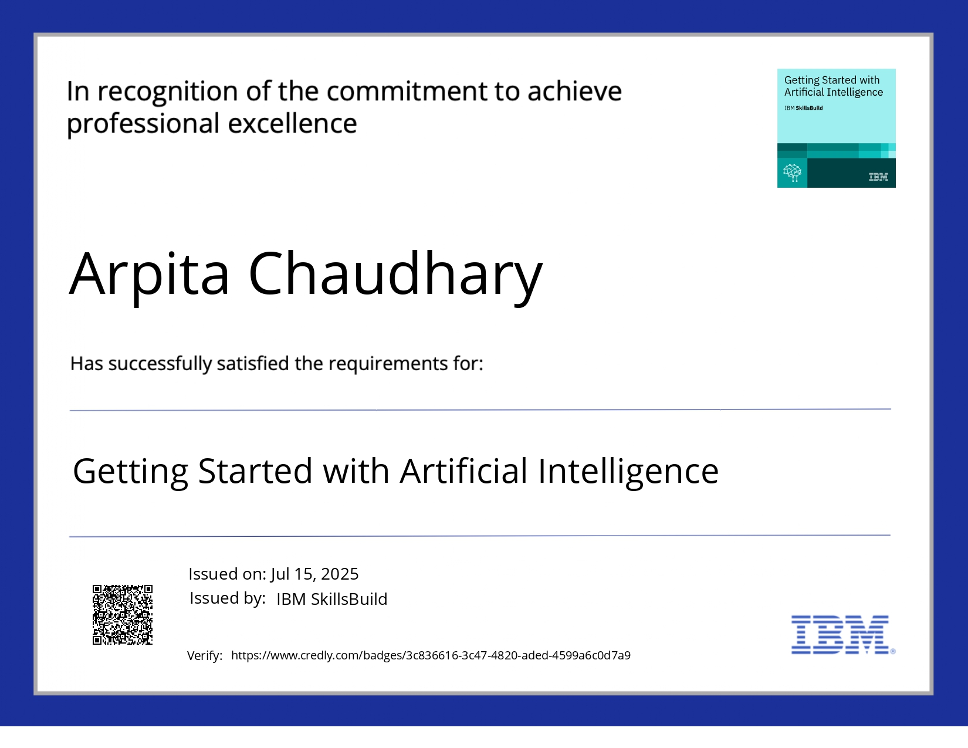
IBM Certifications

Slide 16


Slide 17
THANK YOU

