Slide 1


CMPE 280 Web UI Design and Development September 12 Class Meeting
Department of Computer Engineering San Jose State University Fall 2017 Instructor: Ron Mak
www.cs.sjsu.edu/~mak

Slide 2
The HTML5 Canvas Object
HTML5 introduces the drawing canvas.
The <canvas> tag provides a graphics context.
A rich set of drawing operations.
Execute using JavaScript.
Replaces the need for Flash or Java.
Used by many game developers.
Universally supported by modern browsers.

Slide 3
Simple Canvas Demo
<canvas id = "canvas"
width = "200"
height = "200">
<p>Your browser does not support the canvas tag.</p>
</canvas>
canvas/simple.html
function draw()
{
var canvas = document.getElementById("canvas");
var con = canvas.getContext('2d');
con.strokeStyle = "black";
con.strokeRect(0, 0, 200, 200);
con.fillStyle = "red";
con.fillRect(40, 140, 150, 50);
}
Demo

Slide 4
Canvas Basics
Two main canvas drawing operations:
stroke: draw a line
fill: fill in a shape
Specify strokestyle and fillstyle.
Basic shapes: lines, rectangles, arcs, text
Create paths to draw complex shapes.
Draw images.
Alter pixels.

Slide 5
Ways to Specify Colors
By name: red, silver, gray, etc.
RGB with integers 0-255 or percentages: rgb(10, 250, 100) or rgb(100%, 100%, 0%)
RGBA with alpha transparency.
HSL and HSLA
RGB with six-digit hex values: #FF0000 is red, #FFFF00 is yellow.
RGB with three-digit hex values: #F00 is red, #FF0 is yellow.

Slide 6
Gradients
Fill a shape with a gradient.
Linear gradient or radial gradient.
Color stop: Specifies a color to add to a gradient and a position along the gradient.
Position 0 through 1
0 = beginning of the gradient
1 = end of the gradient

Slide 7
Gradients, cont’d
<canvas id = "linear"
height = "200"
width = "200">
<p>Canvas not supported!</p>
</canvas>
<canvas id = "radial"
height = "200"
width = "200">
<p>Canvas not supported!</p>
</canvas>
canvas/gradients.html

Slide 8
Gradients, cont’d
function draw()
{
var linear = document.getElementById("linear");
var radial = document.getElementById("radial");
// Linear gradient
var con = linear.getContext("2d");
lGrad = con.createLinearGradient(0, 0, 100, 200);
lGrad.addColorStop(0, "#FF0000"); // red
lGrad.addColorStop(0.5, "#00FF00"); // green
lGrad.addColorStop(1, "#0000FF"); // blue
con.fillStyle = lGrad;
con.fillRect(0, 0, 200, 200);
...
}
canvas/gradients.html

Slide 9
Gradients, cont’d
function draw()
{
...
// Radial gradient
con = radial.getContext("2d");
rGrad = con.createRadialGradient(50, 50, 0, 100, 100, 125);
rGrad.addColorStop(0, "#FF0000"); // red
rGrad.addColorStop(0.5, "#00FF00"); // green
rGrad.addColorStop(1, "#0000FF"); // blue
con.fillStyle = rGrad;
con.fillRect(0, 0, 200, 200);
}
canvas/gradients.html

Slide 10
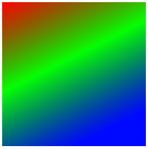
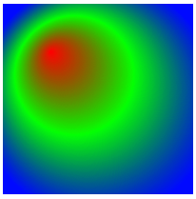
Gradients, cont’d
createLinearGradient(0, 0, 100, 200)
starting position
ending position
radius of
inner circle
radius of
outer circle
createRadialGradient(50, 50, 0, 100, 100, 125)
center position
of inner circle
center position
of outer circle

Slide 11
Rectangle Operations
strokeRect(x, y, w, h)
Draw the outline of a rectangle with the upper left corner at position x, y and width w and height h.
Use the current strokeStyle and lineWidth.
fillRect(x, y, w, h)
Draw a filled-in rectangle.
Fill with the current fillStyle.
clearRect(x, y, w, h)
Erase a rectangle by filling in with the current background color.

Slide 12
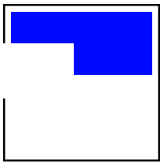
Rectangle Operations, cont’d
<canvas id = "canvas"
height = "200"
width = "200" >
<p>Canvas not supported</p>
</canvas>
canvas/rectangles.html
function draw()
{
var canvas = document.getElementById("canvas");
var con = canvas.getContext("2d");
con.fillStyle = "blue";
con.strokeStyle = "black";
con.lineWidth = "5";
con.strokeRect( 0, 0, 200, 200);
con.fillRect (10, 10, 180, 80);
con.clearRect ( 0, 50, 90, 70);
}

Slide 13
Drawing Text
fillText(string, x, y) Display the characters of string at offset x and baseline at y.
strokeText(string, x, y) Display the outline of the characters of string.
<canvas id = "canvas"
height = "200"
width = "280" >
<p>Canvas not supported</p>
</canvas>

Slide 14

Drawing Text, cont’d
canvas/text.html
function draw()
{
var canvas = document.getElementById("canvas");
var con = canvas.getContext("2d");
con.strokeStyle = "black";
con.strokeRect(0, 0, 280, 200);
con.font = "40pt sans-serif";
con.fillStyle = "red";
con.fillText ("CMPE 280", 5, 75);
con.strokeText("CMPE 280", 5, 150);
}

Slide 15
Shadows
Add a shadow to any object you draw on the canvas.
Canvas shadow attributes:
shadowOffsetX, shadowOffsetY How much to move the shadow along the x and y axes.
shadowColor Default is black.
shadowBlur 0: crisp and sharp 5: softer and lighter

Slide 16

Shadows, cont’d
function draw()
{
var canvas = document.getElementById("canvas");
var con = canvas.getContext("2d");
con.strokeStyle = "black";
con.strokeRect(0, 0, 200, 100);
con.shadowOffsetX = 3;
con.shadowOffsetY = 3;
con.shadowColor = "gray";
con.shadowBlur = 5;
con.font = "40pt sans-serif";
con.fillStyle = "red";
con.fillText("CMPE 280", 5, 65);
}
canvas/shadow.html

Slide 17
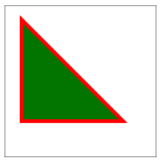
Paths
A path records “pen motion”.
function draw()
{
...
con.strokeStyle = "red";
con.fillStyle = "green";
con.lineWidth = "10";
con.beginPath();
con.moveTo(25, 25);
con.lineTo(150, 150);
con.lineTo(25, 150);
con.lineTo(25, 100);
con.closePath();
con.stroke();
con.fill();
}
canvas/path.html

Slide 18
Line Attributes
strokeStyle
lineWidth
in pixels
lineJoin
miter: sharp corners
round: rounded corners
bevel: squared-off corners
lineCap
round: rounded edges
butt: squared-off edges cut off exactly at line width
square: like butt but with a small added length

Slide 19
Line Attributes, cont’d
Line joins:
con.lineJoin = "round"
con.strokeStyle = "red";
con.beginPath();
con.moveTo(20, 50);
con.lineTo(30, 20);
con.lineTo(40, 50);
con.stroke();
con.closePath();
con.lineJoin = "bevel"
con.strokeStyle = "blue";
con.beginPath();
con.moveTo(60, 50);
con.lineTo(70, 20);
con.lineTo(80, 50);
con.stroke();
con.closePath();
con.lineJoin = "miter";
con.strokeStyle = "green"
con.beginPath();
con.moveTo(100, 50);
con.lineTo(110, 20);
con.lineTo(120, 50);
con.stroke();
con.closePath();
canvas/lines.html

Slide 20
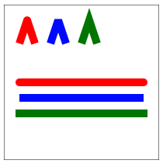
Line Attributes, cont’d
Line caps:
line joins
con.lineCap = "round";
con.strokeStyle = "red"
con.beginPath();
con.moveTo(20, 100);
con.lineTo(180, 100);
con.stroke();
con.closePath();
con.lineCap = "butt";
con.strokeStyle = "blue"
con.beginPath();
con.moveTo(20, 120);
con.lineTo(180, 120);
con.stroke();
con.closePath();
line caps
con.lineCap = "square";
con.strokeStyle = "green"
con.beginPath();
con.moveTo(20, 140);
con.lineTo(180, 140);
con.stroke();
con.closePath();
canvas/lines.html

Slide 21
Arcs and Circles
starting and ending angles
in radians
radius
arc(70, 30, 50, 0, Math.PI, false)
center position
drawing direction
true: counter-clockwise
false: clockwise
Compass | Radians
East | 0
South | Math.PI/2
West | Math.PI
North | 3*Math.PI/2

Slide 22
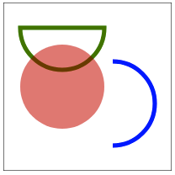
Arcs and Circles, cont’d
// Stroked closed half-circle
con.strokeStyle = "green";
con.lineWidth = "5";
con.beginPath();
con.arc(70, 30, 50, 0, Math.PI, false);
con.closePath();
con.stroke();
// Filled full circle
con.fillStyle = "rgba(255, 0, 0, 0.5)";
con.beginPath();
con.arc(70, 100, 50, 0, 2*Math.PI, true);
con.closePath();
con.fill();
// Stroked quarter arc
con.strokeStyle = "blue";
con.beginPath();
con.arc(130, 120, 50, Math.PI/2, 3*Math.PI/2, true);
con.stroke();
con.closePath();
canvas/arcs.html

Slide 23
Quadratic Curve
Curve with starting and ending points.
A control point affects the shape of the curve.
quadraticCurveTo(100, 10, 190, 190)
control point
position
ending point
position

Slide 24
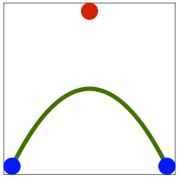
Quadratic Curve, cont’d
con.strokeStyle = "green";
con.beginPath();
con.moveTo(10,190);
con.quadraticCurveTo(100, 10, 190, 190);
con.stroke();
con.closePath();
// Blue dots: start and end points.
drawDot(10, 190, "blue");
drawDot(190, 190, "blue");
// Red dot: control point.
drawDot(100, 10, "red");
canvas/quadratic.html
function drawDot(x, y, color)
{
con.fillStyle = color;
con.beginPath();
con.arc(x, y, 10, 0, 2*Math.PI, true);
con.fill();
con.closePath();
}

Slide 25
Bézier Curve
Similar to the quadratic curve, but with two control points.
bezierCurveTo(100, 10, 100, 190, 190, 190)
control point #1
position
control point #2
position
ending point
position

Slide 26
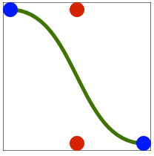
Bézier Curve, cont’d
canvas/bezier.html
con.strokeStyle = "green";
con.beginPath();
con.moveTo(10,10);
con.bezierCurveTo(100, 10, 100, 190, 190, 190);
con.stroke();
con.closePath();
// Blue dots: start and end points.
drawDot(10, 10, "blue");
drawDot(190, 190, "blue");
// Red dots: control points.
drawDot(100, 10, "red");
drawDot(100, 190, "red");

Slide 27
Drawing an Image
Draw the entire image:
Draw part of the image:
destination
position
drawImage(image, 10, 10, 180, 135)
destination
width and height
image upper left
corner position
destination
position
drawImage(image, 150, 70, 190, 120, 10, 10, 180, 110)
image width
and height
destination
width and height

Slide 28
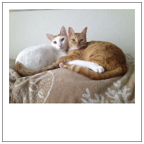
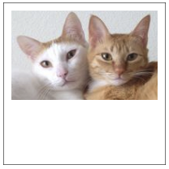
Drawing an Image, cont’d
var image = new Image();
image.src = "images/RonCats.jpg";
...
con.drawImage(image, 10, 10, 180, 135);
...
con.drawImage(image, 150, 70, 190, 120, 10, 10, 180, 110);
canvas/images.html

Slide 29
Altering Pixels
An image is displayed in a canvas as an array of pixels.
Each pixel takes up four elements of the array, R, G, B, and A, each value can be 0 – 255.
Convert an image to imageData to get the array of RGBA values.
You can then alter each value.

Slide 30
Altering Pixels, cont’d
var imageData = con.getImageData(10, 10, 180, 135);
for (var row = 0; row < 135; row++) {
for (var col = 0; col < 180; col++) {
var index = 4*(col + row*imageData.width);
var r = imageData.data[index];
var g = imageData.data[index+1];
var b = imageData.data[index+2];
var a = imageData.data[index+3];
g = r;
b = r;
imageData.data[index] = r;
imageData.data[index+1] = g;
imageData.data[index+2] = b;
imageData.data[index+3] = a;
}
}
con.putImageData(imageData, 10, 10);
Get the image data
from the canvas.
Separate each pixel
into R, G, B, and A
What is
the result?
Alter each pixel.
canvas/pixels.html
Set the altered pixel
back into the image data.
Put the altered image data
back into the canvas.

Slide 31
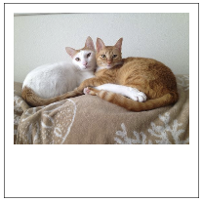
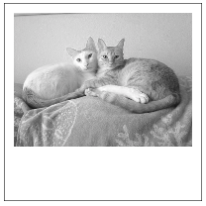
Altering Pixels, cont’d
Original:
Altered:

