Slide 1
TicketBloom
Where Support Blossoms: Real-Time Customer Ticket CRM
ARPITA MALETH | CU23BCA0011A
Chanakya University · BCA Programme · March – April 2026

Slide 2
THE PROBLEM & OUR SOLUTION
Mission & Objective
To bridge the gap between customers and support agents through an enterprise-grade, event-driven ecosystem that ensures scalability and real-time responsiveness.
❌ Legacy CRUD Friction
✅ The Event-Driven Shift
Traditional support systems face blocking operations. Synchronous API calls lead to bottlenecks during high traffic, causing delays in ticket updates and frustrating both agents and customers.
TicketBloom utilizes Apache Kafka to decouple background tasks from the main execution thread. This results in a non-blocking, asynchronous flow where events are streamed instantly across the system.

Slide 3
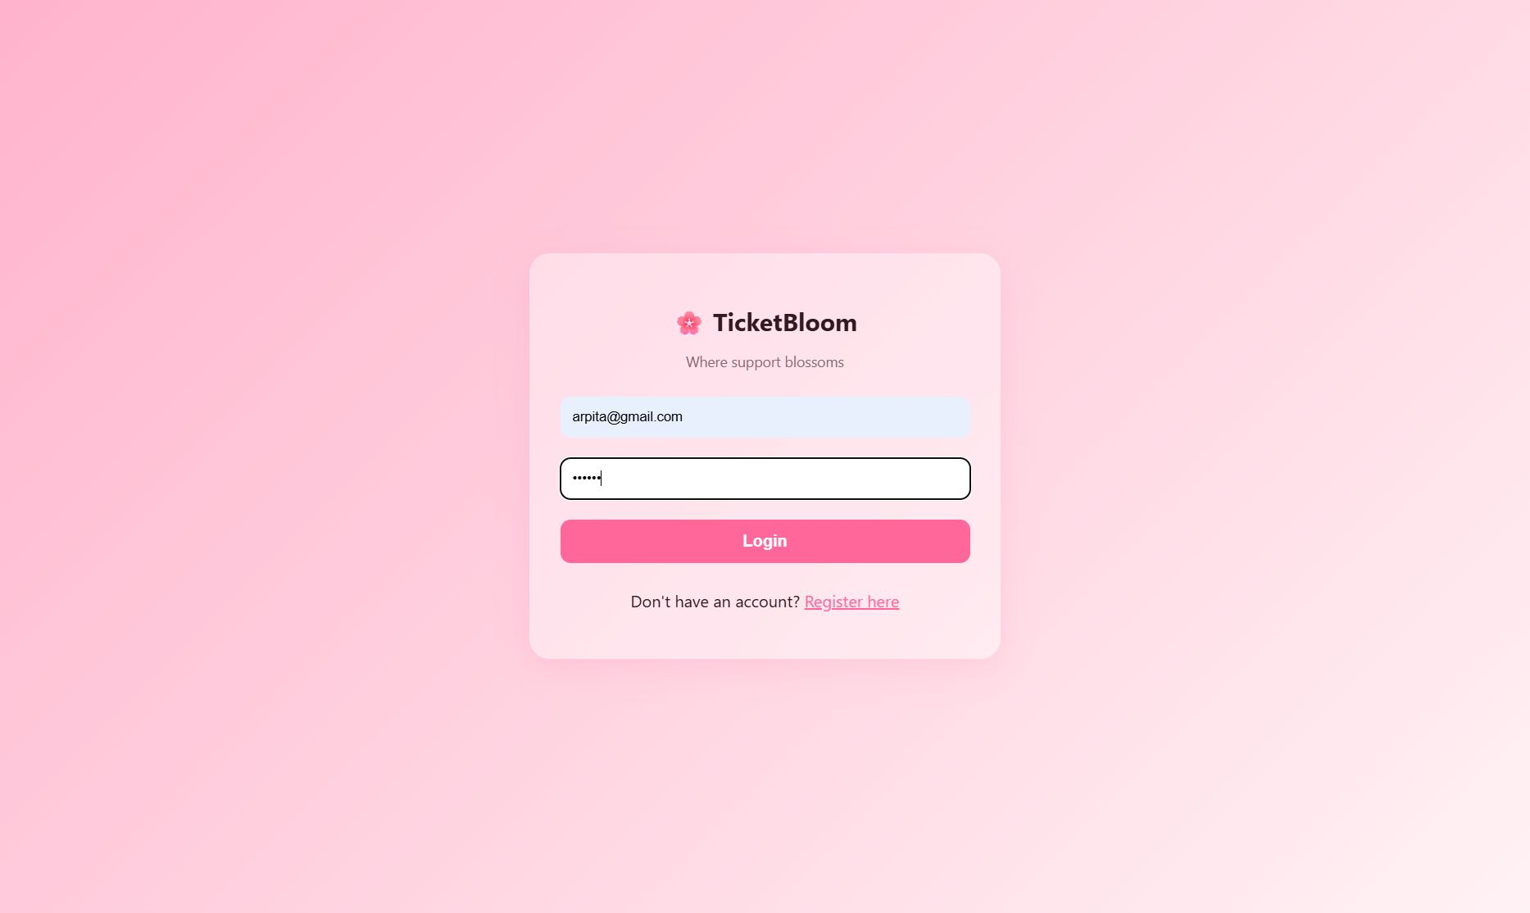
SECURITY
Secure & Stateless Authentication
Stateless Authentication
TicketBloom employs JSON Web Tokens (JWT) for secure, stateless sessions. User privacy is paramount, utilizing bcryptjs for advanced password hashing before data ever reaches the database.
Role-Based Access Control (RBAC) for Customers & Agents
Secure Register / Login endpoints
Protected role-aware dashboard views

Slide 4
ARCHITECTURE
Event-Driven Backend Architecture
Customer
Frontend
Express.js
REST API
Apache
Kafka Broker
Kafka
Consumer Bot
MongoDB
Database
Non-Blocking
Decoupled Services
Real-Time Processing
API requests resolve instantly — Kafka handles heavy tasks in the background without slowing responses.
Producer/Consumer pattern separates ticket events from core business logic for maximum reliability.
Events such as ticket creation and status updates are streamed and processed automatically by consumer bots.

Slide 5
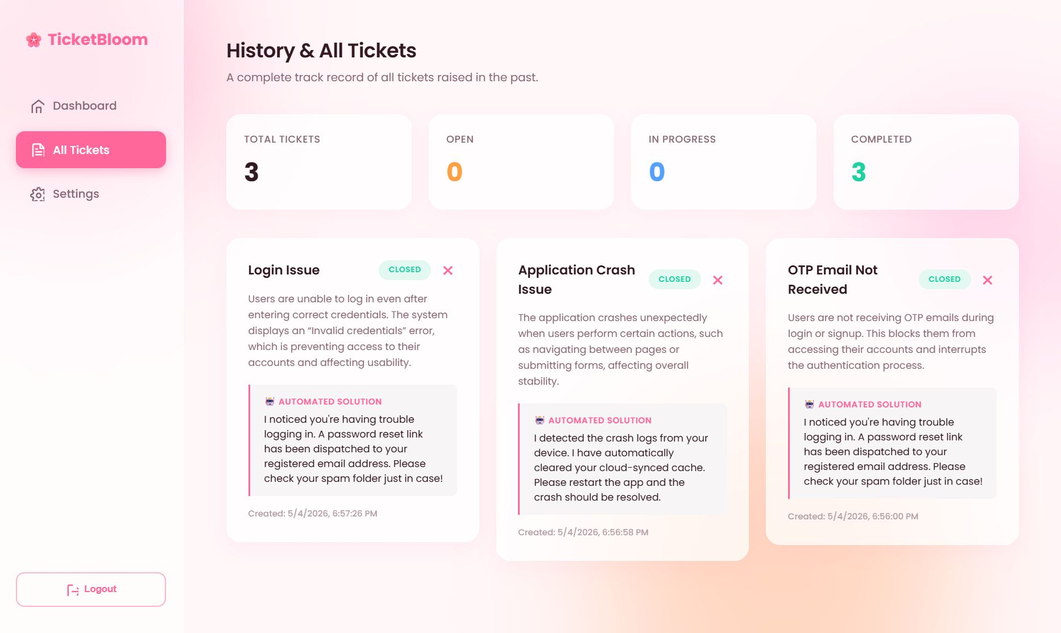
DASHBOARD
Premium UX & Dynamic Analytics
Glassmorphism Styling
High-end frosted glass elements provide a professional yet visually soothing experience across all views.
Comprehensive Tracking
Customers see their own ticket history; Agents have full visibility to manage and close systemic issues in real time.
Status Lifecycle
Statuses update through Open → In Progress → Closed automatically via event-driven Kafka consumer triggers.

Slide 6
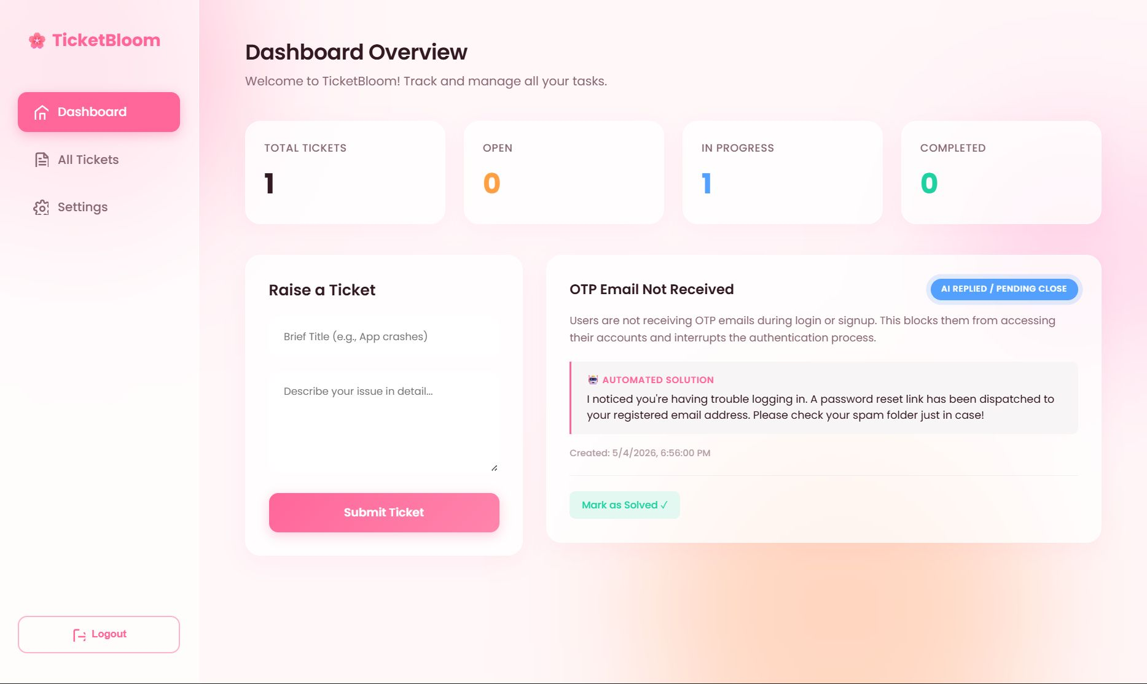
TICKET MANAGEMENT
Full Ticket Lifecycle
Comprehensive Tracking
Every ticket has a detailed journey. Customers can view their history, while Agents have full visibility into systemic issues. Statuses are updated in real-time:
Open
In Progress
Closed

Slide 7
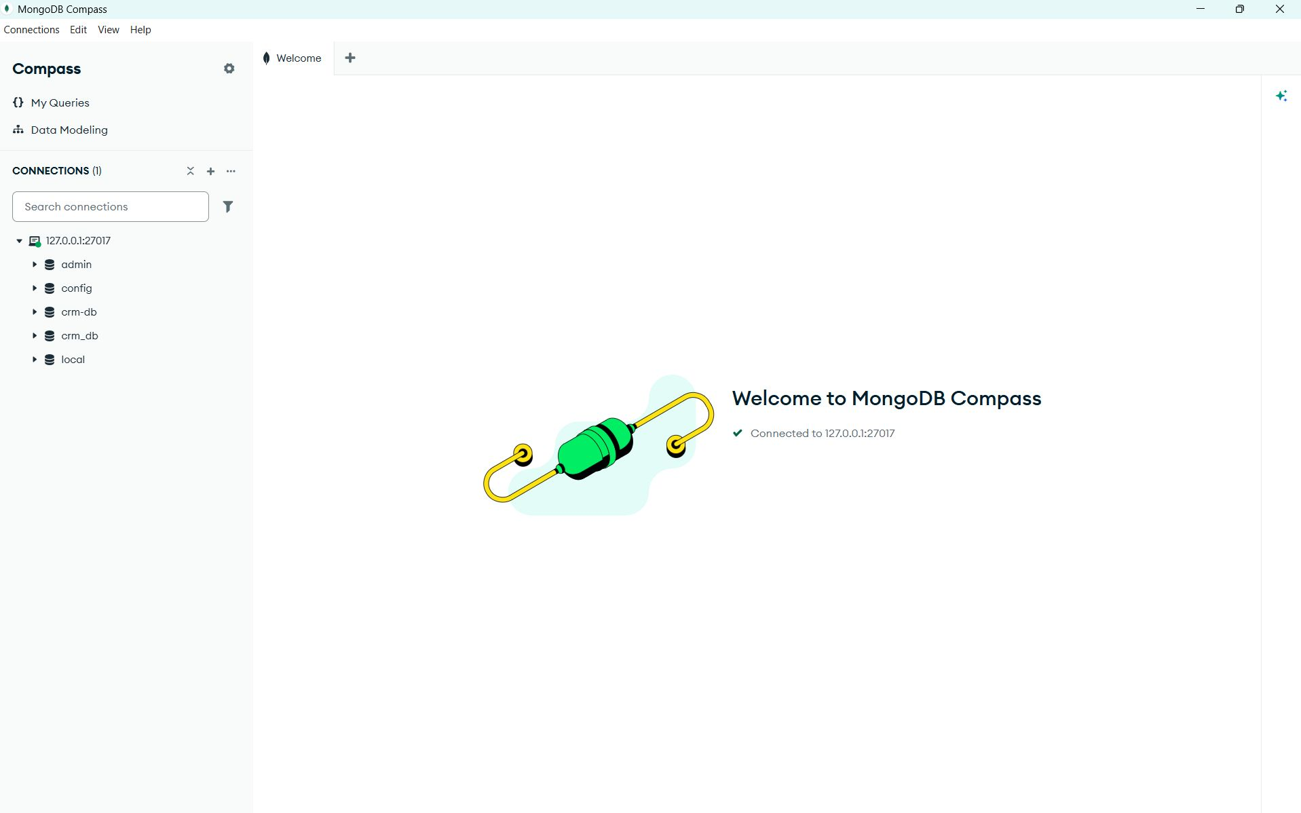
DATA LAYER
Flexible Data Modeling
MongoDB serves as the primary persistence layer, storing Users and Tickets with high availability. The native MongoDB driver enforces strict data schemas, keeping the agility required for a scaling CRM.
Stateless session storage support via JWT
High-performance ticket querying & filtering
Seamless local & MongoDB Atlas integration

Slide 8
TECHNOLOGY
The Technology Stack
⚙️
🗄️
⚡
🔐
Runtime
Database
Broker
Security
Node.js & Express.js
MongoDB
Apache Kafka
JWT & Bcrypt
Scalable backend architecture
NoSQL document storage
Event-driven streaming backbone
Stateless token authentication
Frontend: HTML5 · CSS3 (Glassmorphism) · Vanilla JavaScript · Fetch API · Role-Aware Dashboards

Slide 9
AGILE METHODOLOGY
Agile Roadmap — 3 Sprint Cycle
Sprint 1
Sprint 2
Sprint 3
Auth & Foundation
Ticket Logic & RBAC
Kafka Streaming & UI Polish
Mar 1 – Mar 14, 2026
Mar 15 – Mar 28, 2026
Mar 29 – Apr 11, 2026
24 pts delivered
32 pts delivered
24 pts delivered
User Registration & Login flows
JWT stateless authentication
bcryptjs password hashing
MongoDB database setup
Basic API scaffolding
Ticket schema (MongoDB)
CRUD APIs for ticket management
Role-based access control (RBAC)
Agent & Customer dashboards
Status tracking (Open / In Progress / Closed)
Kafka producer for ticket events
Kafka consumer bot (background processing)
In-app notification logic
Glassmorphism UI polish & responsiveness
Bug resolution & final testing

Slide 10
PROGRESS
Sprint Feature Progress
Phased development ensuring modularity and stability at every release milestone.
Sprint 1: Auth & Foundation
100%
Sprint 2: Ticket Logic & RBAC
100%
Sprint 3: Kafka Streaming & UI Polish
100%
3
80
100%
0
Sprints
Story Points
Velocity
Open Bugs

Slide 11
Any Questions?
Thank you for your time and engagement.
Arpita Maleth | CU23BCA0011A
March – April 2026 Sprint Cycle · Chanakya University

