Slide 1
CUSTOMER SHOPPING BEHAVIOR ANALYSIS
Uncovering insights from 3,900 purchases to guide strategic business

Slide 2
3,900 PURCHASES REVEAL A BROAD BUT UNDER-SUBSCRIBED CUSTOMER BASE
TRANSACTIONS
AVERAGE PURCHASE
AVERAGE REVIEW
3,900
$59.76
3.75
BASELINE READ
REACH IS ALREADY THERE.
Across 4 product categories and 50 locations.
Typical basket size.
Customer experience rating.
Subscription and repeat purchase are the open opportunities.
The base is broad enough to support retention growth. The next question is how to convert reach into repeat behavior.
02

Slide 3
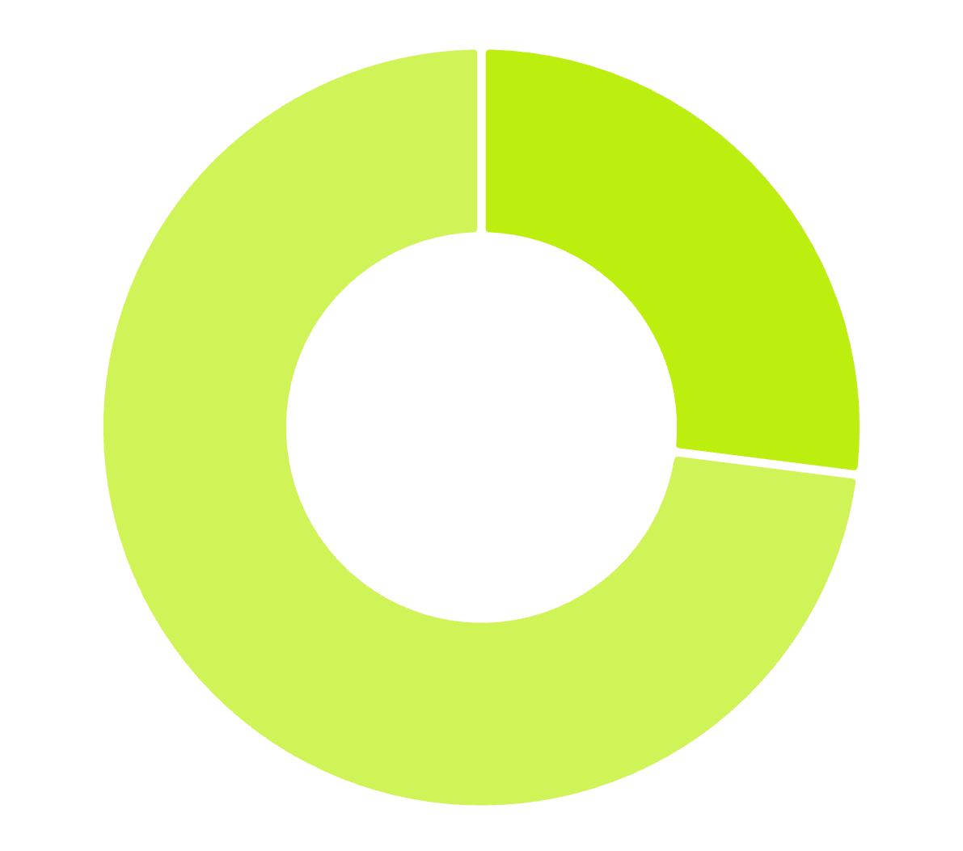
SUBSCRIPTION GAP
SUBSCRIPTION IS THE CLEAREST GROWTH GAP
Only 1,053 customers subscribe versus 2,847 non-subscribers.
Make subscription value visible at the moment of purchase.
27% SUBSCRIBED · 73% NOT SUBSCRIBED
03

Slide 4
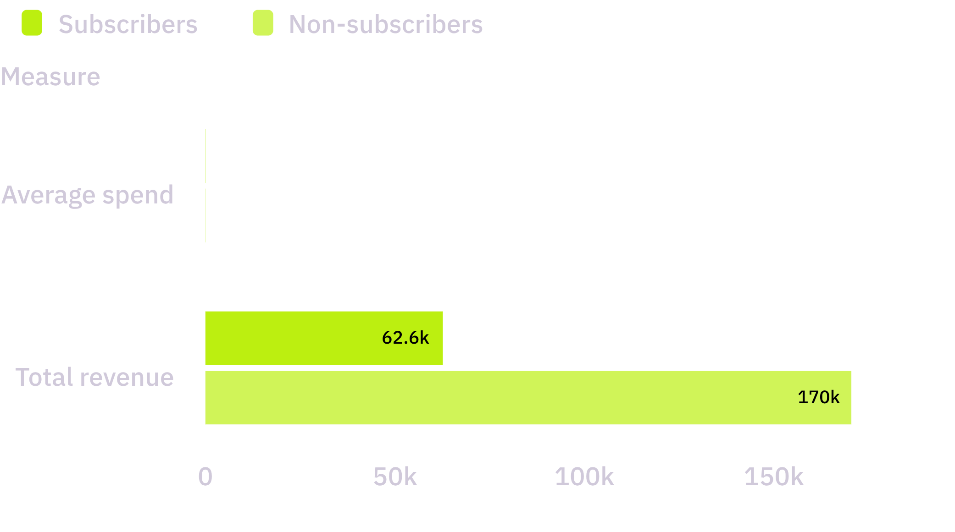
SUBSCRIBERS ARE NOT SPENDING MORE TODAY
AVERAGE SPEND IS NEARLY IDENTICAL; SCALE STILL SITS WITH NON-SUBSCRIBERS.
IMPLICATION
DISCOUNT ALONE IS NOT THE ANSWER.
Subscription strategy needs a frequency or retention benefit, not only a discount.
04

Slide 5
LOYAL
3,116
Customers already showing the strongest relationship.
LOYALTY BASE
LOYAL CUSTOMERS ARE THE FOUNDATION TO ACTIVATE
RETURNING
NEW
701
83
Customers to deepen.
Customers to develop.
Repeat behavior already dominates the customer base.
Convert repeat behavior into membership, referrals, or tailored offers.
05

Slide 6



CLOTHING LEADS CATEGORY DEMAND AND REVENUE
TOP CLOTHING PRODUCTS BY ORDERS
THE DASHBOARD PUTS CLOTHING FIRST IN BOTH SALES AND REVENUE VIEWS.
Category | Demand signal
Clothing | Highest category in dashboard
Accessories | Second tier
Footwear | Third tier
Outerwear | Fourth tier
Blouse
Pants
Shirt
Use clothing as the anchor for bundles and subscription benefits.
06

Slide 7
HIGHEST DISCOUNTED-PURCHASE RATES
47.37–50.00%
Hat · Sneakers · Coat · Sweater · Pants
DISCOUNT SIGNAL
DISCOUNTS CAN DRIVE VOLUME WITHOUT BUILDING LOYALTY
839 customers used a discount and still spent above the average purchase amount.
ABOVE-AVERAGE SPENDERS USING A DISCOUNT
839
Test targeted offers against blanket discounting.
Volume exists. Loyalty still needs a separate mechanism.
07

Slide 8
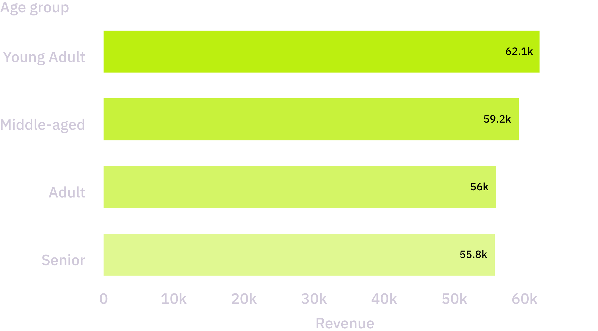
YOUNG ADULTS CONTRIBUTE THE MOST REVENUE
THE SPREAD IS NARROW, BUT YOUNG ADULT LEADS BOTH REVENUE AND SALES IN THE DASHBOARD VIEW.
PRIORITY SEGMENT
START WITH YOUNG ADULT.
Prioritize this segment in acquisition and repeat-purchase journeys.
08

Slide 9
TOP-RATED PRODUCTS
Gloves 3.86 · Sandals 3.84 · Boots 3.82 · Hat 3.80 · Skirt 3.78
OFFER SUPPORT
PRODUCT QUALITY AND CONVENIENCE CAN SUPPORT THE OFFER
SHIPPING SIGNAL
Express shipping averages $60.48 versus $58.46 for Standard shipping
Trusted products and express shipping give membership benefits something concrete to improve.
ACTION
Pair trusted products with convenience-led membership benefits
09

Slide 10
THREE MOVES CAN TURN BEHAVIOR INTO GROWTH
Grow subscriptions
01
Attach clear benefits to the strongest repeat-purchase moments
Reward loyalty
02
Create differentiated offers for the 3,116-customer loyal segment
Protect margin
03
Target discounts where they change behavior, then measure repeat rate

