Slide 1
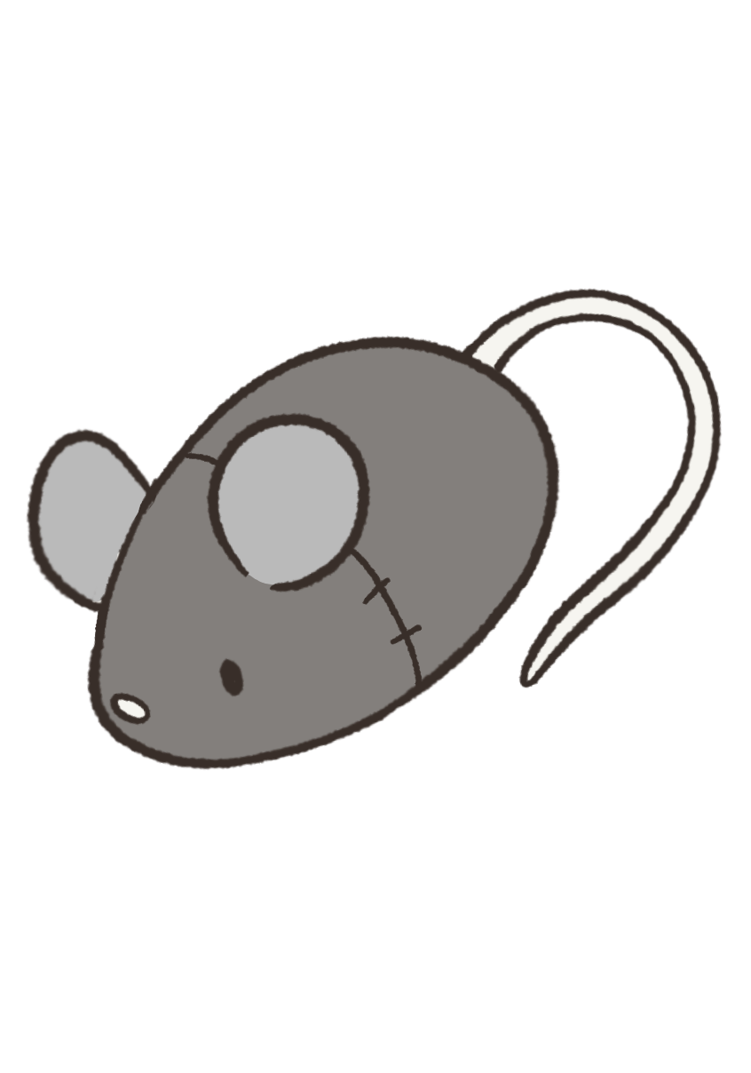

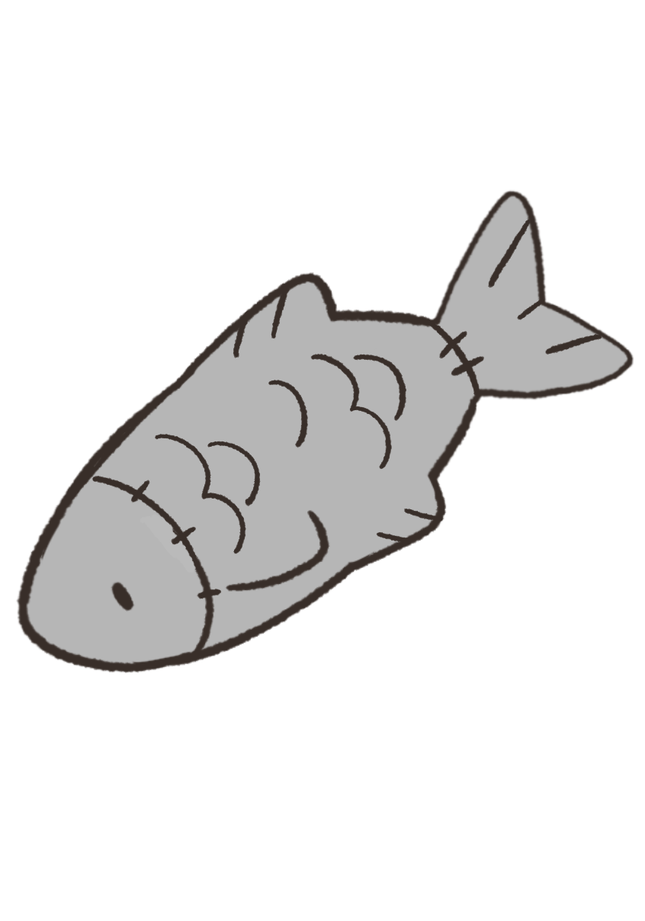
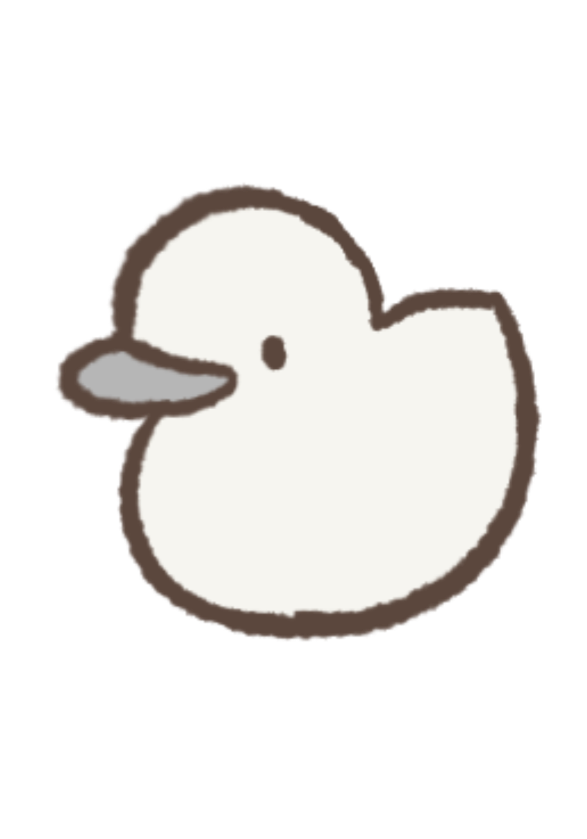
Task Friend
A Tamagotchi inspired To-Do List
Course: CIS 43 Instructor: Helen Sun
Christian Villanueva
Arpita Sakshee
Maya Louise Dagdag
Katrina Mai
Notes:
Christian

Slide 2
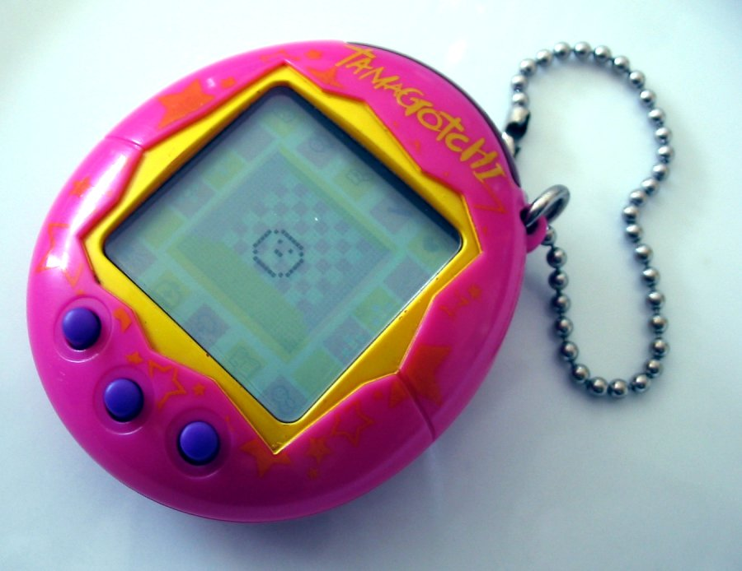

What’s a Tamagotchi?
An interactive digital pet game that allows users to care for a virtual creature
Tamagotchi Connection V1 2004
Users must provide the pet with the proper care so it can evolve into its best possible form
Kuchipatchi Sprite 1996
Users must feed it, play with it, and give it proper attention
Neglecting a Tamagotchi results in negative behavior or even death
Kuchipatchi Artwork
Notes:
Maya

Slide 3
What would a Tamagotchi To-Do List be like?
Earn Points
Based on difficulty of task
Gameplay Loop
Easy
Medium
Hard
Complete tasks to earn points
Based on time of completion
On time
Late
There's always something
that needs to be done
Task Friend health depletes over time
Spend Points
To manage Task Friend’s health
Spend points to care for Task Friend
Fullness
Happiness
Note: Accountability based application
Wellness
Notes:
Katrina

Slide 4
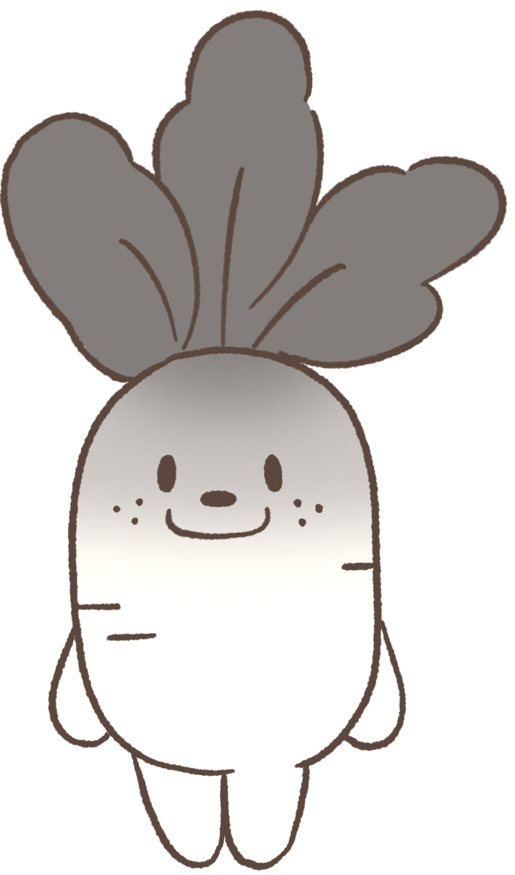

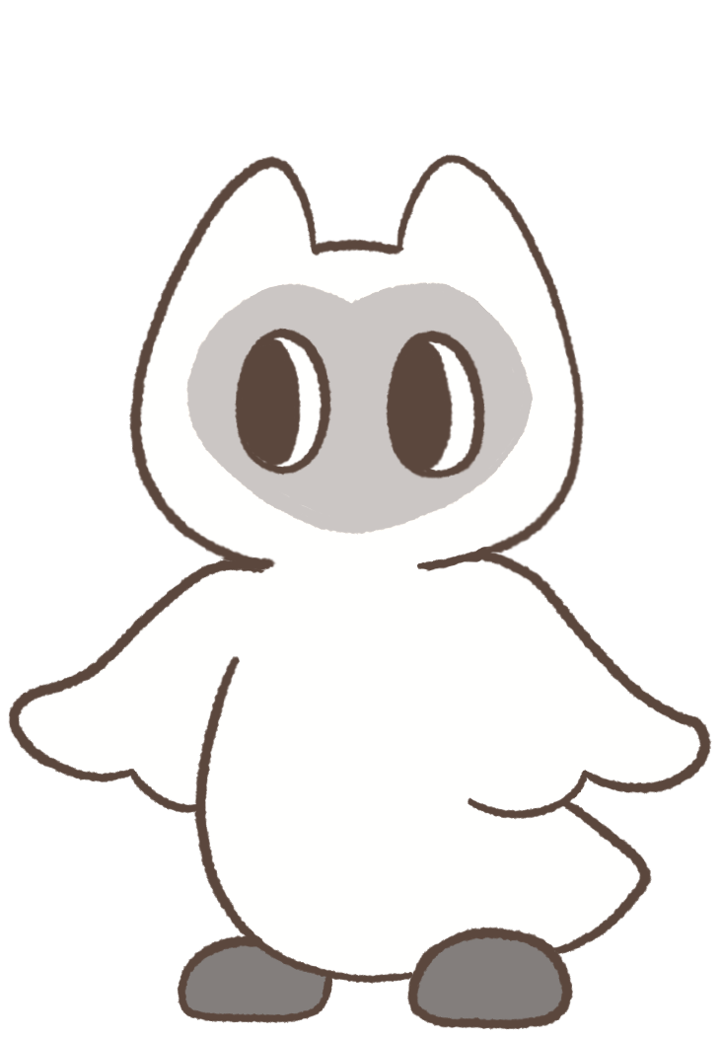
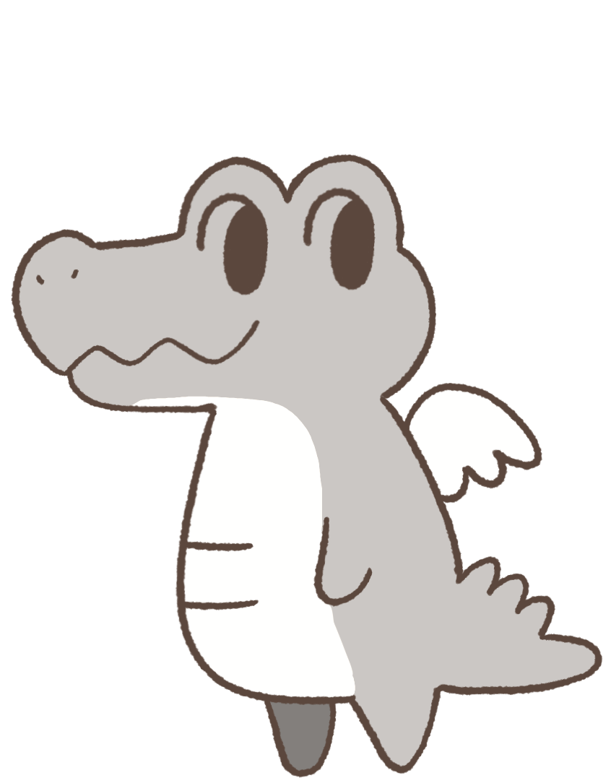
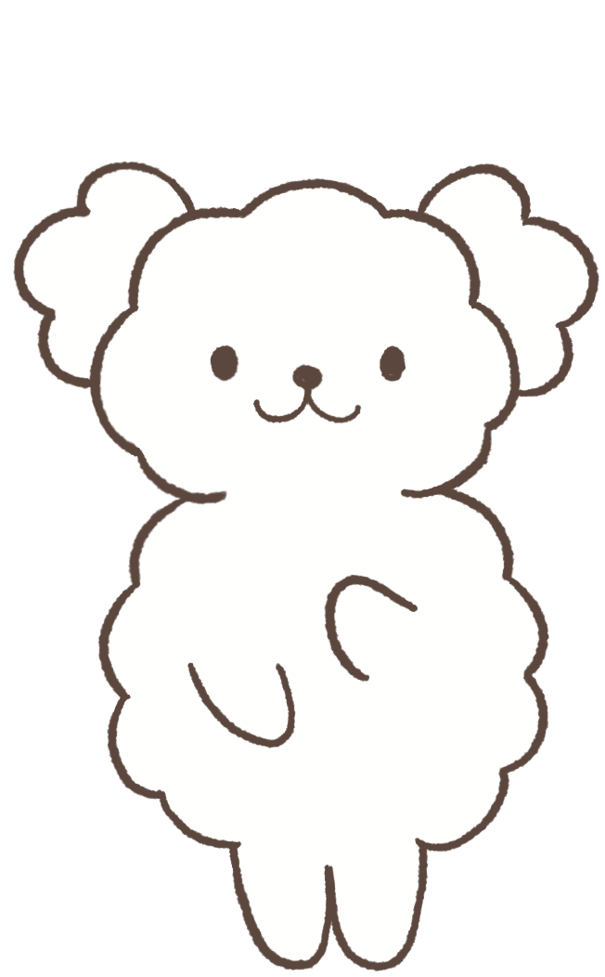
Task Friends!
…
Do your tasks! Or not. It’s your life.
Have some flowers as a reward!
Anyone have snacks? :D
Do your tasks. Or else. :)
Ozzo
Shey
Milo
Petunia
Tee
(Michelangelo)
Notes:
Christian

Slide 5
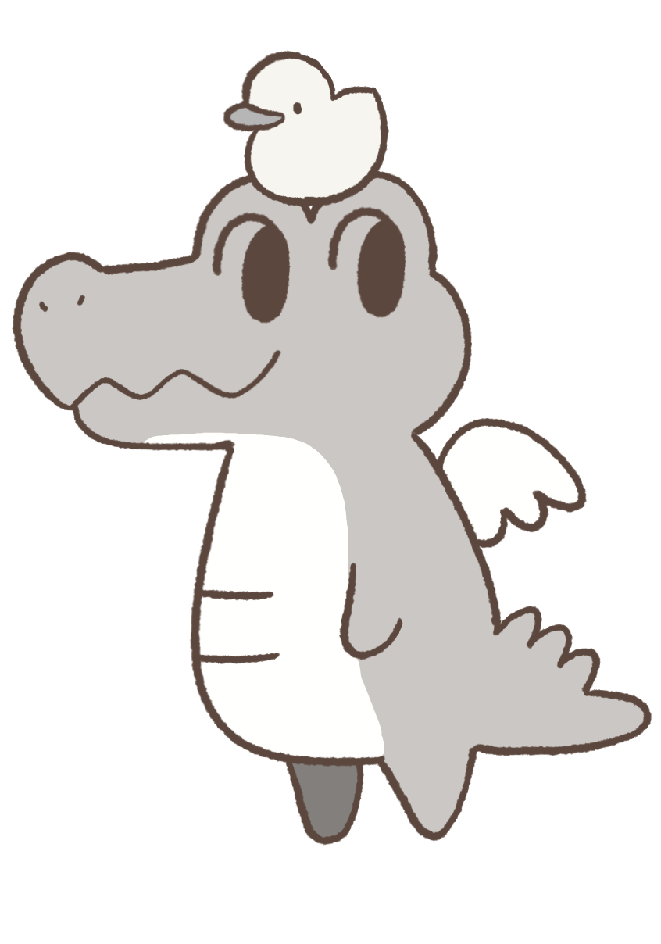

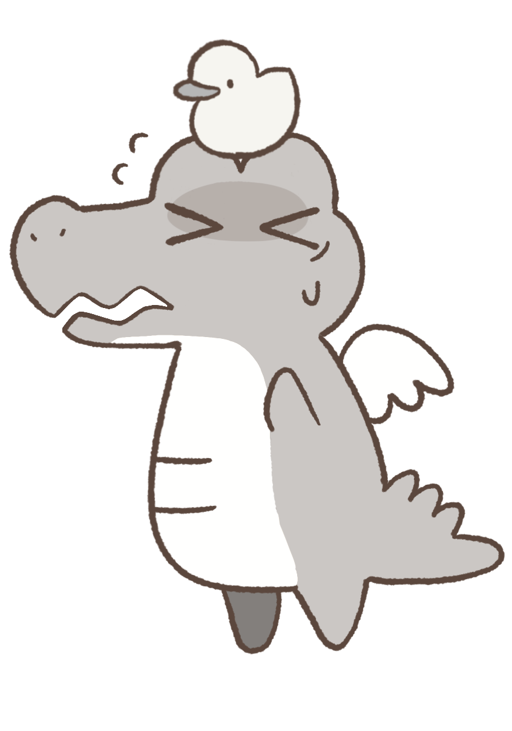

Demo
Health
Healthy
Health
Weak
Health
Sick
Health
Dead
Notes:
Arpita

Slide 6
Future Features
To-Do List
Task Friend
Check Boxes
Removing checked tasks adds points Removing unchecked task adds no points
Death and Revival
Lose all points, Complete certain amount of tasks to revive Task Friend
R I P
Task Difficulty Rating
Growth Stages
Physical
Mental
Time
Egg
Child
Teen
Adult
Web Based
Animations
Expressions, Motivational messages
Online Accessibility
View other player’s Task Friends
Let Task Friends play with each other
:
)
Personalities
Affecting player interactions
Notes:
(Katrina) To-Do List
(Maya) Task Friend #1 & #2
(Christian) Task Friend #3 & #4
(Arpita) Web Based

Slide 7
Any Questions?
?
References
Tamagotchi - Wikipedia (Tamagotchi Toy Picture)
Tamagotchi (1996 Pet)/Character list
(Tamagotchi sprite and artwork)
Notes:
Everyone

