Slide 1
What Is pyspark ?
PySpark has been released in order to support the collaboration of Apache Spark and Python.
It is Python API for Apache Spark, an open source, distributed computing framework and set of libraries for real-time, large-scale data processing.
It supports most of Spark’s features such as Spark SQL, DataFrame, Sreaming, Mlib and Spark Core.
It helps us interface with Resilient Distributed Datasets (RDDs) in Apache Spark and Python programming language.

Slide 2
PySpark modules
PySpark RDD (pyspark.RDD)
PySpark DataFrame and SQL (pyspark.sql)
PySpark Streaming (pyspark.streaming)
PySpark MLib (pyspark.ml, pyspark.mllib)
PySpark GraphFrames (GraphFrames)
PySpark Resource (pyspark.resource)

Slide 3
WHY PYSPARK ?
In memory computation with Spark
Swift Processing
Dynamic in nature
Fault tolerance in spark
Real time stream processing

Slide 4
Project description :
The purpose of our project is using customer review data of Airbnb and apply sentiment analysis to predict customer behavior.
WHAT IS SENTIMENT ANALYSIS ?
Sentiment analysis using pandas API on Spark is also referred to as opinion mining, is an approach to natural language processing (NLP) that identifies the emotional tone behind a body of text.
We concluded that most of the sentiments will be positive with an upward trend over time for the accommodation. As time moves forward, so will the overall sentiment of customers staying there increase and become positive.

Slide 5
Code flow :
Connect to Google Collab
Install PySpark on Google Collab .
Load Dataset
Importing libraries and packages
Create Spark object
Pre-processing Data.
Sentiments Analysis.
Predictions.

Slide 6
apply sentiment score
Textblob is a sentiment analysis library in Python. It can calculate the sentiment score from a method called sentiment.polarity that is scored from -1 (very negative) to +1 (very positive) with 0 being neutral.
Textblob is imported and a function called sentiment_score is applied to the customer feedback column to generate the sentiment polarity of each customer conversation in a new column, also called sentiment_score.

Slide 7
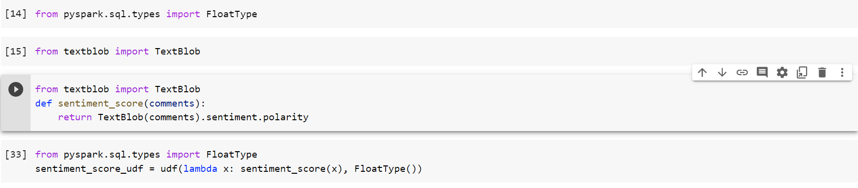
How to do it...
Create a sentiment function, sentiment_score as below:

Slide 8
Create a lambda function, called sentiment_score_udf, that maps sentiment_score into a user-defined function within Spark, udf, to each transaction and specifies the output type of FloatType() as below:

Slide 9
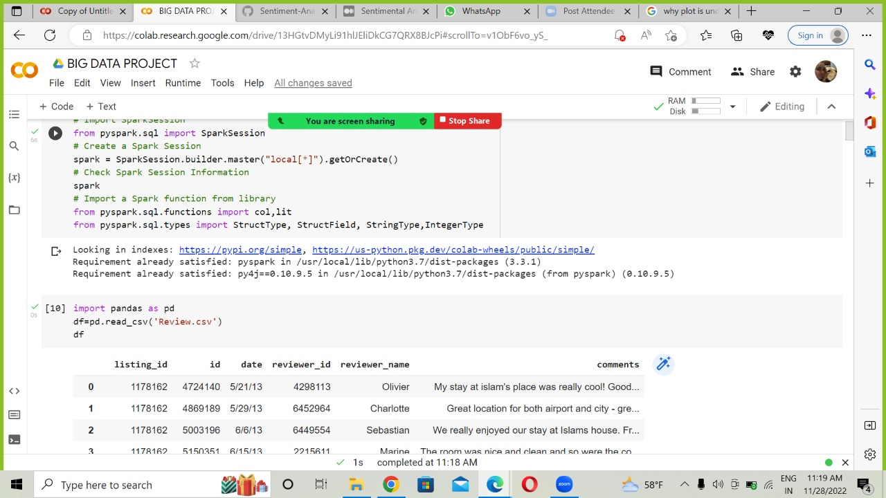
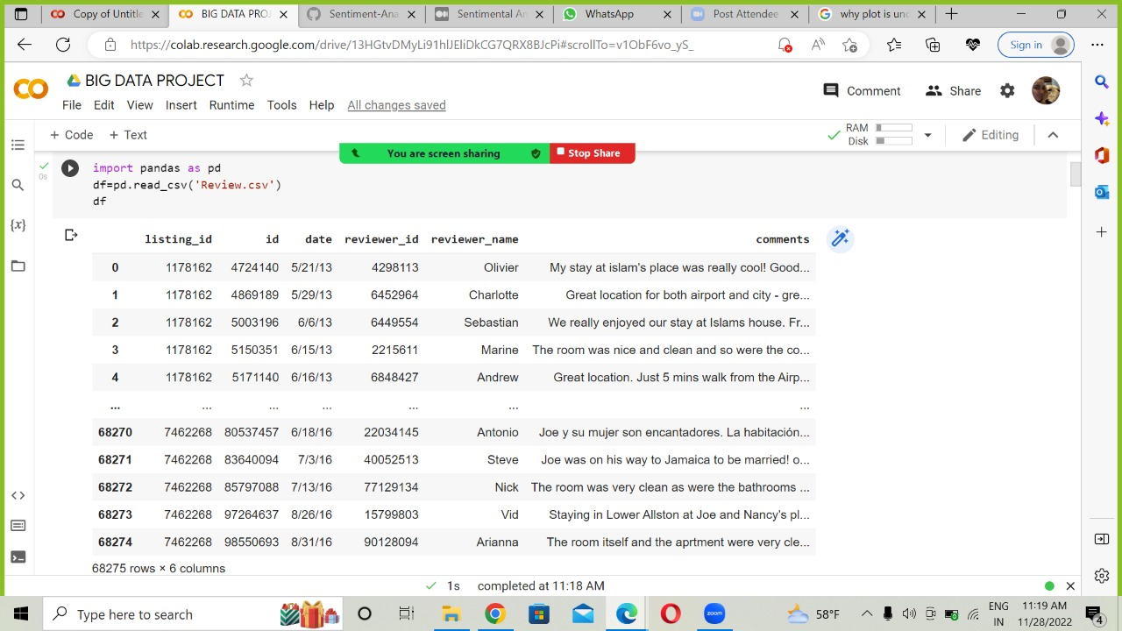
Loading the DATA
Creating Spark Session

Slide 10
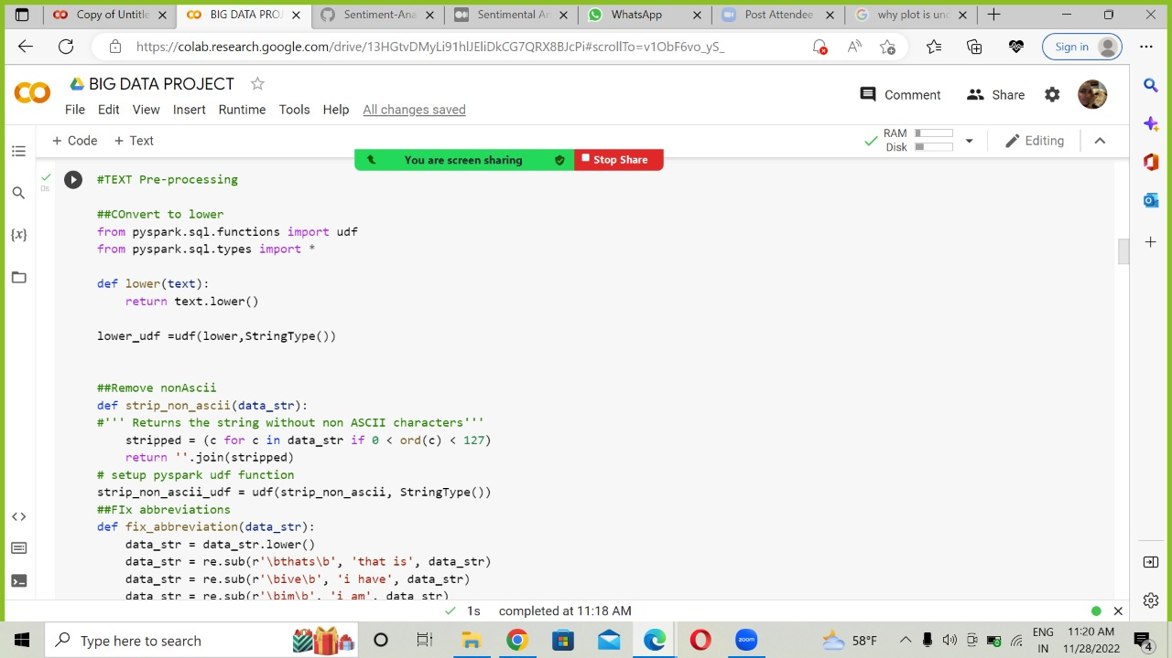
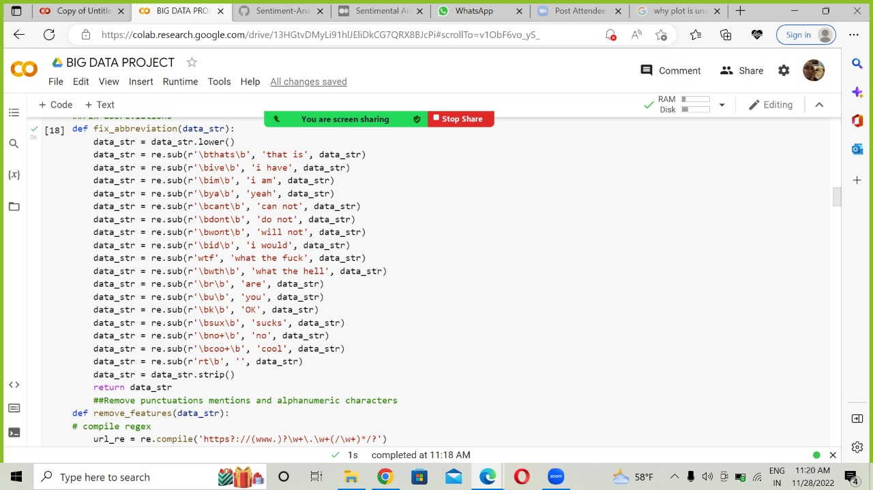
Data Cleaning
It is important to clean the data, to remove stop words, lemmatize, remove punctuation as well as convert upper case to lower case to ensure the data is read correctly. As well, we intentionally decided to split certain abbreviations such as can’t, don’t, isn’t and other colloquial terms common in reviews so that the data reads cannot and can’t similarly.

Slide 11
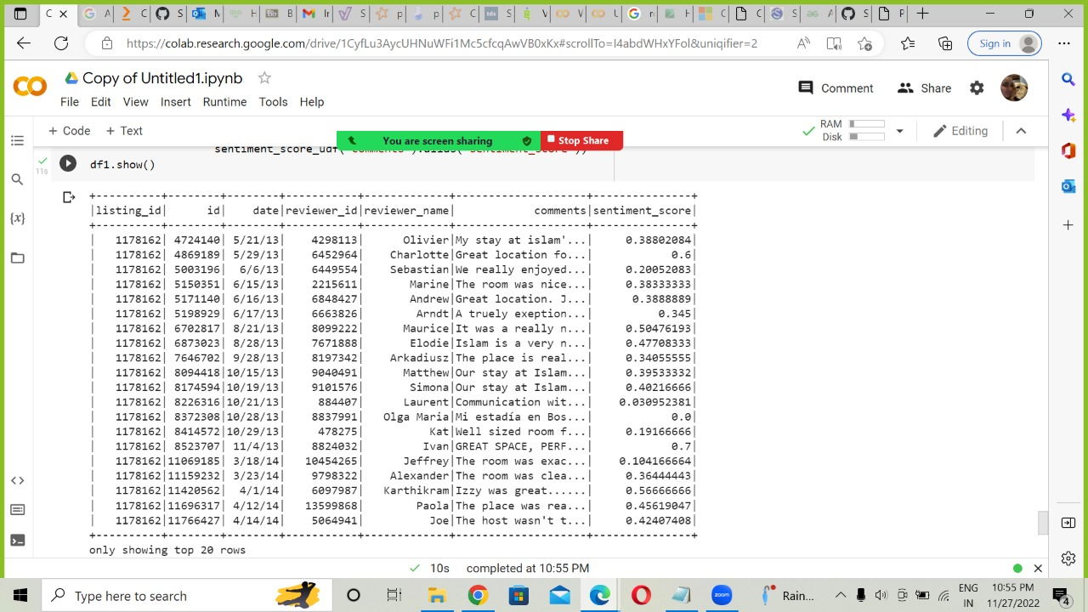
Sentiment Analysis by using NLP in Pyspark:
As we can see here, there are a range of sentiment scores with mostly positive sentiments for each of the listings. There is a significantly positive sentiment associated with the listings.

Slide 12
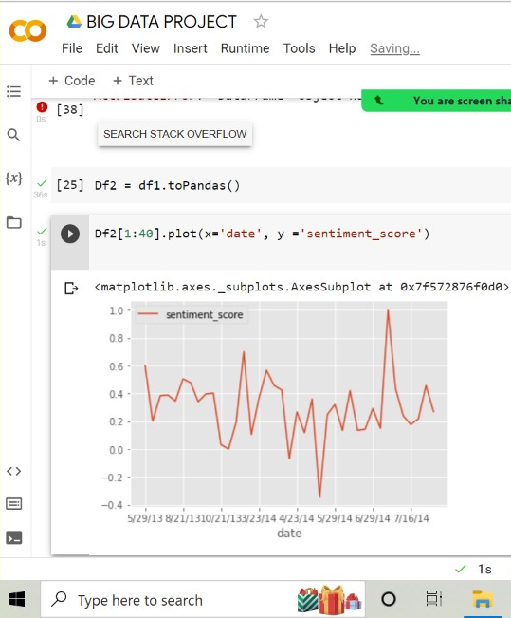
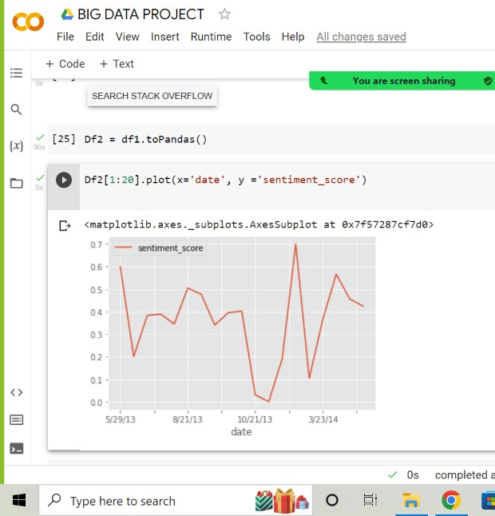
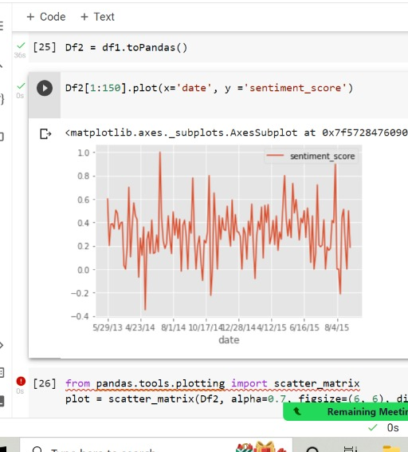
Visualizations with DATA
We can see here on the left for the sentiments that there is significant variation within positive sentiment scores when we do a plot of date vs sentiment score. Which means some people are really excited about the accommodations and others perhaps less as. When we no check this rend over 2014 and 2015, we see there there is more noise and variation with even negative sentiments showing up in 2014. That is of interest and future research could explore specific dates of negative sentiments and why that is the case. Over 2015 we see more such blips which suggests the listings have extreme reviews and suggestions.
Notes:
If we ran a line through the middle of the graph we would see that overall sentiments for the listings are between 0.2 and 0.4 which means they are positive.

Slide 13

THANK YOU!

