Slide 1

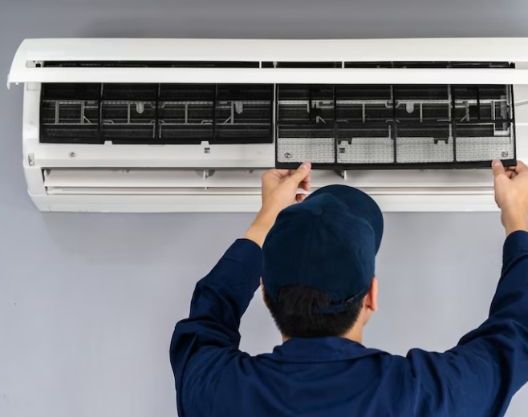
AC Service & Repair

