Slide 1
Implementing and comparing the in-order and out-of-order instruction execution for a two-level on-chip cache optimized for matrix multiplication operation.

Slide 2
Progress made so far:
We have implemented the in-order instruction execution by varying the following 4 fields in the cache configuration of the sim-cache simulator:
<name>:<nsets>:<bsize>:<assoc>:<repl>
<nsets> Number of sets in the cache
<bsize> Block size
<assoc> Associativity (power of two)
<repl> Replacement policy (l | f | r), where l = LRU, f = FIFO, r = random replacement

Slide 3
Benchmarks used:
We will be running the analysis on programs simulating multiplications of two 64X64 2-D matrices of integer values of 64 bits(8 bytes). We will uses three different types of matrices:
1) Full matrix multiplication
2) Diagonal matrix multiplication
3) Sparse matrix multiplication

Slide 4
Approach
We observed the miss rate for level 1 and level 2 data caches, by varying either one or two of the four parameters and keeping the rest constant.
<name>:<nsets>:<bsize>:<assoc>:<repl>
We ran number of configurations and have inferred information related to ideal parameter values for both data cache 1 and data cache 2.
we have generated graphical interpretation for better and easy understanding.

Slide 5
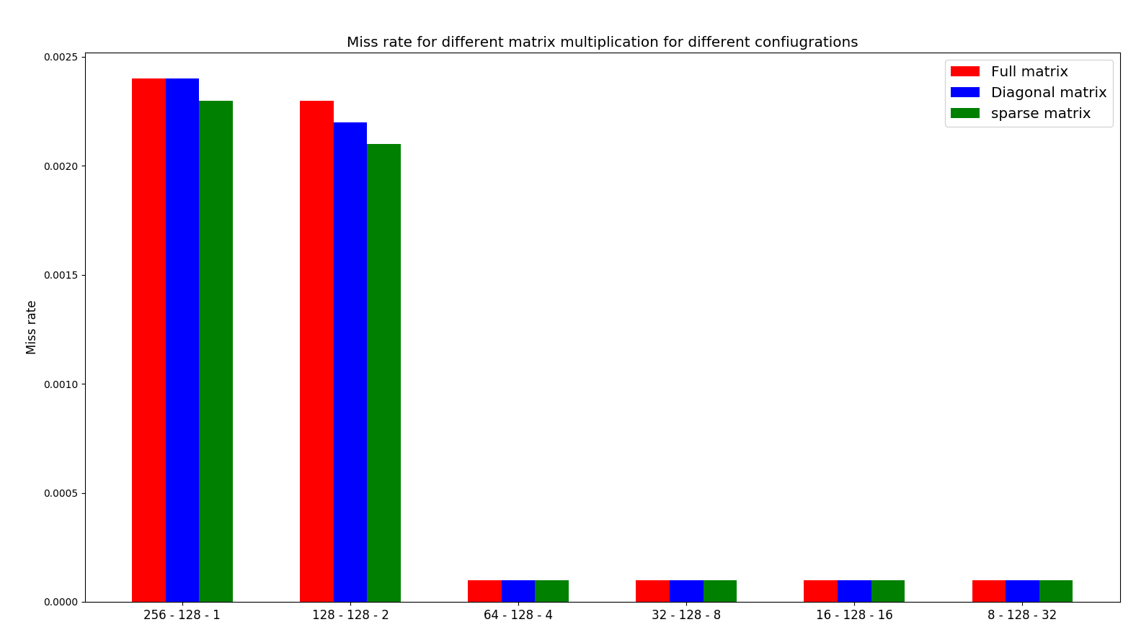
Associativity for Level – 1 Data Cache

Slide 6
Associativity is varied from 1 to 32 by keeping cache size and block size constant
Observation- As the associativity increases, the miss rate starts to decrease.
However, no performance gain is observed for associativity more than 4.
Therefore for data level 1 cache associativity of 4 provides best performance and going beyond that will only increase circuit complexity without any further performance gain .

Slide 7
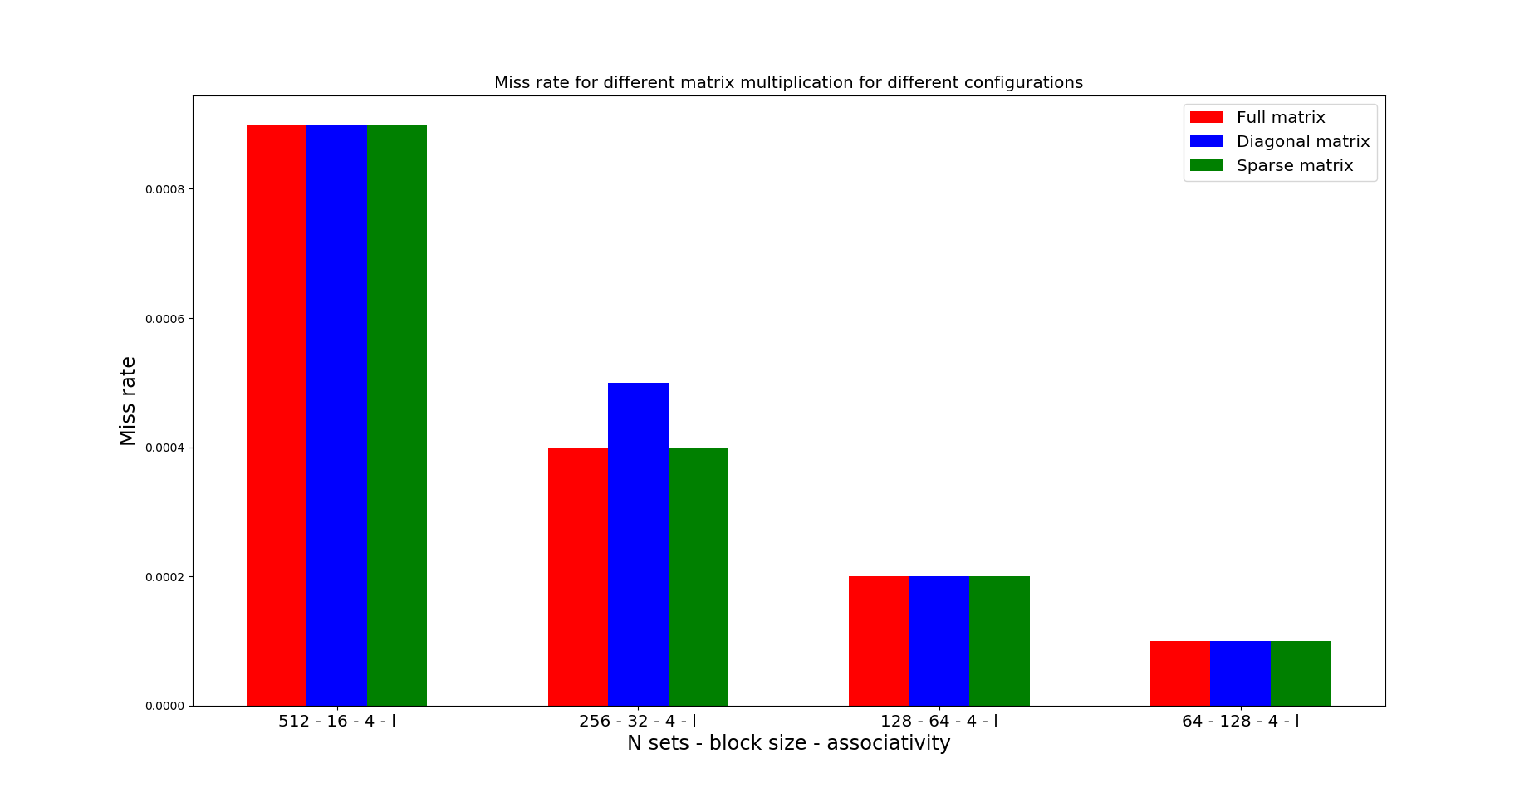
Block size for Level – 1 Data Cache

Slide 8
Associativity is kept constant to 4.
Block size is varied for a constant cache size of 8KB
The block size is varied from 16-128 bytes, and as we increase the block size the miss rate goes down.

Slide 9
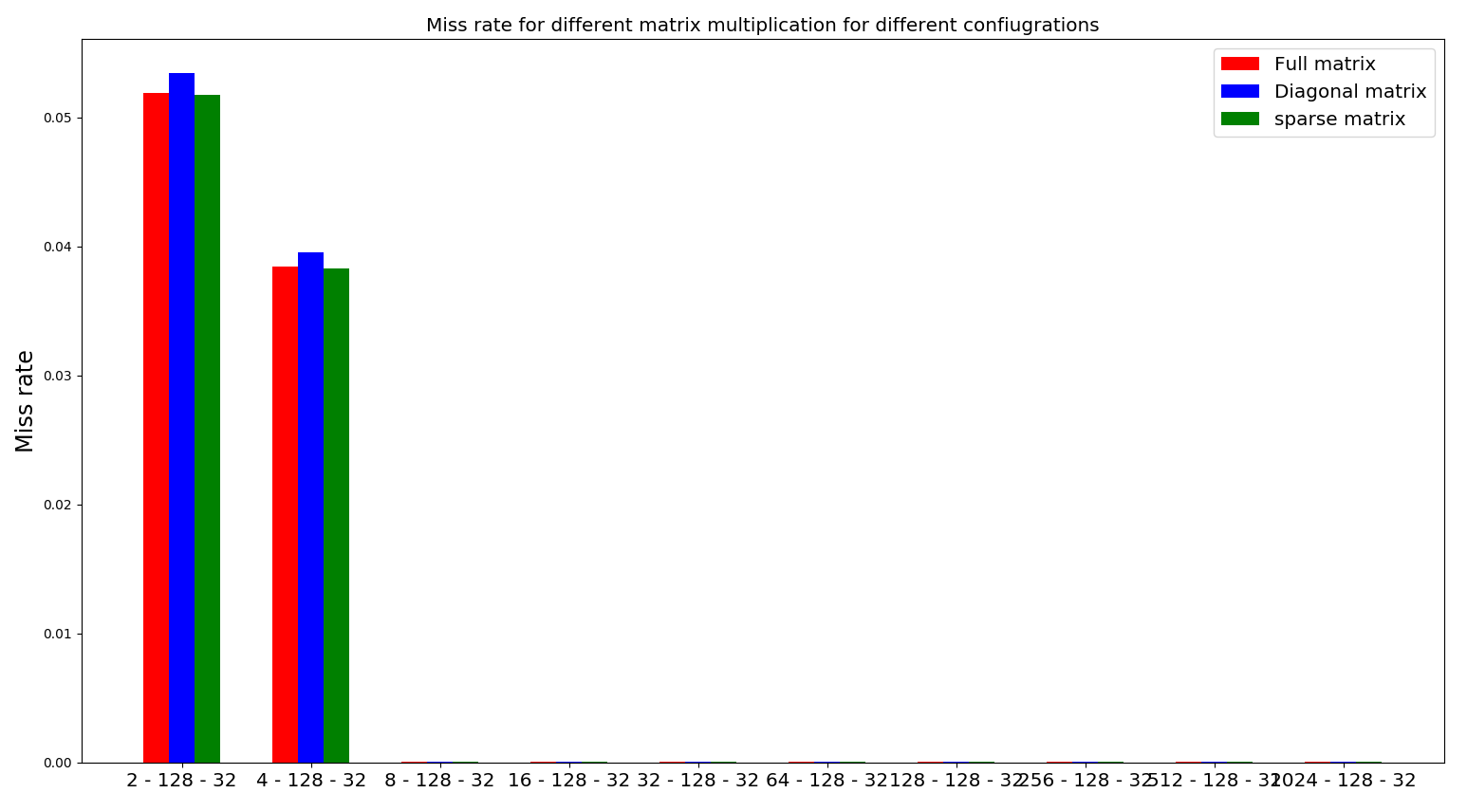
Cache size for Level – 1 Data Cache
8KB 16KB 32KB 64KB 128KB 256KB 512KB 1MB 2MB 4MB

Slide 10
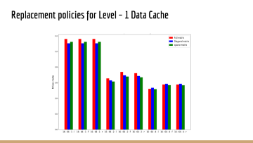
Cache size for Level – 1 Data Cache
Associativity and block size are kept constant; number of sets is varied.
Here, we vary the cache size by varying the number of sets.
( cache size= <nsets> * <bsize> * <assoc>)
As the cache size increases, miss rate decreases.
There is no performance gain if we increase the cache size more than 32 KB.

Slide 11
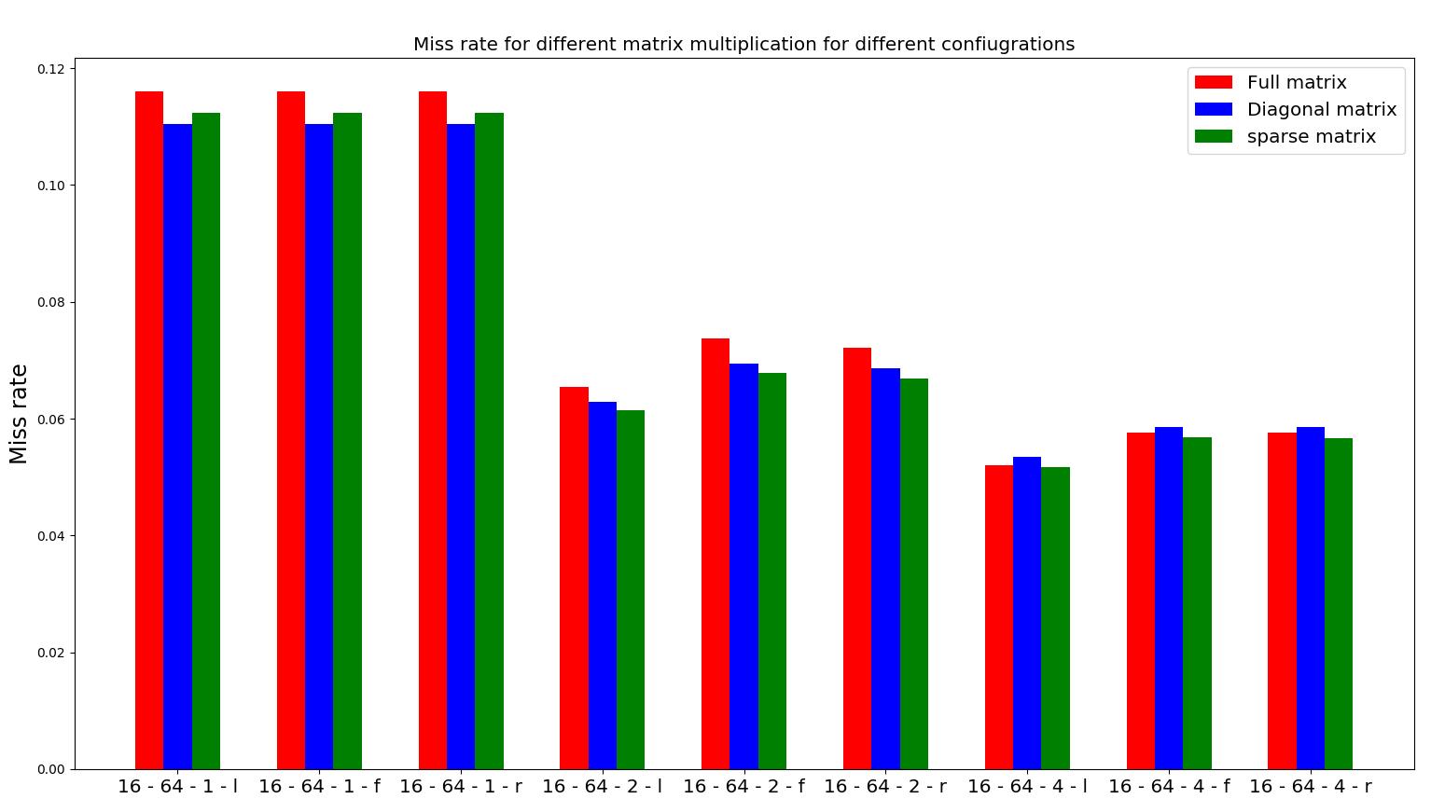
Replacement policies for Level – 1 Data Cache

Slide 12
Number of sets and block size are kept constant; the replacement policies are varied along with associativity.
LRU replacement policy is the best policy for cache optimizations in our case.
Since LRU is based on principle of temporal locality, it is a good replacement policy for programs such as multiplication.

Slide 13
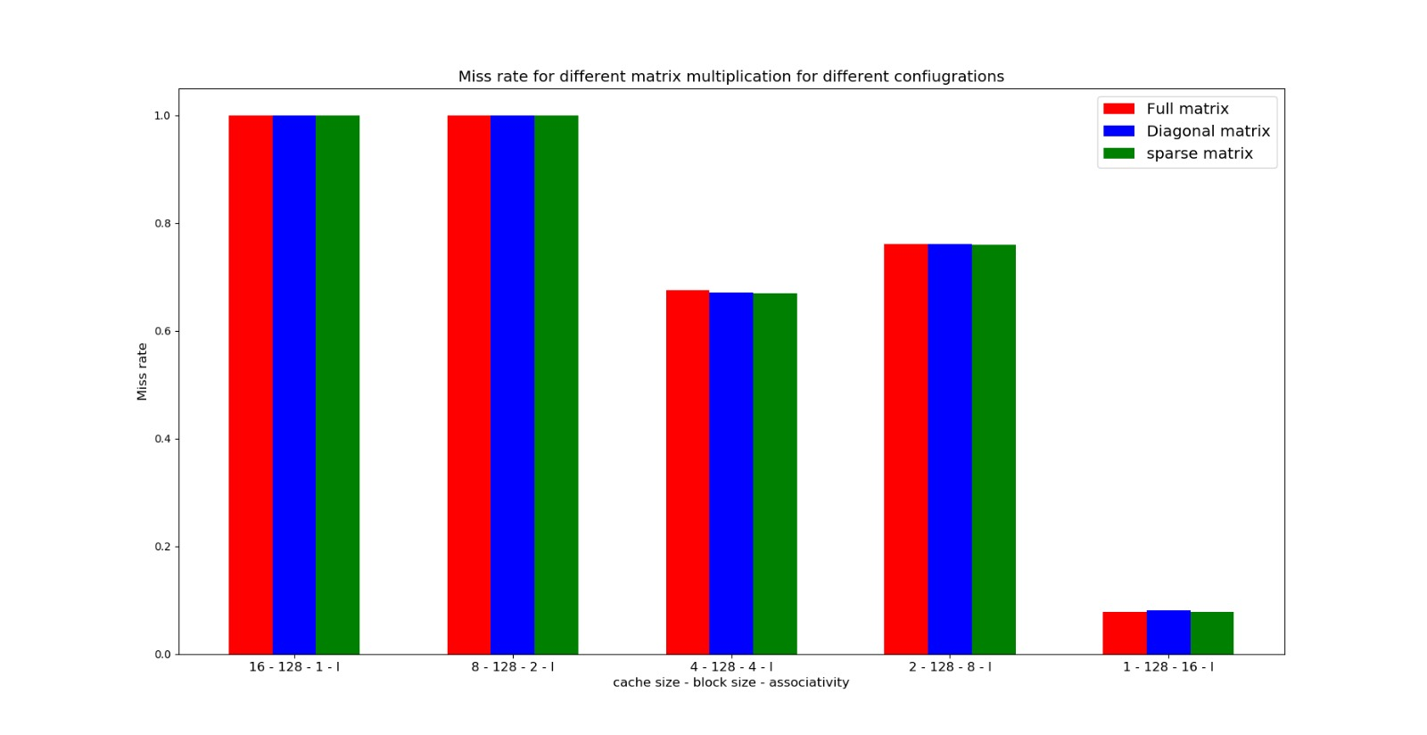
Associativity for Level – 2 Data Cache

Slide 14
Cache size is kept constant (8KB)
From our observations, the miss rate for L2 cache is minimum for n way associative cache

Slide 15
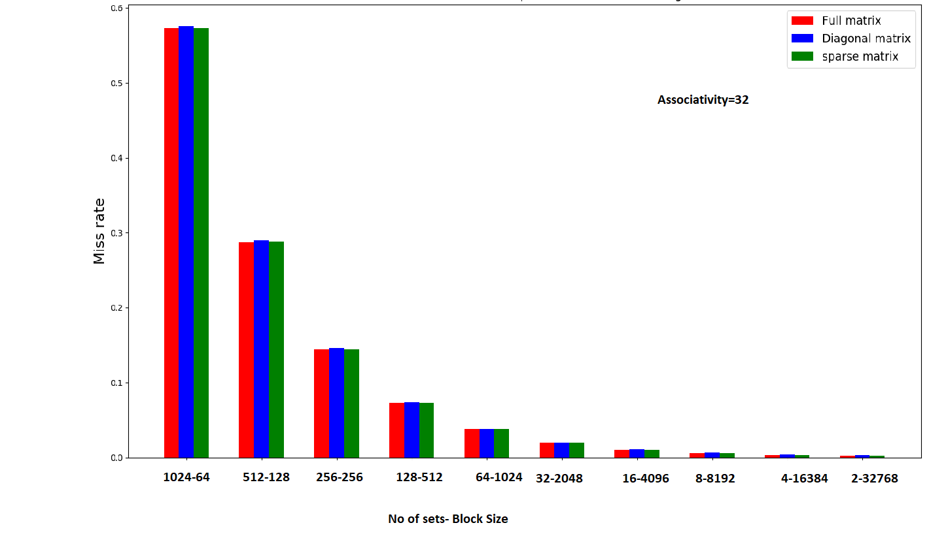
Block size for Level – 2 Data Cache

Slide 16
Associativity is kept constant; block size is varied along with the number of sets to keep the cache size constant.
Miss rate decreases as the block size is increased.

Slide 17
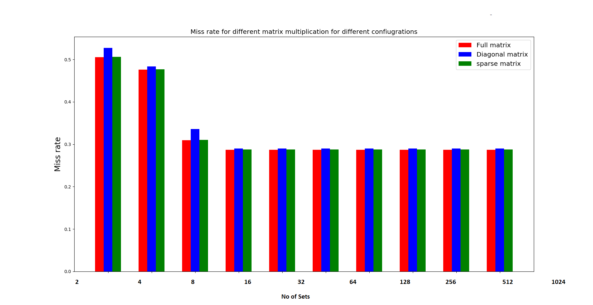
Cache size for Level – 2 Data Cache
8KB 16KB 32KB 64KB 128KB 256KB 512KB 1MB 2MB 4MB

Slide 18
Associativity and block size are kept constant; number of sets is varied.
As the number of sets increases, miss rate decreases.

Slide 19
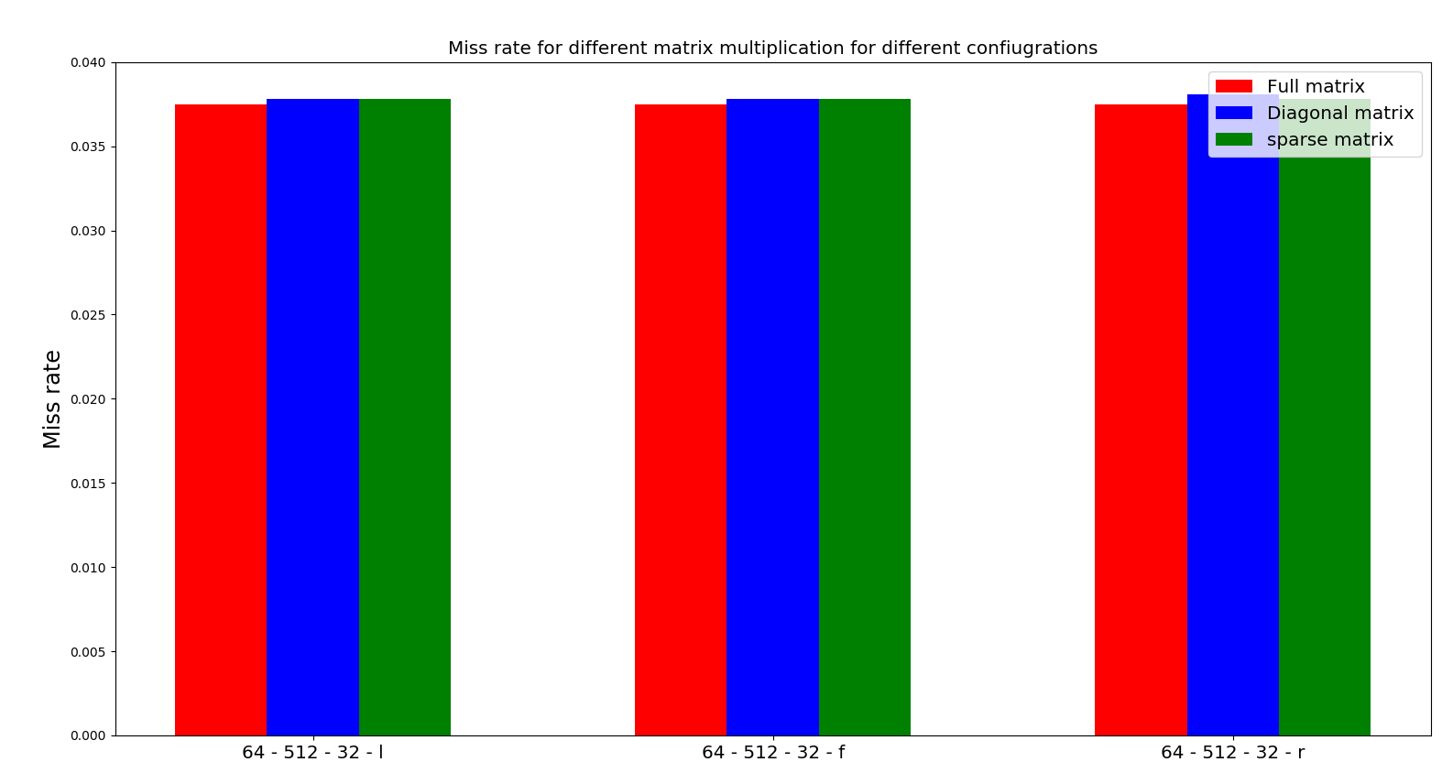
Replacement policy for Level – 2 Data Cache
Number of sets and block size are kept constant; the replacement policies are varied along with associativity.

Slide 20
Conclusion:
Observations for miss rates of L1 Data cache:
●Block size –
●Cache size - Larger cache size
●Associativity - 4 provides best performance to complexity ratio
●Replacement policy - LRU is the most efficient
Observations for miss rates of L2 Data cache:
●Block size - Larger block size
●Cache size - Larger cache size
●Associativity - N-way associative
●Replacement Policy - Independent of replacement policy

Slide 21
Number of sets and block size are kept constant; the replacement policies are varied along with associativity.
We have compared the different replacement policies for all the matrix multiplication codes.
Miss rates are independent of replacement policy for data level 2 cache

Slide 22
Out of order execution
We have implemented the out of order instruction execution by varying the following fields in the cache configuration of the sim-outorder simulator:
<name>:<nsets>:<bsize>:<assoc>:<repl> <ruu> <lsq> <bpred>
<bpred> Branch prediction is specified as taken or not taken
<ruu> capacity of the RUU (in instructions) The Default for RUU is 16
<lsq> capacity of the load/store queue (in instructions). The default is 8.

Slide 23
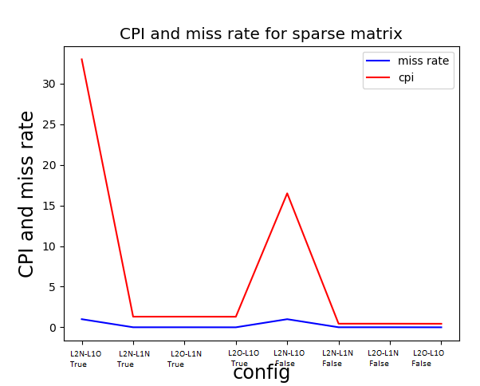
Comparison between O and N

Slide 24
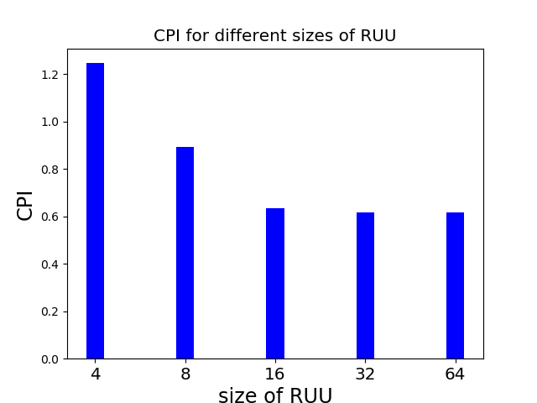
CPI for different sizes of RUU

Slide 25
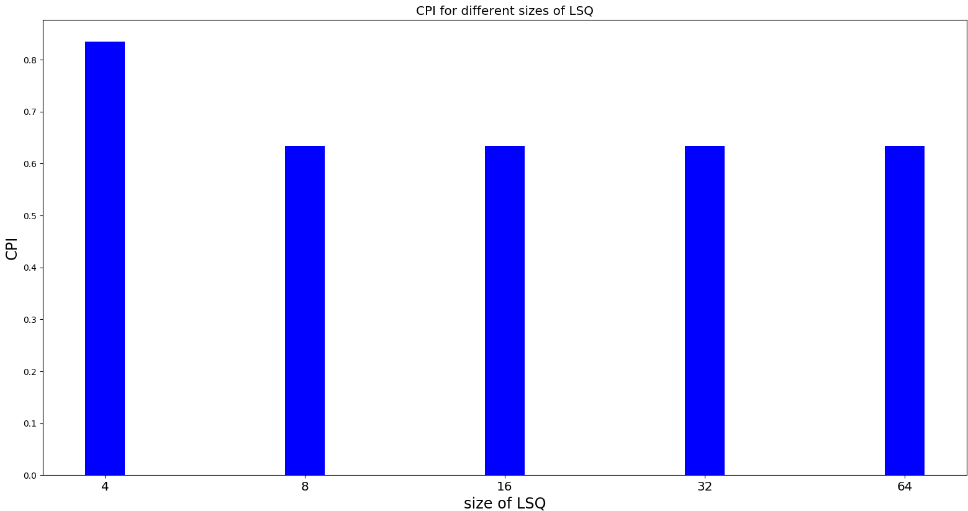
CPI for different sizes of LSQ

Slide 26
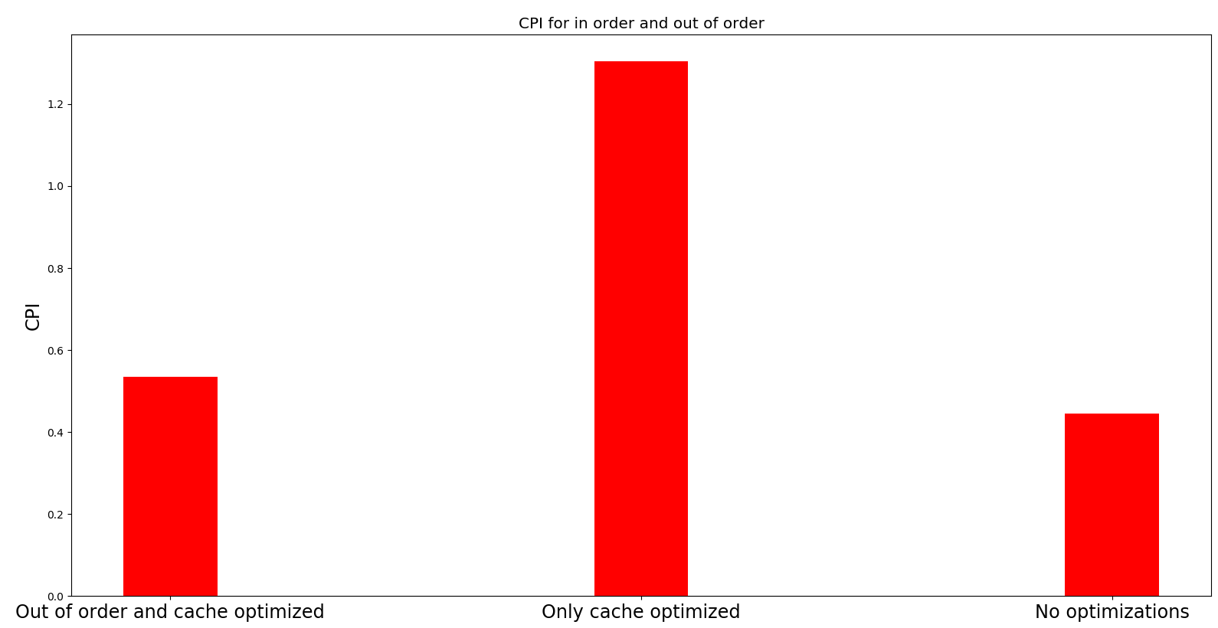
CPI for in-order and out of order execution

Slide 27
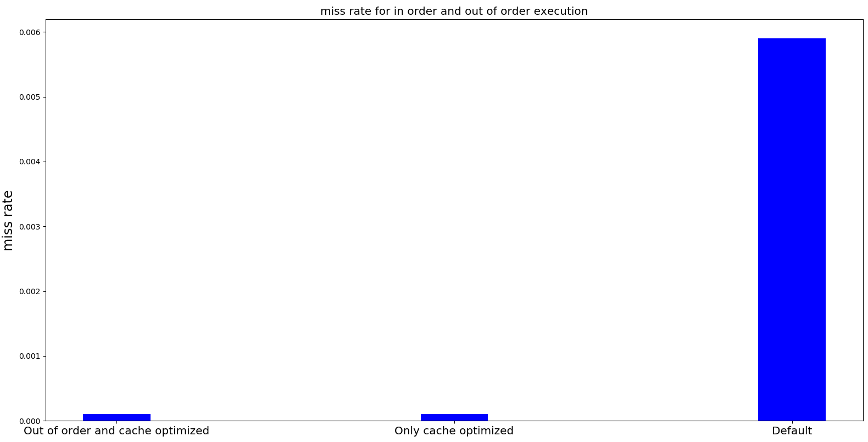
Miss rate for in order and out of order execution

Slide 28
Miss rate for in order and out of order execution

Slide 29
Conclusion
Finally, we can conclude the following:
For minimizing the miss rate:
32KB and 128KB are the best for dl1 and dl2 respectively.
Keeping the associativity at 4 and 8 for dl1 and dl2 respectively.
The LRU is the best replacement policy.
This gives us the best optimized cache. Further, in out of order execution, the best values to reduce the CPI are obtained by keeping
RUU at 32
LSQ at 16

