Slide 1


SURVEY TO UNDERSTAND DATA AND INFORMATION SECURITY ISSUES AND OTHER CHALLENGES FOR IOT
Presented By:
Arpitha S M Kavana N
1SJ16CS012 1SJ16CS041
Under the guidance of
MANJUNATHA S
Assistant prof.
Cse Dept
s.j.c.i.t

Slide 2
CONTENTS
Abstract
Introduction
IoT security problems
Other challenges
Conclusion
References

Slide 3
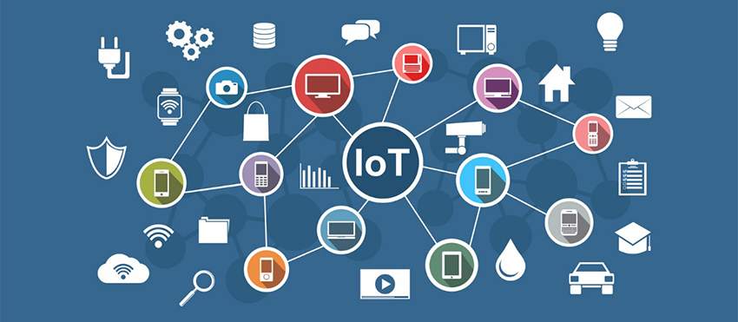
ABSTRACT
At present day use of modern techniques and technology is an essential and required consideration for being smart for every person to make immediate and smart decisions .So one of the method that the users are adopting for daily requirement is IoT.
Authorized user can access data, information for concerned application, make immediate and smart decisions with that information. Hence such sensitive private data & information generated should be secured irrespective of time and place of access from any unauthorized user.
In this paper effort is made to identify and understand issues related to IoT security and other challenges to consider for IoT adaptation in daily use.

Slide 4
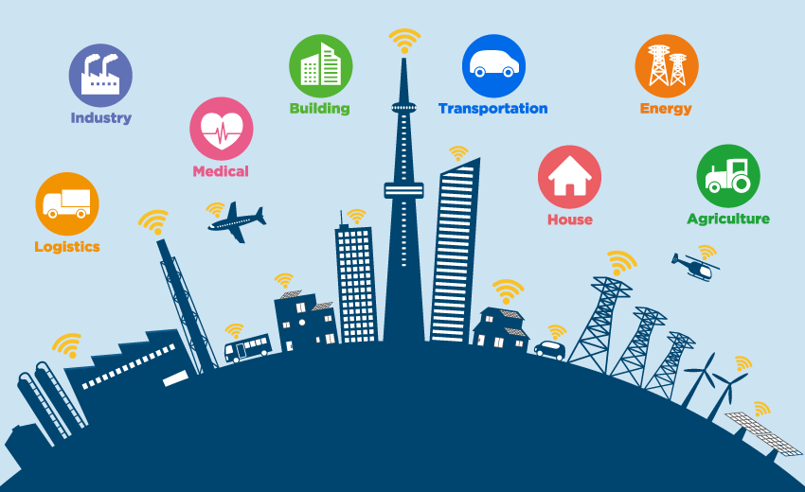
INTRODUCTION
Today, objects/things and devices is less useful without information communication . This barrier is overcoming with industrial revolution 4.0. Use of Internet of Things made its way by providing data and information available to user with electronic applications which is combined with hardware and software.
Many security breaches have been encountered, so that the developers must secure the applications or devices at the time of implementation
only. IoT devices are deployed in uncontrolled and
complex manner.

Slide 5

TOP 10 SECURITY CHALLENGES
Constrained devices security
Device identity via Authorize and Authentication
Secure Access Technology for Communication
Ensure data privacy and integrity
Manage device updates by proper Management
Secure Applications (web, mobile, and cloud)
Ensure high availability
Detect vulnerabilities and incidents
Manage vulnerabilities
Predict and pre-empt security issues

Slide 6
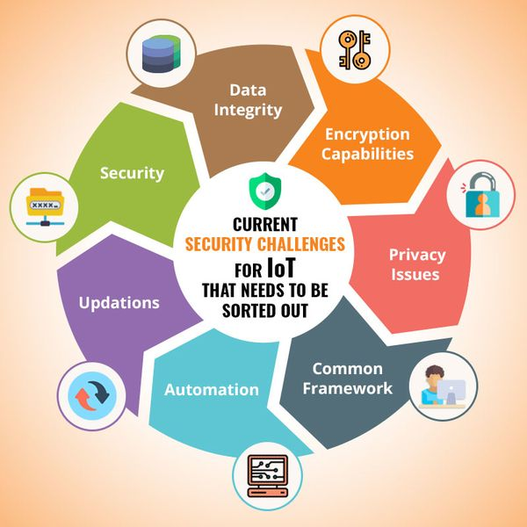

Slide 7
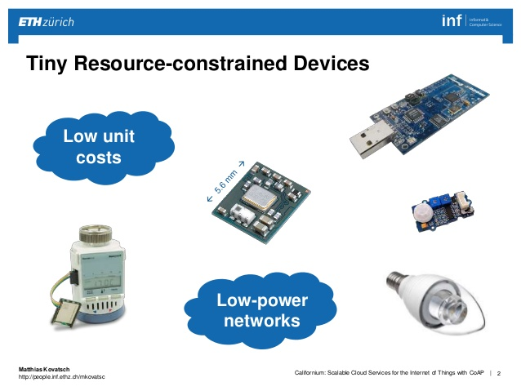
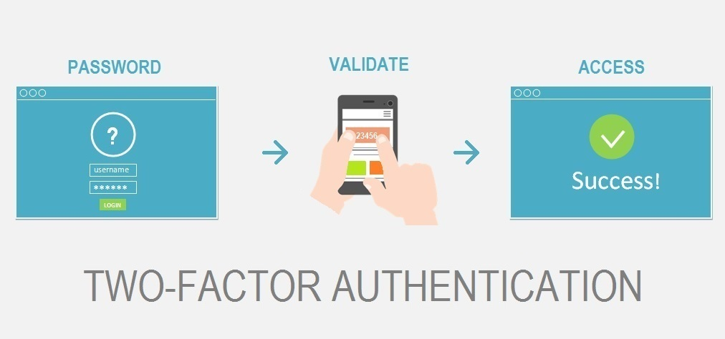
SL No | Security challenges | Vulnerability | Action
1. | Constrained device’s security | Side channel attacks like Cache attack(memory) Timing attack Power monitoring(power) Electromagnetic interference. | Need to develop fast, lightweight encryption algorithm , use of multilayer of defence.
2. | Authorize and authentication devices | Devices must identify themselves. Problem is weak password authentication . Using unchanged password from default values. | IoT uses 2FA and enforce strong password/certificates to authorize the access services with access control.

Slide 8
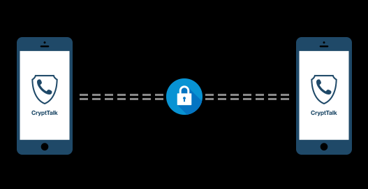
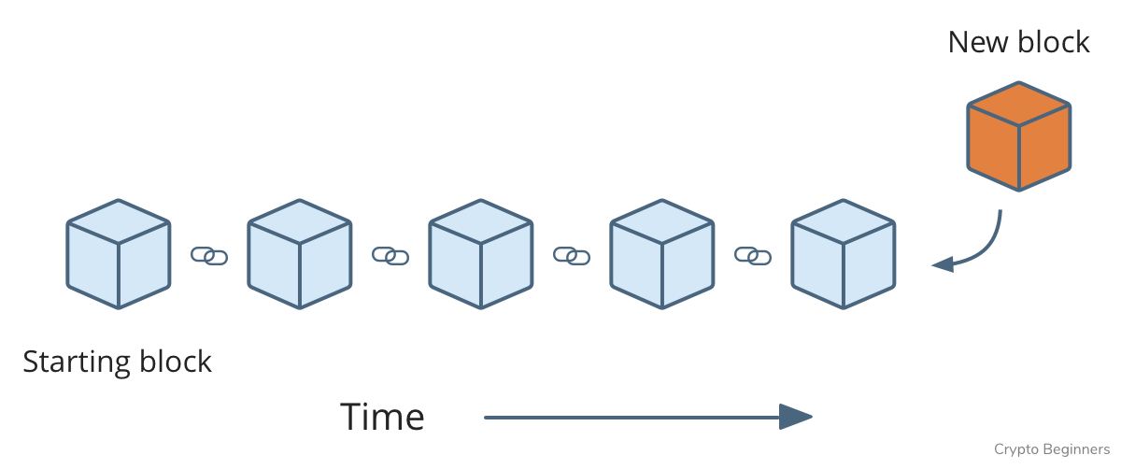
3. | Secure Communication | Maximum IoT devices may not encrypt data/message before sending data. | Make use of TLS . Use of separate networks to isolate devices to have secure and private data to keep confidential.
4. | Ensure data privacy and integrity | Data privacy: Redacting the data before it is stored. If data not used longer period of time , then dispose it securely. | Data integrity: Employing checksum and digital signature. Example : Blockchain

Slide 9

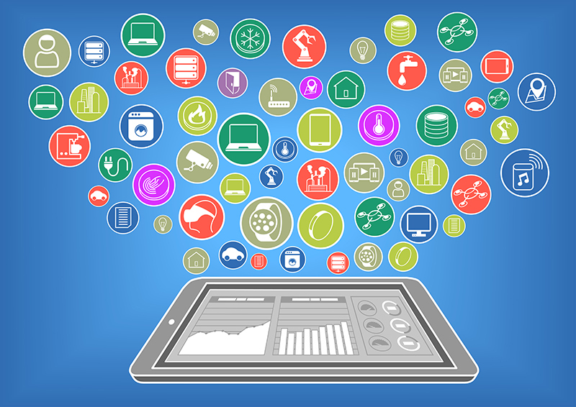
5. | Managing device updates | Due to distributed environment , heterogeneous devices and use of different hardware , updates for security patches to firmware and software is challenging part. Not able to update over air due to the older version updates may not be available. | Need to track on versions/identifications of which devices are older to replace due to aging of devices.
6. | Secure web , mobile and cloud applications | Use to access , manage and process IoT devices and data. Example : Home Automation | Multi-layered approach to IoT security is needed. Adopting secure engineering practices to avoid vulnerabilities.

Slide 10
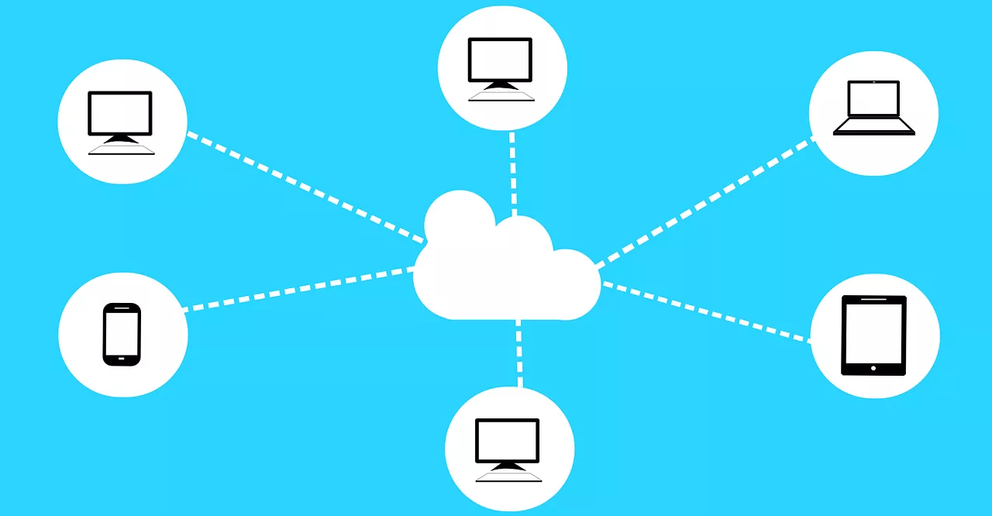
7. | Ensure high availability of IoT data | Data may not be available in time due to connectivity problems , device failure, DoS attack. Lack of availability leads to loss of revenue, damage to equipments & life. | IoT infrastructure is responsible for the services such as traffic control, healthcare. IoT devices must be protected against cyber-attacks and physical tampering. Designed in such a way that it should be resilient and fault tolerant.
8. | Detect vulnerability and incidents | Large scale IoT system with complexity in terms of number of devices connected, variety of device apps and communication protocol is involved. | Use monitoring network communication, activity logs for anomalies. Apply security intelligence and analytics to identify and notify.

Slide 11

9. | Manage vulnerabilities | Need to identify which devices were affected, what data/services accessed / compromised and which user impacted | Device Manager is used Use of rules engines with rules based on vulnerability management policies.
10. | Predict and pre-empt security issues | Not only detecting and overcoming issues, need to predict and proactively protect against potential security threats. | Threat modelling is one approach .Other approaches use monitoring and analytics tools.

Slide 12
III. OTHER CHALLENGES TO BE CONSIDERED FOR IoT
Standardization Lagging
Support for mobility
Address acquisition
Scalability
Handling new network traffic pattern
Energy efficient protocols for low power communication
Non-lossy and high speed channel communication
Low memory routing protocols
Make use of Machine learning, Artificial Intelligence and other technologies.

Slide 13
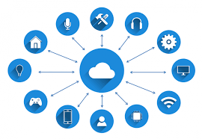
IV. CONCLUSION
To conclude with this survey for IoT data & information security ,use of Lightweight hardware, software design, techniques and use of ML and AI protocols are the preferred option. Also need to consider energy efficient adaptation in developments of application.

Slide 14
V. REFERENCES
[1] Article, “IoT 301: Mastering IoT development”
[2] IoT Analytics “Understanding IoT Security – Part 1 of 3: IoT Security Architecture on the Device and Communication Layers”
[3]Tarun Kumar Goyal & Vineet Sahula “Lightweight Security Algorithm for Low Power IoT Devices”

Slide 15

Any suggestions

Slide 16


