Slide 1
PAPER PRESENTATION ON AIR QUALITY MONITORING SYSTEM
Presented by:
Arpitha S M(1SJ16CS012)
Kavana N(1SJ16CS041)
Under guidance of:
Diwakar K M
Assistance Professor
CSE SJCIT

Slide 2
ABSTRACT The level of pollution has increased with times by lot of factors like the increase in population, increased vehicle use, industrialization and urbanization which results in harmful effects on human wellbeing by directly affecting health of population exposed to it. In order to monitor we are going to make an IOT Based Air Pollution Monitoring System in which we will monitor the Air Quality over a web server using internet and will trigger a alarm when the air quality goes down beyond a certain level, means when there are sufficient amount of harmful gases are present in the air like CO2, smoke, alcohol, benzene and NH3. It will show the air quality in PPM on the LCD and as well as on webpage so that we can monitor it very easily. In this IOT project, you can monitor the pollution level from anywhere using your computer or mobile.

Slide 3
CONTENTS 1. Introduction. 2. Literature Survey. 3. Aims and Objectives. 4. Problem Statement. 5. Hardware Requirements. 6. Principle of Working. Block diagram Circuit diagram 7. Advantages. 8. Applications. 9. Future Scope. 10. References

Slide 4
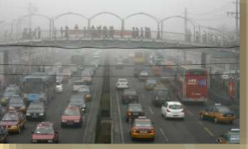
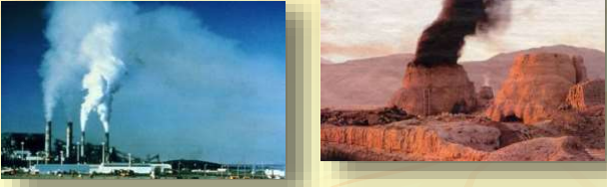
INTRODUCTION 1. Pollution 2. Traffic 3. Industries 4. Increase in vehicles 5. Lack of Data 6. Health Problems

Slide 5
Air pollution is a growing issue these days . It is the presence of extra unwanted biological molecules , particulates or other harmful things into the earth atmosphere. It is necessary to monitor air quality and keep it under control for a better future and healthy living for all. Due to flexibility and low cost Internet of things (IoT) is getting popular day by day. Harmful effects of pollution include mild allergic reactions such as irritation of the throat, eyes and nose as well as some serious problems like bronchitis, heart diseases, pneumonia, lung and aggravated asthma. Analysis of monitoring data allows us to assess how bad air pollution and sound pollution is from day to day.

Slide 6
LITERATURE SURVEY * The commercial meters available in the market are Fluke CO- 220 carbon monoxide meter for CO, Amprobe CO2 meter for CO2, ForbixSemicon LPG gas leakage sensor alarm for LPG leakage detection. * Now each technology has limited uses according to the intended function, as Zigbee is meant for users with Zigbee trans-receiver, Bluetooth

Slide 7
Aim and Objectives 1. To create a tool which will monitor the quality of air of our environment. 2. Content of different gases present in air or area around us. 3. Display the data on LCD.

Slide 8
PROBLEM STATEMENT We propose an air quality monitoring system that allows us to monitor and check live air quality in an area through IOT. System uses air sensors to sense presence of harmful gases/compounds in the air and constantly transmit this data.The sensors interact with arduino uno which processes this data and transmits it over the application. This allows authorities to monitor air pollution in different areas and act against it.

Slide 9
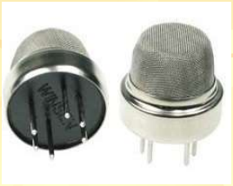
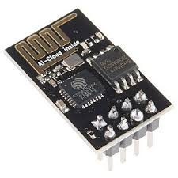
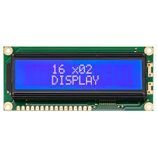
HARDWARE REQUIREMENTS * MQ135 Gas Sensor * Arduino Uno * Wi-Fi module ESP8266 * 16x2 LCD * Breadboard * Potentiometer * Buzzer

Slide 10
PRINCIPLE OF WORKING 1. Project’s basic principle of working is the sensing of data from the sensor. 2. Convert the analog ( voltage ) data into digital form. 3. the digital data and display it on LCD.

Slide 11
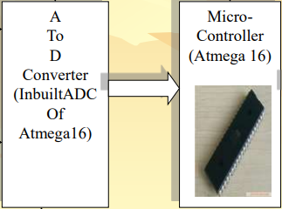
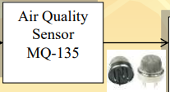
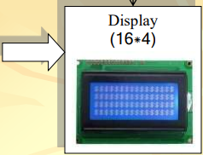
BLOCK DIAGRAM

Slide 12
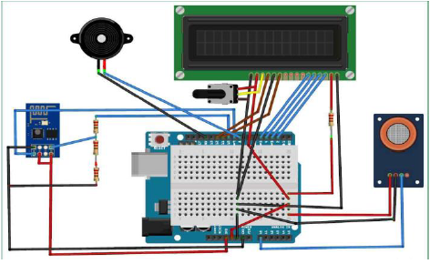
CIRCUIT DIAGRAM

Slide 13
ADVANTAGES * Sensors are easily available . * Detecting a wide range of gases, including NH3, NOx, alcohol, benzene, smoke and CO2,Co etc * Simple, compact & Easy to handle . * Sensors have long life time & less cost. * Simple Drive circuit. * System is Real time. * Operating voltage : 5 volt,-20°C to +50°C * Quality of air can be checked indoor as well as outdoor. Visual output. * Continous update of change in terms of ppm

Slide 14
APPLICATIONS * To monitor environment conditions in smart city. * Real time vehicle emission detection to known whether the vehicle is a polluting vehicle or not. * Detection of forest fire * Industrial Perimeter Monitoring. * Site selection for reference monitoring stations. * Indoor Air Quality Monitoring. * To make this data available to the common man.

Slide 15
FUTURE SCOPE In future the project can be upgraded in more ways than one. * Interface more number of sensors to know detail content of all gases present in air. * Design Webpage and upload data on webpage with date and time. * Interface GPS module to monitor the pollution at exact location and upload on the webpage for the netizens.

Slide 16
REFERENCES * Riteeka Nayak, Malaya Ranjan Panigrahy , Vivek Kumar Rai and T Appa Rao:IOT based air pollution monitoring system Vol-3, Issue-4, 2017 . * Navreetinder Kaur , Rita Mahajan and Deepak Bagai: Air Quality Monitoring System based on Arduino Microcontroller Vol. 5, Issue 6, June 2016 * Palaghat Yaswanth Sai: An IoT Based Automated Noise and Air Pollution Monitoring System Vol. 6, Issue 3, March 2017

