Slide 1
PROJECT PORTFOLIO
Monthly Health Report
July 2026
July 2026 portfolio: 1/3 projects Green, 1/3 Red — overall trajectory is Insufficient data.
Prepared: November 12, 2026 | Evidence-Based Health Agent v1.0

Slide 2
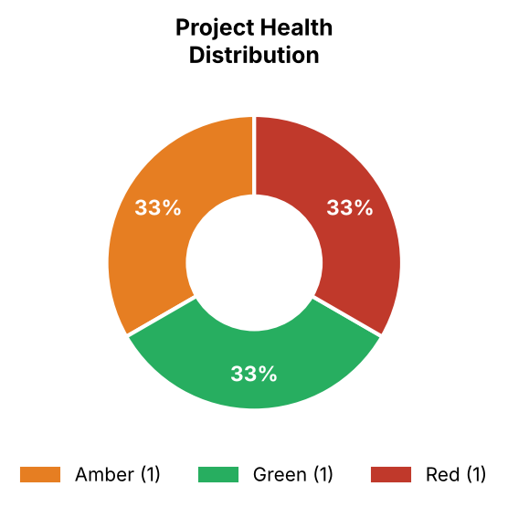
Portfolio Snapshot
As of July 2026 | 3 active project(s)
Project Status
Harbor Foods - Procure-to-Pay Rollout
Score: 78.5/100 | Stage: Integration and Testing | Trend: Insufficient data
Orion Retail - S2P Implementation
Score: 91.7/100 | Stage: Configuration and Build | Trend: Insufficient data
Summit Energy - Sourcing Rollout
Score: 51.2/100 | Stage: Configuration and Build | Trend: Insufficient data
Portfolio Trajectory: Insufficient data

Slide 3
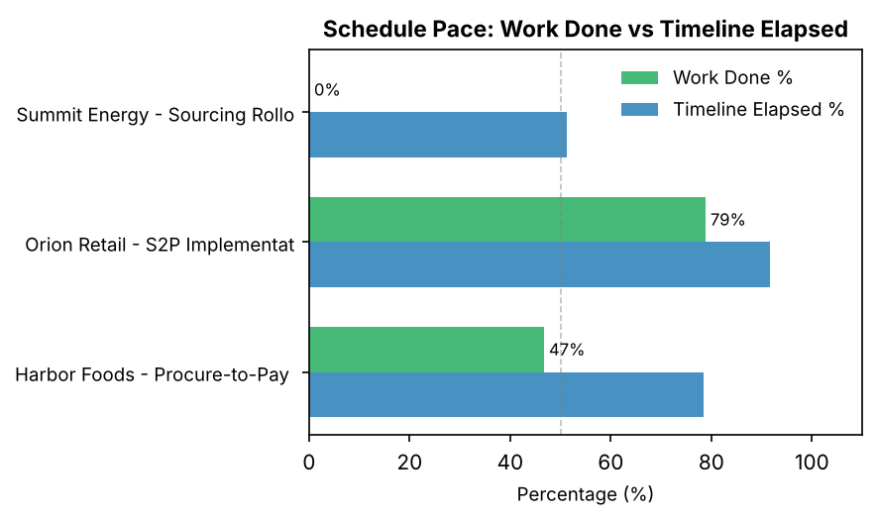
Schedule Velocity
Work completed vs timeline consumed per project
Projects below the 50% midline are behind pace and require attention.

Slide 4

Root Cause Analysis
Risk categories identified from project comments (LLM-classified)

Slide 5
Emerging Risks & Trends
The portfolio entered July 2026 with a Insufficient data trajectory across 3 active projects. The dominant risk themes are under analysis. Projects in later delivery phases show higher schedule exposure than those in earlier configuration stages.
Emerging Risks This Period
Emerging risks this period include: none identified. These patterns warrant escalation before the next milestone cycle.

Slide 6
Portfolio Recommendations
Actions for the Portfolio Director and Delivery Leadership
1
Portfolio Director to review all Red-status projects weekly until resolved.
2
Delivery Leads to address vendor and client dependency blockers before next milestone.
3
PMO to conduct a data quality audit on project plans with missing baseline dates.
Generated by Evidence-Based Project Health Agent | November 2026

Slide 7
Appendix — Project Detail
Latest score, trend and pace per project
Project
Overall
Score
Trend
Pace gap
Stage
Confidence
Harbor Foods - Procure-to-Pay Roll
Amber
78.5
Insufficient data
-32%
Integration and Testing
77%
Orion Retail - S2P Implementation
Green
91.7
Insufficient data
-13%
Configuration and Build
77%
Summit Energy - Sourcing Rollout
Red
51.2
Insufficient data
-58%
Configuration and Build
72%

