Slide 1
PROJECT PORTFOLIO
Monthly Health Report
July 2026
July 2026 portfolio: 3/4 projects Green, 0/4 Red — overall trajectory is Improving.
Prepared: July 10, 2026 | Evidence-Based Health Agent v1.0

Slide 2
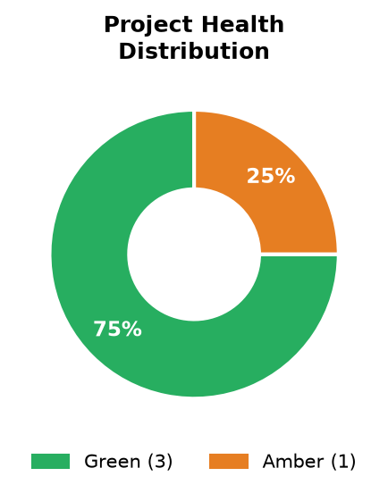
Portfolio Snapshot
As of July 2026 | 4 active project(s)
Project Status
Phase 1- S2C
Score: 90.3/100 | Stage: Configuration and Build phase | Trend: Insufficient data
Phase 2 - P2P
Score: 88.8/100 | Stage: Configuration and Build phase | Trend: Insufficient data
Zycus - Titan S2P Implementation
Score: 65.7/100 | Stage: Configuration and Build phase | Trend: Improving
Zycus - UniSan S2P Implementation
Score: 58.7/100 | Stage: Training Phase I | Trend: Deteriorating
Portfolio Trajectory: Improving

Slide 3
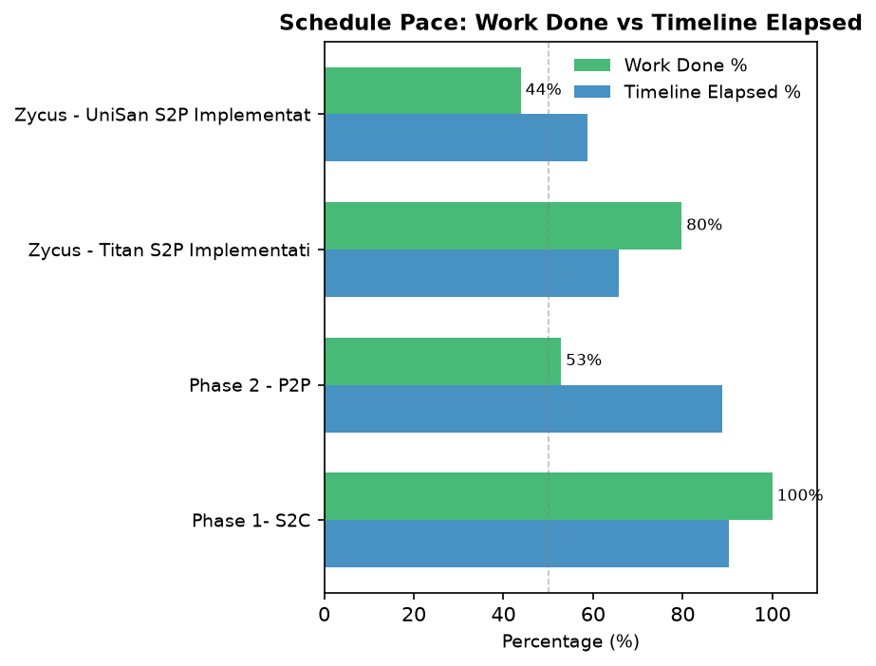
Schedule Velocity
Work completed vs timeline consumed per project
Projects below the 50% midline are behind pace and require attention.

Slide 4

Root Cause Analysis
Risk categories identified from project comments (LLM-classified)
Common pattern: on pace: 71% complete with 57% of timeline elapsed

Slide 5
Emerging Risks & Trends
The portfolio entered July 2026 with a Improving trajectory across 4 active projects. The dominant risk themes are under analysis. Projects in later delivery phases show higher schedule exposure than those in earlier configuration stages.
Emerging Risks This Period
Emerging risks this period include: none identified. These patterns warrant escalation before the next milestone cycle.

Slide 6
Portfolio Recommendations
Actions for the Portfolio Director and Delivery Leadership
1
Portfolio Director to review all Red-status projects weekly until resolved.
2
Delivery Leads to address vendor and client dependency blockers before next milestone.
3
PMO to conduct a data quality audit on project plans with missing baseline dates.
Generated by Evidence-Based Project Health Agent | July 2026

Slide 7
Appendix — Project Detail
Latest dimension scores per project
Project
Overall
Score
Schedule
Execution
Milestones
Blockers
Confidence
Phase 1- S2C
Green
90.3
—
—
—
—
72%
Phase 2 - P2P
Green
88.8
—
—
—
—
52%
Zycus - Titan S2P Implementa
Green
65.7
—
—
—
—
72%
Zycus - UniSan S2P Implement
Amber
58.7
—
—
—
—
42%

