Slide 1

NovaRetail Performance Review
2026-Q2
1,280M USD
4.5%
50
Total Revenue
QoQ Revenue Growth
Average NPS
EXECUTIVE SUMMARY
Revenue growth is positive, driven by strong performance in APAC. Customer satisfaction is stable overall, but regional disparities persist. Latin America shows significant operational challenges including stockouts and fraud.
NovaRetail Quarterly Business Review — Capstone Template
1

Slide 2
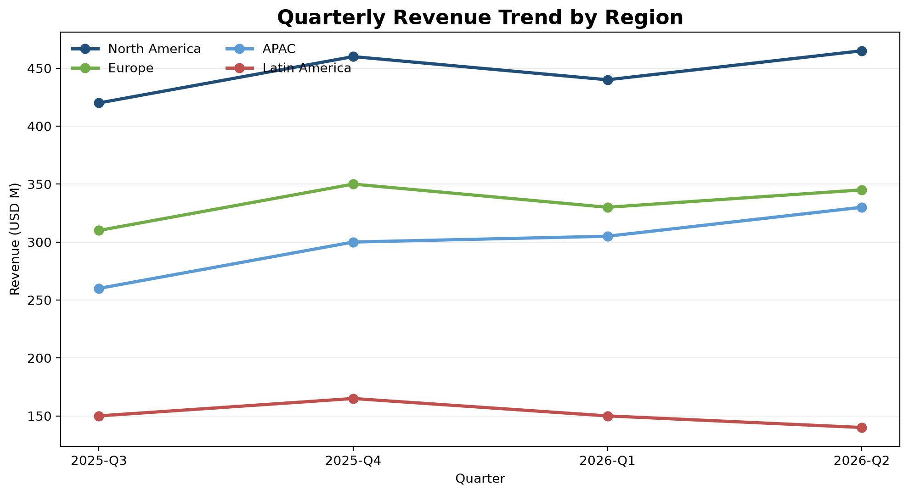

Regional Performance Highlights
• APAC leads with 8.2% QoQ revenue growth.
• Latin America experienced a decline of -6.7% QoQ.
• Regional performance varies significantly, requiring targeted strategies.
NovaRetail Quarterly Business Review — Capstone Template
2

Slide 3
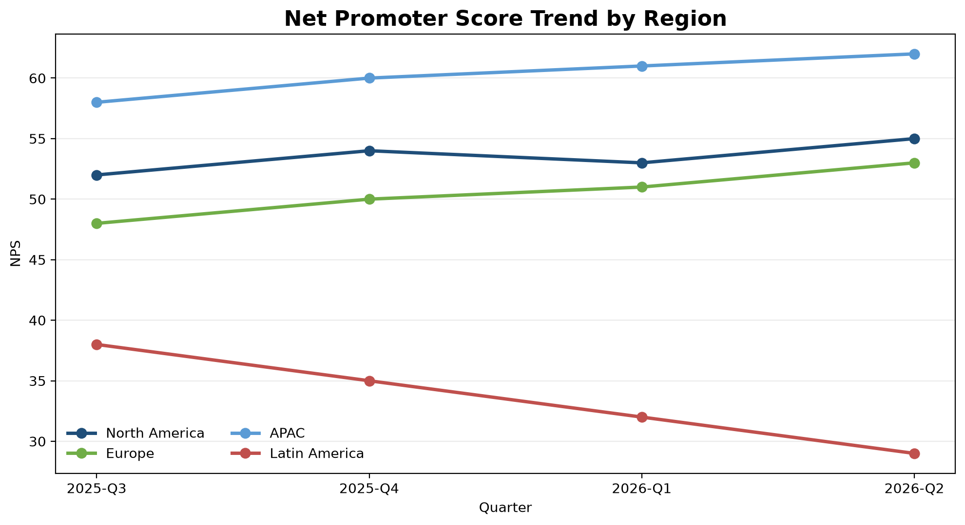

Customer Experience Insights
• Overall NPS is 49.75, indicating steady customer loyalty.
• APAC region boasts the highest NPS at 62.
• Latin America's NPS is notably low at 29, aligning with other regional challenges.
NovaRetail Quarterly Business Review — Capstone Template
3

Slide 4
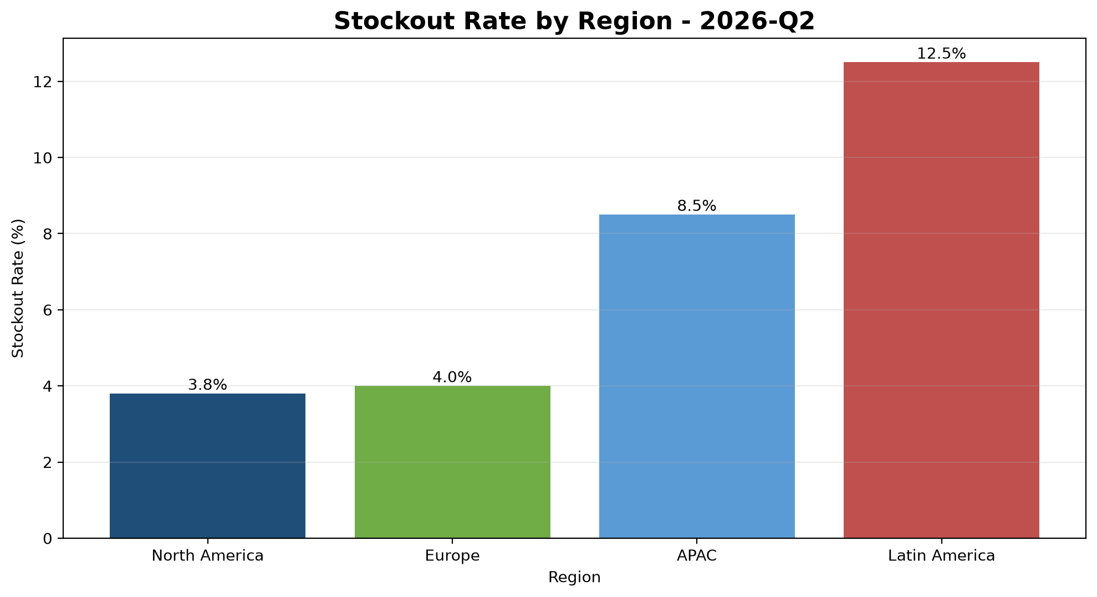

Operational Risk Assessment
• Latin America faces the highest stockout rate at 12.5%.
• Latin America also reports the highest number of fraud incidents (30).
• APAC operates at high capacity (92.0%), nearing saturation.
NovaRetail Quarterly Business Review — Capstone Template
4

Slide 5

Strategic Recommendations
• Address Latin America's operational issues: reduce stockouts and combat fraud.
• Investigate and mitigate the low NPS in Latin America.
• Monitor APAC's high capacity utilization to prevent future stockouts.
Focusing on these key areas will drive sustained growth and improve overall business health.
NovaRetail Quarterly Business Review — Capstone Template
5

