Slide 1


RCC Institute of Information Technology
Canal South Road, Beliaghata Kolkata - 700 015, West Bengal, India
Topic: Hybrid Deep Learning Model for Hate Speech Detection in Tweets (BERT + CNN + LSTM)
Developed By:
Mentor:
Mrs. Monika Singh, Assistant Professor, CSE
Name | Roll No | Registration No.
Ashif Mondal | 11700119010 | 038895 OF 2019-20
Diya Neogi | 11700120131 | 201170100120004 OF 2020-21
Arpon Roy | 11700119024 | 031262 OF 2019-20
Bidisha Saha | 11700119021 | 038523 OF 2019-20
Department of Computer Science & Engineering

Slide 2
List of Contents
Introduction
Understanding the Problems
Problem Statement
Motivation
Literature Survey
Project Objectives
Methodology
Dataset Analysis
Complete Workflow
Software & Hardware requirements
Performance analysis
UI and Testing
Comparison with our other models
Challenges Faced
Conclusion
Future Plan
Dataset References
Questions?

Slide 3
Introduction
Twitter and other social sites have grown exponentially in the past decade. These media promote user anonymity and freedom of speech, thereby driving the growth and transmission of hate speech.
Hate speech is a speech that attack a person a group on the basis of attributes such as religion, race, gender, national origin, disability.
It’s a world-wide problem that many countries and organizations have been standing up against it.

Slide 4
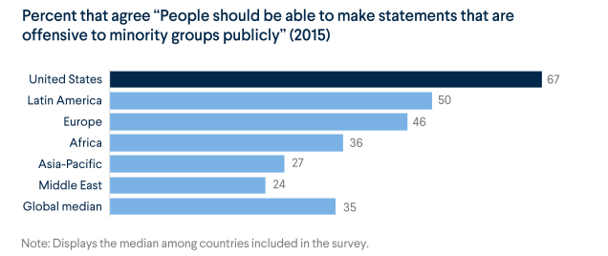
Understanding the Problems
Rapid growth of internet &social media people tend to become very reactive.
Talks might lead to physical riot or communal unrest.
Imperative to stop the spawning of this hate speech.
Source: Council on Foreign Relations

Slide 5
Problem Statement
The main task is to develop an automated deep-learning based approach for detecting hate speech and offensive language.
Classify tweets into three categories (hate speech, offensive language, neither as positive nor negative) based on tweet sentiment and other features that a tweet demonstrates.

Slide 6
Motivation
Hate speech towards people of a particular gender, ethnicity, caste or religion is rampant in social media leading to real life consequences.
This online discrimination has led to the rise of communal hate.
Hate-speech is a subjective and complex term with no single definition.
Irrespective of the definition of the term or the problem, it is clear that automated methods for detecting hate-speech are necessary in some circumstances.

Slide 7
Literature Survey / Related work
 | Reference | Dataset Size | Method | Result
 |  |  |  | Accuracy | Precision | Recall | F1
1 | Ji Ho et al, Waseem and Hovy dataset, 2016 | 25k | Hybrid CNN | 0.827 | 0.827 | 0.827 | 0.827
2 | Ziqi Zhang, David Robinson, Jonathan Tepper, 2019 | 24k | CNN + LSTM, emb-ggl2 | 0.919 | 0.919 | 0.919 | 0.919
3 | Zhang et al, 2018 | 24k | CNN + GRU | 0.94 | 0.94 | 0.94 | 0.94
4 | “Deep Learning for Hate Speech Detection in Tweets” published on 2020 by Pinkesh Badjatiya, Shashank Gupta, Manish Gupta and Vasudeva Varma | 16k | CNN + Random Embedding + GBDT | 0.864 | 0.864 | 0.864 | 0.864
 |  |  | FastText + Random Embedding + GBDT | 0.886 | 0.886 | 0.887 | 0.886
 |  |  | LSTM + Random Embedding + GBDT | 0.930 | 0.930 | 0.930 | 0.930
5 | “Detecting Hate Speech using Deep Learning Techniques” published on 2021 by Chayan Paul and Pronami Bora | 16k | LSTM | 0.9785 | 0.9598 | 0.9986 | 0.9785
 |  |  | Bi-LSTM | 0.9781 | 0.9582 | 0.9990 | 0.9781
After reading those papers we found that LSTM and Bi-LSTM shows superior performance across these datasets.

Slide 8
Project Objectives
Download and prepare dataset for Hate Speech detection.
Design & implement a embedding Deep Learning model to detect Hate Speech.
Build our own model by combining BERT tokenizer with a classifier.
Train our model and apply in real time examples.

Slide 9
Methodology
Approach to solve the problem where we need to detect the hate speech using the Twitter’s tweets data set.
Splitting the data between train, validation and test sets.
Build TensorFlow input for model.
Pre-processing with BERT.
Building hybrid model with CNN and LSTM.
Testing model with sample user input.
Tweet dataset
Data Pre-processing
Classifier Implementation
Model
Test Model

Slide 10
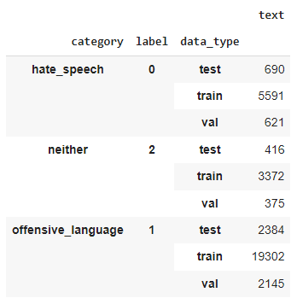
Dataset analysis
Source of dataset
1. Hate speech offensive tweets by Davidson
2. Hate and not hate by Basile
3. Offensive and not offensive by Zampieri
Dataset size
24,794
12,970
14,100
Dataset Columns
tweet
label
Tweets Label
0 – Hate speech
1 - Offensive speech
2 - Neutral
Merged dataset size: 34896
Group-by view of train validation and test data of each category

Slide 11
Complete Workflow
Dataset
Train
(81%)
Validation (9%)
Test
(10%)
Preprocess with BERT
Convert to TensorFlow
input
Preprocessed
Train data
Preprocessed
Val data
Model Layers
Preprocessed
Test data
CNN
LSTM
DENSE
CNN
LSTM
DENSE
POOLING
DENSE
DROPOUT
DENSE
Final Trained model
Predict Output with the test data
Calculate accuracy and other parameters
Testing model with sample user input and predict the output

Slide 12
Deep learning frameworks used:
bert_en_uncased_L-12_H-768_A-12 (small bert)
CNN
LSTM
Language used:
Python
Packages used:
Tensorflow
Keras
Sklearn
Pandas
Numpy
Matplotlib
Streamlit
Localtunnel

Slide 13
Software & Hardware Requirements
Software Requirements:
Google Colab
Microsoft Edge / Google Chrome
Google Drive
Microsoft Excel
Hardware Requirements:
Local Machine:
Windows 10 / Windows 11
Google Colab environment:
System RAM (16GB)
NVIDIA T4 Tensor Core GPUs (12GB)
SSD (120GB)

Slide 14
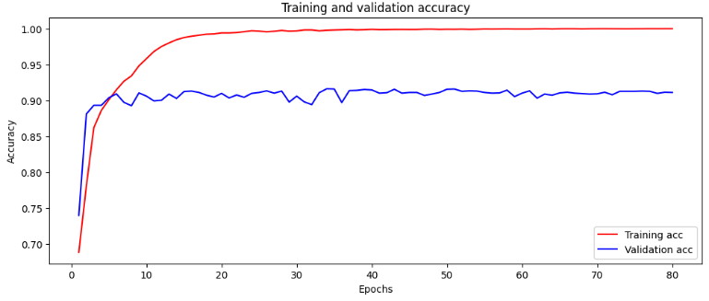
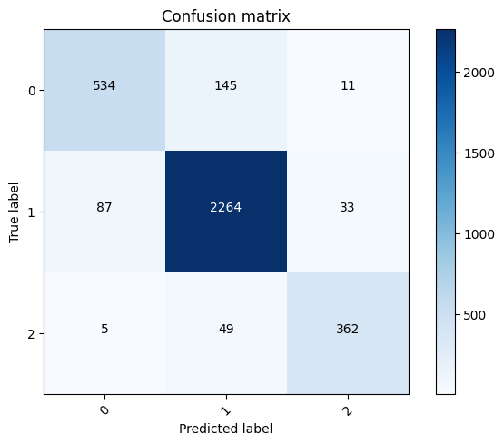
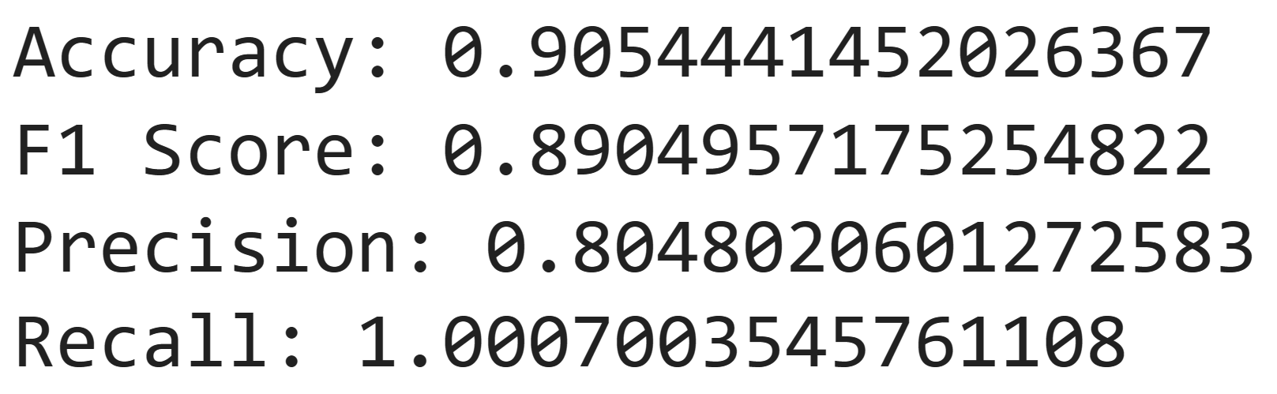
Performance Analysis
Training and validation accuracy vs no of epochs
Confusion matrix
Accuracy and other parameters against test data

Slide 15
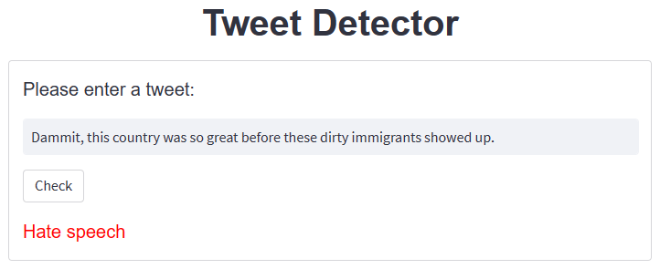
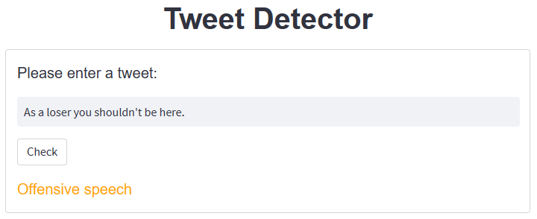
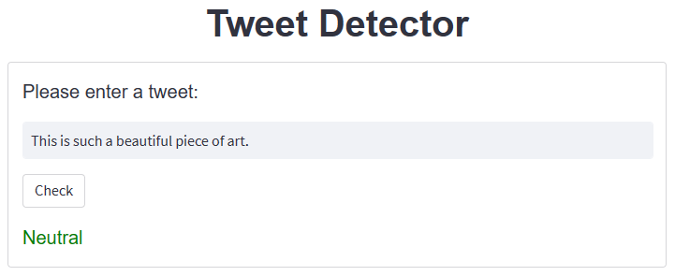
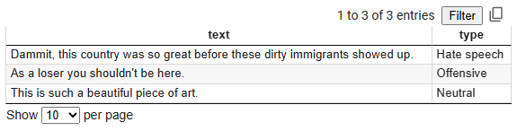
UI and Testing
Testing with hate speech
Testing with offensive speech
result.csv
Testing with normal speech

Slide 16
Comparison with our other models
Model | Accuracy
BoWV + LSTM | 0.7981
BERT LSTM | 0.9032
BERT CNN | 0.9027
BERT Bi-LSTM | 0.8921
BERT CNN BILSTM | 0.8985
BERT CNN LSTM | 0.9054

Slide 17
Challenges Faced
Limited GPU quota in Google Colab for free version.
Library importing error such as tensorflow official library, tensorflow-text. module and adamw optimizer in Jupyter Notebook.
Intentional Obfuscation of words using special characters or spelling.
Usage of sarcasm.
Conversational hierarchy on social media.
Diversity of insults found in English language alone.

Slide 18
Conclusion
We introduced a method for automatically classifying hate speech on twitter using deep neural networks (DNN) such as LSTM, CNN, BERT and we investigated the application of deep neural network architectures for the task of hate speech detection. According to the result of accuracy, precision, recall and F1 score BERT-CNN-LSTM hybrid model, BERT-CNN and BERT-LSTM model performs better than other models. However, the models give almost the same score. The score is very similar to draw comparison between these models.

Slide 19
Future Plan
In future, we’ll be fine tuning the hyperparameter which can improve accuracy with large language model (cutting edge LLM), also we’ll be using other different algorithms to experiment which will give more accurate result over the dataset.
We’ll enlarge our data information by adding the metadata such as numbers of followers, location, account age, total number of posted / favorites / liked tweets etc. of a user which can give more detailed information of a user.
Deploy our model as a product.

Slide 20
Dataset References
Dataset 1:
hate-speech-and-offensive-language/labeled_data.csv at master · t-davidson/hate-speech-and-offensive-language · GitHub
Dataset 2:
tweeteval/datasets/hate at main · cardiffnlp/tweeteval · GitHub
Dataset 3:
tweeteval/datasets/offensive at main · cardiffnlp/tweeteval · GitHub

Slide 21
Any Questions?

Slide 22
Thank You

