Slide 1


Electronic door lock Arquitectura de Microprocesadores

Slide 2
Team Members
Jorge Daniel Núñez
Kirath Alejandra Vázquez Muñoz
Roberto Mosqueda
Alejandro Olvera
Alejandro Enriquez

Slide 3




Proposed IoT Solution
Electronic door lock
Main Components
Hardware
Use Cases
IoT Solution to control door lock using fingerprints
Microcontroller stm32 Blue Pill, using features like: UART, TIMER, and GPIO
Servo, fingerprint sensor, several leds with a buzzer, nuts, bolts, etc
Locking/unlocking a door via biometrics validation. Door could be at home or to protect critical assets on a company .

Slide 4
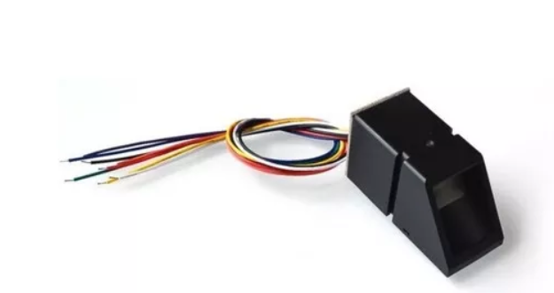
Technical specs - Biometric sensor
Fingerprint Sensor As608
Interface: Serial (TXRX)
Supply Voltage: 3.6-6.0 VDC
Peak Current: 150mA
Storage Capacity:162 Templates
Signature File:256 Bytes

Slide 5
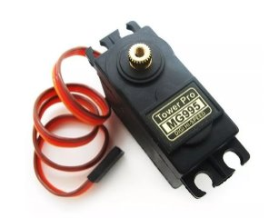
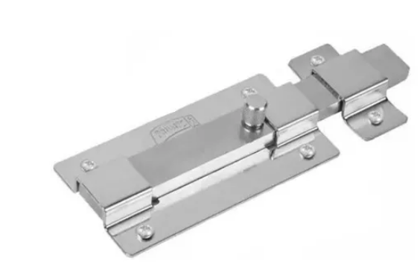
Technical Specs – Mechanics components
Door Latch
The servo will be connected to the latch so it can grant or not access to the person
Servo Motor
This will be the one in charge of moving the lock upon successful recognition of the fingerprint

Slide 6
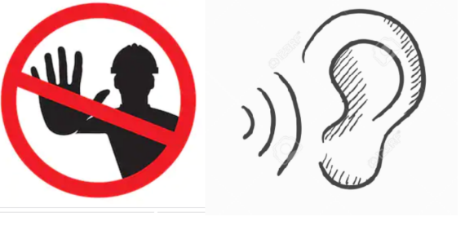
Technical specs – Electronic components
For this project, a sound alarm is going to be implemented, alarm will consider different sounds for valid or invalid access attempts.
Also for functionality and debugging, leds will be used.

Slide 7

Energy Saving
ARM Interrupt handling

