Slide 1














HawkTU
Presented by Tabish | Arqam | Danish

Slide 2
Overview
HawkTU is a comprehensive e-commerce platform designed for seamless interaction between sellers and customers. It features distinct user views—seller dashboards and customer portals—catering to specific needs. HawkTU also includes a tracking page for all users to check order status.

Slide 3
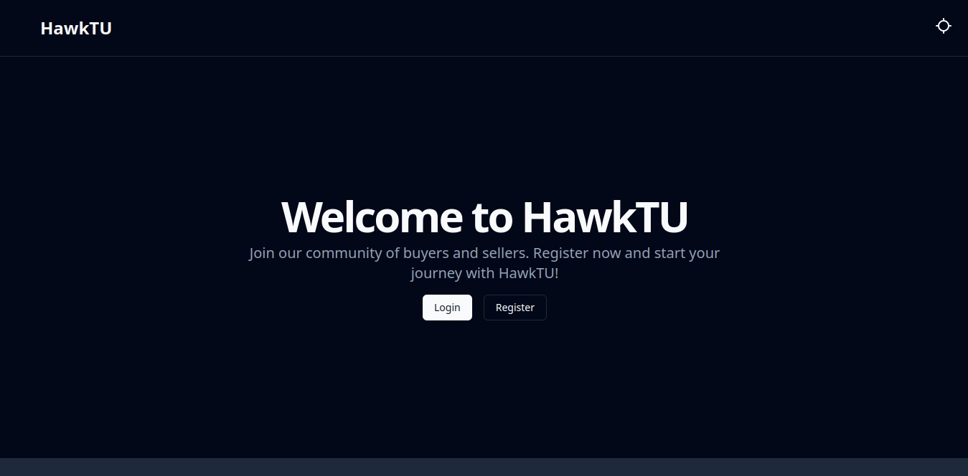
Landing Page

Slide 4
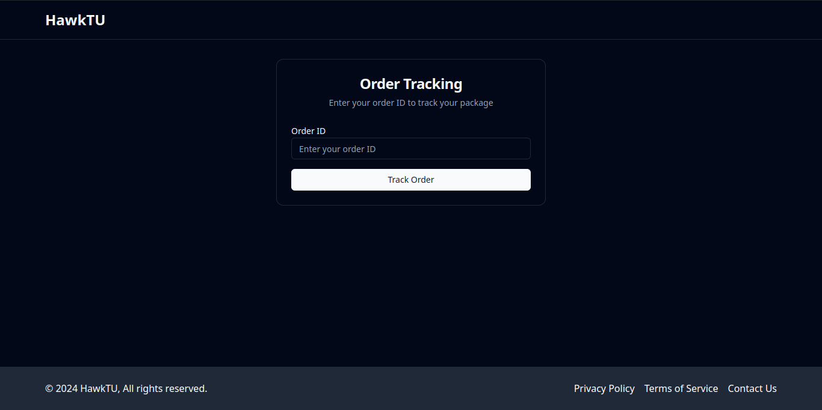
Tracking

Slide 5
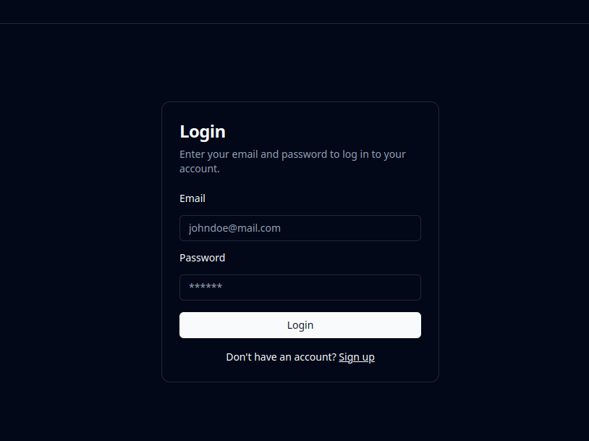
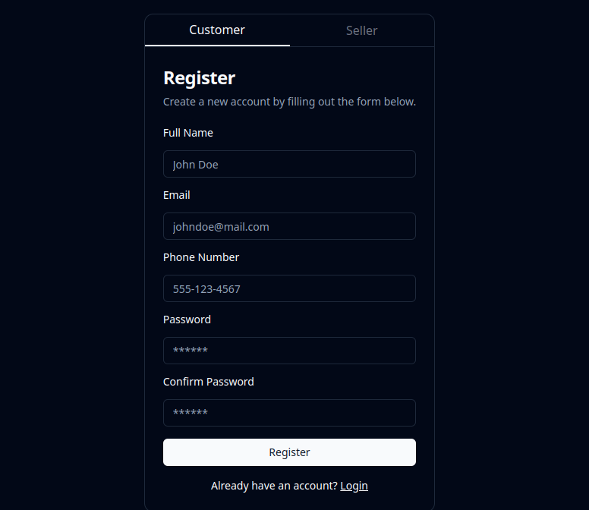
Login and Registration

Slide 6
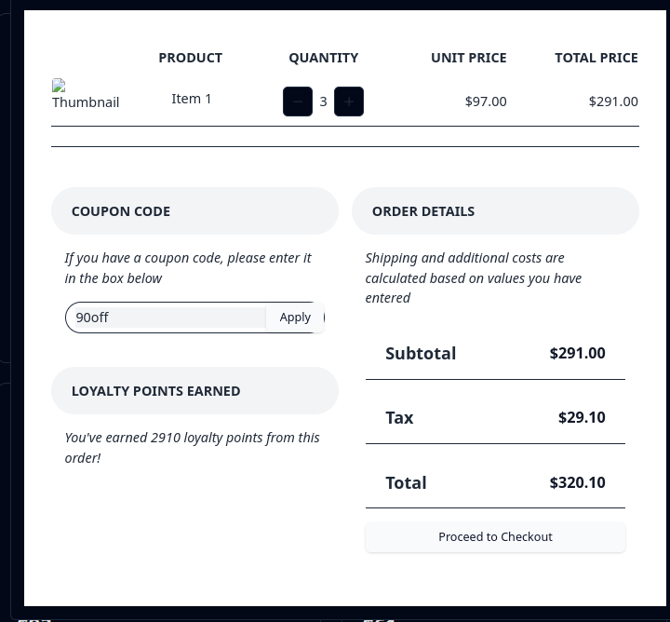
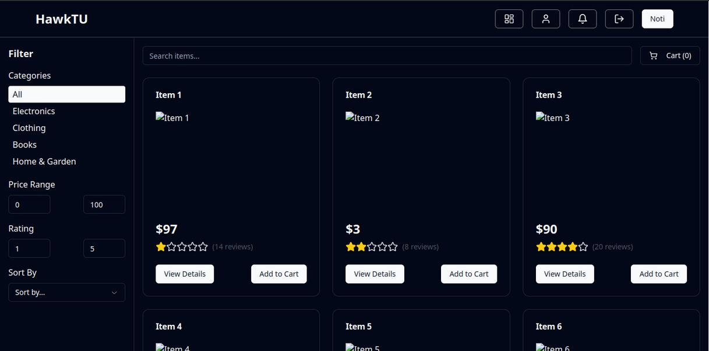
Shop and Cart

Slide 7
Shop and Cart

Slide 8
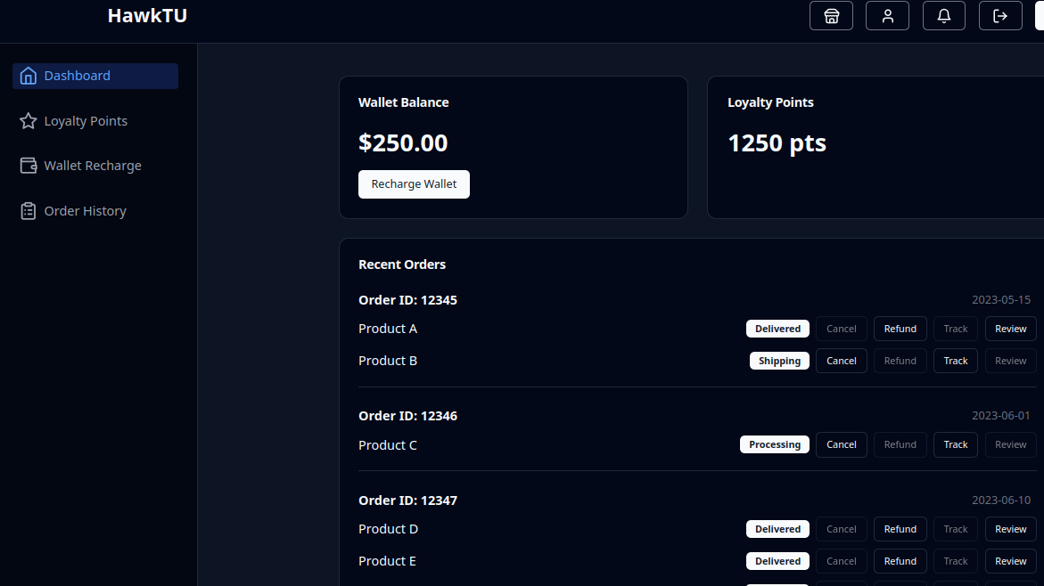
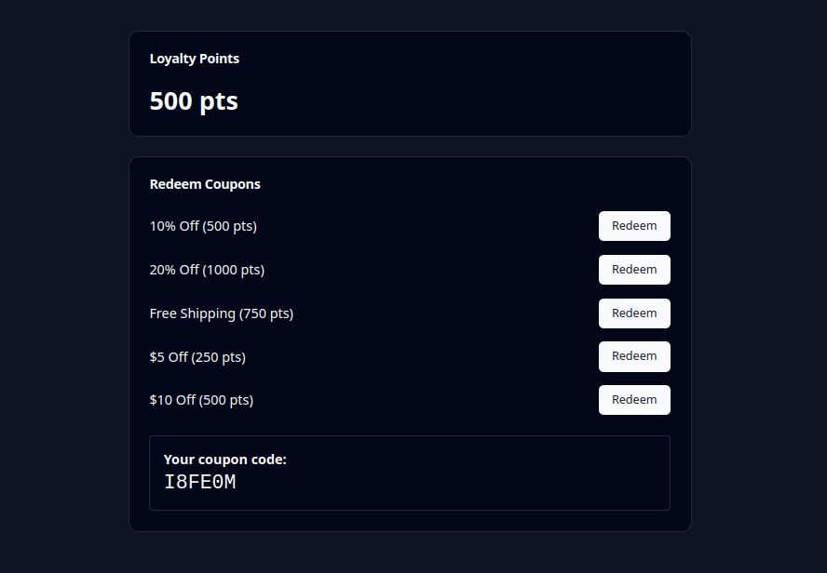
Customer Dashboard

Slide 9
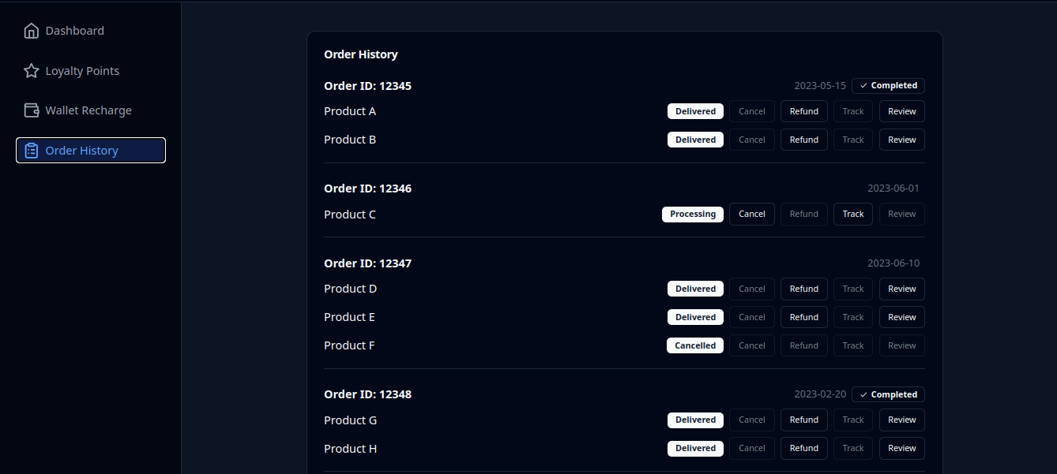
Order History

Slide 10
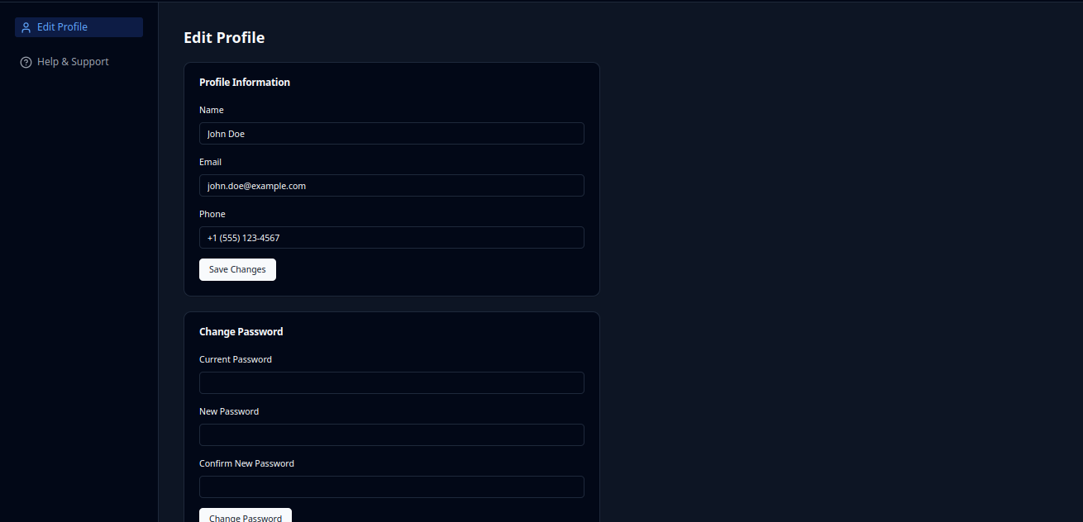
Customer Profile

Slide 11
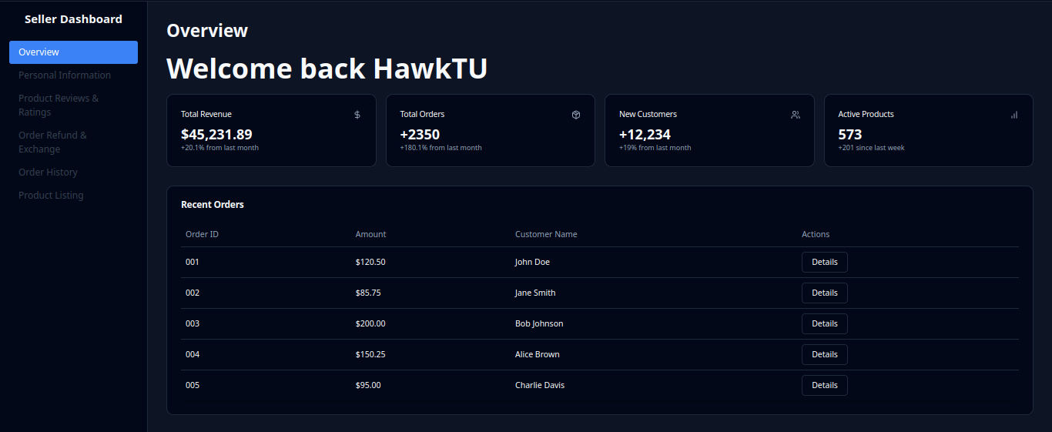
Seller Dashboard

Slide 12
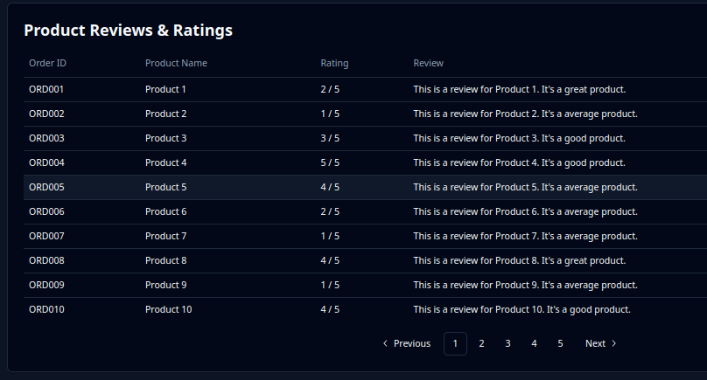
Review and Rating

Slide 13
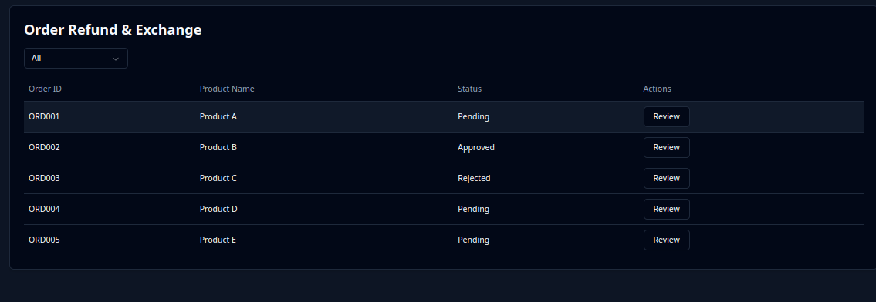
Refunds

Slide 14
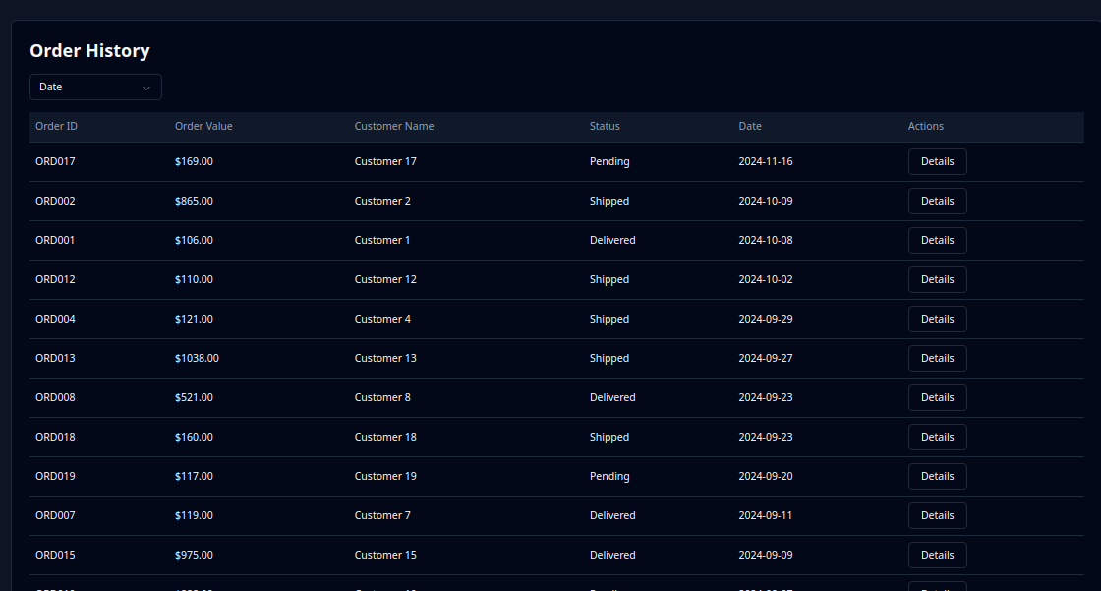
Seller Order History

Slide 15
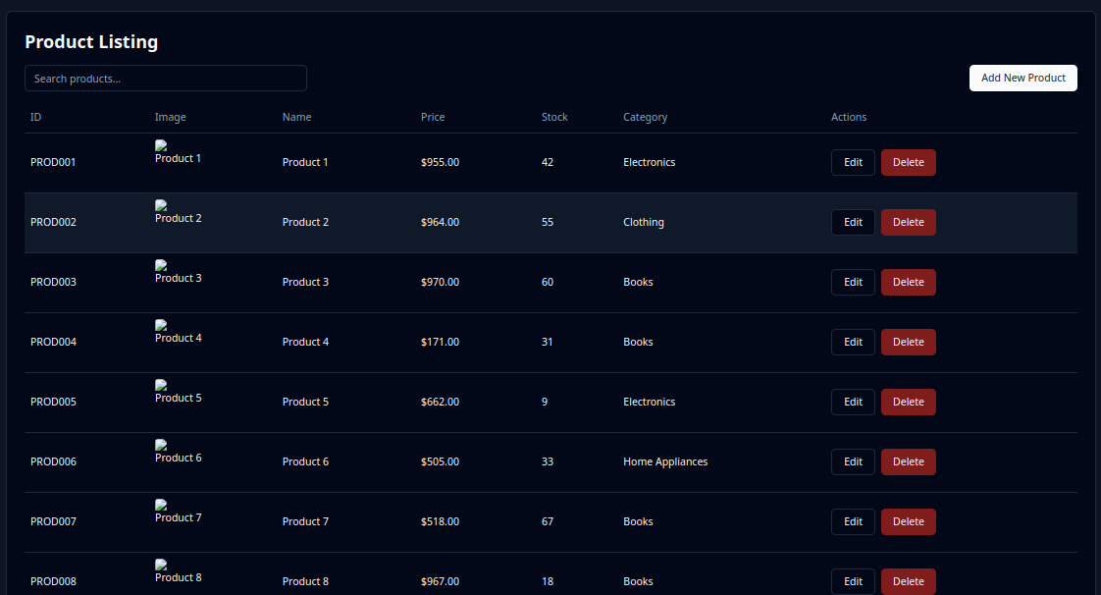
Product Listings

Slide 16
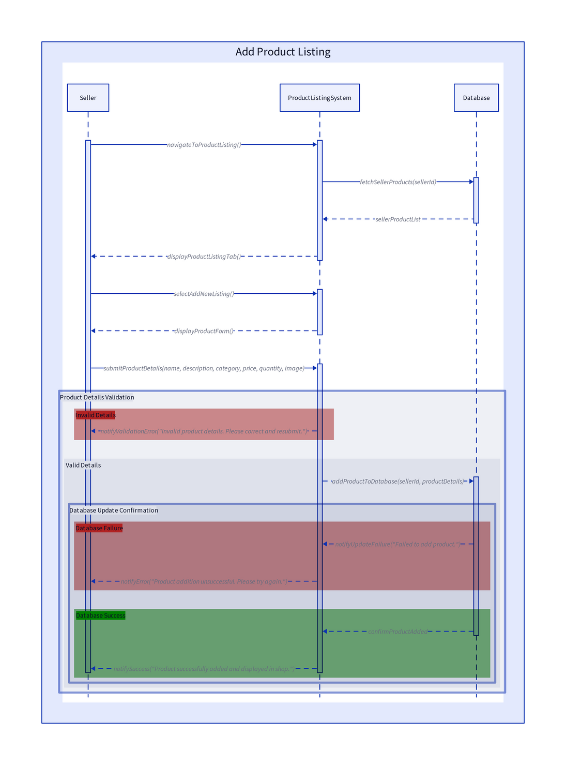
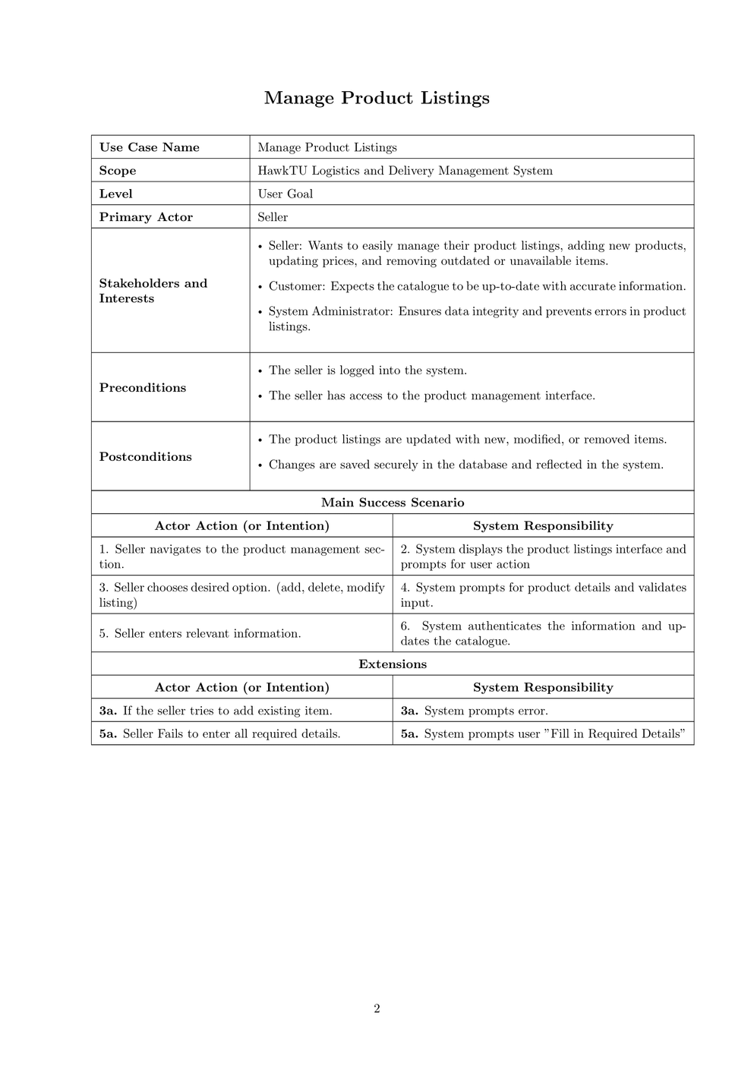
Use Case & Sequence Diagram

