Slide 1

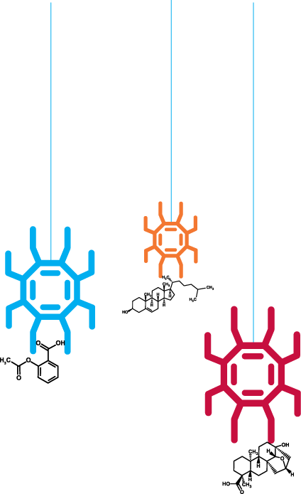
Meeting UoS with RSC Tuesday 9th April of the pillars of a

Slide 2


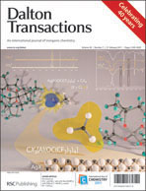
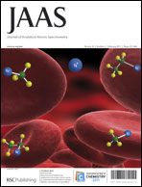
RSC eScience Databases
RSC Databases
Publishing Platform
ChemSpider Molecules
ChemSpider Spectra
ChemSpider SyntheticPages
ChemSpider Reactions
ChemSpider Materials
Digitally Enhancing RSC Archive (DERA)
1841 – present, >300k articles
Text mining and information retrieval
OSR, graphs and spectra extraction
Layering ontologies and adding semantic meaning
Technology will be used on other corpora
Feeds back to RSC Databases

Slide 3


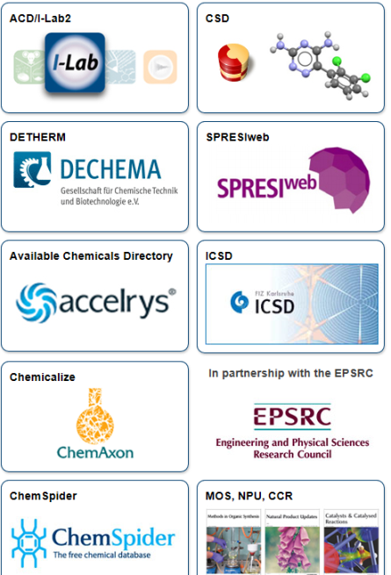
RSC eScience Projects
Grants and Projects
Open PHACTS
Semantic Web
Artificial Intelligence
Hosting Data and Algorithms
PharmaSea
Chemical Database for Natural Products
Drug Discovery
National Chemical Database Service
Chemistry Database Service
Chemistry Data Repository
Open Source Drug Discovery
Collaborating with Indian scientists

Slide 4
RSC Global Chemistry Hub
Data → Knowledge
RSC Archive and Publishing Platform
RSC (ChemSpider) Databases
DERA
National Data Repository
Semantic Web projects
Community → Professional Networks
Challenger - crowdsourcing
Rewards and Recognition - altmetrics
Open Innovation
Open Innovation Platform

Slide 5
ChemSpider Materials
Types of data
CIFs
X-Rays
Photographs
Use cases?
Existing examples?

Slide 6
DaM and ELN
Platform(s)
CSSP
Blog3
LabTrove
ChemSpider components and data services
Workflow
Minimal requirements
Existing prototypes
Screenshots

Slide 7
RSC Databases
UI components
Data services
Federated system modules
Security model
SPARQL API

Slide 8
National Data Repository

Slide 9
Wow projects
Visualization
zSpace and alike
Massive parallel computing

Slide 10




Thank you
Email: tkachenkov@rsc.org
Blog: www.chemspider.com/blog
SLIDES: http://www.slideshare.net/valerytkachenko16
Notes:
10

