Slide 1
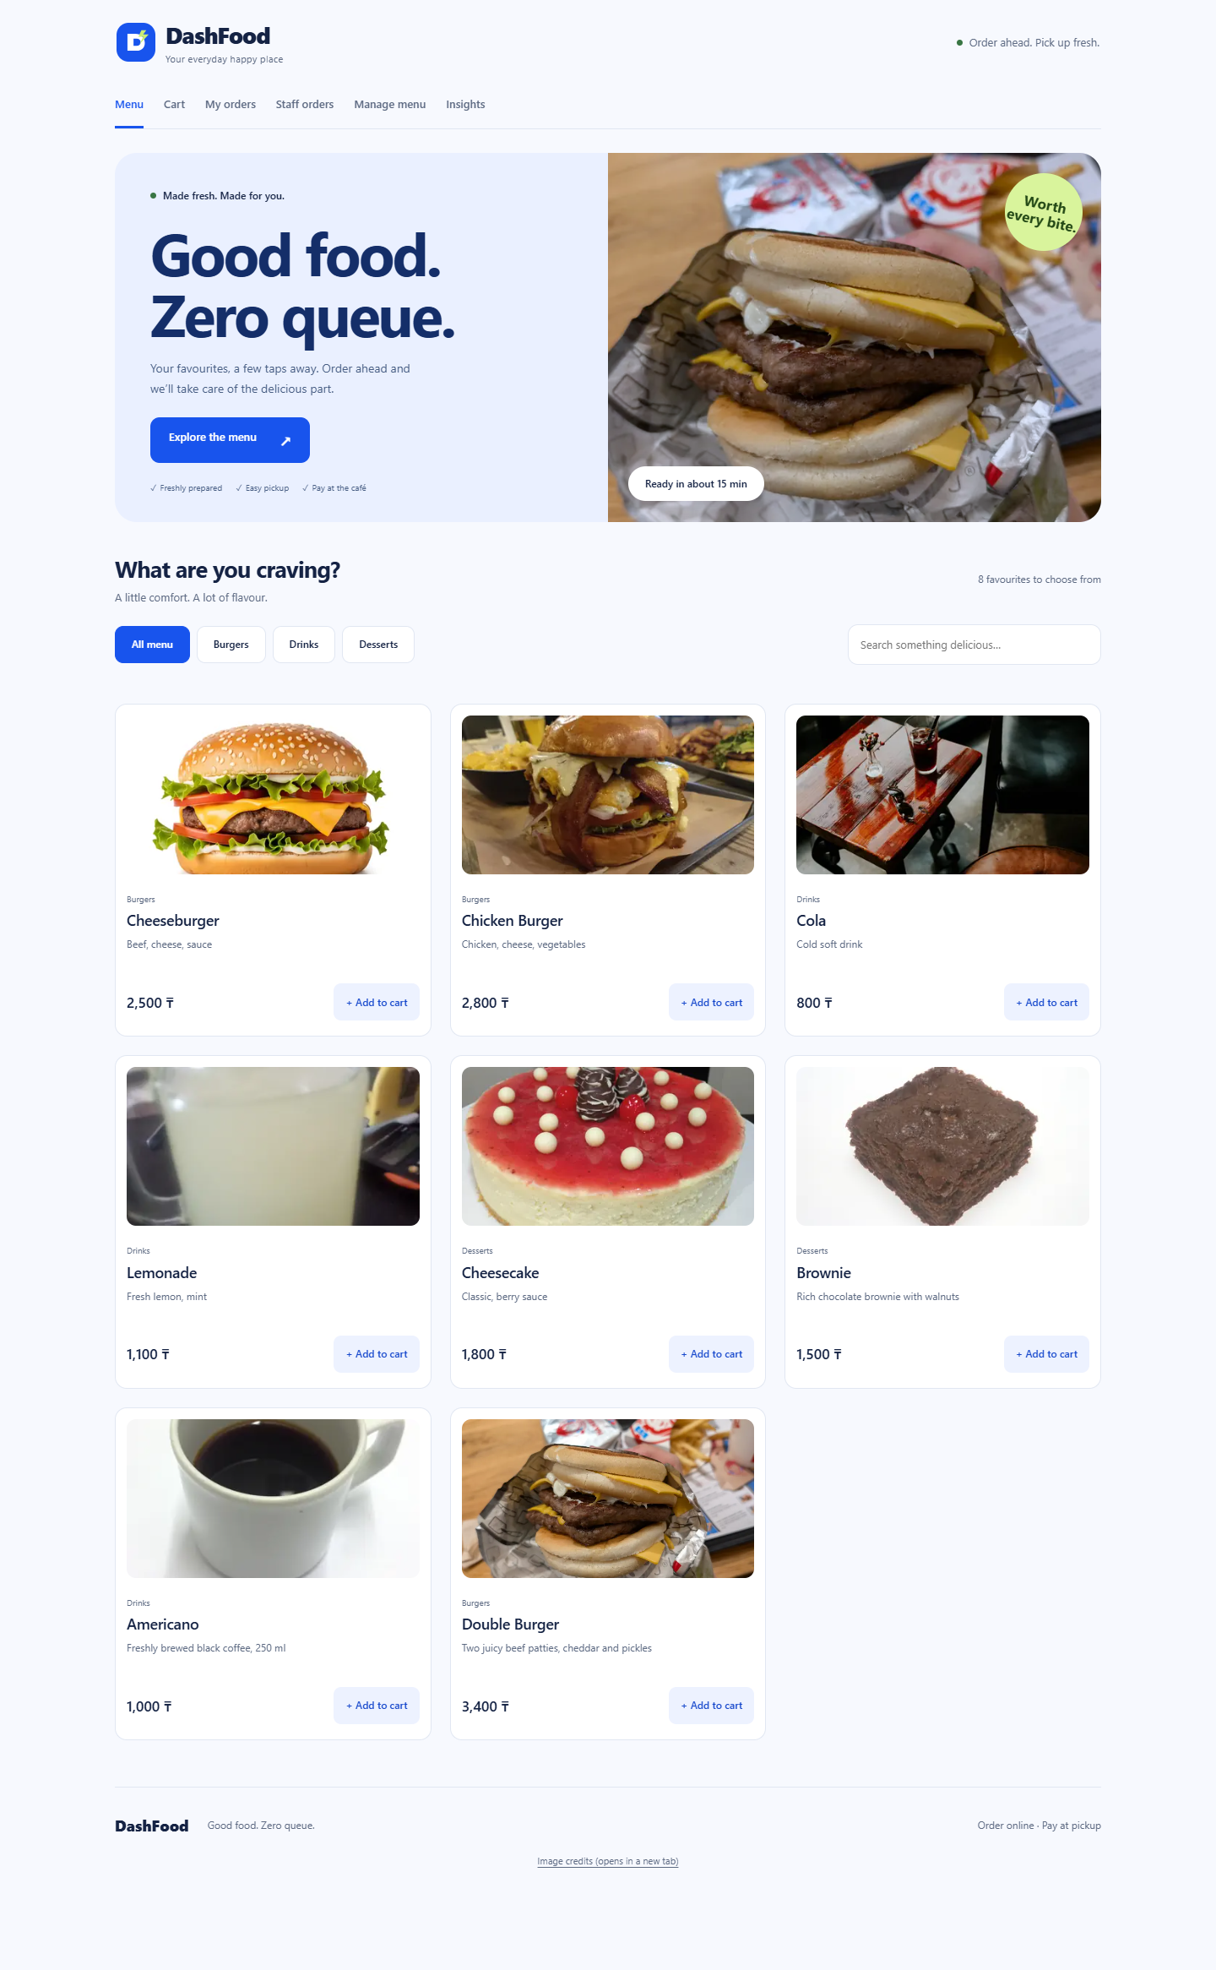
DashFood
Cafe online ordering system
SE-2622
Artur, Adiyat, Erdaulet
Final ICT Project
8 November 2026
Notes:
Artur, 25 seconds. Introduce pickup ordering and the shared database. Sources: supplied ICT_Final (1).pdf and repository https://github.com/Arqode/CafeSystem. This is a review edition with evidence gaps stated in the final report.

Slide 2
Problem and users
Customers need a clear menu and a reliable pickup order.
Customers browse, check the cart and track preparation.
Staff receive orders, update status and control availability.
Evidence: documented Stage 1 problem and reproducible interface findings.
Real queue reduction has not been measured.
DashFood / SE-2622
Notes:
Artur, 45 seconds. Explain two user groups. Stage 1 page 5 gives success criteria. Avoid claiming measured queue reduction or a local customer survey. Scope excludes delivery and online card payments.

Slide 3
As-built architecture
Phone or laptop browser
Wi-Fi / internet / loopback
Responsive React web app
Cart and secret order receipts
Node HTTPS or Caddy TLS
Express API and PostgreSQL 16
Public: menu and validated checkout
Customer receipt key: own order read
Staff JWT: orders, menu writes, Insights
DashFood / SE-2622
Notes:
Adiyat, 55 seconds. Actual build uses web browsers and local images, not React Native/AWS. Local :4443 is self-signed; trusted public TLS is pending. DB lives on the review laptop or Docker volume. No application AES-256-at-rest claim. See server/schema.sql and index.ts. Original design deltas appear in report page 6.

Slide 4
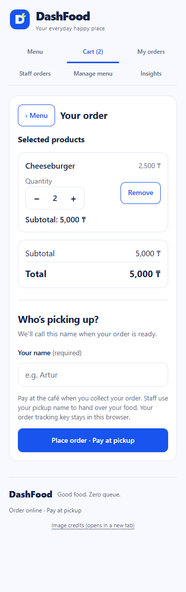
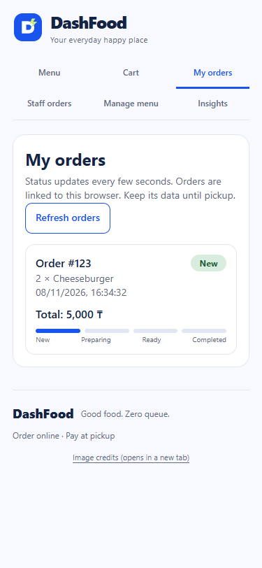
Customer live demonstration
Cart, quantity and pickup name
Saved order and tracking status
DashFood / SE-2622
Notes:
Artur, 110 seconds including live demo. Open Menu, add Cheeseburger and Cola, remove Cola, increase Cheeseburger quantity, enter a fictitious name and submit. Point to the created order number and New status. Browser sends product IDs/quantities, server uses DB prices. Source: current screenshots A1-2/A1-3 and tools/test-browser.mjs.

Slide 5
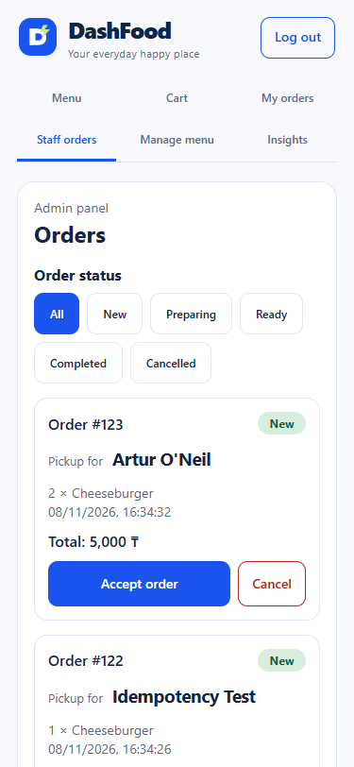
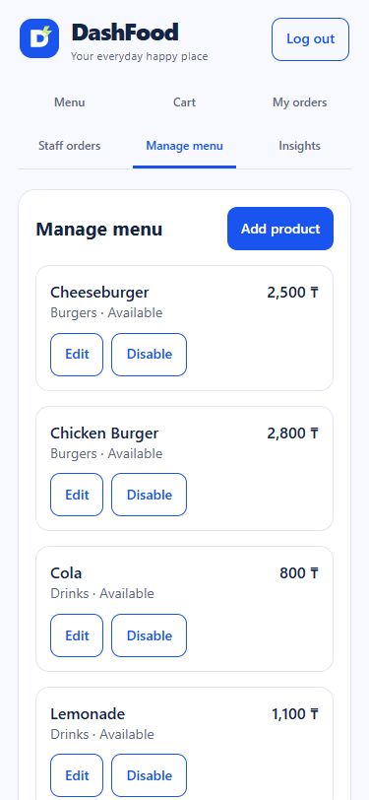
Staff live demonstration
Receive, prepare and mark Ready
Edit products and disable availability
DashFood / SE-2622
Notes:
Adiyat, 100 seconds. Log in as staff, show the same order number and pickup name, Accept then Ready. Switch to customer status. Show a separate Test Tea being disabled; explain stale-cart rejection. Cancellation is allowed only in New/Preparing. Never project the plaintext credential file. Source: A1-4/A1-6, server/src/index.ts.

Slide 6
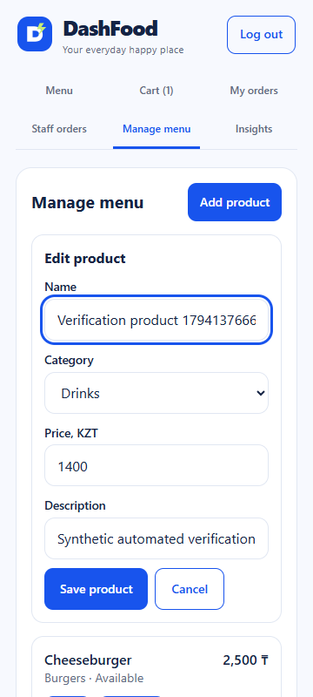
Resolved Stage 2 findings
F01 All mobile routes remain visible
F02 Search ignores surrounding spaces
F03 Editing opens a visible, focused form
The regression checks cover 320, 360, 375, 768 and 1440px.
DashFood / SE-2622
Notes:
Erdaulet, 45 seconds. Match each finding to the last five supplied Stage 2 pages and docs/FEEDBACK_RESPONSE.md. Explain focus return on Cancel and why navigation discoverability matters even without document overflow.

Slide 7
Final verification and original criteria
53 API checks pass
Original Stage 1 criterion | Final result | Evidence limit
Order in less than 2 minutes | Human time unmeasured | Participants were not timed
Reject unavailable products | Automated pass | Record external observation
Interface works at 360px | Automated pass | Record external observation
Six WCAG A/AA scans detect zero violations in the tested scope.
Automated runs do not replace the three external users.
DashFood / SE-2622
Notes:
Erdaulet, 60 seconds. Source of criteria is annotated Stage 1 p5, not the three important functions on p8. Team confirms Medet/Nurdaulet/Iskander tested without timing. Show final-checks.json, api-tests.json and FINAL_TESTING.md. Do not claim all human targets met.

Slide 8
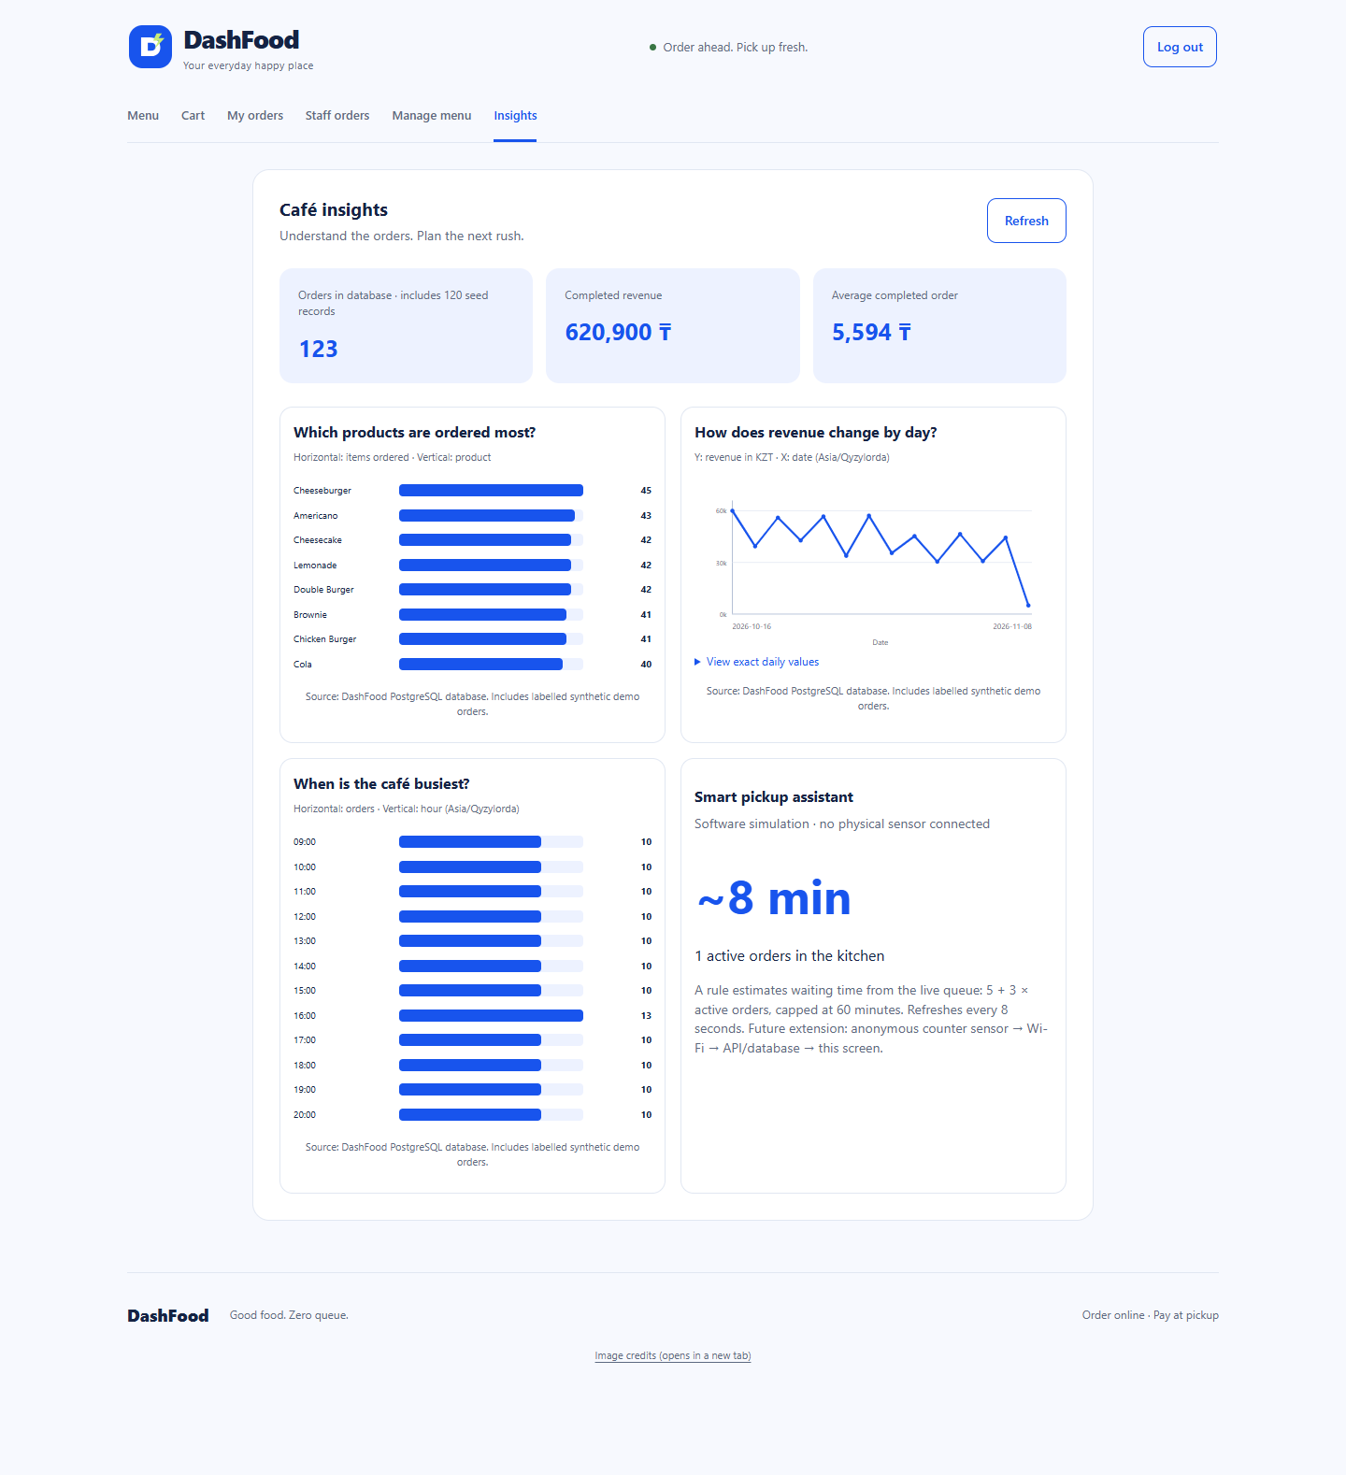
Data analysis from the shared database
123 orders
120 flagged seed records
620,900 KZT completed total
Popularity, daily revenue and hourly orders answer different questions.
All assessment records are synthetic.
DashFood / SE-2622
Notes:
Adiyat, 40 seconds. Snapshot data: final-dataset.json and C5 screenshot. Explain SUM(qty) excluding Cancelled, completed SUM(total) by date, COUNT(*) by local hour. Remaining unflagged records are verification orders, not real customers. Numbers describe this capture, not an always-live promise.

Slide 9
Smart pickup simulation
min(60, 5 + 3 × active orders)
New and Preparing orders form the active queue.
Insights refreshes every eight seconds.
No physical sensor is connected.
The formula has not been calibrated to kitchen preparation times.
DashFood / SE-2622
Notes:
Erdaulet, 35 seconds. For three active orders estimate=14 minutes. This is a software simulation. Future anonymous sensor ingestion needs device authentication, validation, deduplication and stale-data handling. Source: API analytics route and AnalyticsPage.tsx.

Slide 10
Lessons and remaining evidence
A shared database makes the customer and staff journey verifiable.
Complete timed external retests and personal signed statements.
Confirm trusted HTTPS and measure availability over a declared period.
Each member reviews and commits their own current contribution.
Backup: DashFood_Demo.webm
Full traceability: final report and docs/FINAL_DEFENSE_RU.md
DashFood / SE-2622
Notes:
Erdaulet, 30 seconds. State that R11 source wording remains cropped, R15 uptime unmeasured and public TLS unverified. The review package preserves these gaps honestly. Every member speaks and answers individual 3-5 minute questions. Sources: supplied final brief, annotated midterm, current evidence and README.

