Slide 1
Project Update #1
Clayton, Zach, Rachel, Molly

Slide 2

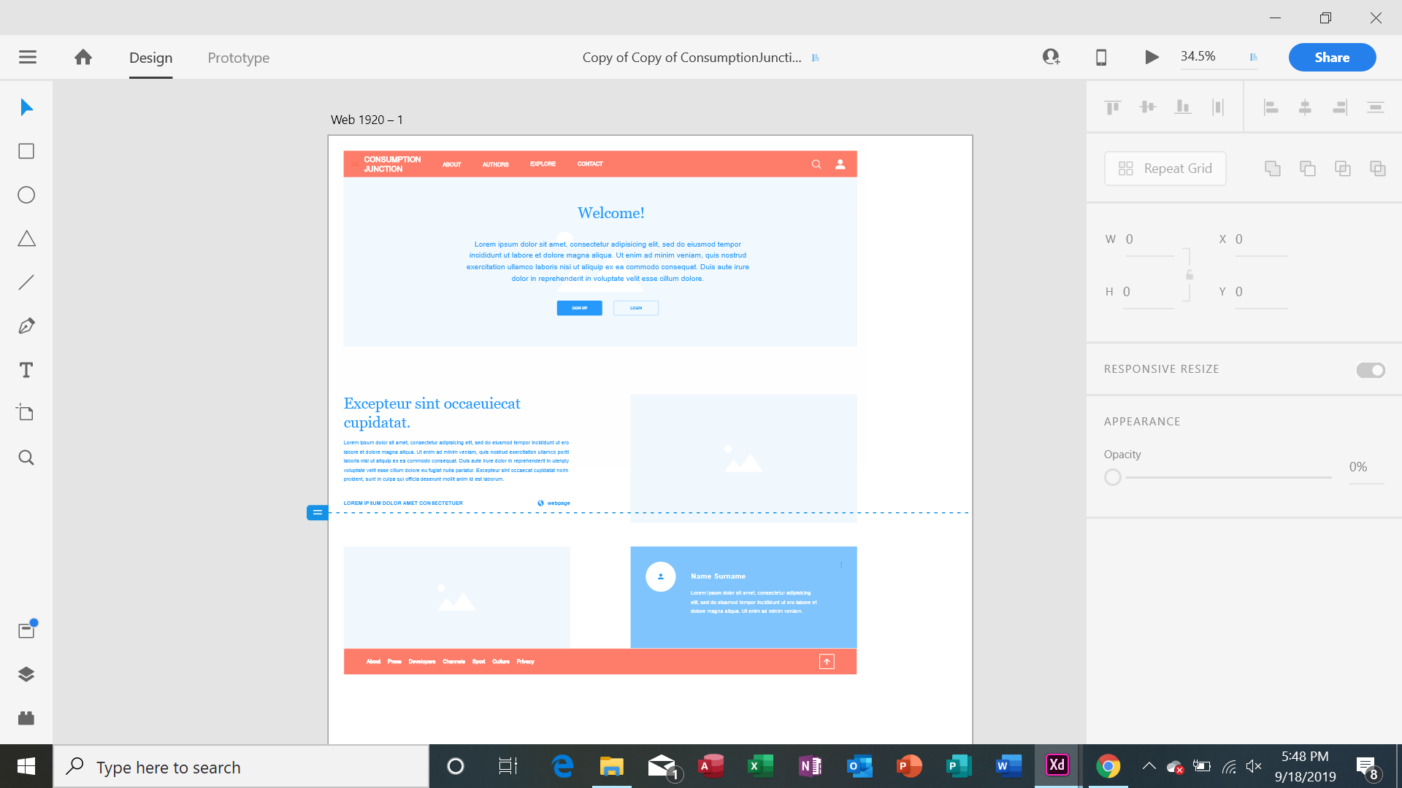
What we’ve done...
Molly and Rachel finished the wireframe of what the website will look like
Zach and Clayton created “models” for recipes and account info using Django web framework

Slide 3
What we plan to do...
Molly and Rachel learn/relearn HTML
Molly and Rachel start HTML for the homepage
Zach and Clayton will work on account info and recipe management

Slide 4
Road Blocks
Molly and Rachel hit a roadblock learning the software (Adobe XD) to create the wireframe
Zach is learning how to use python and Django.

