Slide 1
Software for Embedded Systems
Lab Assignment – Collection of Sensor Information and transmission to laptop or through Wi-Fi

Slide 2
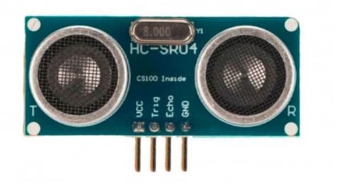
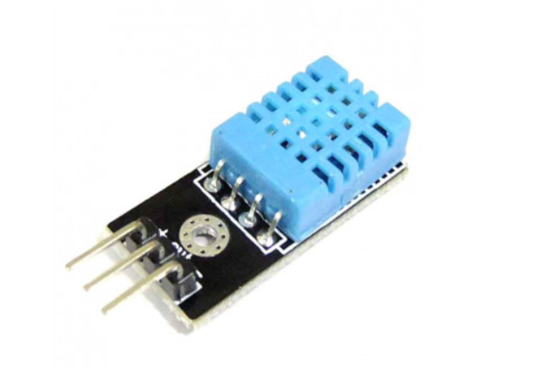
Sensors
Electronic devices that collect information about the real world, and transmit it in a machine readable format.
Two types of information relayed:
  Analog Signal – voltage values from 0 – 2^{n} based on sensor precision.
  Digital Signal – 0/1
  HC-SR04 Ultrasound Distance DHT11-Temp & Humidity

Slide 3
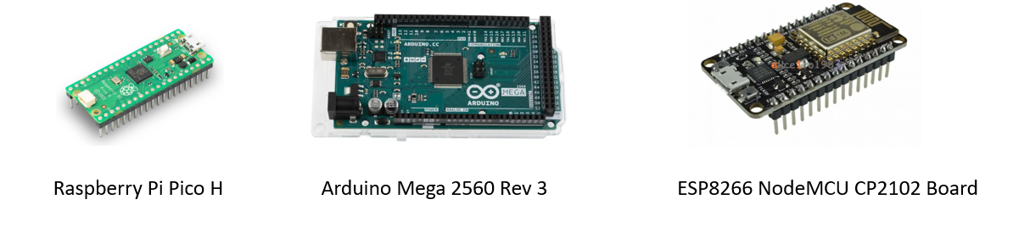
Micro-controllers
Small computers with ability to interact with sensors and process the data received.

Slide 4
Transmission
In any system, data (analog/digital) has to be transmitted between
  Sensor and Microcontroller
  Microcontroller and other parent device e.g. laptop/other microcontrollers
Transmission is either:
  Wired - Connect every component that needs to send/receive data using ethernet cables/jumper wires etc. e.g. Telephone lines.
  Wireless – Several different technologies can be used to wirelessly connect two components
    WIFI / Radio / Mobile GSM / Bluetooth / Lora wan etc

Slide 5
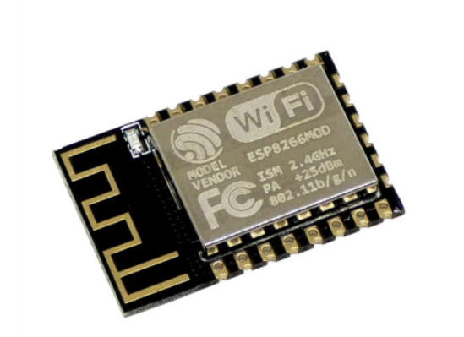
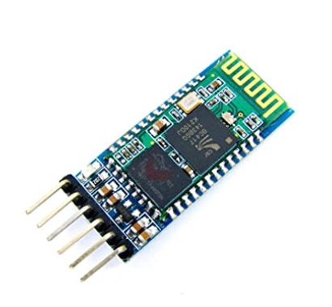
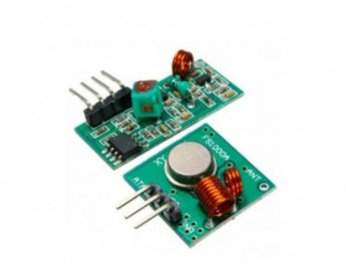
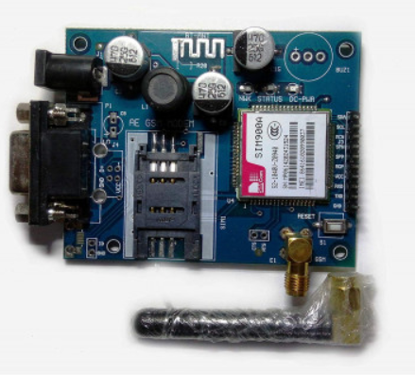
Transmission Devices

Slide 6
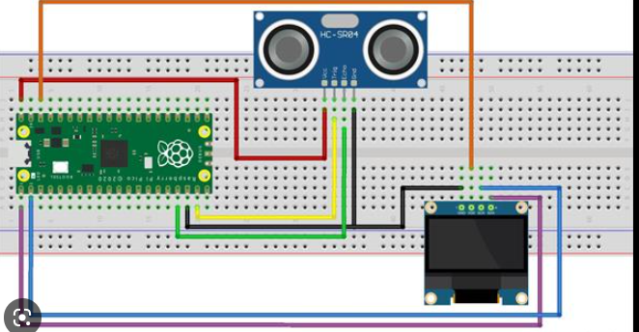
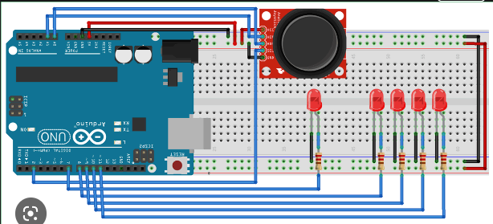
A simple Wired Sensor Data Collection Set up

Slide 7
List of Sensors We can use
Basic Sensors
  Ultrasound
  Temp Humidity
Better Sensors
  LDR
  Joystick

Slide 8
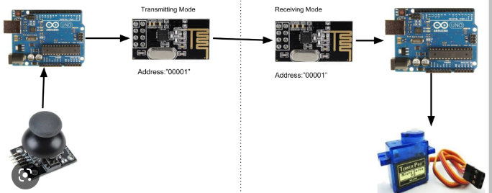
Wireless data transmission

Slide 9
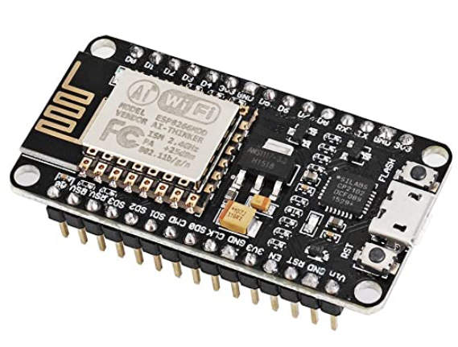
ESP8266-12E NodeMcu
Low cost, open source IoT platform.
Inbuilt Wi-Fi module, programmable with Arduino IDE.

