Slide 1
LAB4 ASSIGNMENT
1. Carry Lookahead Adder
1.1 Adder
library ieee;
use ieee.std_logic_1164.all;
use ieee.numeric_std.all;
entity adder is
port(
x, y, cin : in std_logic ;
sum : out std_logic
);
end entity;
architecture beh of adder is
begin
sum <= x xor y xor cin;
end beh;
1.2 Carry Block
entity carry_block is
port(
cin : in std_logic;
x, y: in std_logic_vector(3 downto 0);
cout : out std_logic_vector(3 downto 0)
);
end entity ;

Slide 2
architecture beh of carry_block is
signal P0, P1, P2, P3 : std_logic;
signal G0, G1, G2, G3 : std_logic;
begin
P0 <= x(0) or y(0);
G0 <= x(0) and y(0);
P1 <= x(1) or y(1);
G1 <= x(1) and y(1);
P2 <= x(2) or y(2);
G2 <= x(2) and y(2);
P3 <= x(3) or y(3);
G3 <= x(3) and y(3);
cout(0) <= G0 or (P0 and cin);
cout(1) <= G1 or (P1 and cout(0));
cout(2) <= G2 or (P2 and cout(1));
cout(3) <= G3 or (P3 and cout(2));
end beh; library ieee;
2.3. Carry Lookahead Adder
entity carry_lookahead_adder is
port(
x, y : in std_logic_vector(3 downto 0);
cin : in std_logic;
sum : out std_logic_vector(3 downto 0);
cout : out std_logic
);
end entity;
architecture struct of carry_lookahead_adder is
signal s_internal_carries : std_logic_vector(3 downto 0);
component adder is
port(x, y, cin: in std_logic ;
sum : out std_logic
);
end component;
component carry_block is
port(
cin : in std_logic;
x, y: in std_logic_vector(3 downto 0);
cout : out std_logic_vector(3 downto 0)
);
end component;

Slide 3
begin
CB : carry_block port map
(cin , x, y ,s_internal_carries);
adder0 : adder port map
(x(0) , y(0), cin, sum(0));
adder1 : adder port map
(x(1) , y(1), s_internal_carries(0), sum(1));
adder2 : adder port map
(x(2) , y(2), s_internal_carries(1), sum(2));
adder3 : adder port map
(x(3) , y(3), s_internal_carries(2), sum(3));
cout <= s_internal_carries(3);
end struct ;
1.4. Carry Lookahead Adder Test Banch
entity carry_lookahead_adder_tb is
end carry_lookahead_adder_tb;
architecture behavior of carry_lookahead_adder_tb is
signal x_tb, y_tb : std_logic_vector(3 downto 0);
signal cin_tb : std_logic;
signal sum_tb : std_logic_vector(3 downto 0);
signal cout_tb : std_logic;
component carry_lookahead_adder is
port(
x, y : in std_logic_vector(3 downto 0);
cin : in std_logic;
sum : out std_logic_vector(3 downto 0);
cout : out std_logic
);
end component;

Slide 4
begin DUT: carry_lookahead_adder port map(
x => x_tb,
y => y_tb,
cin => cin_tb,
sum => sum_tb,
cout => cout_tb
);
stimulus_proc : process
begin
-- Test case 1: Add 4 + 5 without carry
x_tb <= "0100"; -- 4
y_tb <= "0101"; -- 5
cin_tb <= '0';
wait for 2 ns;
-- Test case 2: Add 7 + 3 with carry
x_tb <= "0111"; -- 7
y_tb <= "0011"; -- 3
cin_tb <= '1';
wait for 2 ns;
-- Test case 3: Add 15 + 15 without carry
x_tb <= "1111"; -- 15
y_tb <= "1111"; -- 15
cin_tb <= '0';
wait for 2 ns;
-- Test case 3: Add 15 + 15 with carry
x_tb <= "1111"; -- 15
y_tb <= "1111"; -- 15
cin_tb <= '1';
wait for 2 ns;
-- Test case 4: Add 0 + 0 with carry
x_tb <= "0000"; -- 0
y_tb <= "0000"; -- 0
cin_tb <= '1';
wait for 2 ns;
wait;
end process;
end behavior;

Slide 5
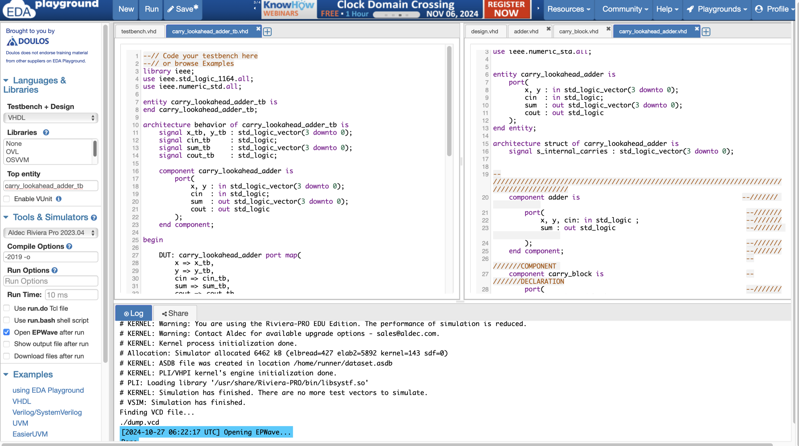
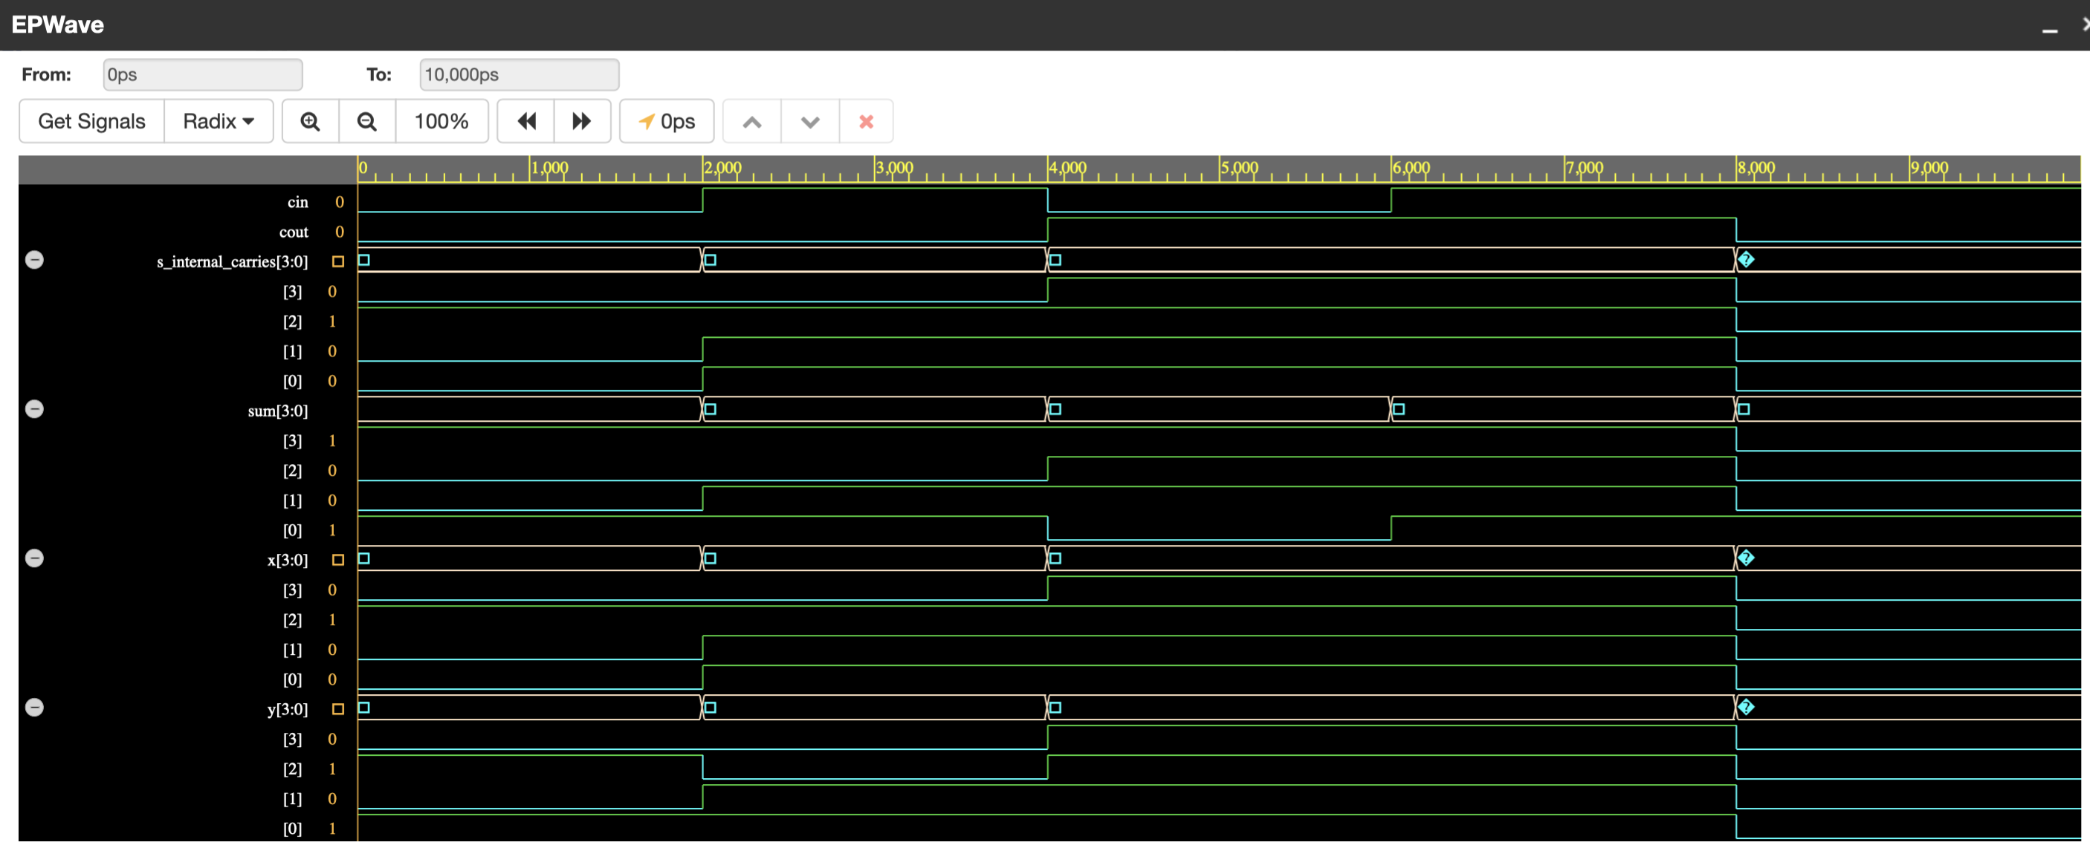
1.5. Simulation
1.5.1. Set up
1.5.2. Result

Slide 6
2. Wallace Tree Multiplier
2.1 Full Adder
entity full_adder is
port(
x, y, cin : in std_logic;
sum, cout : out std_logic
);
end entity;
architecture beh of full_adder is
begin
sum <= x xor y xor cin ;
cout <= (x and y ) or ((x or y) and cin);
end beh;
2.2 Wallace Tree Multiplier
entity wallace_tree_multiplier is
port(
x, y : in std_logic_vector(3 downto 0);
p : out std_logic_vector(7 downto 0)
);
end entity;
architecture struct of wallace_tree_multiplier is
signal s_bottom_level_carry_out : std_logic_vector(4 downto 0) := "00000";
signal s_middle_level_carry_out : std_logic_vector(3 downto 0) := "0000";
signal s_top_level_carry_out : std_logic_vector(1 downto 0) := "00";
signal s_middle_level_sum : std_logic_vector(3 downto 0) := "0000";
signal s_top_level_sum : std_logic_vector(1 downto 0) := "00";
component full_adder is
port(
x, y, cin : in std_logic;
sum, cout : out std_logic
);
end component;
begin
p(0) <= (x(0) and y(0));
--mapping the full adders
FA_0 : full_adder
port map(
x => (x(0) and y(1)),
y => (x(1) and y(0)),
cin => '0',
sum => p(1),
cout => s_bottom_level_carry_out(0)
);

Slide 7
FA_1 : full_adder
port map(
x => (x(2) and y(0)),
y => (x(1) and y(1)),
cin => '0',
sum => s_middle_level_sum(0),
cout => s_middle_level_carry_out(0)
);
FA_2 : full_adder
port map(
x => (x(3) and y(0)),
y => (x(2) and y(1)),
cin => '0',
sum => s_top_level_sum(0),
cout => s_top_level_carry_out(0)
);
FA_3 : full_adder
port map(
x => s_middle_level_sum(0),
y => (x(0) and y(2)),
cin => s_bottom_level_carry_out(0),
sum => p(2),
cout => s_bottom_level_carry_out(1)
);
FA_4 : full_adder
port map(
x => (x(0) and y(3)),
y => s_top_level_sum(0),
cin => (x(1) and y(2)),
sum => s_middle_level_sum(1),
cout => s_middle_level_carry_out(1)
);
FA_5 : full_adder
port map(
x => (x(3) and y(1)),
y => (x(2) and y(2)),
cin => '0',
sum => s_top_level_sum(1),
cout => s_top_level_carry_out(1)
);
FA_6 : full_adder
port map(
x => s_middle_level_sum(1),
y => s_middle_level_carry_out(0),
cin => s_bottom_level_carry_out(1),
sum => p(3),
cout => s_bottom_level_carry_out(2)
);
FA_7 : full_adder
port map(
x => (x(1) and y(3)),
y => s_top_level_sum(1),
cin => s_top_level_carry_out(0),
sum => s_middle_level_sum(2),
cout => s_middle_level_carry_out(2)
);
FA_8 : full_adder
port map(
x => s_middle_level_sum(2),
y => s_middle_level_carry_out(1),
cin => s_bottom_level_carry_out(2),
sum => p(4),
cout => s_bottom_level_carry_out(3)
);
FA_9 : full_adder
port map(
x => (x(3) and y(2)),
y => (x(2) and y(3)),
cin => s_top_level_carry_out(1),
sum => s_middle_level_sum(3),
cout => s_middle_level_carry_out(3)
);
FA_10 : full_adder
port map(
x => s_middle_level_sum(3),
y => s_middle_level_carry_out(2),
cin => s_bottom_level_carry_out(3),
sum => p(5),
cout => s_bottom_level_carry_out(4)
);
FA_11 : full_adder
port map(
x => (x(3) and y(3)),
y => s_middle_level_carry_out(3),
cin => s_bottom_level_carry_out(4),
sum => p(6),
cout => p(7)
);
end struct;

Slide 8
2.3. Wallace Tree Multiplier Test Banch
entity wallace_tree_multiplier_tb is
end wallace_tree_multiplier_tb;
architecture beh of wallace_tree_multiplier_tb is
signal x_tb, y_tb : std_logic_vector(3 downto 0);
signal p_tb : std_logic_vector(7 downto 0);
component wallace_tree_multiplier is
port(
x, y : in std_logic_vector(3 downto 0);
p : out std_logic_vector(7 downto 0)
);
end component;
begin
DUT: wallace_tree_multiplier port map(
x => x_tb,
y => y_tb,
p => p_tb
);
stimulus_proc : process
begin
-- Test case 1: multiply 4 * 5
x_tb <= "0100"; -- 4
y_tb <= "0101"; -- 5
wait for 2 ns;
-- Test case 2: multiply 1 * 1
x_tb <= "0001"; -- 1
y_tb <= "0001"; -- 1
wait for 2 ns;
-- Test case 3: multiply 15 * 15
x_tb <= "1111"; -- 15
y_tb <= "1111"; -- 15
wait for 2 ns;
-- Test case 3: multiply 1 * 15
x_tb <= "0001"; -- 1
y_tb <= "1111"; -- 15
wait for 2 ns;
-- Test case 4: multiply 0 * 15
x_tb <= "0000"; -- 0
y_tb <= "1111"; -- 15
wait for 2 ns;
wait;
end process;
end beh;

Slide 9
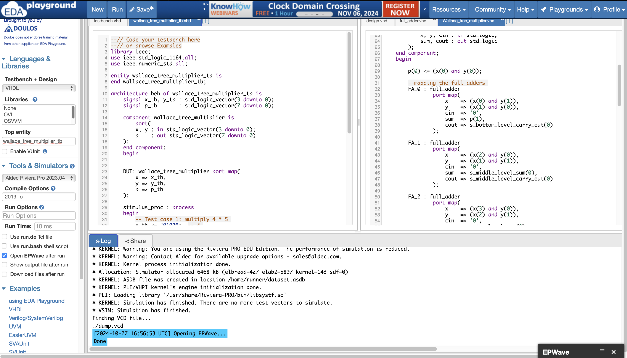
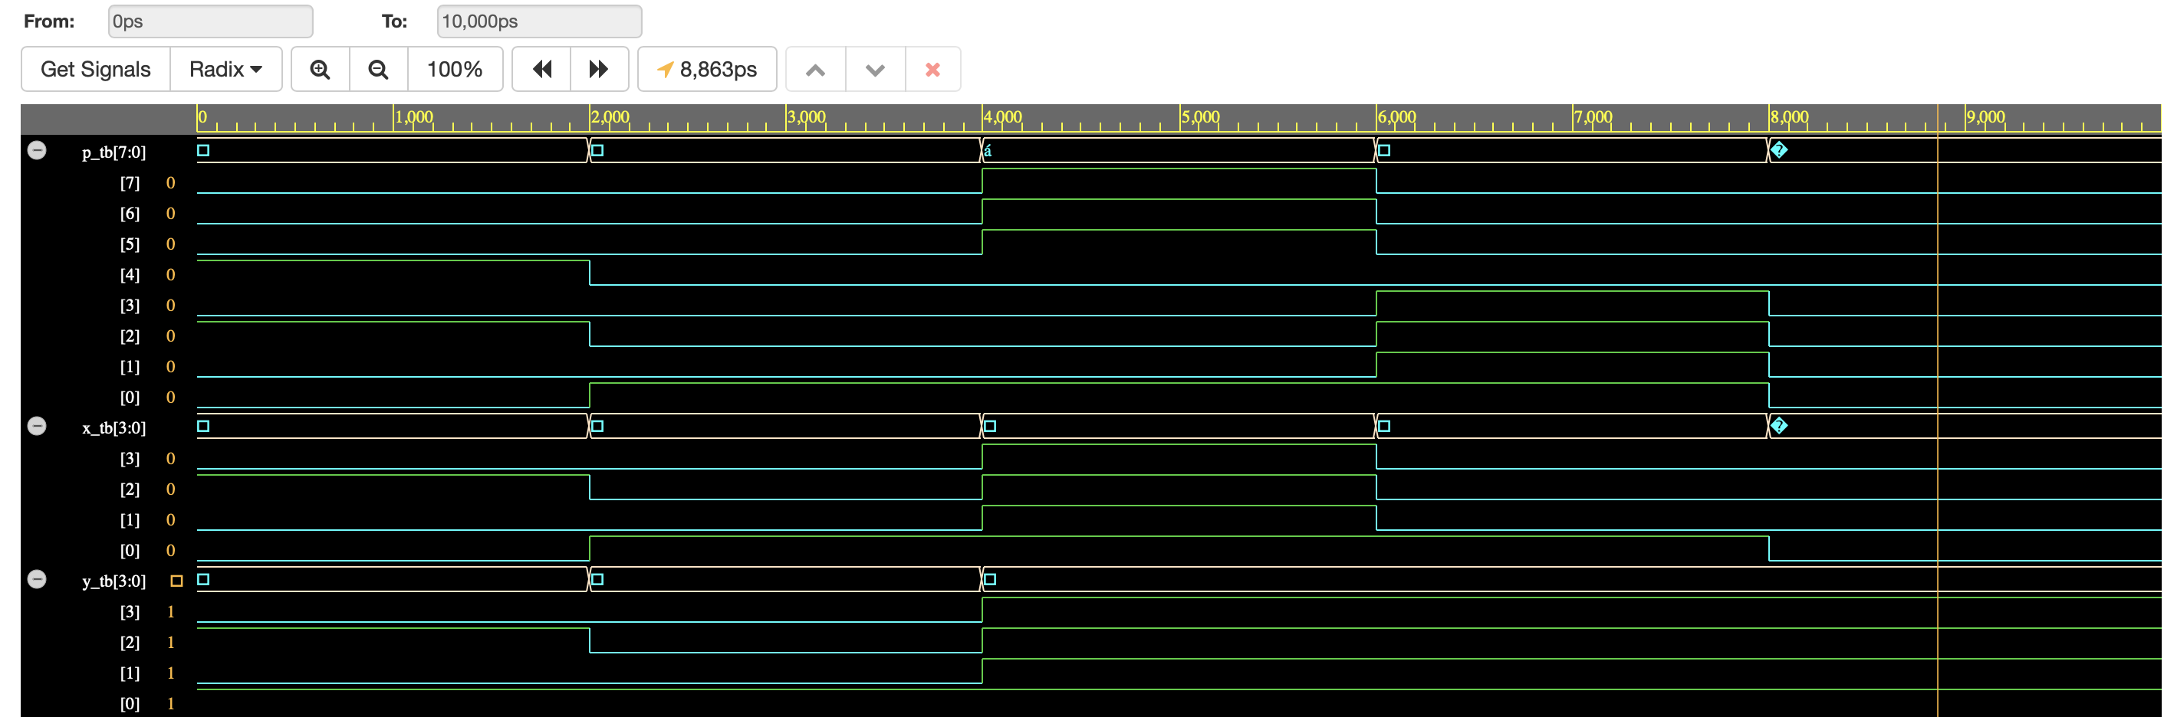
2.4. Simulation
2.4.1. Set up
2.4.2. Result

