Slide 1
Title: Credit Card Fraud Detection: Data Preparation & Analysis
Subtitle: Business Analytics Project - Milestone 1
Abdullahi Mohamed Jibril – Data Analytics Capstone - 11-19-2025
GitHub link: https://github.com/Arralle21/credit-card-fraud-detection/tree/main
Google Drive(processed data) : https://drive.google.com/file/d/1CZiBQf-M2I5D1luaom_rmwgt7c22o47E/view?usp=drive_link

Slide 2
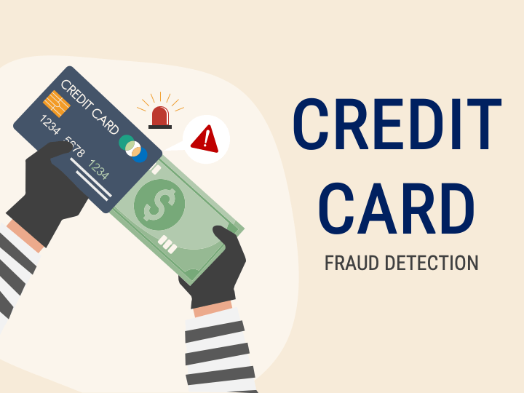
PROJECT OVERVIEW
Objective Detect fraudulent credit card transactions using machine learning techniques
Dataset Source
Kaggle Credit Card Fraud Detection Dataset
Real-world anonymized transactions
Key Challenge Highly imbalanced dataset requiring careful preprocessing and feature engineering

Slide 3
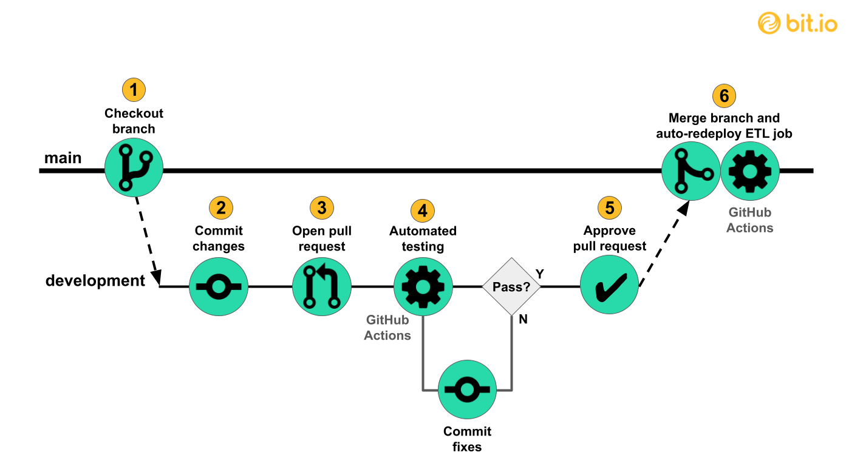
DATA COLLECTION METHODS
Data Source
CSV file: creditcard.csv
Downloaded from Kaggle repository
Collection Tools
Python 3.x
Pandas library for data manipulation
NumPy for numerical operations
Storage & Sharing
GitHub repository for version control
Google Colab for analysis environment

Slide 4
DATASET STRUCTURE
Dataset Dimensions
Total Transactions: 55,551
Total Features: 31
Feature Breakdown
Time: Transaction timestamp (seconds)
V1-V28: PCA-transformed features (28 anonymized variables)
Amount: Transaction amount ($0 - $12,910.93)
Class: Target variable (0 = Normal, 1 = Fraud)

Slide 5
DATA QUALITY ASSESSMENT
Missing Values
Total: 16 missing values (0.00%)
Location: Last row only (V15-V28, Amount, Class)
Duplicate Records
Found: 237 duplicate rows
Action: Identified for potential removal
Data Types
Numerical: 30 float64, 1 int64
No categorical variables
Overall Quality: High-quality, minimal cleaning required

Slide 6
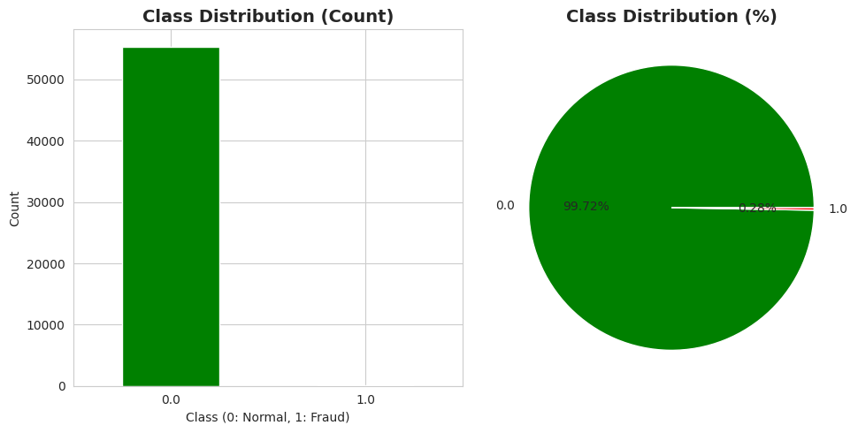
CLASS DISTRIBUTION ANALYSIS
Transaction Breakdown
Normal Transactions: 55,394 (99.72%)
Fraudulent Transactions: 156 (0.28%)
Imbalance Ratio
355:1 (Normal to Fraud)
Business Impact
Severe class imbalance
Requires specialized handling (SMOTE, under sampling)
Risk of model bias toward majority class

Slide 7
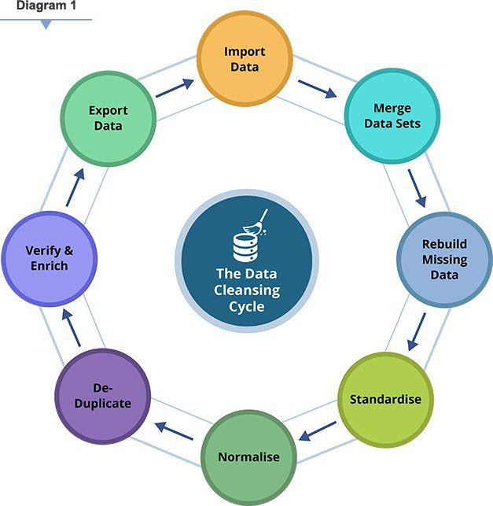
DATA CLEANING STEPS
Step 1: Missing Value Analysis
Identified 16 missing values in last row
Decision: Remove incomplete row
Step 2: Duplicate Detection
Found 237 duplicate transactions
Assessed impact on analysis
Step 3: Data Type Verification
All features numerical
No conversion needed
Step 4: Outlier Identification
Amount outliers: 5,828 (10.49%)
Retained for fraud pattern analysis

Slide 8
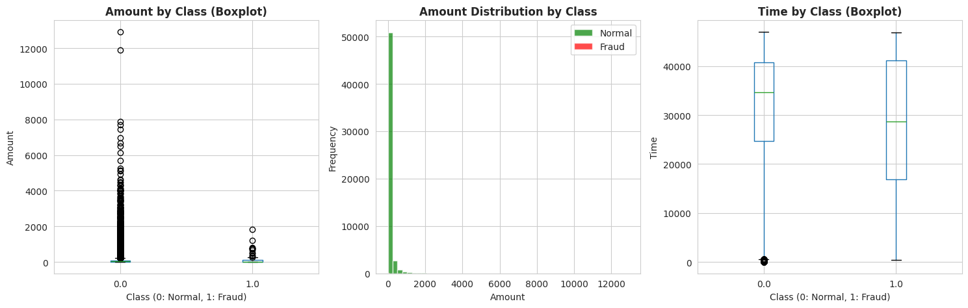
FEATURE ANALYSIS – AMOUNT - Statistical Summary
Mean: $94.71
Median: $25.77
Standard Deviation: $256.95
Range: $0.00 - $12,910.93
Key Findings
Right-skewed distribution
Most transactions under $100
High-value transactions are outliers
Fraud vs Normal Comparison
Normal Mean: $94.70
Fraud Mean: $95.76
Similar average amounts

Slide 9
FEATURE ANALYSIS - TIME
Time Range
Total Duration: 47,005 seconds (13.1 hours)
Represents continuous transaction period
Distribution Characteristics
Relatively uniform distribution
Covers business hours and beyond
Temporal Insights
Hour range: 0-13 hours
Enables time-based pattern detection

Slide 10
DATA PREPROCESSING - Standardization Applied
Method: StandardScaler
New Feature: Amount_scaled
Mean: ~0, Std: 1
Time Feature
Method: StandardScaler
New Feature: Time_scaled
Mean: ~0, Std: 1
Purpose
Normalize feature scales
Improve model convergence
Enable fair feature comparison

Slide 11
FEATURE ENGINEERING - Time-Based Features Created
Hour Feature
Extracted from Time variable
Range: 0-13 hours
Captures hourly transaction patterns
Day Feature
Transaction day number
Enables day-level analysis
Business Value
Identify time-based fraud patterns
Peak fraud hours detection
Temporal trend analysis

Slide 12
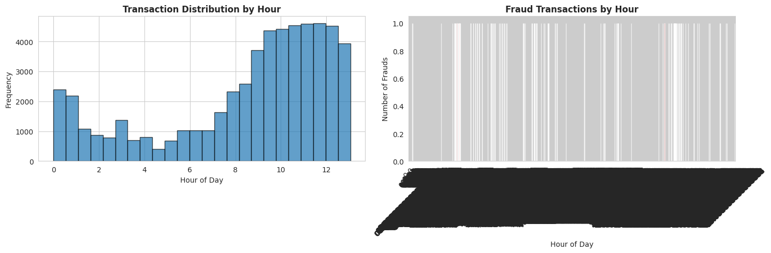
Transaction Distribution by Hour" and "Fraud Transactions by Hour"

Slide 13
CORRELATION ANALYSIS - Top Positive Correlations with Fraud
V11: 0.235
V4: 0.211
V2: 0.170
Top Negative Correlations with Fraud
V17: -0.478
V14: -0.426
V12: -0.331
V10: -0.343
Key Insight
V17 and V14 are strongest fraud predictors
Multiple features show meaningful relationships

Slide 14
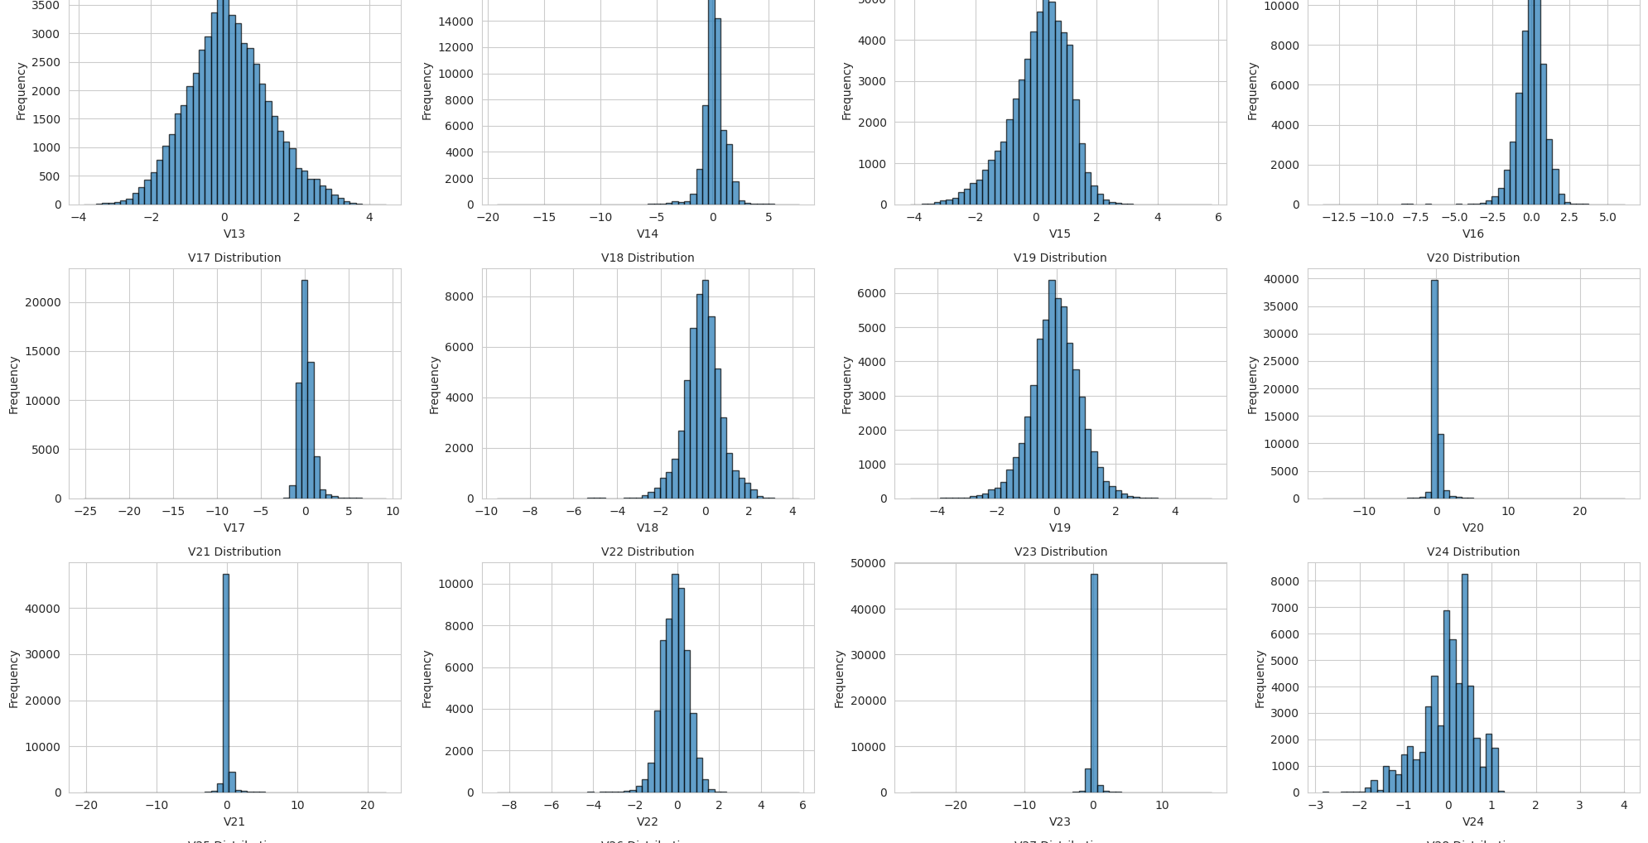
correlation heatmap and top features correlation matrix

Slide 15
DATA INTEGRATION & COMPATIBILITY
Data Source
Single CSV file (no integration needed)
Self-contained dataset
Feature Compatibility
All features numerical
Same scale after preprocessing
No type conflicts
Final Processed Dataset
Original Features: 31
Engineered Features: 4
Total Features: 35
Rows: 55,551 (after cleaning)

Slide 16
ETHICS & BIAS ASSESSMENT - Privacy Protection
Features anonymized via PCA transformation
No personally identifiable information
Protects customer privacy
Bias Considerations
Severe class imbalance (99.72% vs 0.28%)
Potential geographic/demographic sampling bias
Time period limited to 13 hours
Mitigation Strategy
Apply resampling techniques (SMOTE/under sampling)
Cross-validation for robust evaluation
Monitor false positive/negative rates
Ethical Use: Fraud prevention, customer protection, financial security

Slide 17
DELIVERABLES & NEXT STEPS - Deliverables
✓ Cleaned dataset: creditcard.csv ✓ Processed dataset: creditcard_processed.csv
✓ Python Notebook: Complete EDA with visualizations ✓ GitHub Repository: All files version controlled
Dataset Status: Ready for modeling phase
Next Steps
Feature selection based on correlation analysis
Address class imbalance (SMOTE/undersampling)
Model development (Logistic Regression, Random Forest, XGBoost)
Model evaluation and optimization
Business recommendations and deployment strategy

Slide 18
Thanks

