Slide 1
FINTWIN
AI-Powered Banking
Database Performance Simulator
Predictive workload modeling and intelligent performance optimization for financial database systems
CORE IDEA
Learn the relationship between workload and PostgreSQL performance from real executions — then predict new workload behaviour before running it.
Project Review / Faculty Presentation
B.Tech CSE • VIT Vellore

Slide 2
01 | MOTIVATION
02
The problem we are solving
Database performance changes with workload. Testing every possible workload directly is expensive.
BANKING WORKLOAD IS NOT STATIC
TRADITIONAL APPROACH
• Normal transaction flow during ordinary periods
• Salary-day bursts with high account activity
• Month-end loan and payment processing
• Sudden card / merchant transaction spikes
• Higher concurrency can create contention and latency
Execute the workload → measure PostgreSQL → repeat
The design question
Can we predict database behaviour for a hypothetical workload without executing that workload first?
FinTwin | AI-Powered Banking Database Performance Simulator

Slide 3
02 | SOLUTION
03
What FinTwin does
FinTwin builds a data-driven performance model around a real PostgreSQL banking workload.
01
02
03
04
05
06
Generate
Execute
Observe
Learn
Predict
Optimize
Banking workloads
with controlled parameters
→
Run against PostgreSQL
under concurrency
→
Collect latency, TPS,
CPU, locks & DB telemetry
→
Train regression models
on measured experiments
→
Estimate performance
for unseen workloads
→
Compare scenarios and
surface evidence-based actions
FinTwin | AI-Powered Banking Database Performance Simulator

Slide 4
03 | ARCHITECTURE
04
System architecture
Clear separation between workload generation, database execution, telemetry, ML and the user interface.
User / Admin
→
React
Dashboard
→
FastAPI
Backend
→
Workload
Engine
→
PostgreSQL
Banking DB
→
Telemetry /
Experiments
ML Prediction
Engine
What-If +
Optimization
historical experiments
predictions
FinTwin | AI-Powered Banking Database Performance Simulator

Slide 5
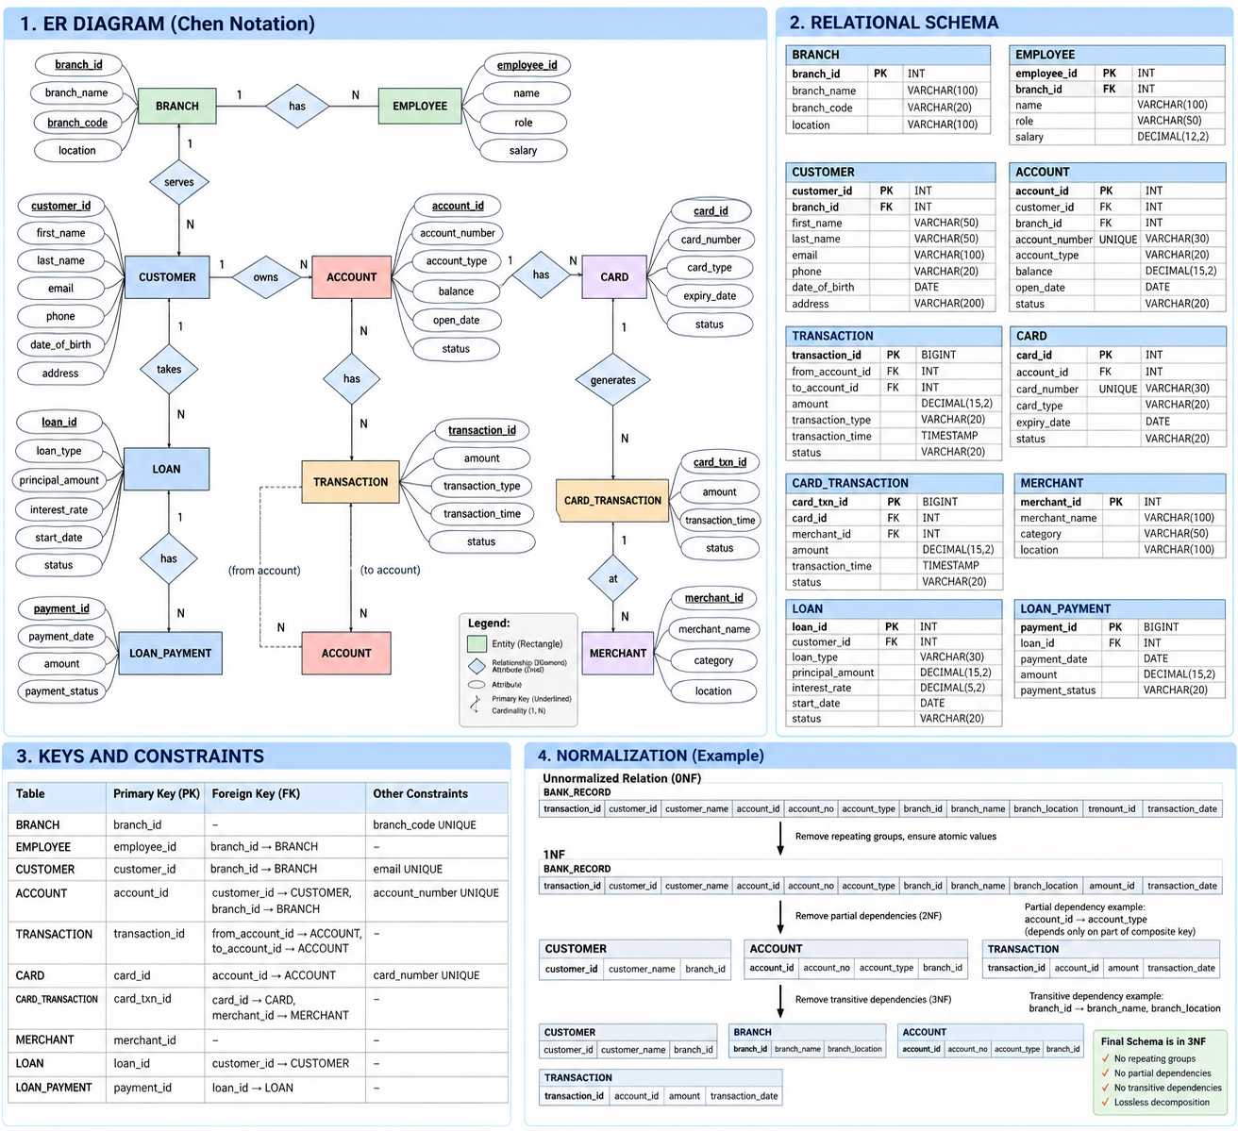
04 | DATABASE DESIGN
05
Banking database model
Designed to support realistic transactional workloads while remaining small enough for controlled experiments.
CORE ENTITIES
• BRANCH — banking location / workload scope
• CUSTOMER — customer master data
• ACCOUNT — central financial entity
• TRANSACTION — transfer / account activity
• CARD + CARD_TRANSACTION — card workload
• MERCHANT — merchant dimension
• LOAN + LOAN_PAYMENT — loan workload
• EMPLOYEE — branch / organizational context
FinTwin | AI-Powered Banking Database Performance Simulator

Slide 6
05 | RELATIONAL DESIGN
06
From ER model to PostgreSQL tables
Primary and foreign keys preserve identity and referential integrity across the banking domain.
CUSTOMER
ACCOUNT
TRANSACTION
CARD
customer_id PK
branch_id FK
account_id PK
customer_id FK
branch_id FK
transaction_id PK
from_account_id FK
to_account_id FK
card_id PK
account_id FK
CARD_TRANSACTION
LOAN
LOAN_PAYMENT
MERCHANT
card_transaction_id PK
card_id FK
merchant_id FK
loan_id PK
customer_id FK
payment_id PK
loan_id FK
merchant_id PK
Design rule: 1:N relationship → primary key of the 1-side becomes a foreign key on the N-side.
FinTwin | AI-Powered Banking Database Performance Simulator

Slide 7
06 | NORMALIZATION
07
Why the schema is normalized
Normalization reduces update anomalies and keeps each fact stored in the relation where it belongs.
1NF
2NF
3NF
Atomic attributes
No repeating groups
1NF + no partial
dependencies on a composite key
2NF + no transitive
dependencies among non-key attributes
Example dependency chain
TRANSACTION → ACCOUNT → BRANCH → BRANCH_NAME / LOCATION
Therefore branch attributes belong in BRANCH rather than being duplicated in every transaction row.
FinTwin | AI-Powered Banking Database Performance Simulator

Slide 8
07 | WORKLOAD ENGINE
08
Controlled banking workload generation
The generator creates repeatable experiments where workload parameters can be changed independently.
Normal day
Balanced account activity
Baseline
Salary day
Deposit + account activity
High writes
Month-end
Loan payments + account queries
Batch pressure
Card spike
Card / merchant transactions
High concurrency
Traffic surge
Same mix at higher TPS
Capacity pressure
Experimental controls
concurrency • target TPS • duration • operation mix • scenario
FinTwin | AI-Powered Banking Database Performance Simulator

Slide 9
08 | TELEMETRY
09
Performance telemetry: measure the database, not assumptions
Every experiment links workload configuration to observations collected from the real PostgreSQL system.
LATENCY
THROUGHPUT
CPU
LOCKS
DB STATE
Average / P50 / P95 / P99
Actual TPS
System / process utilisation
Lock / contention signals
Connections, size, counters
End-user responsiveness
Completed work per second
Resource pressure
Concurrency pressure
Execution context
Key principle
Target TPS is an input. Actual TPS is measured. Prediction targets come from real PostgreSQL telemetry.
FinTwin | AI-Powered Banking Database Performance Simulator

Slide 10
09 | MACHINE LEARNING
10
Learning workload → performance
The ML layer predicts measurable performance outcomes for workload configurations it has learned from.
INPUT FEATURES
PREDICTED OUTPUTS
• Scenario
• Concurrency
• Target TPS
• Duration
• Requested operation mix
• Optional pre-execution DB state
REGRESSION PIPELINE
• Average latency
• P95 latency
• Actual throughput
• CPU utilisation
• Lock metric when coverage is sufficient
Preprocessing
↓
Linear baseline
↓
Tree-based models
↓
Holdout evaluation
Validation uses unseen workload configurations to reduce leakage.
FinTwin | AI-Powered Banking Database Performance Simulator

Slide 11
10 | WHAT-IF ANALYSIS
11
Explore performance before executing the workload
Predictions become useful when users can compare a baseline with a hypothetical change.
BASELINE
CONCURRENCY
TARGET TPS
AVG LATENCY
20
80
—
Measured / predicted depending on the comparison mode.
FinTwin | AI-Powered Banking Database Performance Simulator

Slide 12
10 | WHAT-IF ANALYSIS
11
Explore performance before executing the workload
Predictions become useful when users can compare a baseline with a hypothetical change.
BASELINE
HYPOTHETICAL
CONCURRENCY
TARGET TPS
AVG LATENCY
CONCURRENCY
TARGET TPS
PRED. LATENCY
20
80
—
40
120
—
Measured / predicted depending on the comparison mode.
Δ latency • Δ TPS • pressure classification • out-of-domain warning
Sensitivity analysis can sweep one parameter at a time without running the database.
FinTwin | AI-Powered Banking Database Performance Simulator

Slide 13
11 | OPTIMIZATION
12
Evidence-based performance review
FinTwin recommends where to investigate; it does not autonomously modify a production database.
CPU
CONCURRENCY
LOCKING
High utilisation / pressure
Connections / contention
Blocking or lock pressure
LATENCY
QUERY
INDEX
Tail-latency degradation
Frequent / expensive patterns
Candidate indexes only
Recommendation format
evidence → severity → action → expected benefit → coverage → requires validation
FinTwin | AI-Powered Banking Database Performance Simulator

Slide 14
12 | VALIDATION
13
Predicted vs actual: the credibility layer
A prediction is only useful if it is tested against a real execution under the same workload configuration.
Prediction
created
→
Actual workload
executed
→
Telemetry
captured
→
Compare
metrics
Model
assessment
→
METRIC
PREDICTED
ACTUAL
ERROR
Avg latency • P95 • TPS • CPU • locks
MAE | RMSE | R² | percentage error where appropriate
FinTwin | AI-Powered Banking Database Performance Simulator

Slide 15
13 | DBMS DEPTH
14
What this project demonstrates from a DBMS perspective
FinTwin is not just an ML wrapper — the database is the system being studied.
ER modeling
Entities, relationships, cardinalities
Relational design
PK / FK / referential integrity
Normalization
FDs, 1NF → 2NF → 3NF
SQL & joins
Transactional and analytical access
Query processing
Planner / optimizer / execution
Indexing
Access paths and write overhead
Transactions
ACID, commit / rollback
Concurrency
Locks, contention, throughput
FinTwin | AI-Powered Banking Database Performance Simulator

Slide 16
14 | RESEARCH ANGLE
15
Research question, contribution and boundaries
Positioned as an undergraduate systems + ML research prototype, not a claim of replacing a production DBA.
PRIMARY RESEARCH QUESTION
HONEST BOUNDARIES
Can machine learning predict database performance under hypothetical banking workloads without executing those workloads first?
• Synthetic banking data
• Scoped database-level digital twin
• No production banking infrastructure
• No autonomous DBA changes
• Predictions depend on training coverage
Contribution
• Finance-specific workload + PostgreSQL experiment framework
• Measured telemetry → predictive performance model
• What-if analysis + evidence-based recommendations
• Predicted-vs-actual validation loop
FinTwin | AI-Powered Banking Database Performance Simulator

Slide 17
15 | DEMONSTRATION
16
End-to-end demonstration
A single demo should show the complete scientific loop — configuration → execution → measurement → prediction → validation.
A
Choose workload
B
Run experiment
C
Train / load model
Select scenario, concurrency, TPS and operation mix.
Execute against PostgreSQL and collect telemetry.
Use measured experiments as the learning set.
D
Predict
E
What-if
F
Validate
Submit an unseen workload configuration.
Change concurrency / TPS and compare predicted outcomes.
Execute the predicted configuration and compare with actual.
FinTwin | AI-Powered Banking Database Performance Simulator

Slide 18
FIN
FinTwin
A data-driven digital twin for understanding and predicting banking database performance.
The central loop
Workload → PostgreSQL → Telemetry → ML → Prediction → What-If → Validation
Thank you
Questions / Discussion
FinTwin • Project Review

