Slide 1
In This Course We are going to learn js(knows as javascript)
ArrayOfSilicon

Slide 2
But what is javascript? 🤔
Let’s see why javascript was invented 🤯
ArrayOfSilicon

Slide 3


In 1990s Website Work something like this:
I Wanna Go to Website
Sending Request to sever
Getting website in response
Client Side
Server Side
ArrayOfSilicon

Slide 4
So What is Problem with this thing
I Want to login to a website
I will enter username and password to website
Then I will get reply invalid login or valid
Client Side
Server Side
ArrayOfSilicon

Slide 5
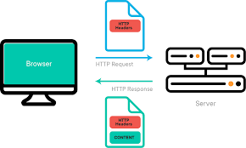

But everytime if I send some request to server it will become time consuming
So to avoid this thing we implemented a language
Called livescript to the browser itself
ArrayOfSilicon

Slide 6


But at that time java was very trendy(popular)
So to also rank our language (livescript)
We renamed it as javascript
Java and javascript has nothing in common so don’t be confuse 😪
ArrayOfSilicon

Slide 7
So, we learned that to save time and increase
Performance js was invented.
Js is also used to manipulate Html and css on browsers.
So let’s see in Practice
ArrayOfSilicon

