Slide 1

Artificial Intelligence

Slide 2
What is AI ?
AI is nothing but building smart machines that are capable of performing tasks that typically require human intelligence, such as
visual perception,
speech recognition,
decision making
translation between languages and so on.
This is also called as machine intelligence.
The term AI is first coined by John McCarthy in 1956.
Ex:
Google Predictive Search Engine
Google SPAM or Non-SPAM Email Filter
Virtual Asistance Siri or Alexa etc.

Slide 3
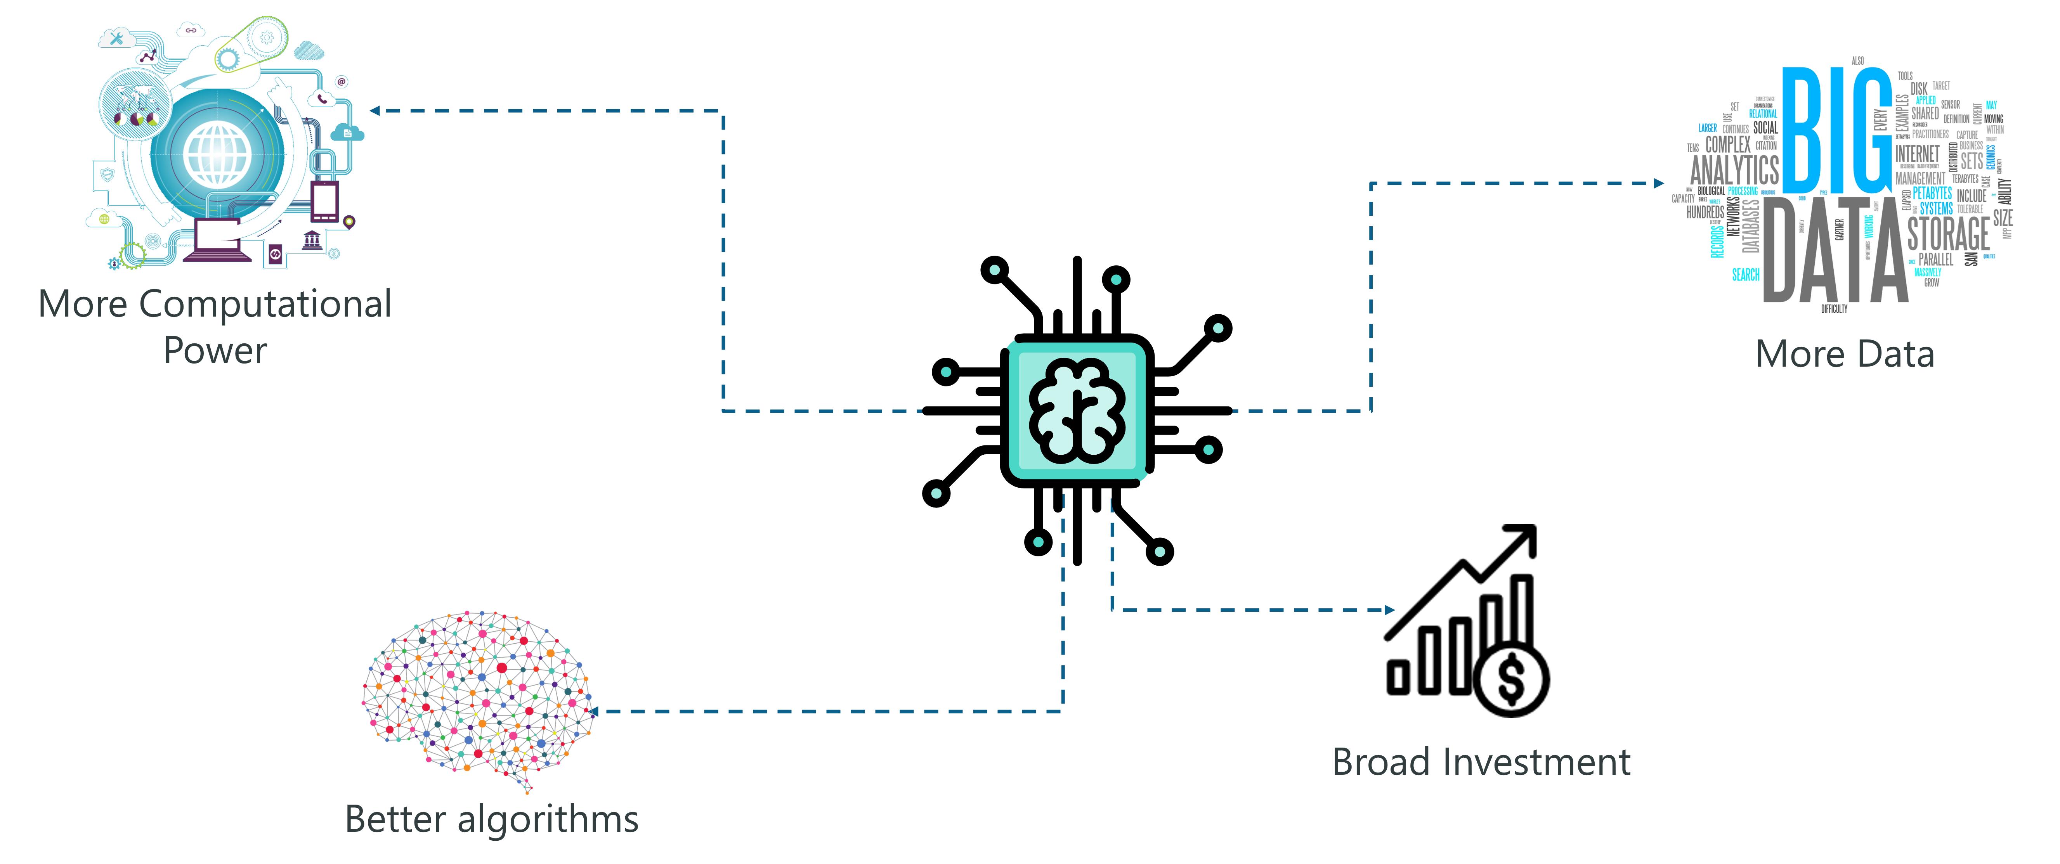
Why it has gain popularity now ?
Now a days we have more computational power with big data and better algorithm to implement correct model for AI

Slide 4
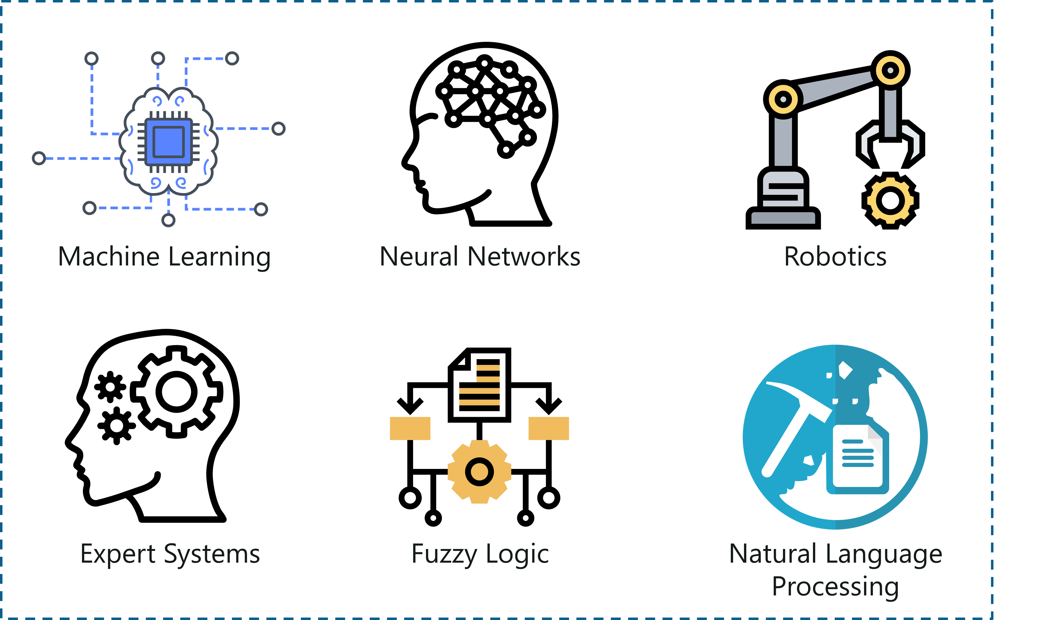
What AI contains ?
In AI most popular techniques are Machine Learning , Natural Langauge Processing and Deep Learning.

Slide 5

Which Programming Languages Used ?
Most preferable programming languages are Python and R due to its built-in packages and libraries.
We have other languages also like Lisp but mostly used one is Python.

Slide 6
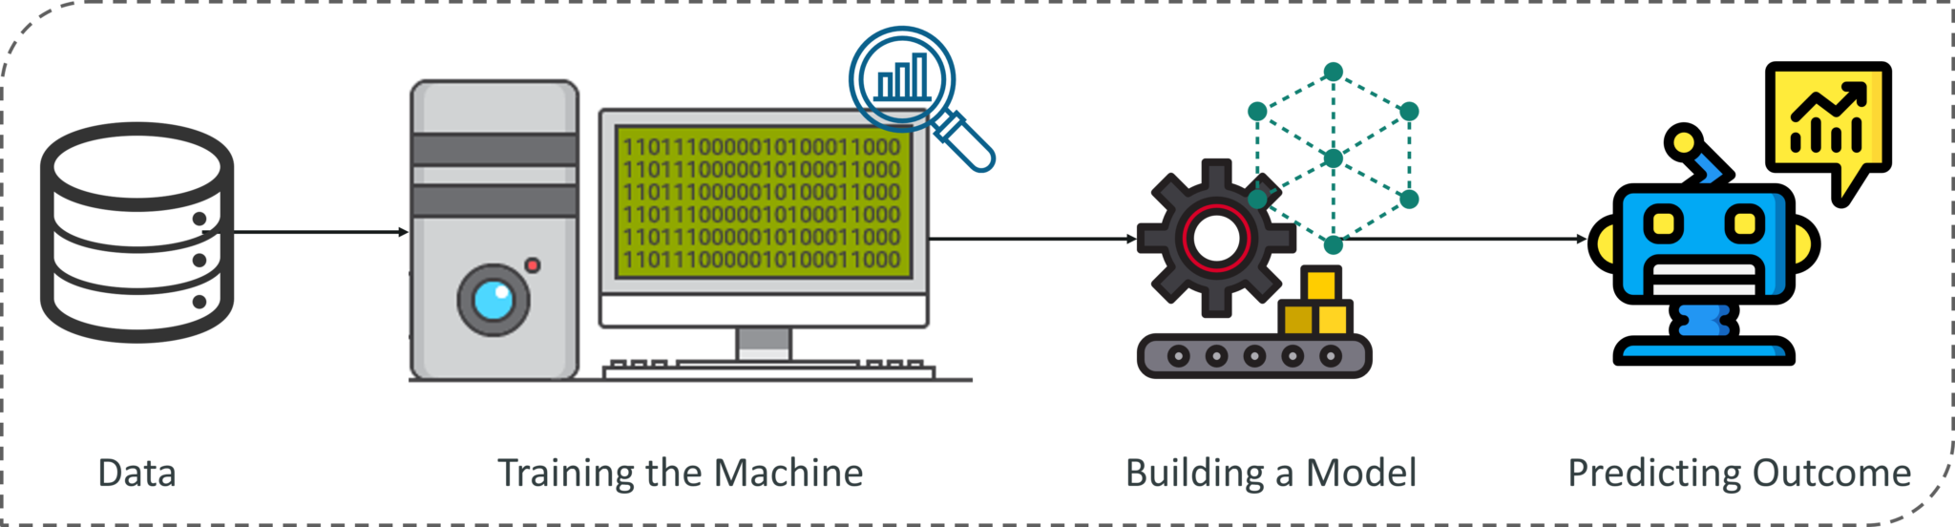
What is Machine Learning ?
Provding ability to machine, to learn from experiences and making decisions without being explicitly programmed.
Machine Learning allows system to take decisions autonomously without any external support

Slide 7
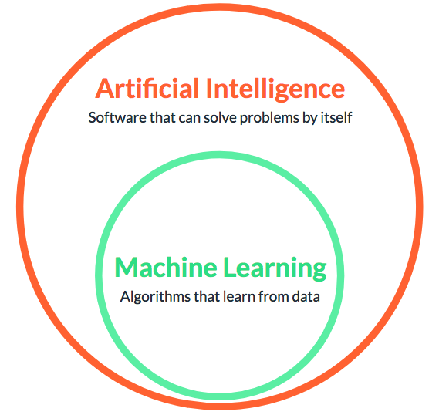
Machine Learning Vs Aritificial Intelligence
Machine Learning is subset of Artificial Intelligence
Machine learning throgh which you can feed data to machine and make it learn, so that it can make its own decisions.
It makes use of stastical methods for developing alogorithm which we will use for building model.

Slide 8
Important Concepts of ML
Algorithm
A Machine Learning algorithm is a set of rules and statistical techniques used to learn patterns from data and draw significant information from it. It is the logic behind a Machine Learning model. An example of a Machine Learning algorithm is the Linear Regression algorithm.
Model
A model is trained by using a Machine Learning Algorithm. An algorithm maps all the decisions that a model is supposed to take based on the given input, in order to get the correct output.
Predictor Variable
It is a feature of the data that can be used to predict the output.
Response Variable
It is the feature or the output variable that needs to be predicted by using the predictor variable.
Training Data
The Machine Learning model is built using the training data. The training data helps the model to identify key trends and patterns essential to predict the output.
Testing Data
After the model is trained, it must be tested to evaluate how accurately it can predict an outcome. This is done by the testing data set.

Slide 9
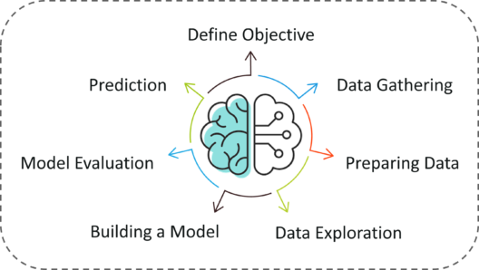
Machine Learning Process
In above steps, most time consuming steps are preparing data and data explorartion where we have to clean data and we have to put it in structured form as well as we have to do feature engineering.

