Slide 1

Machine Learning

Slide 2
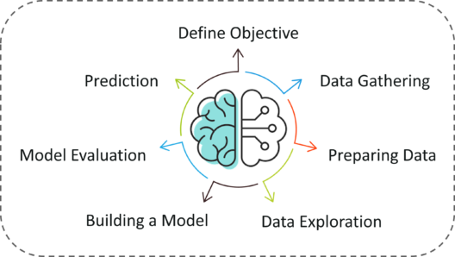
Machine Learning Process
In above steps, most time consuming steps are preparing data and data explorartion where we have to clean data and we have to put it in structured form as well as we have to do feature engineering.

Slide 3
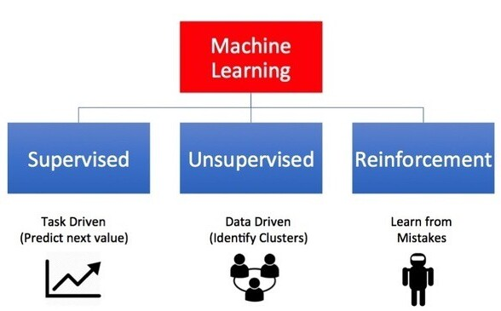
Types of Machine Learning

Slide 4
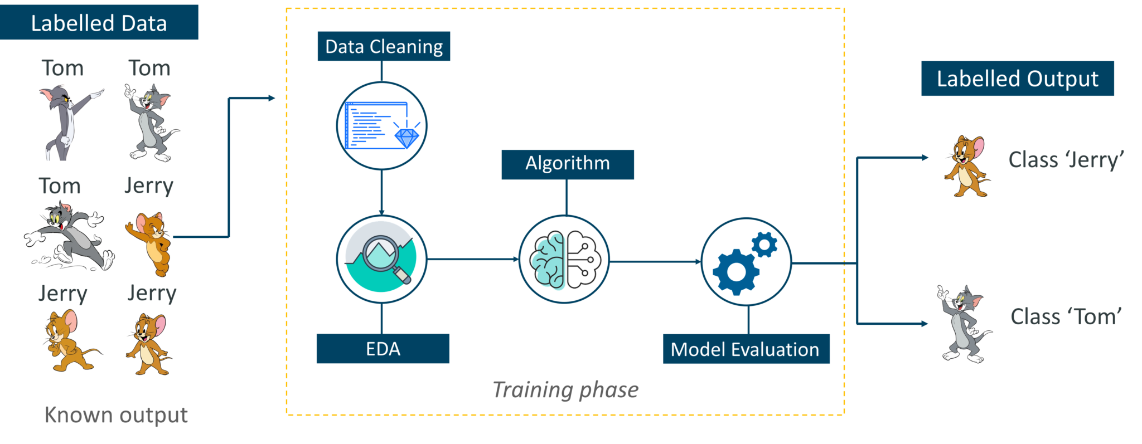
Supervised Learning
Supervised learning is a technique in which we teach or train the machine using data which is well labeled.
This labelled data set is nothing but tarining data set.

Slide 5
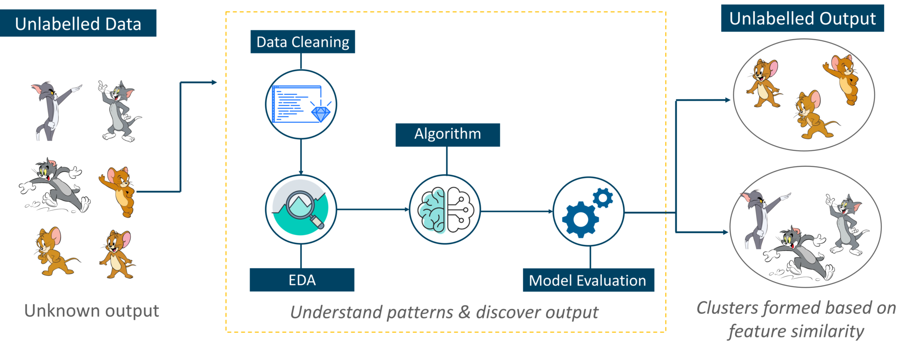
Unsupervised Learning
Unsupervised learning involves training by using unlabeled data and allowing the model to act on that information without guidance.
Ex: Clustering and Association Analysis

Slide 6
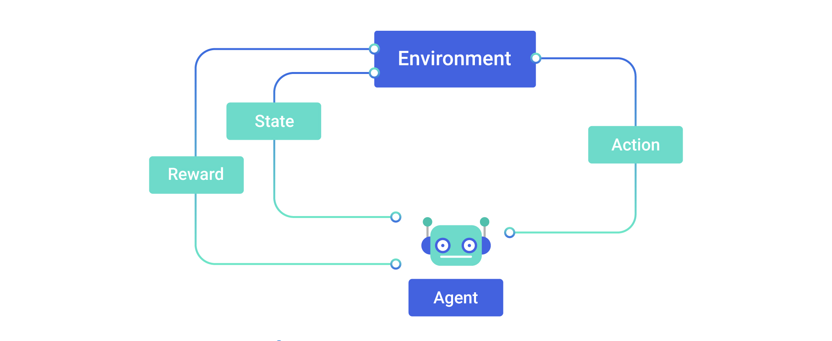
Reinforcement Learning
Reinforcement Learning is a part of Machine learning where an agent is put in an environment and he learns to behave in this environment by performing certain actions and observing the rewards which it gets from those actions.

Slide 7
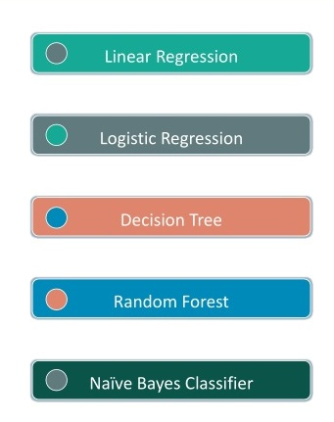
Types of Supervised Learning
Regression
(Continuos Variable)
Classification
(Categorical Variable )
Regression and Classification Both
Regression and Classification Both
Classification

Slide 8
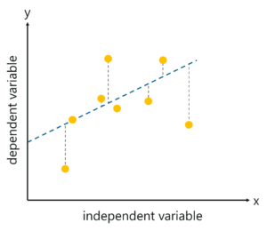
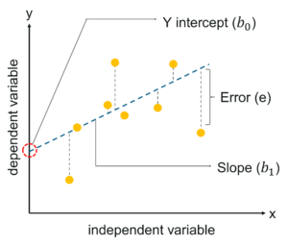
Linear Regression
It is a predictive modelling technique used to predict a continuous dependent variable, given one or more independent variables.
Linear Regression Equation :

Slide 9
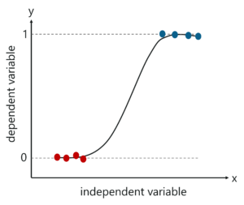
Logistic Regression
Logistic Regression is a method used to predict a dependent variable (Y), given an independent variable (X), such that the dependent variable is categorical.
predict the outcome in a binary variable, meaning it will have only two outcomes.
We use the Sigmoid function/curve to predict the categorical value. The threshold value decides the outcome
Logistic Regression Equation :

Slide 10
Naive Bayes
The principle behind Naive Bayes is the Bayes theorem also known as the Bayes Rule.
Bayes theorem :
P(A|B): Conditional probability of event A occurring, given the event B
P(A): Probability of event A occurring
P(B): Probability of event B occurring
P(B|A): Conditional probability of event B occurring, given the event A

Slide 11
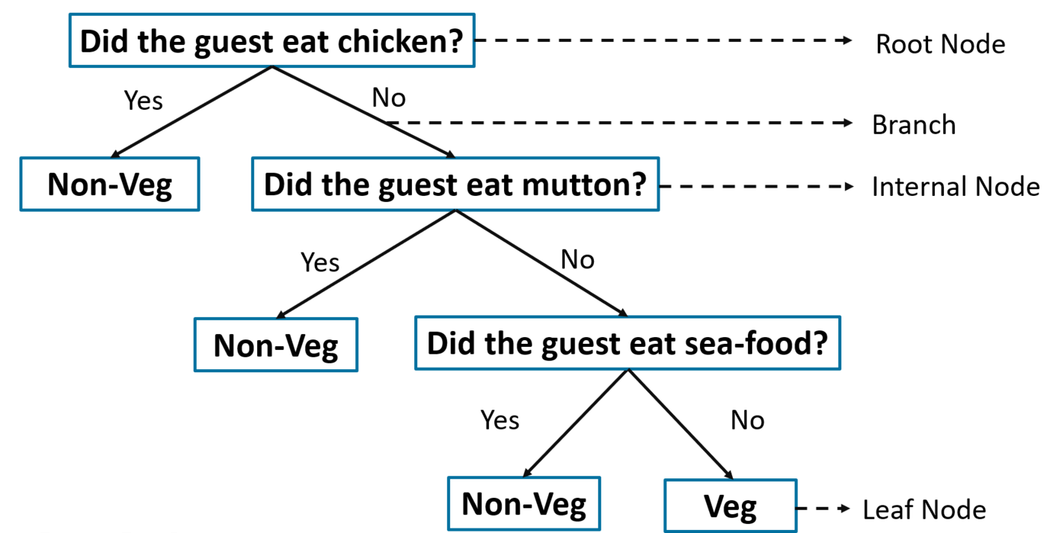
Decision Tree
A Decision Tree is a Supervised Machine Learning algorithm which looks like an inverted tree, wherein each node represents a predictor variable (feature), the link between the nodes represents a Decision and each leaf node represents an outcome (response variable).

Slide 12
Decision Tree Using ID3 Algorithm
The ID3 algorithm follows the below workflow in order to build a Decision Tree:
Select Best Attribute (A)
Assign A as a decision variable for the root node.
For each value of A, build a descendant of the node.
Assign classification labels to the leaf node.
If data is correctly classified: Stop.
Else: Iterate over the tree.
Two measures are used to decide the best attribute:
Information Gain
Entropy

Slide 13
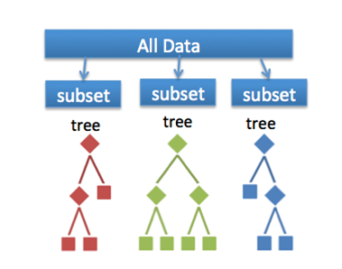
Random Forest
Random forest builds multiple decision trees (called the forest) and glues them together to get a more accurate and stable prediction.
Why Rnadom Forest ?
More Accuaracy
Avoid Overfitting
Bagging
Bootstrpping is used for creating subset
Out of bag dataset is for testing model
This is used for classification as well as regression exaple

Slide 14
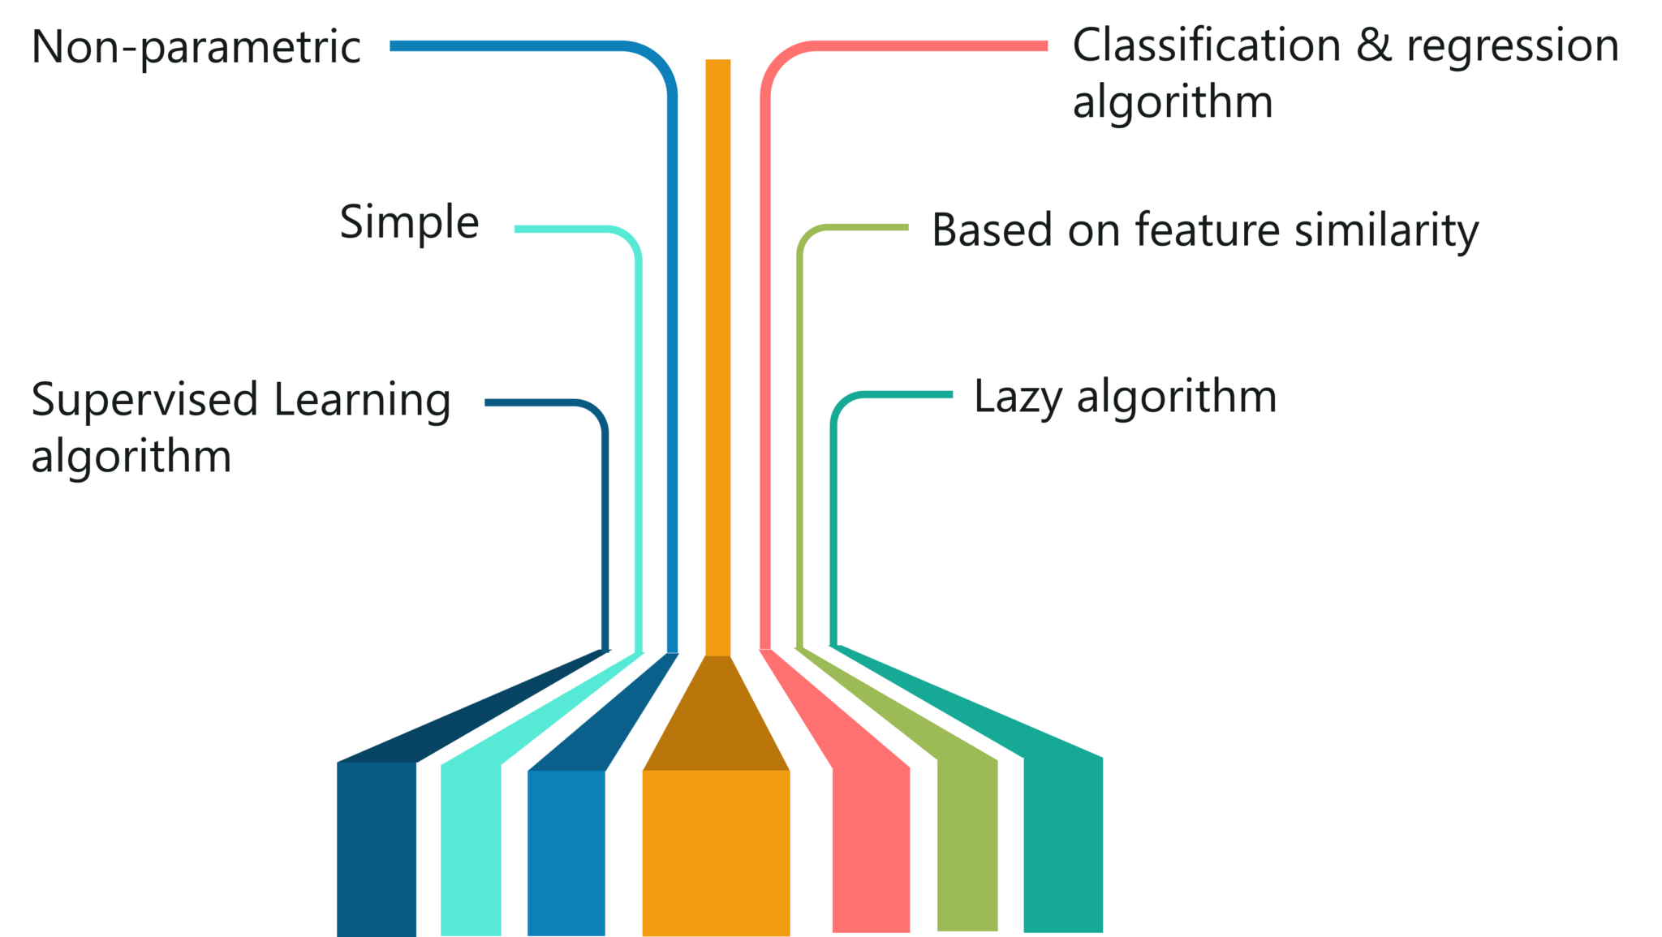
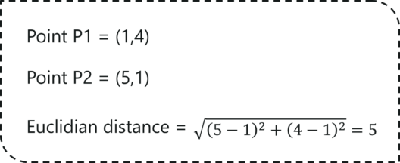
K Nearest Neighbour
KNN which stand for K Nearest Neighbor is a Supervised Machine Learning algorithm
It is used classifies a new data point into the target class, depending on the features of its neighboring data points.

Slide 15
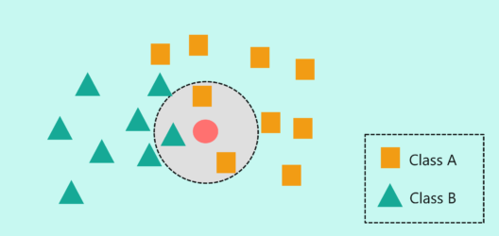
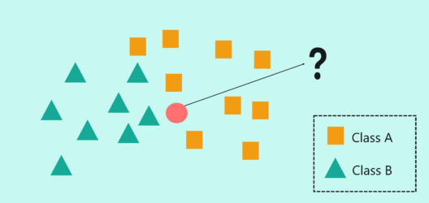
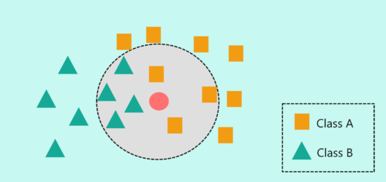
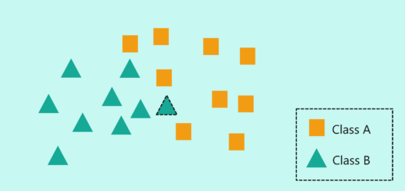
Example
k=3
k=7

Slide 16
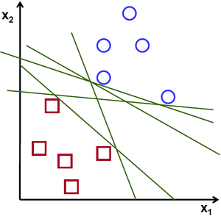
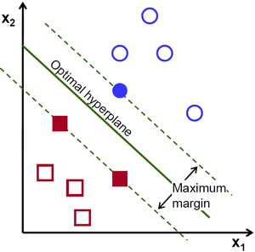
Support Vector Machine
The objective of the support vector machine algorithm is to find a hyperplane in an N-dimensional space(N — the number of features) that distinctly classifies the data points.
Support Vector

Slide 17
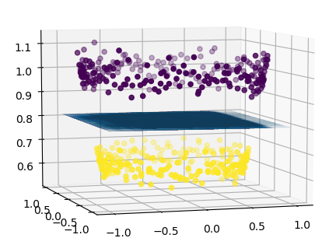
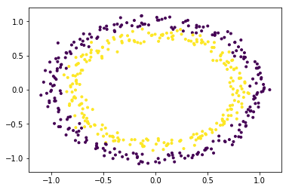
Non-Linear SVM
In machine learning, a trick known as “kernel trick” is used to learn a linear classifier to classify a non-linear dataset. It transforms the linearly inseparable data into a linearly separable one by projecting it into a higher dimension.

Slide 18
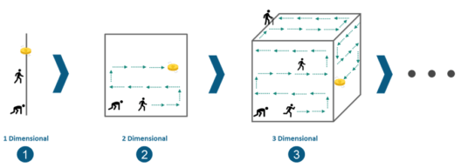
Limitations of Machine Learning
Machine Learning is not capable of handling high dimensional data that is where input & output is quite large.
Handling and processing such type of data becomes very complex and resource exhaustive. This is termed as Curse of Dimensionality

Slide 19
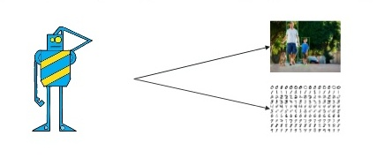
Limitations of Machine Learning
One of the biggest challange in machine learning model process is called feature extaraction.
For complex problems like image recongnization, handwritting recognization its huge problem.

